Slide 1



Smarter NPL Trading
Connecting Sellers and Investors
Eppu Hassinen
Jarmo Tahvanainen
Risto Teerikoski
Notes:
Slide 1: Title Slide Hi, I’m [Your Name], and I’m here to introduce BidWise, a smarter way to trade unpaid consumer-related invoices—or in business terms, non-performing loans (NPLs).

Slide 2

Challenges in NPL Trading
Small and mid-sized businesses struggle to monetize unpaid receivables efficiently.
Investors face time-consuming searches and lack transparency.
Traditional methods are slow and expensive.
Notes:
Slide 2: The Problem Every year, businesses struggle with unpaid receivables. Small and mid-sized companies, in particular, face challenges in turning these into cash quickly without relying mainly on expensive and slow debt collection methods. On the other hand, investors often spend too much time searching for quality portfolios, with little transparency or data-driven insights to help them decide.

Slide 3
Introducing BidWise
A platform connecting businesses and investors for NPL trading.
AI-driven analytics to support valuations and risk assessments.
Transparent and data-backed transactions.
Notes:
Slide 3: The Solution That’s where BidWise comes in. Our platform connects businesses looking to sell their overdue receivables with investors seeking new opportunities. Powered by AI-driven analytics, BidWise ensures sellers get fair valuations and buyers gain clear risk assessments—instantly.

Slide 4












Simplified Process for Sellers and Investors
Upload
Wait for offers
Browse offers
Get money
Steps for Sellers:
Steps for Investors:
Browse
Evaluate
Make offers
Purchase portfolio
Notes:
Slide 4: How It Works Imagine this: A small business can upload their receivables, and with the click of a button, receive offers from multiple investors. No waiting, no uncertainty—just streamlined transactions. For investors, our tailored portfolio recommendations and transparent data make finding and evaluating NPLs effortless.

Slide 5
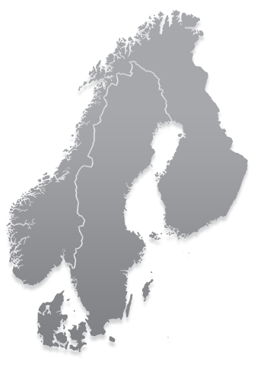

Nordic NPL Market: A Growing Opportunity
Demand for streamlined solutions in B2C receivables.
Initial focus on the Nordic market with plans to expand across Europe.
Notes:
Slide 5: Market Opportunity We’re starting with the Nordic market, where small businesses often lack solutions for selling B2C receivables. As we grow, we plan to expand across Europe, addressing an even bigger gap in the NPL market.

Slide 6
Revenue and Funding Plan
Funding Need: €300,000 for year one.
Revenue Projections: €50k (Year 1), €200k (Year 2), multi-million by Year 5.
Scaling strategy to larger markets and higher transaction volumes.
Notes:
Slide 6: Financial Projections To build and launch BidWise, we’re seeking €300,000 in funding for the first year to develop the platform, onboard partners, and execute our go-to-market strategy. We anticipate modest revenue of €50,000 in year one as we establish our presence, followed by €200,000 in year two, with rapid growth expected thereafter as we scale operations and expand to larger markets. By year five, we project multi-million euro revenues, driven by increased transaction volumes and customer acquisition.

Slide 7
Our Edge and Vision
AI-driven insights for efficiency and fairness.
Tailored solutions for small and mid-sized businesses and investors.
Vision for a more accessible and transparent NPL trading future.
Faster, Simpler, Smarter NPL Trading.
Notes:
Slide 7: Why Us? At BidWise, we’re not just creating a marketplace; we’re building a more accessible, transparent, and efficient future for NPL trading. Whether you’re a seller or an investor, BidWise is your smarter choice for trading debt.

Slide 8
Join Us in Transforming NPL Trading
First_name@bidwise.com
Let’s make the future of NPL trading faster, simpler, and smarter—together.
Eppu Hassinen
Jarmo Tahvanainen
Risto Teerikoski
Notes:
Slide 8: Call to Action Let’s make the future of NPL trading faster, simpler, and smarter—together.

