Slide 1
空間資料驗證
Geo data validation

Slide 2
Geo data validation?
Coordinates to administrative division for Taiwan?
Google geocoding API?
Max 2000 queries per day with limit of access frequency
Or PAY
Others?
All of them with limit of access frequency
or SLOW
Point of polygon algorithm
SLOW
We have to develop or modify appropriate algorithm for ourselves
Notes:
地理資料驗證，對TaiBIF來說主要是檢驗坐標與行政區是否符合。
坐標反查行政區服務一般有不支援中文、存取頻率限制、或效能不佳等問題。
對於主要以PHP開發為主的TaiBIF來說，point in polygon演算法值行效能不彰，因此需要自行開發或修改演算法。

Slide 3
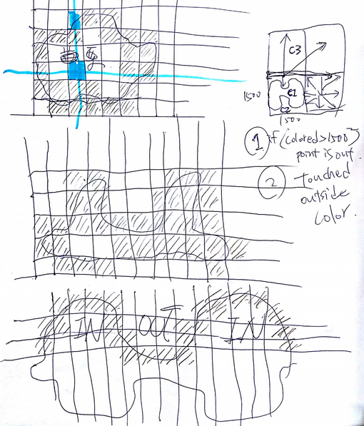
Grid in Polygon algorithm from sketch
Acceptable error?
Tens of to hundreds of meters
Algorithm
Prepare
Cut 1 x 1 degree of latitude and longitude into N x N grids
For each polygon, mark all the grid touched by its border (grid-based polygon)
Find out the plus-two-grid bounding box of grid-based polygon
Determine if grid in Polygon
For any given point, calculate its belonged grid (target grid)
Use flood-fill algorithm to find out if target grid is inside or outside the grid-based polygon as long as
Outside: Flood-fill touches bounding box
Inside: Flood-fill ends without touching bounding box
Flood-fill algorithm ref: https://en.wikipedia.org/wiki/Flood_fill
Indexing
Pre-calculate each grid of interest is inside or outside each grid-based polygons
Appropriate size of N?
200 for Taiwan (0.005 degree x 0.005 degree)
Notes:
在容許的誤差範圍提升效能。將經緯度1x1度的格子切成NxN的小格(grids)
對每個行政區多邊形的點跟邊界壓到的格子做標記，產生以格子為基礎的行政區多邊形
求出格子多邊形的四方邊界各自往外推兩格的bounding box (因為之後要用floodfill演算法，所以在box跟polygon之間要留一格空隙)
倘若要求任一坐標是否在一行政區多邊形內，可先求該點之grid，接著用floodfill演算法向四周擴張，如果會碰到bounding box帶表該點在多邊形之外

Slide 4
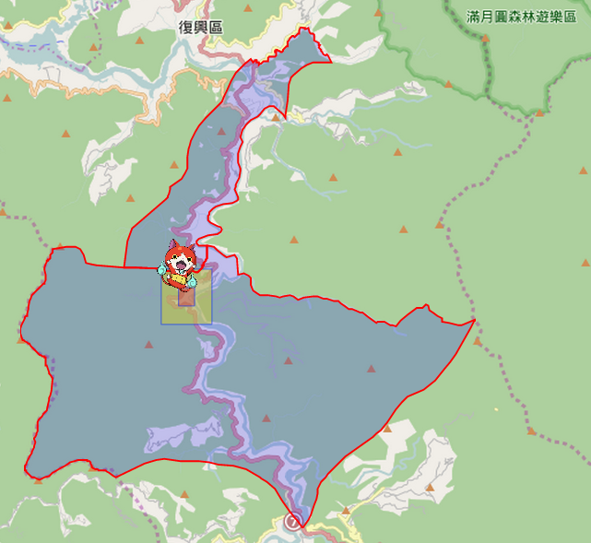
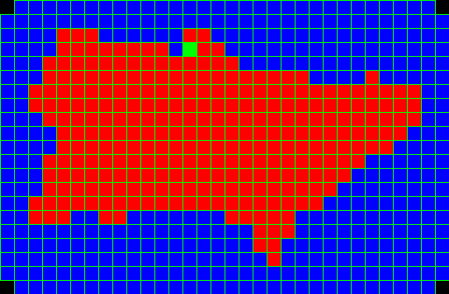
Grid in Polygon algorithm for geo data validation
Get administrative division of a given geo-point with very good performance (< 30ms per query from 8,337 polygons with average 259 points) and acceptable loss in precision
Red square is target grid (see next page)
Yellow square is error zone
Plus-2-grid bounding box and the outside region (Orange)
Application in roadkill.tw http://taibif.tw/vgd/aprxGeoValidation/map.html?latlng=24.742921,121.346338&zoom=12&fit=no
latlng=24.742921,121.346338 @ Gao-yi Village, Fu-xing dist., Tao-yuan City
Notes:
Grid in Polygon演算法在路殺社之實作應用。圖例顯示一筆路殺記錄，以及該記錄點位附近之行政區(村里層級) 。紅格子色是路殺記錄位於之網格，黃格子是回傳行政區可能的誤差範圍。人可憑一眼正確判讀出點位所處之行政區(桃園市復興區高義村)，協助快速建立資料，或是驗證使用填寫之坐標與行政區是否吻合。

