Slide 1
A Brief History of Data Sharing in the U.S. LTER Network
John Porter

Slide 2



Science in a number of disciplines are recognizing that our ability to manage and assimilate massive quantities of data are a key to understanding of our world.

Slide 3
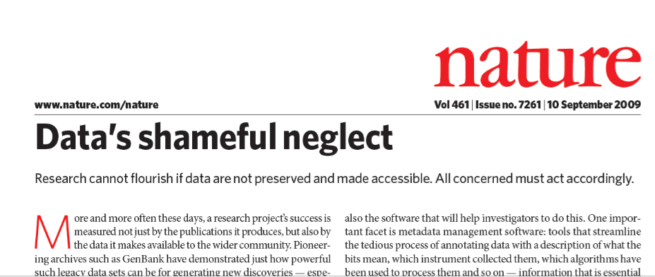
In September 2009 a special issue of NATURE addressed data sharing. Some quotes from the leadoff editorial:
“More and more often these days, a research project’s success is measured not just by the publications it produces, but also by the data it makes available to the wider community.”
“universities and individual disciplines need to undertake a vigorous programme of education and outreach about data”

Slide 4
Sharing Data is Needed:
To address complex, large scale and long-term environmental challenges
Global and Regional studies require data that are often beyond the ability of a single researcher to collect
Replication is a fundamental part of science
Data used to parameterize models needs to be available

Slide 5
Data Sharing
Improves data quality
“fresh eyes” detect problems that went previously unnoticed
If you doubt this, consider the changes made in a draft of a manuscript as it is viewed by reviewers and editors
Enables New Science
Makes possible comparisons between systems
Enhances regional, global scale and long-term science
Multiple investigators, who may be working independently

Slide 6
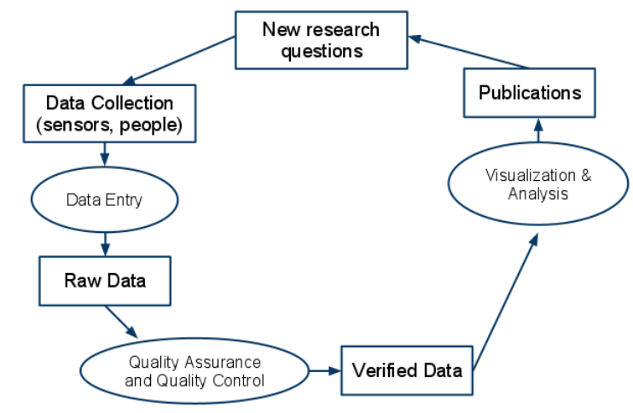
Scientific Use of Data
The traditional model of using data

Slide 7
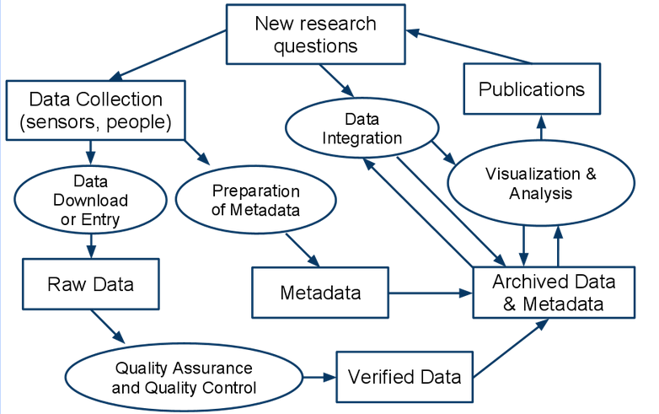
Scientific Use of Data
A new model, incorporating sharing and archiving

Slide 8
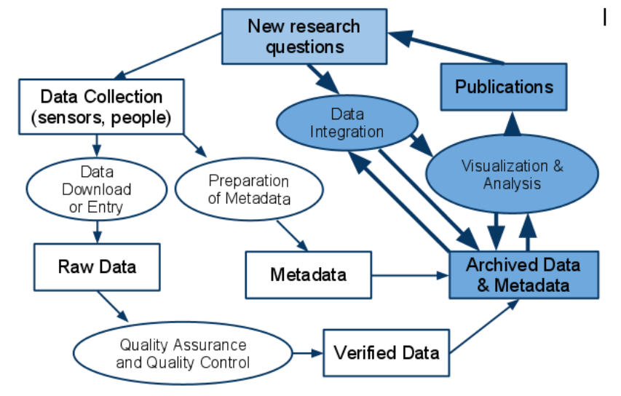

Scientific Use of Data
Archiving and sharing data provides new opportunities for better understanding our environment

Slide 9
Sharing Data
We may all agree that sharing data is a good thing and advances the cause of science
But why is sharing of data so rare?
What can we do to increase data sharing?
The U.S. LTER Network has been sharing data since 1994 and currently shares more than 6,800 datasets.
The experience there may provide some helpful insights.

Slide 10
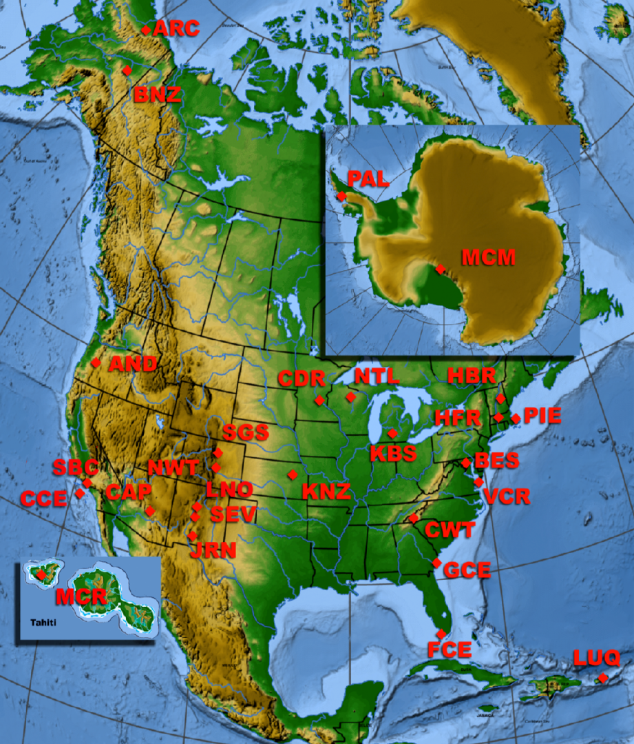
U.S. LTER Network – 26 sites + LNO
AND – H.J. Andrews Experimental Forest LTER, Oregon
ARC – Arctic Tundra LTER, Alaska
BES – Baltimore Ecosystem Study LTER, Maryland
BNZ – Bonanza Creek Experimental Forest LTER, Alaska
CAP – Central Arizona-Phoenix LTER, Arizona
CCE – California Current Ecosystem LTER, California
CDR – Cedar Creek Natural History Area LTER, Minnesota
CWT – Coweeta LTER, North Carolina
FCE – Florida Coastal Everglades LTER, Florida
GCE – Georgia Coastal Ecosystem LTER, Georgia
HBR – Hubbard Brook LTER, New Hampshire
HFR – Harvard Forest LTER, Massachusetts
JRN – Jornada Basin LTER, New Mexico
KBS – Kellogg Biological Station LTER, Michigan
KNZ – Konza Prairie LTER, Kansas
LUQ – Luquillo Experimental Forest LTER, Puerto Rico
MCM – McMurdo Dry Valleys LTER, Antarctica
MCR – Moorea Coral Reef LTER, French Polynesia
NWT – Niwot Ridge LTER, Colorado
NTL – North Temperate Lakes LTER, Wisconsin
PAL – Palmer Station LTER, Antarctica
PIE – Plum Island Ecosystem LTER, Massachusetts
SBC – Santa Barbara Coastal Ecosystem LTER, California
SEV – Sevilleta LTER, New Mexico
SGS – Shortgrass Steppe LTER, Colorado
VCR – Virginia Coast Reserve LTER, Virginia
LNO – LTER Network Office, University of New Mexico,
Albuquerque, NM

Slide 11
LTER Timeline and Funding Sources - 2010
MCR
GEO-OCE
CCE
SBC
GCE
FCE
PIE
SBE, EHR
BES
Polar
CAP
MCM
PAL
HFR
SEV
LUQ
DEB
VCR
KBS
HBR
BNZ
ARC
JRN
X
CDR
X
ILL
OKE
X
X
SGS
NIN
NWT
KNZ
CWT
AND
NTL
1980
1985
1990
1995
2000
2005
2010

Slide 12
LTER and Data
At its founding in 1980 LTER was almost unique in that NSF required sites to include management of data in proposals
Reason: Long-term studies and experiments require data to be managed, otherwise you lose old data as fast as you gain new data
Analysis of a 20-year experiment requires data from year 1 as well as year 20

Slide 13
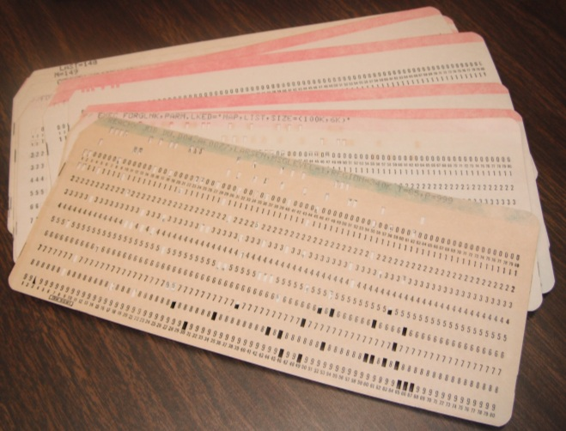
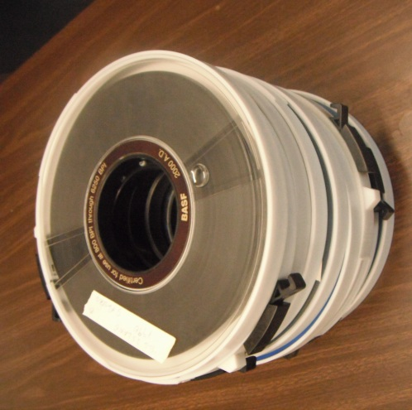
LTER’s First Decade – 1980-1989
LTER did substantial work on developing best practices for managing data at the level of the individual LTER site
This was a the dawn of the microcomputer/PC era
Merging practices from mainframe computing with emerging technologies
1986 “Research Data Management” volume published
Focus was almost entirely on the site
Little sharing of information on what data was being archived between sites
No formal mechanisms for sharing data
1989 – LTER Network Office (LNO) established

Slide 14
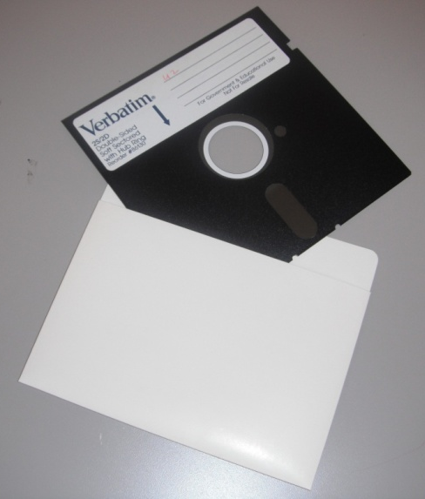
2nd Decade – 1990-2000
1990 - an important year!
First LTER-wide Data Catalog
10 datasets per site were listed
First Network Guidelines for Site Data Access Policies
Described elements that should be included in individual site policies

Slide 15
1990 Guidelines for Site Data Management Policies
General Guidelines - The management policy should include provisions that assure:
The timely availability of data to the scientific community;
That researchers and LTER sites contributing data to LTER databases receive adequate acknowledgement for the use of their data by other researchers and that sites receive copies of any publication using that data;
That documentation and transformation of data are adequate to permit data to be used by researchers not involved in its original collection;
That data must continue to be available even if an investigator leaves the project through transfer or death;
That standards of quality assurance and quality control are adhered to;
That long-term archival storage of data is maintained;
That researchers have an obligation both to contribute data collected with LTER funding to the LTER site database and to publish the data in the open literature in a timely fashion;
That costs of making data available should be recovered directly or by reciprocal sharing and collaborative research;
That LTER data sets not be resold or distributed by the recipient; and
That investigators have a reasonable opportunity to have first use of data they collected.

Slide 16
Example Policy (1990)
Data Type I. Published data and metadata (i.e., data about data).
Policy: Data are available upon request without review.
Data Type II. Collective data of the LTER site (usually routine measurements generated by technical staff).
Policy: Data are available for specific scientific purposes one year after generation.
Data Type III. Original measurements by individual researchers.
Policy: Data are available for specific scientific purposes two years after generation.
Data can be released earlier with permission of the researcher.
Data Type IV. Unusual long-term data collected by individual researchers.
Policy: The principal investigator of the LTER site can designate that such data can be withheld for longer periods. Such action should be rare and justified in writing.

Slide 17
Why “Guidelines” for Site Policies?
Why not just adopt a uniform policy?
We had no example policies to work from, so guidelines let us “test” a wide variety of options
Most researchers were not yet comfortable with sharing data - site policies could be crafted to address the specific concerns of researchers at the sites
By 1994 most sites had published data policies that could then be compared to discern “best practices”

Slide 18
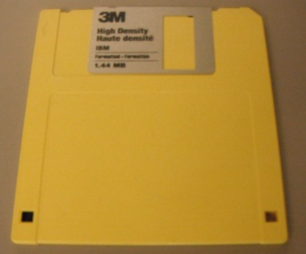
1992
First easy-to-use Internet downloading tools - Gopher
Demonstration of the power of structured metadata
Start of work on developing a content standard for exchange of metadata between sites
Looked for common elements in existing site metadata
This effort paved the way for development of Ecological Metadata Language a decade later

Slide 19
1994
With the release of the first web browser in 1993, the World-Wide-Web became practical
With substantial input from NSF, the LTER Coordinating Committee mandated that each site should make at least one dataset available online
Demonstration of feasibility
In fact, most LTER sites put more than one dataset online, often all their datasets
Competition developed between sites over who had the “best” data online

Slide 20
Rapid Growth of LTER Data

Slide 21
1997
Michener et al. paper on N0n-Geospatial Metadata published
Set initial content standards for ecological metadata that were used to create Ecological Metadata Language
LTER Network formerly adopts a network-wide standard for data sharing
Data can be held back for 2 years
Exceptions must be rare, justified and documented

Slide 22
Data access policy for the LTER Network 1997
There are two types of data:
Type I (data that are freely available within 2–3 years) with minimum restrictions, and
Type II (Exceptional data sets that are available only with written permission from the PI/investigator(s)).
Implied in this timetable, is the assumption that some data sets require more effort to get online and that no "blanket policy" is going to cover all data sets at all sites. However, each site would pursue getting all of their data online in the most expedient fashion possible.
2) The number of data sets that are assigned TYPE II status should be rare in occurrence and that the justification for exceptions must be well documented and approved by the lead PI and site data manager. Some examples of Type II data may include: locations of rare or endangered species, data that are covered by copyright laws (e.g. TM and/or SPOT satellite data) or some types of census data involving human subjects.

Slide 23
Addition of Data to LTER Goals - 2001
In January 2001 a meeting of LTER Lead Investigators was convened to revise the goals for the LTER Network. Only one completely new goal was added:
“Information: To inform the LTER and broader scientific community by creating well-designed and well-documented databases.”
Thus in little more than a decade the U.S. LTER went from not sharing data to having data sharing as one of its primary goals

Slide 24
Lessons Learned
Research communities need to “own” their data policies
Difficult to do if policies are imposed from without
Incentives and Provisions must make sense to the community involved
Experience with data sharing generally makes people more willing to share
Myths get dispelled

Slide 25
Myths About Sharing Data
“If I share my data, there are lots of people who will “steal” it by creating publications with it and not acknowledging my contribution”
Not true:
Data sharing policies dictate that users must acknowledge or cite data
By having your data in an archive you establish clear priority – no one else can make a credible claim that they collected the data, not you

Slide 26
2006 Survey
A survey of LTER information managers sought to identify “problems” that had occurred due to data sharing
In aggregate, those who responded reported on the results of 31,789 data set downloads and identified a grand total of four instances where problems occurred:
where a litigator requested unpublished data for courtroom use,
where a data requestor lied about their identity (circumstantial indications are that it was a K–12 student),
different researchers downloaded the same data to work on similar papers without knowing that the other was doing so, and finally
where a researcher disagreed with a subsequent
Interpretation of their data. Taken together these problems occurred in <0.1% of the requests.

Slide 27
Myths About Sharing Data
“Other researchers may analyze or interpret my data in different ways that contradict my conclusions”
True:
Honest disagreements are inevitable
Such disagreements are a critical part of the scientific process and have often led to important new understandings
Withholding data just makes you look as if you have something to hide
Journals are increasingly requiring that data used for publications be archived

Slide 28
Myths About Sharing Data
“So many researchers will download my data that I’ll be asked to spend my valuable time answering their questions”
Usually False:
Only a few, incredibly valuable datasets are used frequently
You should be more worried that no-one will think your data is worth downloading
Often users are the subsequent graduate students of the professor who initiated the data collection
Good quality metadata means that people won’t be bothering you
Some researchers may contact you about collaboration or possible co-authorship

Slide 29
Improving Incentives for Sharing Data
For Scientists the following incentives may exist for sharing data
Money
Increased likelihood of grant funding (common)
US National Science Foundation now requires data management plans for all proposals
Direct payments for data (rare)
Scientific Credit
Often data sharing leads to co-authorship on papers
Citations of datasets (increasingly common)
Acknowledgments
Posterity
Valuable, Well-documented data will long outlive their creator

Slide 30
Slide from James Brunt
Increasing value of data over time
Serendipitous
Discovery
Inter-site
Synthesis
Data Value
Gradual Increase
In Data Equity
Methodological Flaws,
Instrumentation
Obsolescence
Non-scientific
Monitoring
Time
Notes:
The coupling of comprehensive metadata with data generally facilitates the gradual increase in value of a data set over time. In some cases, well-documented data will lead to an important serendipitous discovery whereby the data rapidly accrue new value. Similarly, utilization of documented data for an intersite synthesis project (e.g., broad-scale comparison) can increase the value of a particular data set for both the short term and long term. In contrast, however, well-documented data can lose value. For instance, discovery of methodological flaws or obsolescence of instruments may render a data set worthless. Likewise, monitoring without a clear scientific objective can lead to a data set that atrophies over time.

Slide 31
Final Thoughts
Developing a culture of data sharing takes time, but when the culture starts to shift, it can move incredibly fast
Sharing still requires time and effort, so incentives for sharing need to be as strong as possible

