Slide 1
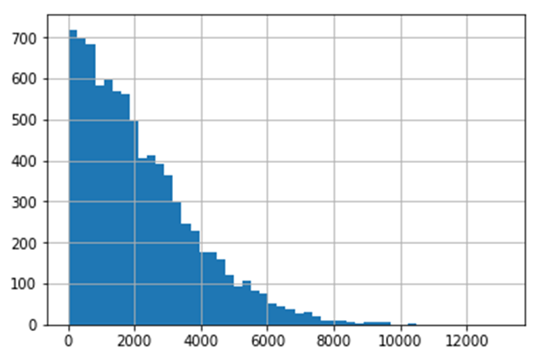
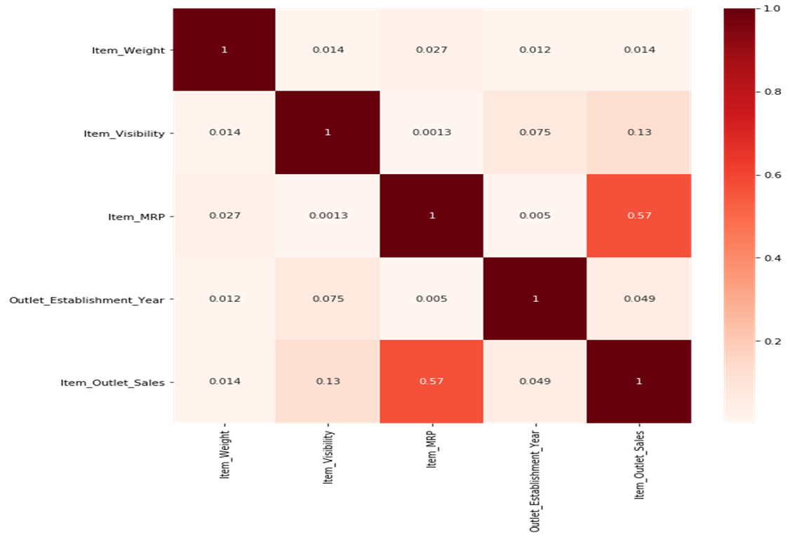
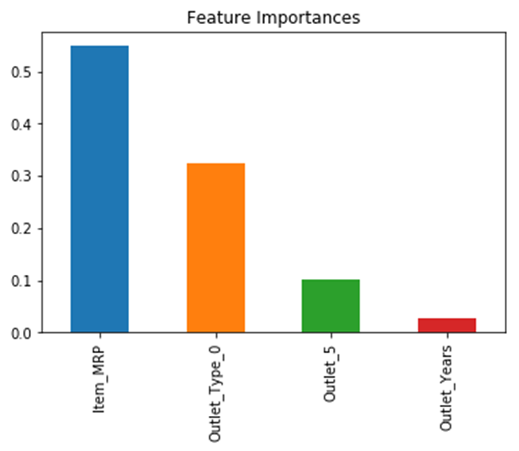
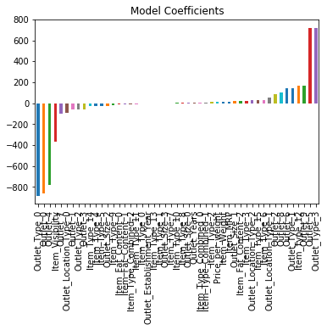
Sales Prediction Of Retail Store
The data scientists at Metro Big Mart have collected 2013 sales data for 1559 products across 10 stores in different cities.
The aim is to build a predictive model and find out the sales of each product at a store.
Using this model, MetroBigMart will try to understand the properties of products and stores which play a key role in increasing sales.
Item outlet sales
Linear Regression
RMSE : 1129 CV Score : Mean - 1140 | Std - 47.45 | Min - 1076 | Max – 1243
Ridge Regression
RMSE : 1129 CV Score : Mean - 1133 | Std - 45.07 | Min - 1078 | Max – 1222
Decision Tree
RMSE : 1058 CV Score : Mean - 1092 | Std - 46.73 | Min - 1016 | Max – 1181
Decision Tree using only the top 4 variables
RMSE : 1071 CV Score : Mean - 1096 | Std - 43.3 | Min - 1027 | Max – 1172
Random Forest
RMSE : 1074 CV Score : Mean - 1084 | Std - 43.7 | Min - 1021 | Max - 1162
Based on the bivariate analysis stores located in urban or Tier 1 cities do not necessarily have higher sales.
Based on the bivariate analysis stores which are very big in size do not necessarily have higher sales
From decision tree model, the most important variable is item MRP(monthly revenue).
The ridge regression model is the best model because it has the lowest RMSE and mean CV score compared to the other algorithms.

