Slide 1
Data science HW4
Deadline: 2020/6/8 23:59

Slide 2
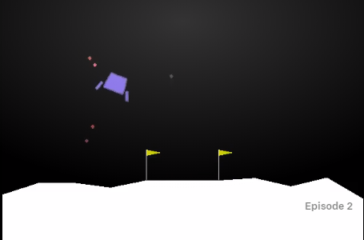
Lunar lander
In this homework, you are asked to train an agent on environment “LunarLander-v2”
https://gym.openai.com/envs/LunarLander-v2/

Slide 3

Lunar lander
You need to install Box2D
pip install Box2D
If you have some problem when install Box2D on your computer, you can use google colab (jupyter notebook store in google drive)
https://drive.google.com/file/d/17BHEDY9UNLhb0py54RTKJlZfgD5WG0Ty/view?usp=sharing
Make a copy on your own account
Remember to run the cell to install necessary package
More information: https://www.youtube.com/watch?v=inN8seMm7UI
Render on colab:
https://colab.research.google.com/drive/1flu31ulJlgiRL1dnN2ir8wGh9p7Zij2t?fbclid=IwAR1b6xw4CGnmqCqMpTWYpahidcvoDAS_JB0lS4AtTae4Z1TiLP2n7nxtdpY

Slide 4
Lunar lander
https://github.com/openai/gym/blob/master/gym/envs/box2d/lunar_lander.py
State space
Index | Name | Equation
0 | Position X | (pos.x - VIEWPORT_W/SCALE/2) / (VIEWPORT_W/SCALE/2)
1 | Position Y | (pos.y - (self.helipad_y+LEG_DOWN/SCALE)) / (VIEWPORT_W/SCALE/2)
2 | Velocity X | vel.x*(VIEWPORT_W/SCALE/2)/FPS
3 | Velocity Y | vel.y*(VIEWPORT_H/SCALE/2)/FPS
4 | Angle | self.lander.angle
5 | Angular velocity | 20.0*self.lander.angularVelocity/FPS
6 | Leg 1 contact | 1.0 if self.legs[0].ground_contact else 0.0
7 | Leg 2 contact | 1.0 if self.legs[1].ground_contact else 0.0

Slide 5

Lunar lander
Left
engine
Right engine
Main
engine
Action space
Index | Action
0 | Do nothing
1 | Fire the right engine
2 | Fire the main engine
3 | Fire the left engine

Slide 6
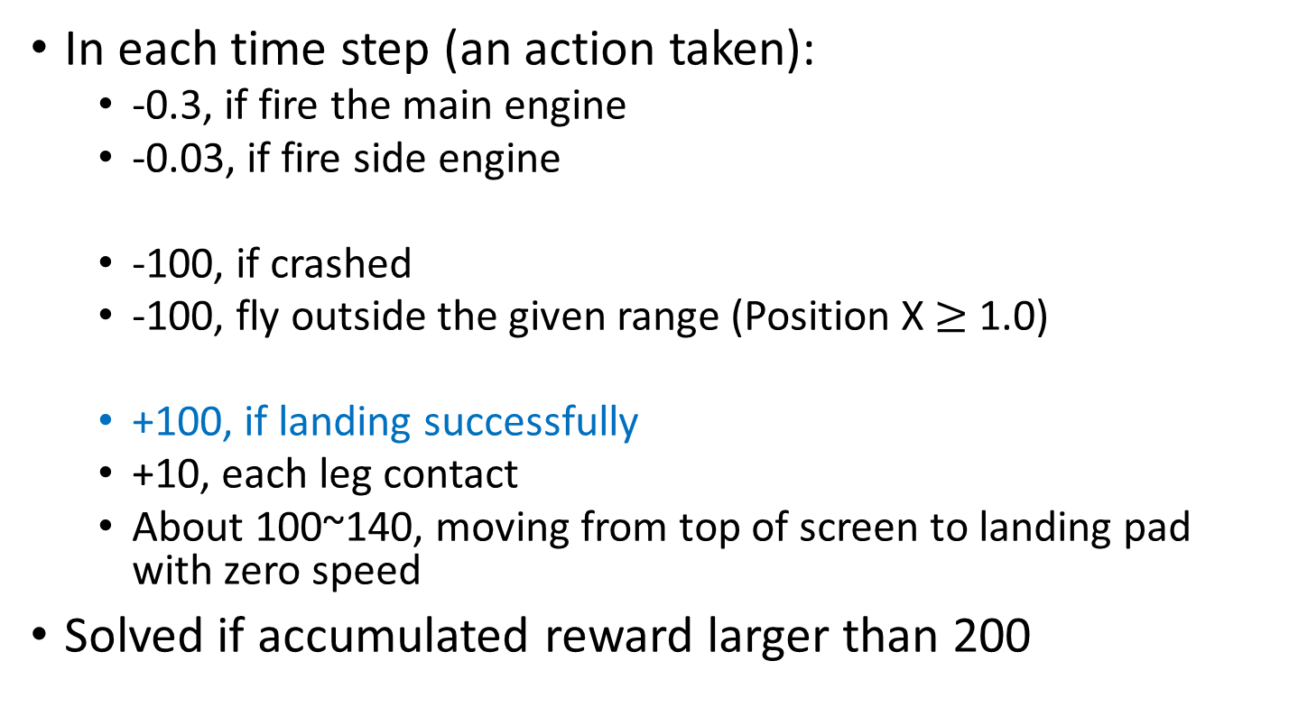
Reward
In each time step (an action taken):
-0.3, if fire the main engine
-0.03, if fire side engine
-100, if crashed
-100, fly outside the given range (Position X $≥$ 1.0)
+100, if landing successfully
+10, each leg contact
About 100~140, moving from top of screen to landing pad with zero speed
Solved if accumulated reward larger than 200

Slide 7
Task
Your task is to train an agent that can landing safely
Example

Slide 8
Fail case: crash

Slide 9
Fail case: fly away

Slide 10
Submission
Submit following files
Your code, can be .py or .ipynb (40%)
A gif file, record the result of your agent (40%)
A report, can be PDF or docx (20%)

Slide 11
Score
If you success to land, you get 85
You can choose one the following tasks for more score
Try at least two different kind of reward-shaping (90)
Implement Actor-Critic (95)
Implement improved RL algorithm that been proposed in recent years (100)
However, if you fail to land, but you analysis the possible reasons for why fail on the report, you will get 70

Slide 12
RL improvement
Improvements to DQN
https://arxiv.org/pdf/1710.02298.pdf
You can choose one of mentioned method in the paper
Improvements to policy gradient
Natural policy gradient/ TRPO / PPO
http://rll.berkeley.edu/deeprlcourse/f17docs/lecture_13_advanced_pg.pdf
Or other methods in papers (2015 after)

Slide 13
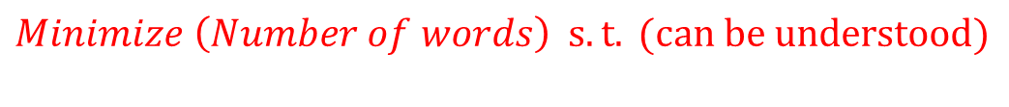
Report
$$Minimize \left(Number of words\right) s.t. (can be understood)$$
You have to describe following things in your report
What algorithm have you implemented
How do you implement the algorithm
Anything you have tried
What hyper parameters have you tried? How you design the reward function
If your agent fail to land, analysis the possible reasons

Slide 14
附註
Gif可以是直接從render下來, 或者螢幕錄影, 只要能想辦法呈現結果即可
如果中途遇到困難(gif弄不出來, 環境建不起來…)請提前聯絡助教
請不要拿別人的gif來交作業
成功登陸的那瞬間會拿到+100的reward, 同學不確定有沒有成功的話可以用reward驗證
加分項目如果不確定能得到的分數, 也可以提早與助教聯繫討論

