Slide 1
How to Install Hortontworks Sandbox and Build a MapReduce program
2018.10.5

Slide 2
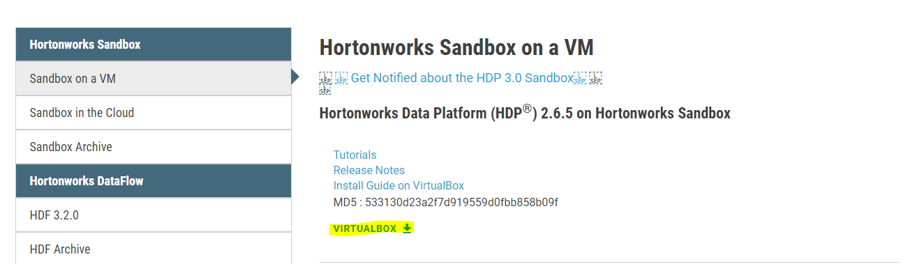
Download Virtualbox and Sandbox
Download Oracle VM Virtualbox
https://www.virtualbox.org/
Download Hortonworks Sandbox
http://hortonworks.com/downloads/#sandbox

Slide 3
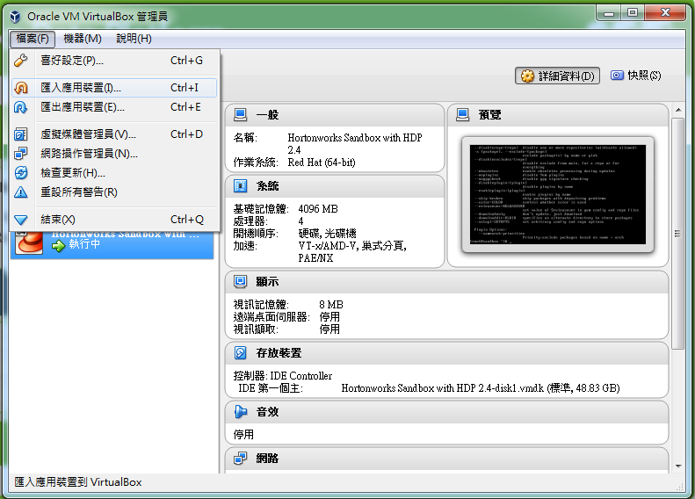

Slide 4
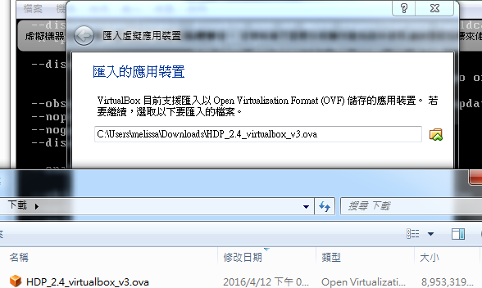

Slide 5
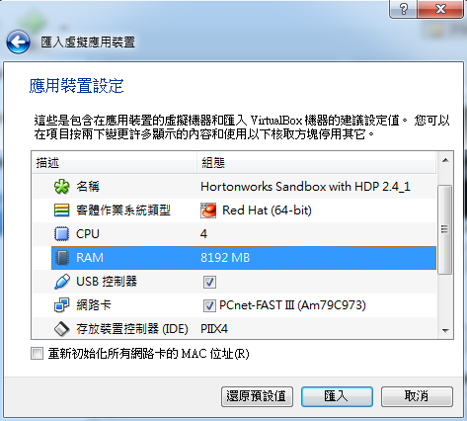
PLEASE check your computer’s RAM size and make sure your computer can handle with the setting of RAM.
Ex: My computer’s RAM size is 8G,
so I set 4096 MB here.

Slide 6
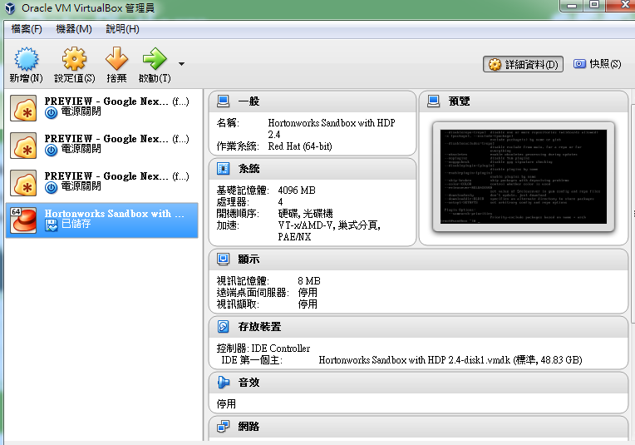

Slide 7
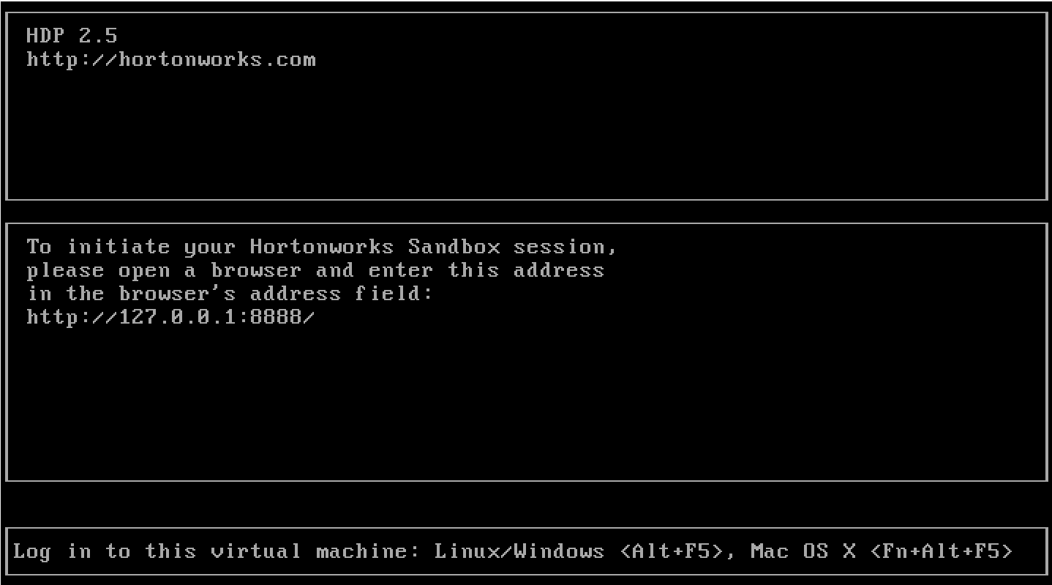

Slide 8
Connect using SSH
You can use Terminal or MobaXterm(Windows) to connect to the server.
ssh root@127.0.0.1 -p 2222
Password: hadoop
Change the password when you first time login

Slide 9
Install Maven(1/2)
wget http://mirror.cc.columbia.edu/pub/software/apache/maven/maven-3/3.0.5/binaries/apache-maven-3.0.5-bin.tar.gz
tar xzf apache-maven-3.0.5-bin.tar.gz -C /usr/local
cd /usr/local
ln -s apache-maven-3.0.5 maven
sudo vi /etc/profile.d/maven.sh
加入
export M2_HOME=/usr/local/maven
export PATH=${M2_HOME}/bin:${PATH}

Slide 10
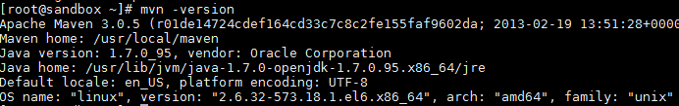
Install Maven(2/2)
Finally, log out and log in again to activate the above environment variables.
To verify successful installation of maven, check the version of maven:
mvn -version

Slide 11
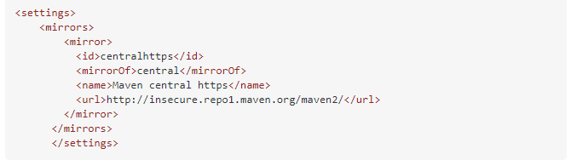
Start a new MapReduce
https://azure.microsoft.com/en-us/documentation/articles/hdinsight-develop-deploy-java-mapreduce-linux/
(root/.m2 裡面建立一個檔案settings.xml，然後貼上下圖的程式)
FROM 建立 Maven 專案
TO 建置應用程式
編輯檔案時如果遇到notepad command not found，請改用sudo vi 檔案名稱編輯

Slide 12
Copy your input file to hdfs
Make a new file on hdfs
Then copy your input file to hdfs
See more hadoop commands in the last page
hadoop fs -mkdir -p /user/root/data/
hadoop fs -copyFromLocal inputfile.txt /user/root/data/

Slide 13
Run the MapReduce
cd wordcountjava/target
yarn jar wordcountjava-1.0-SNAPSHOT.jar org.apache.hadoop.examples.WordCount /user/root/data/inputfile.txt output/out1
So you can find your output in /user/root/ on hdfs
hadoop fs -cat /user/root/output/out1/*

Slide 14
Hadoop commands
Make a directory name “remote”
List files recursive in directory “remote” (-ls: list, -ls -R: list recursive)
Print every file in directory “remote”
Remove directory “remote” recursive (-rm: remove file)
List all command options
hadoop fs -mkdir /remote
hadoop fs -ls -R /remote
hadoop fs -cat /remote/*
hadoop fs -rm -R /remote
hadoop fs -help

