Slide 1
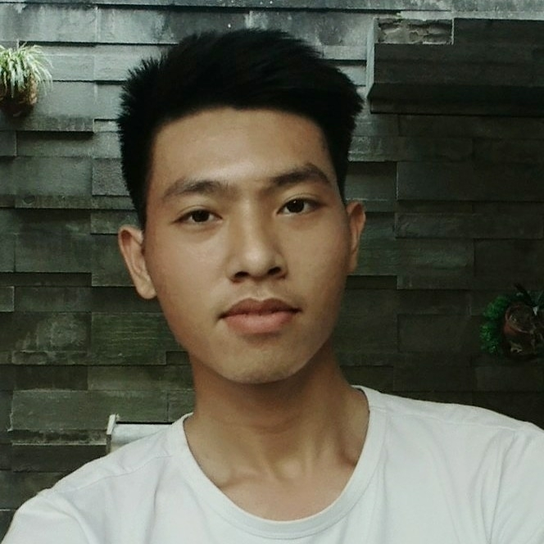

NGUYEN BUI TAI LINH
Isolation area management – Java OOP project <!–Jan 2021->
Team leader
a product about personnel management in the centralized isolation area
http://github.com/hqtriaidenboizz
linh.nguyenbuitai23@student.
passerellesnumeriques.org
0839266965
<Education> <!-2020-2023->
Passerelles Numériques Vietnam
Bachelor of Information Technology
Second-year student
Education program:
Information Technology
Professional life training
English
Front-End
Developer Intern
The Band - Web project <!–Aug 2021->
Personal project
a product to introduce a band and sells music tickets.
http://github.com/hqtriaidenboizz
<Programming languages>
JavaScript <!-main>
Java
Python
Mysq
Blue Sky - Web project <!–Oct 2021->
Team leader
<Project experience>
A product to introduce a gym center and sell food supplements.
Blue Sky - Web project <!-Oct 2021->
Team leader
http://github.com/hqtriaidenboizz
<Web skills>
HTML
CSS
JavaScript
Figma
UI/UX
Bootstrap
Adobe photoshop
A product to introduce a gym center and sell food supplements.
http://github.com/hqtriaidenboizz
<Portfolio>
Link my portfolio web: http://github.com/hqtriaidenboizz
The Band - Web project <!-Aug 2021->
Personal project
A product to introduce a band and sells music tickets.
<Working languages>
English
Vietnamese
http://github.com/hqtriaidenboizz
Isolation area management
- Java OOP project <!-Jan 2021->
Team leader
<Reference>
Mr. Vo Cong Dinh
IT teacher
(+84) 905 729 707
A product about personnel management in the centralized isolation area.
http://github.com/hqtriaidenboizz
dinh.cong@passerellesnumeriques.org
<Portfolio>
Link my portfolio web:
http://github.com/hqtriaidenboizz

Slide 2
NGUYEN BUI TAI LINH
Isolation area management – Java OOP project <!–Jan 2021->
Team leader
a product about personnel management in the centralized isolation area
http://github.com/hqtriaidenboizz
linh.nguyenbuitai23@student.
passerellesnumeriques.org
0839266965
<Education> <!-2020–2023->
Passerelles Numériques Vietnam
Bachelor of Information Technology
Second-year student
Education program:
Information Technology
Professional life training
English
Front-End
Developer Intern
The Band - Web project <!–Aug 2021->
Personal project
a product to introduce a band and sells music tickets.
http://github.com/hqtriaidenboizz
<Programming languages>
JavaScript <!-main->
Java
Python
Mysq
Blue Sky - Web project <!–Oct 2021->
Team leader
<Project experience>
A product to introduce a gym center and sell food supplements.
Blue Sky - Web project <!–Oct 2021->
Team leader
http://github.com/hqtriaidenboizz
<Web skills>
HTML
CSS
JavaScript
Figma
UI/UX
Bootstrap
Adobe photoshop
A product to introduce a gym center and sell food supplements.
http://github.com/hqtriaidenboizz
<Portfolio>
Link my portfolio web: http://github.com/hqtriaidenboizz
The Band - Web project <!–Aug 2021->
Personal project
A product to introduce a band and sells music tickets.
<Working languages>
English
Vietnamese
http://github.com/hqtriaidenboizz
Isolation area management
– Java OOP project <!–Jan 2021->
Team leader
<Reference>
Mr. Vo Cong Dinh
IT teacher
(+84) 905 729 707
A product about personnel management in the centralized isolation area.
http://github.com/hqtriaidenboizz
dinh.cong@passerellesnumeriques.org
<Portfolio>
Link my portfolio web:
http://github.com/hqtriaidenboizz

