Slide 1
Introduction to parallel computing
Presented by Tai Nguyen
3+ Years experience of optimizing performance
December, 2021
Version 1.0

Slide 2
Disscustion Topics
Overview parallel computing
OpenMP
Cuda
OpenCL
Demo

Slide 3
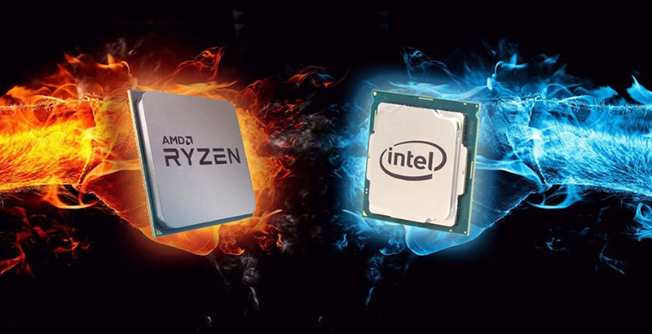
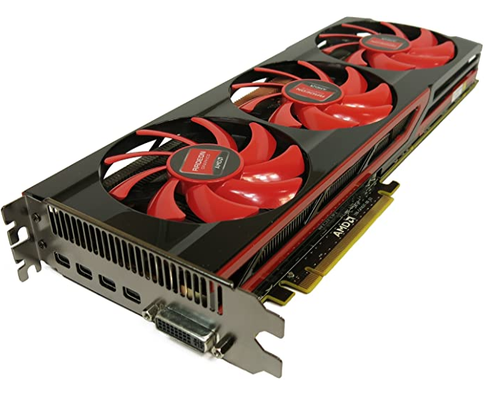
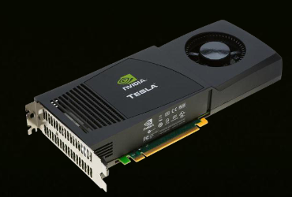
I.Resources to parallel computing
CPU
Graphics card(GPU)
Nvidia
AMD
Asus
Intel
Gigabyte
Zotac

Slide 4
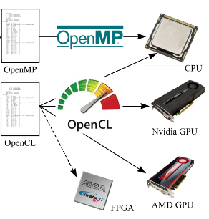
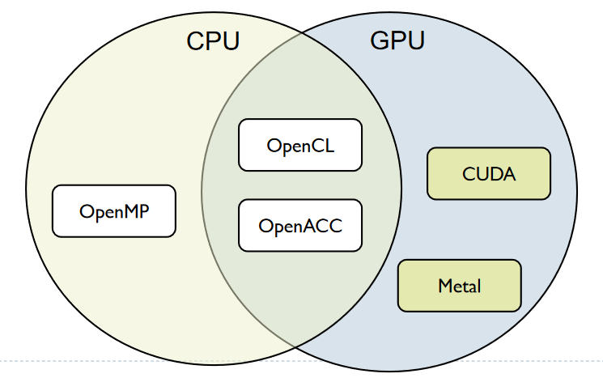
I.Parallel programming frameworks
OpenMP
OpenCL
CUDA
Notes:
These are some of more relevant frameworks for creating parallelized code

Slide 5
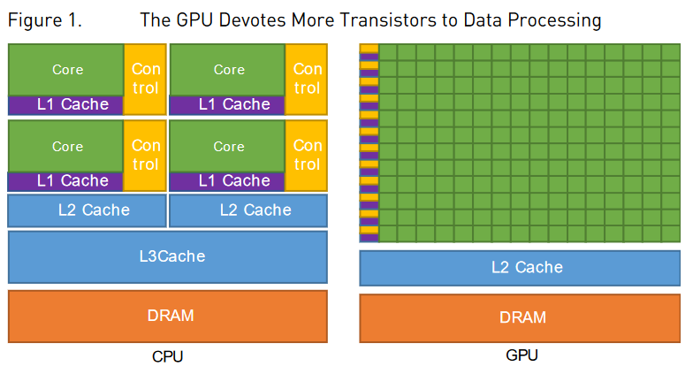
I.GPU
Notes:
These are some of more relevant frameworks for creating parallelized code

Slide 6
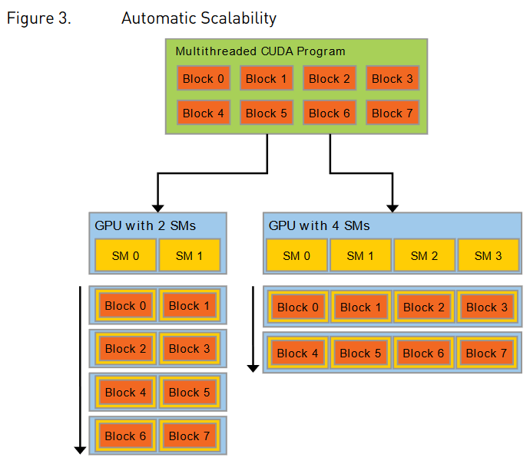
I.GPU
Notes:
These are some of more relevant frameworks for creating parallelized code

Slide 7
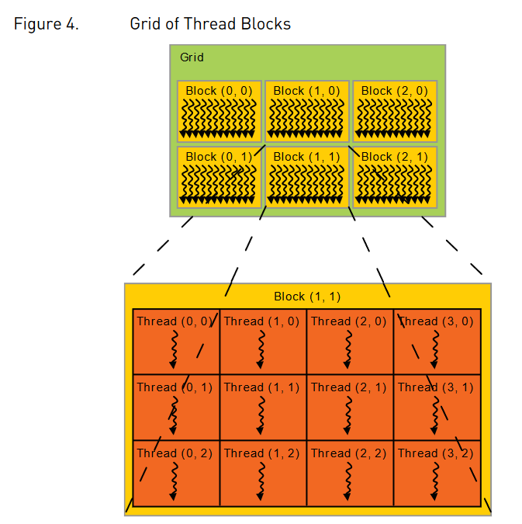
I.GPU
Notes:
These are some of more relevant frameworks for creating parallelized code

Slide 8
II.OpenMP
The OpenMP API supports multi-platform shared-memory parallel programming in C/C++ and Fortran. The OpenMP API defines a portable, scalable model with a simple and flexible interface for developing parallel applications on platforms from the desktop to the supercomputer.
Link: https://www.openmp.org/
Notes:
These are some of more relevant frameworks for creating parallelized code

Slide 9
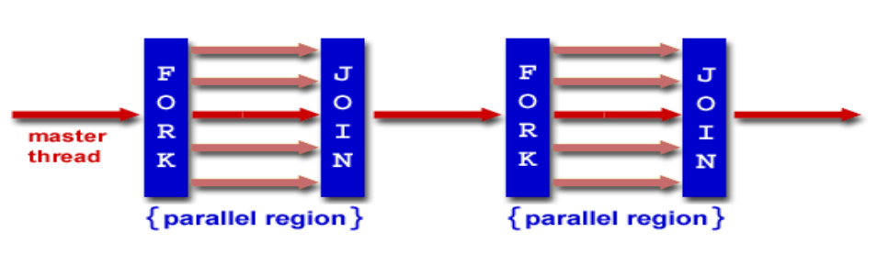
II.OpenMP: Fork and Join model
Notes:
These are some of more relevant frameworks for creating parallelized code

Slide 10
II.OpenMP: Pragma Syntax
Most constructs in OpenMP* are compiler directives or pragmas.
#pragma omp construct [clause [clause]…]
C/C++: Serial Code
for(i = 1, i < 20, i++)
c[i] = a[i] + b[i]
C/C++: Parallel Code
#pragma omp parallel for
for(i = 1, i < 20, i++)
c[i] = a[i] + b[i]
Notes:
These are some of more relevant frameworks for creating parallelized code

Slide 11
II.OpenCL
What is OpenCL?
OpenCL™ (Open Computing Language) is an open, royalty-free standard for cross-platform, parallel programming of diverse accelerators found in supercomputers, cloud servers, personal computers, mobile devices and embedded platforms. OpenCL greatly improves the speed and responsiveness of a wide spectrum of applications in numerous market categories including professional creative tools, scientific and medical software, vision processing, and neural network training and inferencing.
Initial Release: Aug-2009 OpenCL 1.0 by Apple
Latest Release: Sep-2020 OpenCL 3.0
Supported: AMD, IBM, Qualcomm, Intel and Nvidia…
OS: Windows, Linux, Android, MacOS
Link: https://www.khronos.org/opencl/
Notes:
These are some of more relevant frameworks for creating parallelized code

Slide 12
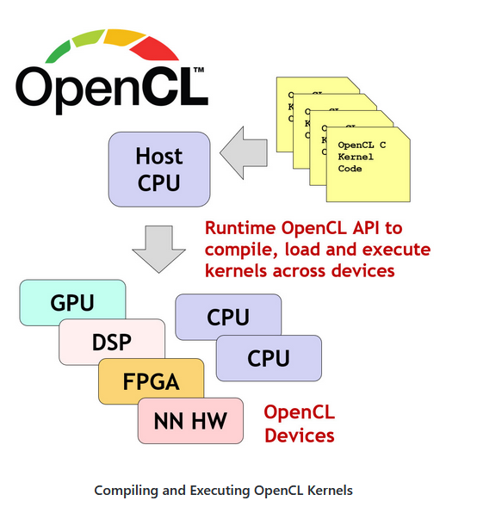
II.How Does OpenCL Work?
Notes:
These are some of more relevant frameworks for creating parallelized code

Slide 13
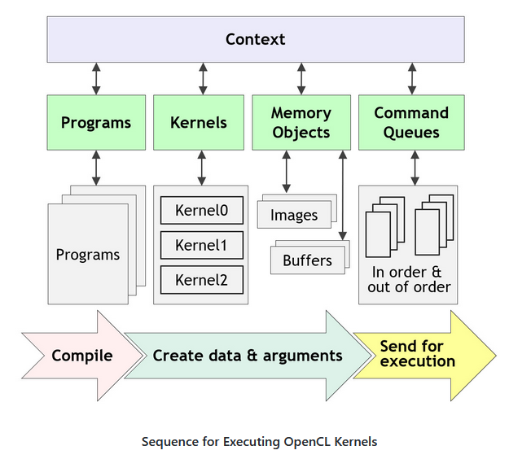
II.How Does OpenCL Work?
Notes:
A complete sequence for executing an OpenCL program is:
Query for available OpenCL platforms and devices
Create a context for one or more OpenCL devices in a platform
Create and build programs for OpenCL devices in the context
Select kernels to execute from the programs
Create memory objects for kernels to operate on
Create command queues to execute commands on an OpenCL device
Enqueue data transfer commands into the memory objects, if needed
Enqueue kernels into the command queue for execution
Enqueue commands to transfer data back to the host, if needed
https://github.com/KhronosGroup/OpenCL-Guide

Slide 14
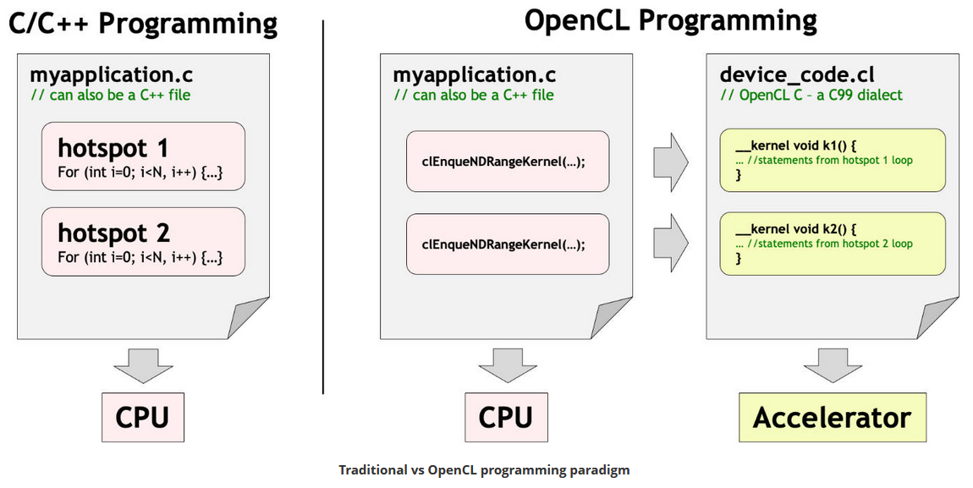
II.Programming OpenCL
Notes:
These are some of more relevant frameworks for creating parallelized code

Slide 15
III.CUDA
CUDA is a parallel computing platform and application programming interface that allows software to use certain types of graphics processing unit for general purpose processing – an approach called general-purpose computing on GPUs.
Initial Release: June-2007 Cuda 1.0
Latest Release: Nov-2021 Cuda 11
Supported: Nvidia
OS: Windows, Linux
Link: https://developer.nvidia.com/
Notes:
These are some of more relevant frameworks for creating parallelized code

Slide 16
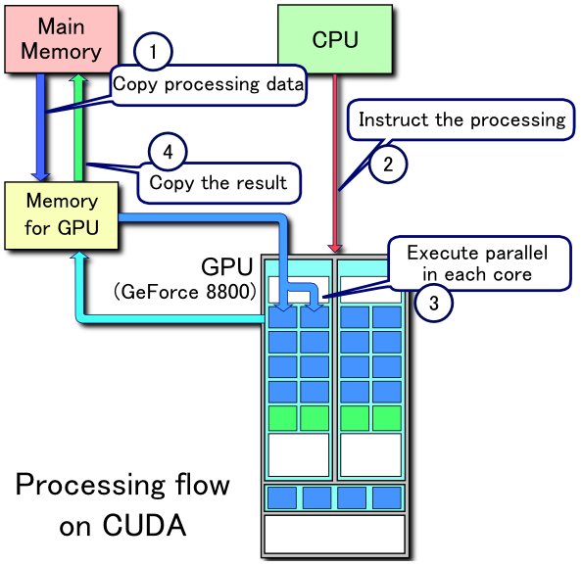
III.How Does Cuda Work?
Notes:
1.Copy data from main memory to GPU memory
2.CPU initiates the GPU compute kernel
3.GPU's CUDA cores execute the kernel in parallel
4.Copy the resulting data from GPU memory to main memory

Slide 17
III.Parallel Demo
Matrix multiplication
Sobel edge detection filter
Notes:
1.Copy data from main memory to GPU memory
2.CPU initiates the GPU compute kernel
3.GPU's CUDA cores execute the kernel in parallel
4.Copy the resulting data from GPU memory to main memory

Slide 18
Reference links
https://www.nvidia.com/docs/IO/116711/sc11-cuda-c-basics.pdf
https://www.openmp.org/
https://www.khronos.org/opencl/
https://www.cl.cam.ac.uk/teaching/1819/AdvGraphIP/03_OpenCL.pdf
https://www.incredibuild.com/blog/cuda-vs-opencl-which-to-use-for-gpu-programming
https://www.nvidia.com/content/cudazone/download/OpenCL/NVIDIA_OpenCL_ProgrammingGuide.pdf
https://synergy.cs.vt.edu/pubs/papers/gardner-cu2cl-parco13.pdf
https://www.intel.com/content/dam/www/public/apac/xa/en/pdfs/ssg/Programming_with_OpenMP-Linux.pdf

