Slide 1
MACHINE LEARNING CASE STUDY
Predicting Football Match Scores
Using In-Match Performance Metrics
A Multiple Linear Regression approach to estimating final scores from shots, saves,
possession and attacking metrics

Slide 2
01 PROBLEM STATEMENT
Can in-match statistics predict the final score?
Shots on target, goal attempts, possession and goalkeeper saves are recorded continuously throughout a match. This project tests whether these performance metrics can be used to estimate the final score and the likely winner, using a Multiple Linear Regression model.
Shots on Target
Attacking accuracy
Goal Attempts
Attacking volume
Scope note
The dataset holds only full-time statistics, not time-stamped, in-play data. The model is therefore trained as a proof of concept — the same approach could extend to live/half-time prediction if timestamped stats were available.
Ball Possession
Territorial control
Goalkeeper Saves
Defensive pressure
2

Slide 3
02 THE DATA
Dataset overview
95,384
31
25
raw match rows
original columns
features after cleaning
Feature groups used in modelling
Attacking: Goal Attempts, Shots on Target (Home & Away)
Possession: Ball Possession % (Home & Away)
Defensive: Goalkeeper Saves (Home & Away)
Discipline (dropped later): Free Kicks, Fouls, Offsides
Targets: Home Score, Away Score
3

Slide 4
02 THE DATA
Data cleaning pipeline
1
2
3
4
5
Remove duplicates
Assess missing values
Drop sparse columns
Fix data types
Final clean set
95,384 → 95,340 rows
Dropping all N/A rows loses 95% of data — rejected
6 high-null pass/attack columns removed instead
home_score / away_score coerced to numeric
95,340 rows × 25 columns retained
4

Slide 5
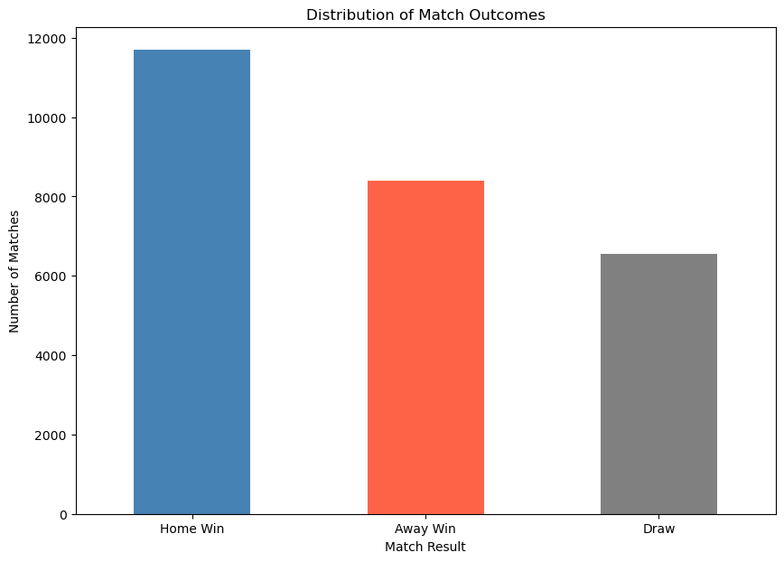
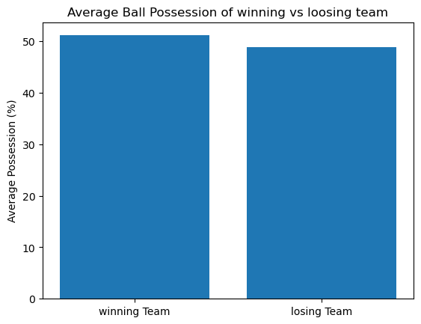
03 EXPLORATORY ANALYSIS
Does home advantage or possession decide matches?
Key findings
Home wins (11.7k) clearly outnumber away wins (8.4k) and draws (6.6k) — home advantage is real.
Winners average only ~1-2 points more possession than losers — the gap is too small to explain the outcome gap alone.
Conclusion: possession is, at best, a minor predictive factor.
5

Slide 6
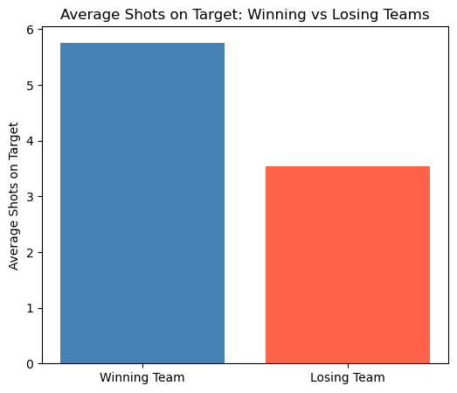
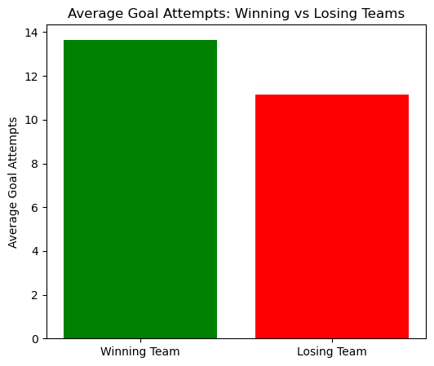
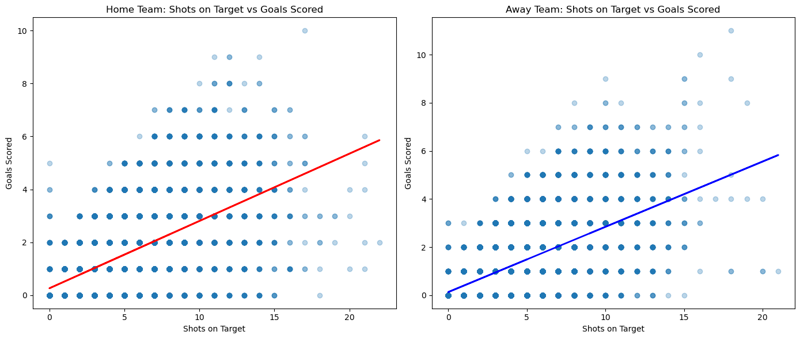
03 EXPLORATORY ANALYSIS
Attacking output separates winners from losers
Winning teams average more shots on target AND more goal attempts than losing teams — a larger gap than possession showed.
More shots on target also tracks with more goals scored, for both home and away teams (bottom chart).
Attacking intent is a stronger signal than possession.
6

Slide 7
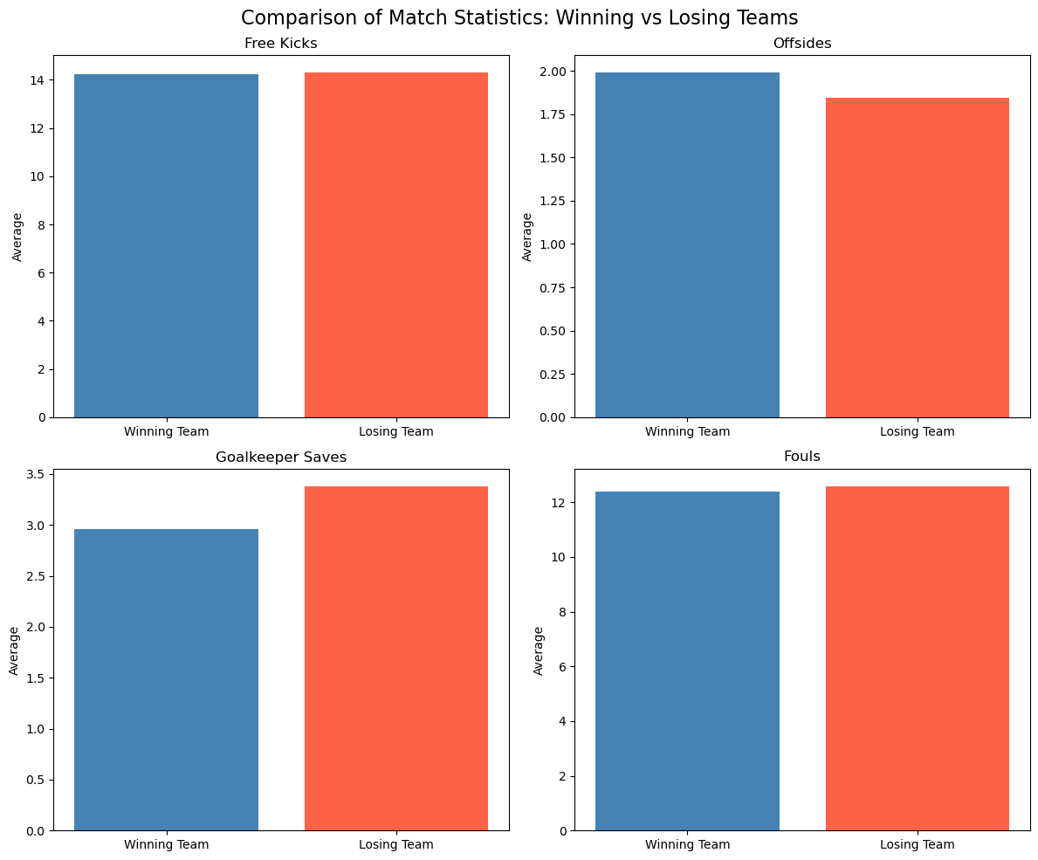
03 EXPLORATORY ANALYSIS
Defensive and disciplinary metrics add less signal
Offsides
Slightly higher for winners — greater attacking intent
Goalkeeper Saves
Higher for losers — reflects more pressure faced
Free Kicks & Fouls
Minimal difference between winners and losers
Takeaway: attacking metrics (shots, attempts) outperform defensive/disciplinary metrics as predictors.
7

Slide 8
04 FEATURE ENGINEERING
Checking multicollinearity with VIF
Many candidate predictors move together (e.g. shots on/off target, fouls and free kicks). A Variance Inflation Factor (VIF) check on the full feature set showed several features above 20-60 — far beyond the common threshold of 5-10 — confirming heavy overlap.
Feature selection flow
25 candidate features
↓
Compute VIF for each
Highest VIF (before)
Highest VIF (after)
Free_Kicks_Home
60.6
Shots_on_Goal_Home
21.1
↓
Fouls_Home
54.5
Goal_Attempts_Home
15.5
Drop redundant / high-VIF fields
(passes, fouls, offsides, shots off target)
Goal_Attempts_Home
43.6
Goalkeeper_Saves_Home
13.3
↓
8-feature reduced set → modelling
8

Slide 9
05 METHODOLOGY
End-to-end modelling pipeline
1
2
3
4
5
6
Raw Data
Clean & Type-Fix
Feature Selection
Train / Test Split
Multiple Linear
Regression
Evaluate
→
→
→
→
→
95,384 rows
31 columns
Drop duplicates/nulls
Coerce numeric types
VIF check
8 low-collinearity features
90% train
10% test
Predicts home_score
& away_score jointly
R², MAE, RMSE
vs held-out matches
Target: predict both home_score and away_score in a single regression model.
9

Slide 10
06 RESULTS
Final model performance
Shots on Target + Goalkeeper Saves (Home & Away)
0.989
0.030
0.130
R² Score
Mean Absolute Error
Root Mean Squared Error
Score-specific accuracy
Reading the numbers
Home Score R²
0.989
An R² of 0.989 means the model explains ~99% of the variance in final scores from shots-on-target and saves alone. The average prediction is off by just 0.03 goals (MAE) — effectively near-exact for full-time statistics used as inputs.
Away Score R²
0.988
10

Slide 11
06 RESULTS
Comparing feature combinations
Model
Features used
R²
1
Possession + Attempts + Shots + Saves
0.989
2
Possession only
0.015
3
Goal Attempts only
0.094
4
Possession + Goal Attempts
0.095
5
Possession + Attempts + Shots
0.315
6
Attempts + Shots + Saves
0.989
7
Shots + Saves (final model)
0.989
Possession and Goal Attempts alone explain almost none of the score variance. Once Shots on Target and Goalkeeper Saves are included, R² jumps to ~0.99 — adding possession or raw attempts on top of them contributes nothing further.
11

Slide 12
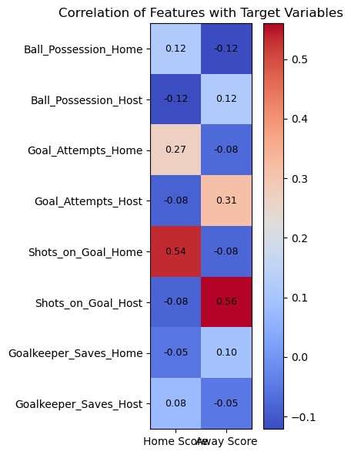
06 RESULTS
Which features correlate with the final score?
How to read this heatmap
Each row is a candidate feature; the two columns show its correlation with the home and away final score. Warmer (red) cells indicate a stronger positive relationship, cooler (blue) cells a weaker or negative one.
Shots on Target shows by far the strongest correlation with the final score (0.54-0.56). Goalkeeper Saves, Possession and Goal Attempts each correlate only weakly on their own — but the regression results show Saves still adds real predictive value once combined with Shots on Target, since it captures defensive pressure that a simple correlation misses.
12

Slide 13
07 CONCLUSION
Shots on target and saves are the strongest predictors
Across seven candidate feature sets, the final Multiple Linear Regression model — built on Shots on Target and Goalkeeper Saves (home & away) — achieved an R² of 0.989, meaning it explains almost all of the variance in final match scores from these four in-match metrics alone. Ball Possession and raw Goal Attempts added no meaningful improvement once these two were included.
FINAL MODEL
Shots on Target
+ Goalkeeper Saves
R² = 0.989
Beyond the notebook: potential applications
The trained model was packaged into an interactive predictor (next slide) that takes two teams' shots and saves and returns a scoreline. The same approach generalises to odds-setting and sports-betting markets, fantasy sports scoring tools, live broadcast prediction graphics, and coaching/scouting analytics.
MAE 0.03 · RMSE 0.13
Limitations
Trained on full-time stats only, not live/in-play data — a production betting or broadcast tool would need time-stamped features and ongoing recalibration against real odds/outcomes.
13

Slide 14
08 FINAL PROGRAMME
The model, in action
The final notebook cell wraps the trained model in an interactive programme: enter two teams' shots on target and goalkeeper saves, and it returns a predicted scoreline and winner. This is the actual console output captured from the notebook run.
python — Predict a New Match
Where this kind of model gets used
Enter Team 1 Name: Argentina
Enter Team 2 Name: Egypt
Sports betting & odds-setting
Enter Argentina Shots on Target: 7
Fast scoreline estimates to inform lines or flag mispriced odds
Enter Egypt Shots on Target: 2
Fantasy sports platforms
Enter Argentina Goalkeeper Saves: 0
Projected scorelines feed player/team scoring tools
Enter Egypt Goalkeeper Saves: 4
MATCH PREDICTION
Live broadcast graphics
Real-time "predicted final score" overlays
Argentina: 3 Egypt: 2
Predicted Winner: Argentina
Coaching & scouting
Quantifying which in-match actions most move the scoreline
Note: prediction is based on full-match statistics.
14

