Slide 1
OCR Image Processing & Model Evaluation
Optimizing OCR with Image Processing, Model Evaluation, and Performance Tracking

Slide 2
Overview of OCR Process
This presentation demonstrates the key steps in image preprocessing for OCR:
1. Image Processing (Thresholding, Deskewing, etc.)
2. OCR Integration with Tesseract
3. Model Evaluation using Cosine Similarity
4. Performance Tracking (Time and Memory)

Slide 3
Image Preprocessing Techniques
1. **Adaptive Thresholding**: Adjusts the threshold based on local image regions.
2. **Grayscale Conversion**: Converts color images to grayscale for better processing.
3. **Deskewing**: Corrects skew or rotation of images for accurate OCR.
4. **Global Thresholding**: Binarizes images with a fixed threshold.
5. **Saturation Adjustment**: Enhances image contrast and brightness.

Slide 4
OCR Integration with Tesseract
Tesseract OCR is used for extracting text from processed images. The process involves:
1. Convert processed image to text format.
2. Use Tesseract Engine to extract text.
3. Store the extracted text with model labels.

Slide 5
Cosine Similarity for Model Comparison
Cosine Similarity is used to compare different models' embeddings:
1. Calculate cosine similarity between model embeddings.
2. Generate a similarity report for model comparison.

Slide 6
Embedding Generation with OpenAI API
Embeddings are generated using OpenAI's API for text processing:
1. Text from OCR models is sent to OpenAI API.
2. Embeddings are created for each model's extracted text.
3. Embeddings help compare models and evaluate their similarity.

Slide 7
Performance Tracking
Performance metrics are crucial for optimizing models:
1. **Time Tracking**: Measures processing time for each model.
2. **Memory Tracking**: Monitors memory usage during image processing.
3. Track average time and memory across multiple runs.

Slide 8
File and Directory Management
Efficient file and directory management ensures smooth processing:
1. **Directory Cleaner**: Cleans up output directories.
2. **File Writer**: Saves extracted text and results.
3. **Logger**: Logs processing details for review.

Slide 9
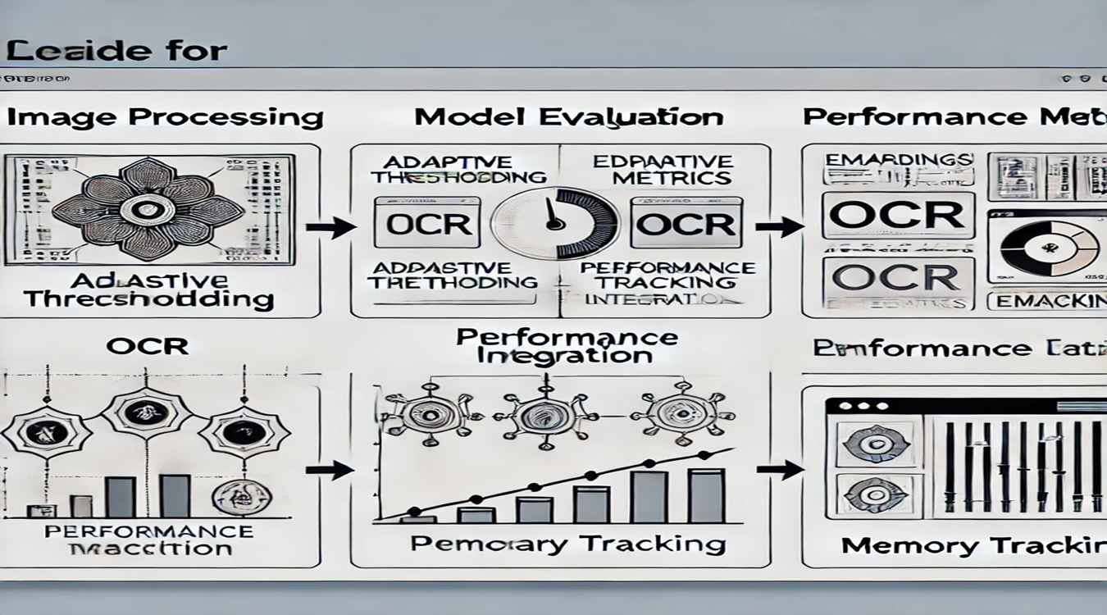
Flow of the OCR Program

Slide 10
Conclusion
1. OCR Processing improves text extraction accuracy.
2. Model Evaluation ensures optimal performance.
3. Performance tracking helps refine models.
This project enables efficient OCR workflows and comparisons.

Slide 11
Q&A
• Please feel free to ask any questions.

