Slide 1
Implement: Decentralized Opportunistic Coflow-Aware Scheduling for Data Center Networks
Agenda:
1. How to Build the new Linux kernel
2. How to generate the coflow traffic
3. Code in Linux kernel
4. Demo

Slide 2
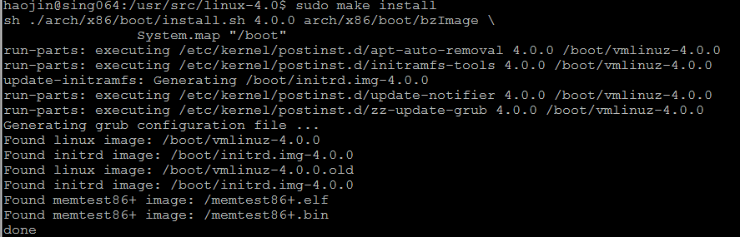
How to build new Linux kernel
STEPS:
Download kernel source code: https://www.kernel.org/
tar xvJf ***.tar.xz –C /usr/src/
sudo chown -R haojin linux-***
sudo chmod 775 -R linux-***
make -j5
make -j5 modules
sudo make -j5 modules_install
sudo make install
sudo shutdown –r now
Verify (uname -r)

Slide 3
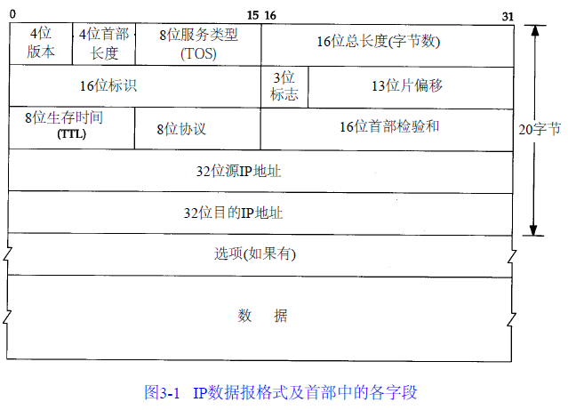
Add the taskid in ip Options field

Slide 4
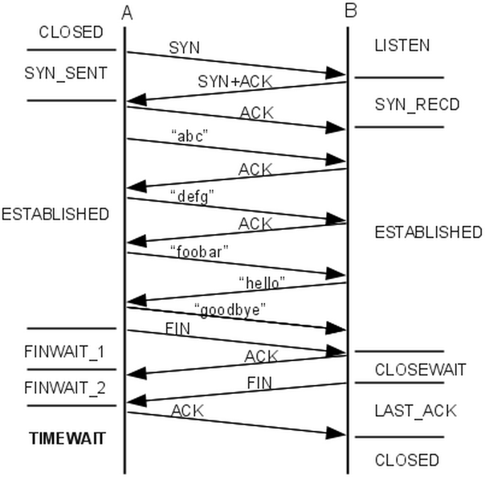
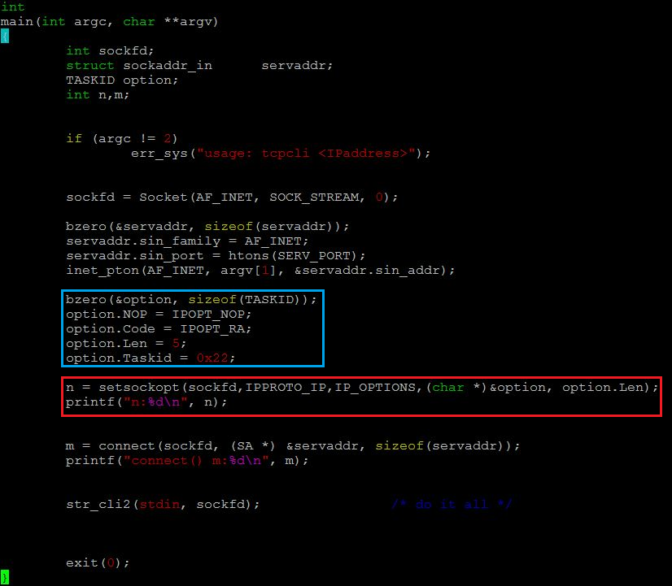
How to generate the coflow traffic

Slide 5
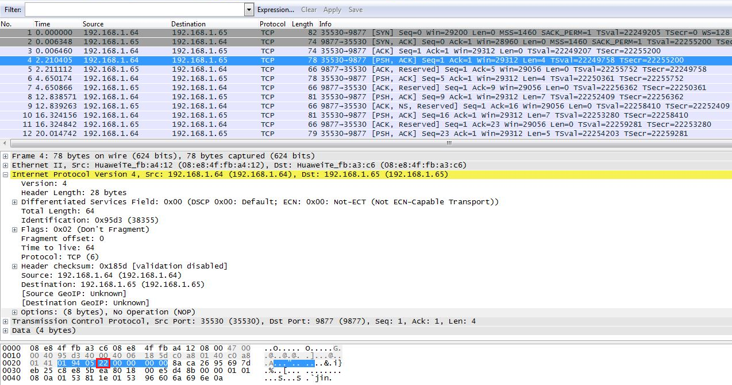

Slide 6

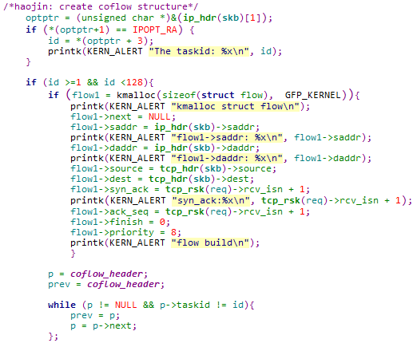
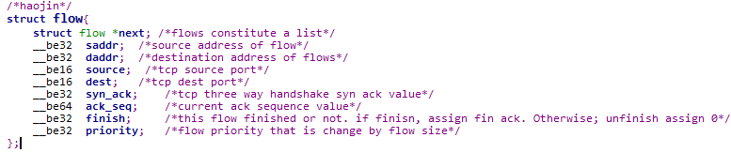
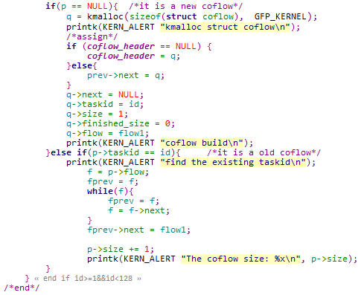


Slide 8
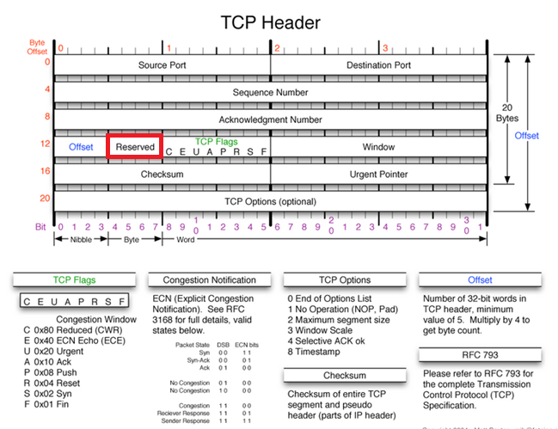
Add priority in TCP Reserved field

Slide 9
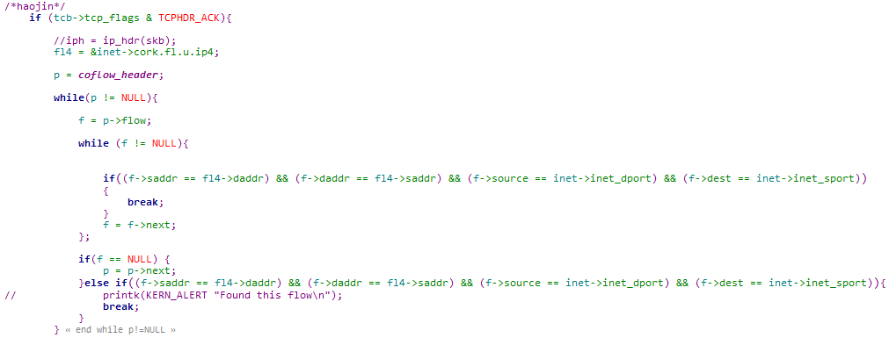
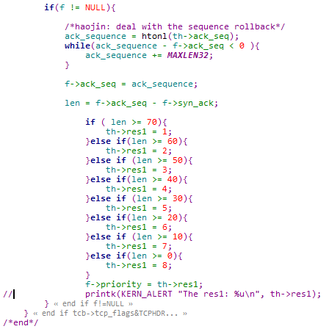

Slide 10
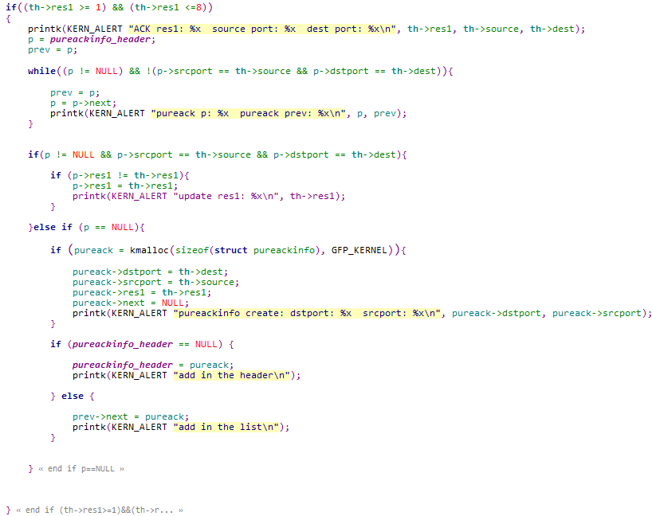


Slide 11
Record tcp ACK res1 != 0.
It is used to modify ip data dscp value when send the next packet.

Slide 12
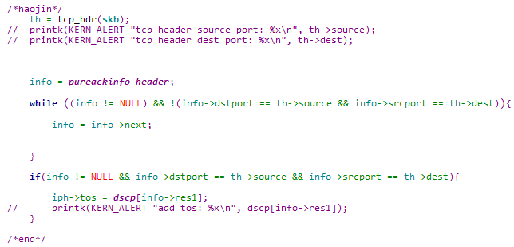

Slide 13

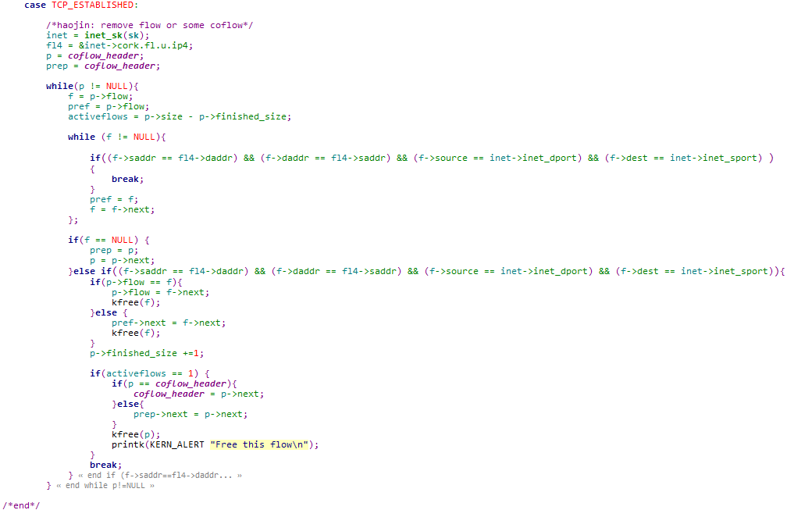

Slide 14
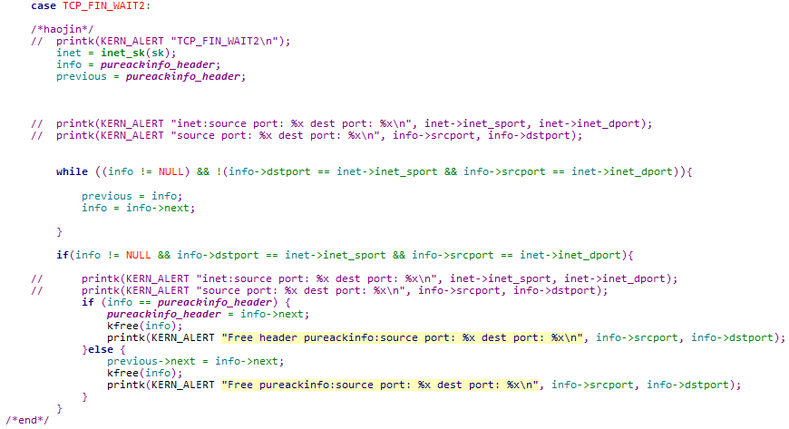

Slide 15
Demo & QA

