Slide 1
STUDENT MANAGEMENT
SYSTEM
BY- ANAND MOHAN
Session - 2022-25
Sem - 4

Slide 2
REQUIREMENT
SOFTWARE
JAVA
PostgreSQL
DOCKER

Slide 3
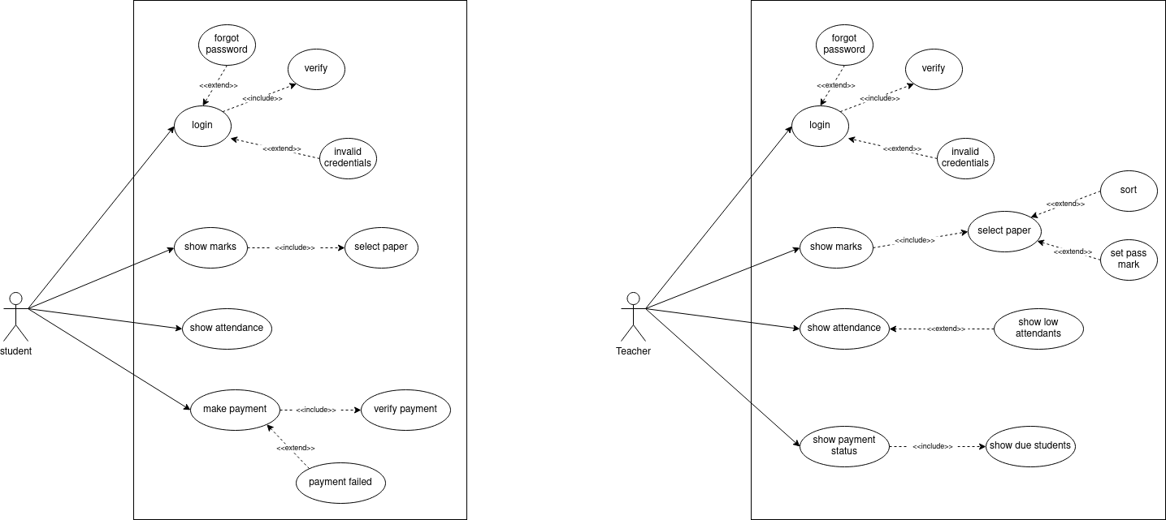

Slide 4
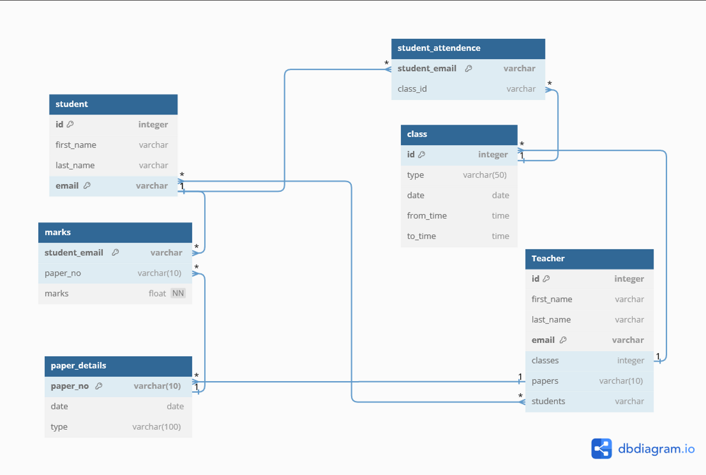

Slide 5
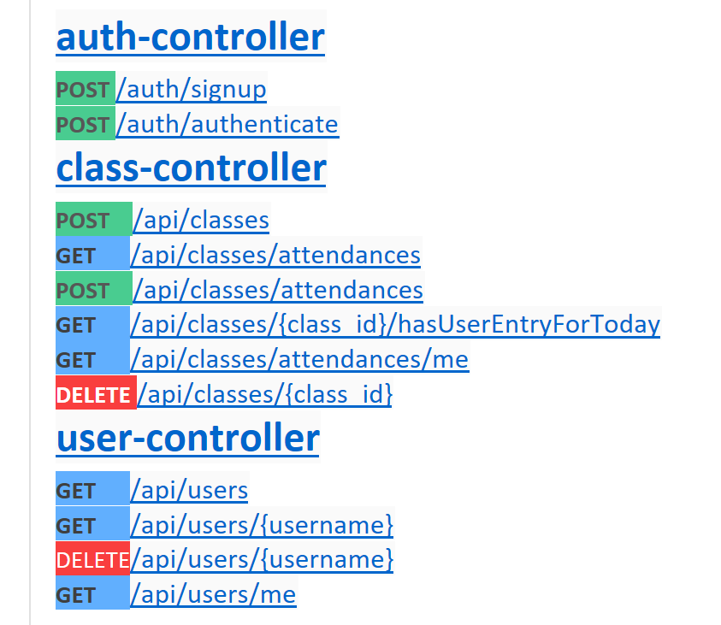
API Endpoints

Slide 6
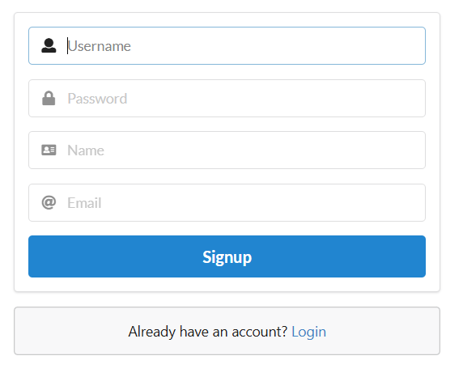
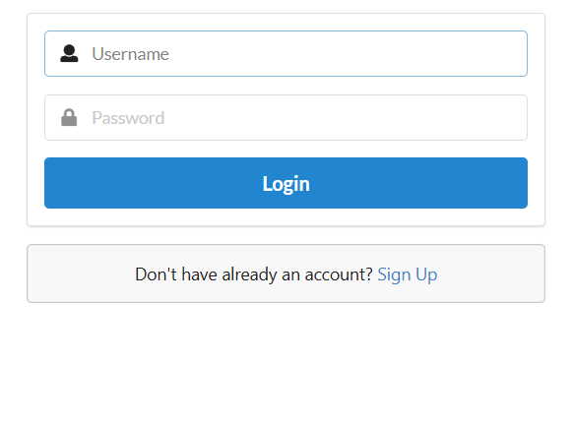
SIGNUP PAGE
LOGIN PAGE

Slide 7
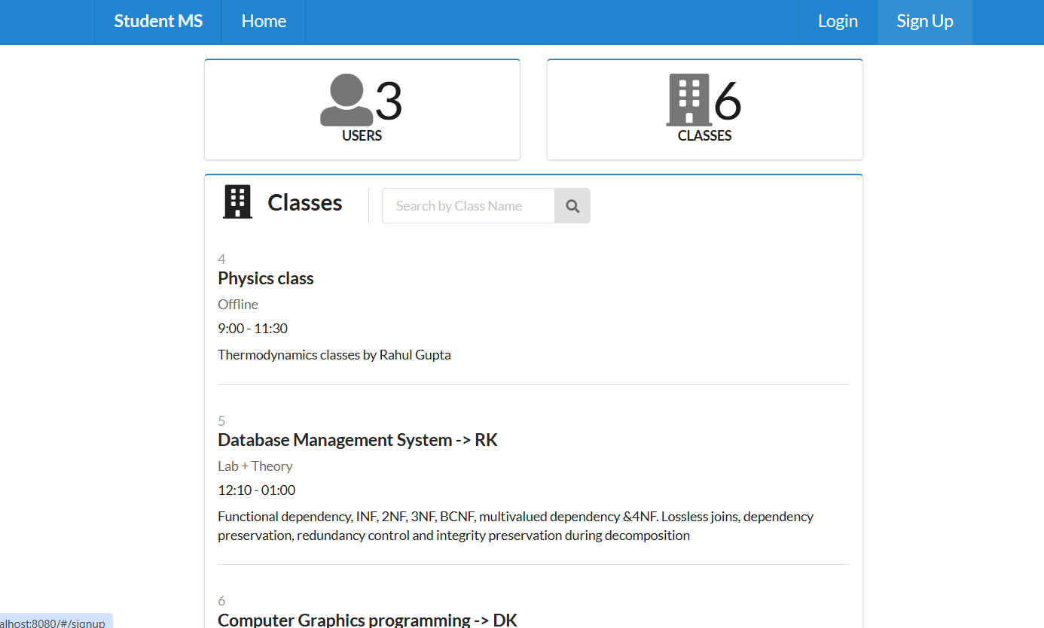
Home Page

Slide 8
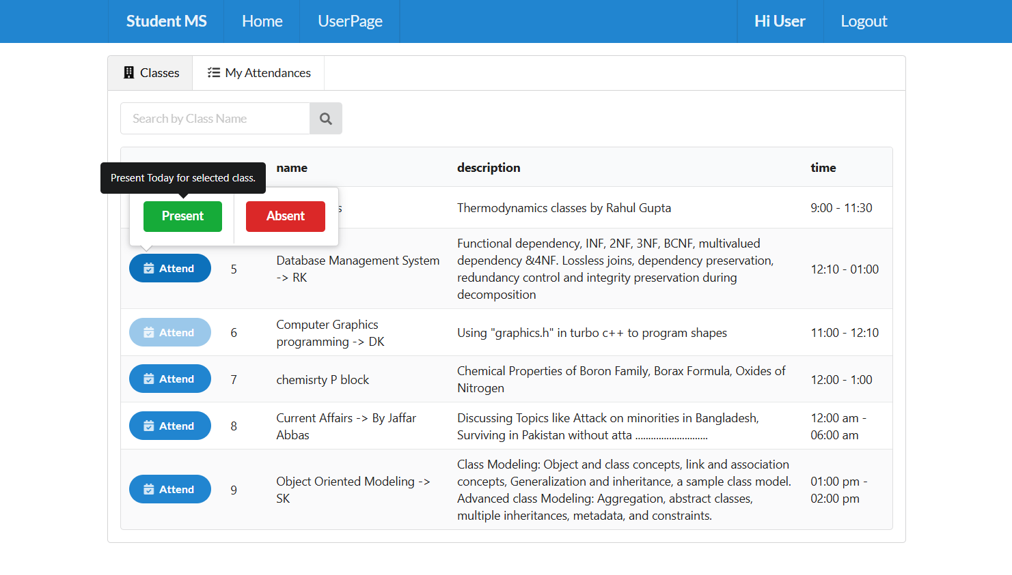
Student Page

Slide 9
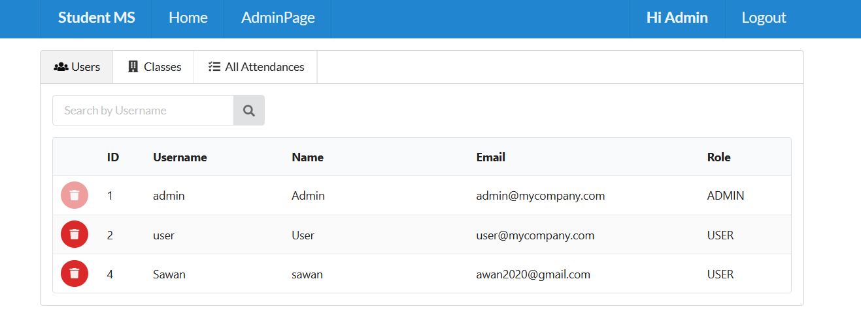
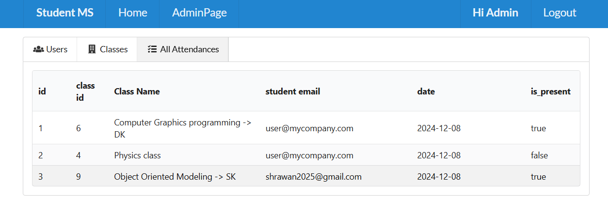
Teacher’s Page

Slide 10
BIBLIOGRAPHY
Spring boot reference guide
Comprehensive guide covering all aspects of Spring Boot.
React official documentation
The official React website with resources and tutorials.
Docker documentation
Official documentation of docker for detailed tutorials.

Slide 11
THANK YOU

