Slide 2
Buyer
Shop
Cart
Payment System
Account System
Invoice
Seller
Login(Buyer account)
Seller Stock (unique)
Order
Sale report
See product allocate
Admin
Login with unique page
Sales report
Stock management
Dealer report
Dealer billing
Order receive
Shipping (pick pack)
Report per dealer

Slide 3
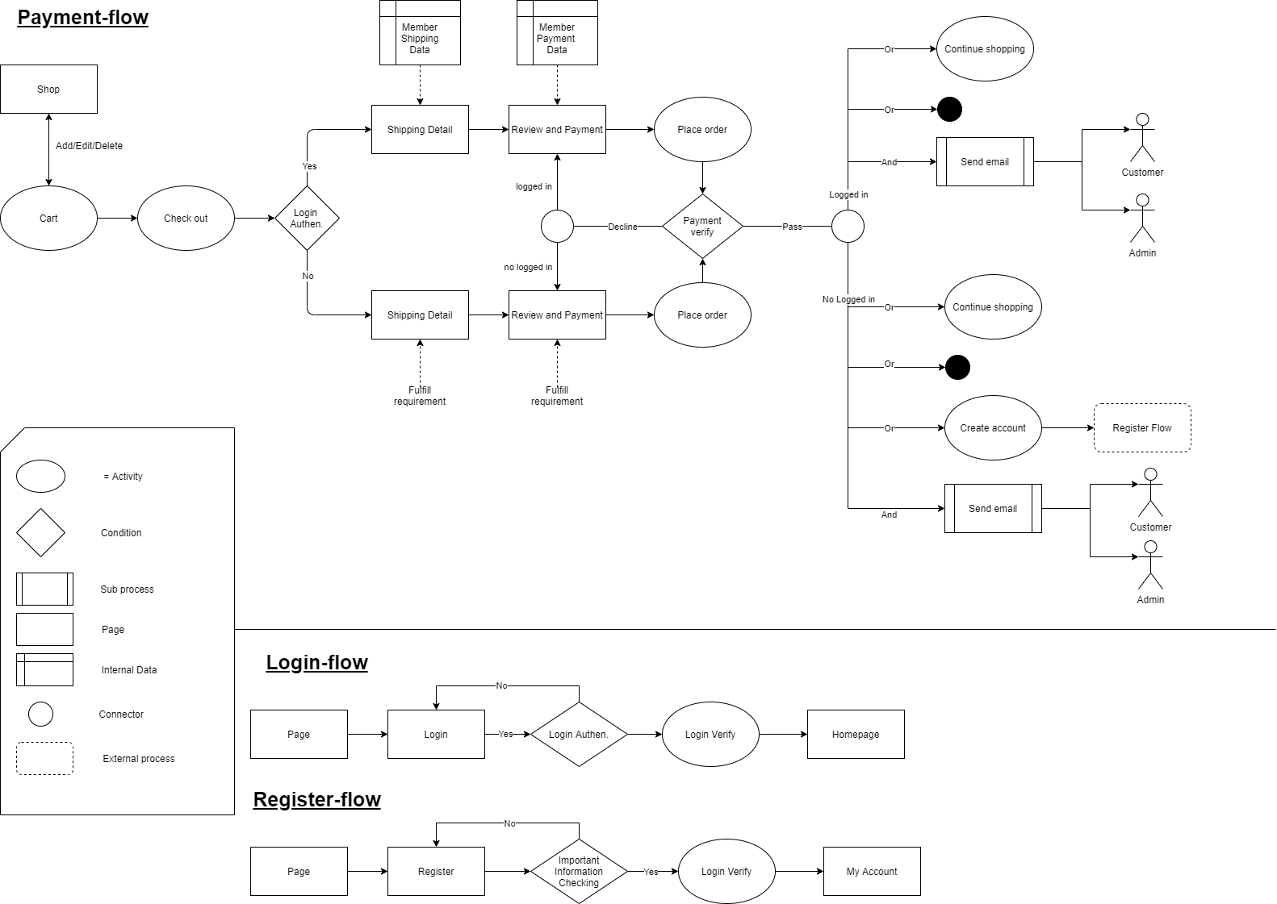
Phase 1 Make it commerce

Slide 4
Phase 2 Seller function
Seller managing page
Register as Buyer
Register as Seller
Login
Seller Stock
Order
Sale report
See product allocate

Slide 5
Phase 3
Buyer
Seller
Order
Buyer information
Many order
Little order that can manage
Seller solve this by Chatbot
Filled by themself
Little money by compare with salary

