Slide 1



Core-to-Margin Radiomic Profiling
for Predicting Kidney Cancer Grade
from Variable Phase CT
Tairan Song
songtai1@msu.edu
Tairan Song¹, Sabrina L Noyes², Robert D. Muterspaugh³, Midhhath Afza Munavar Ali³,
Shuyan Zhou⁴, Brian R. Lane², Emerson Lim⁵, Adam M. Alessio^{1,6}
Department of Computational Mathematics, Science, and Engineering, Michigan State University, East Lansing, Michigan
Division of Urology, Corewell Health West, Grand Rapids, Michigan
Department of Radiology, Corewell Health West, Grand Rapids, Michigan
College of Osteopathic Medicine, Michigan State University, East Lansing, Michigan
START Center for Cancer Research, Grand Rapids, Michigan
Department of Radiology, Michigan State University, Michigan
01
Notes:
Hello everyone. I'm Tairan Song from Michigan State University. Today I'll talk about our study on using CT images to predict kidney cancer grade. The main idea is simple: instead of only looking at a tumor as a whole, we look at the differences between its center and outer regions.

Slide 2
Study Overview
01
02
03
04
Clinical Question & cohort
Benign, low-grade, and high-grade renal masses
Segmentation and Feature Extraction
Whole mass, kidney/aorta references, core/margin, and 27 patches
Model Evaluation and Results
Multiclass and binary classification using patient-grouped five-fold cross validation
Limitations and Conclusions
Class imbalance, surgical selection, and future multicenter validation
02
Notes:
I'll briefly cover the clinical question, our image-processing methods, the classification results, and the main limitations.

Slide 3
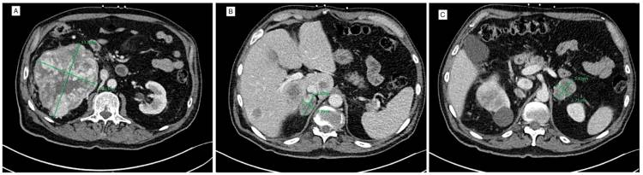
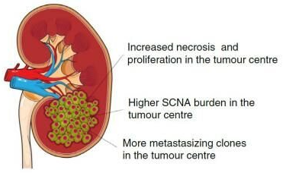
Spatial Heterogeneity in Renal Mass
Heterogeneity within the tumor
Attenuation and enhancement varies across locations within the same renal mass
Differences from core to margin
Heterogeneous attenuation and enhancement within a renal mass [2]
Prior research has demonstrated differences in enhancement between central and peripheral tumor regions [1]
Potential clinical relevance
Differences in blood supply and oxygen availability may contribute to biological heterogeneity between the tumor center and margin [3]
Imaged tumor heterogeneity may contain information related to tumor biology and pathological aggressiveness
Study hypothesis: Spatial distribution of CT heterogeneity, especially core-to-margin differences, may help distinguish benign, low-grade, and high-grade masses
[1] Orton et al, Cancer Imaging. 2023:23:76.doi:10.1186/s40644-023-00594-3
[2] CTisus, Johns Hopkins. “Necrotic Renal Cell Carcinoma Extends into the Left Adrenal Bed.” Case 6,765.
[3] Zhao Y, et al. Nature Ecology & Evolution. 2021;5:1033–1045. doi:10.1038/s41559-021-01456-6. Image credit: The Francis Crick Institute, via Medical Xpress.
03
Notes:
A renal mass is not always uniform. On CT, different parts of the same mass can have different brightness and contrast enhancement. The center may look different from the edge, and these changes may be related to the tumor's biology.
Previous studies have reported differences between central and peripheral regions. So our question was: can we use this spatial information to better tell apart benign masses, low-grade cancers, and high-grade cancers?

Slide 4
Study Cohort
312 exams with masses characterized by pathology after partial or radical nephrectomy
IRB-approved retrospective study from Corewell Health. Mass volumes: 1–300 cm³.
Low grade: Fuhrman Grade 1 and 2
High grade: Fuhrman Grade 3 and 4
04
Notes:
This was a retrospective study approved by our institutional review board, using data from Corewell Health. We included 312 CT examinations with pathology results.
There were 45 benign masses, 190 low-grade tumors, and 77 high-grade tumors. Low grade refers to Fuhrman grades one and two, and high grade to grades three and four.

Slide 5
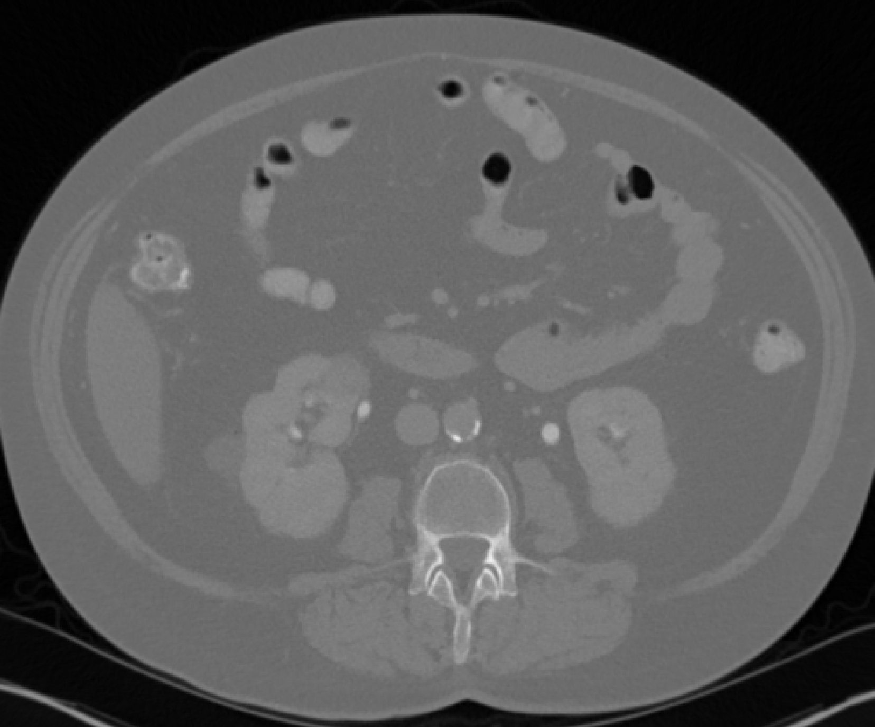

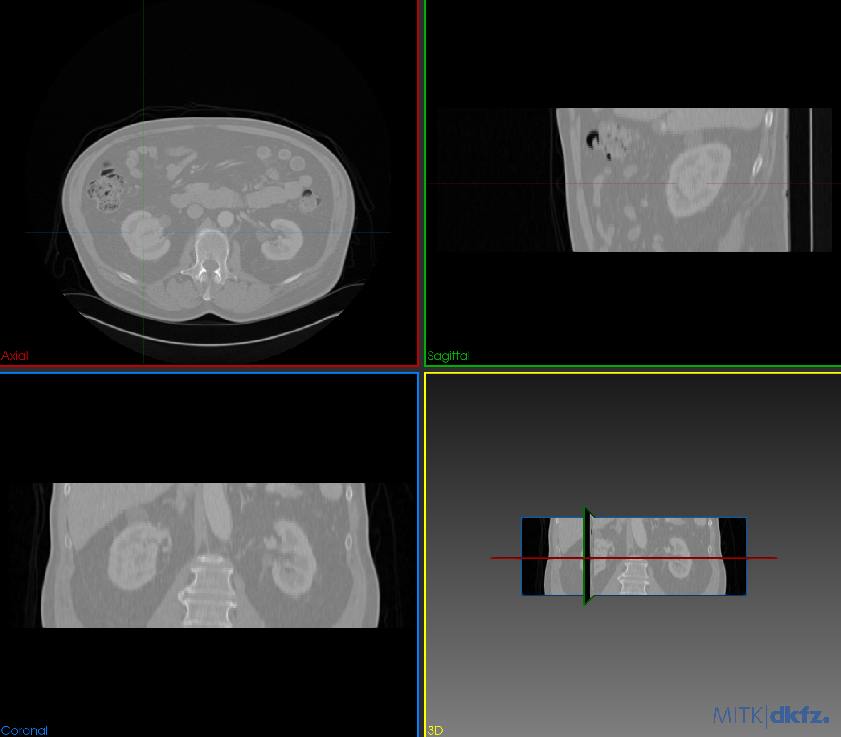
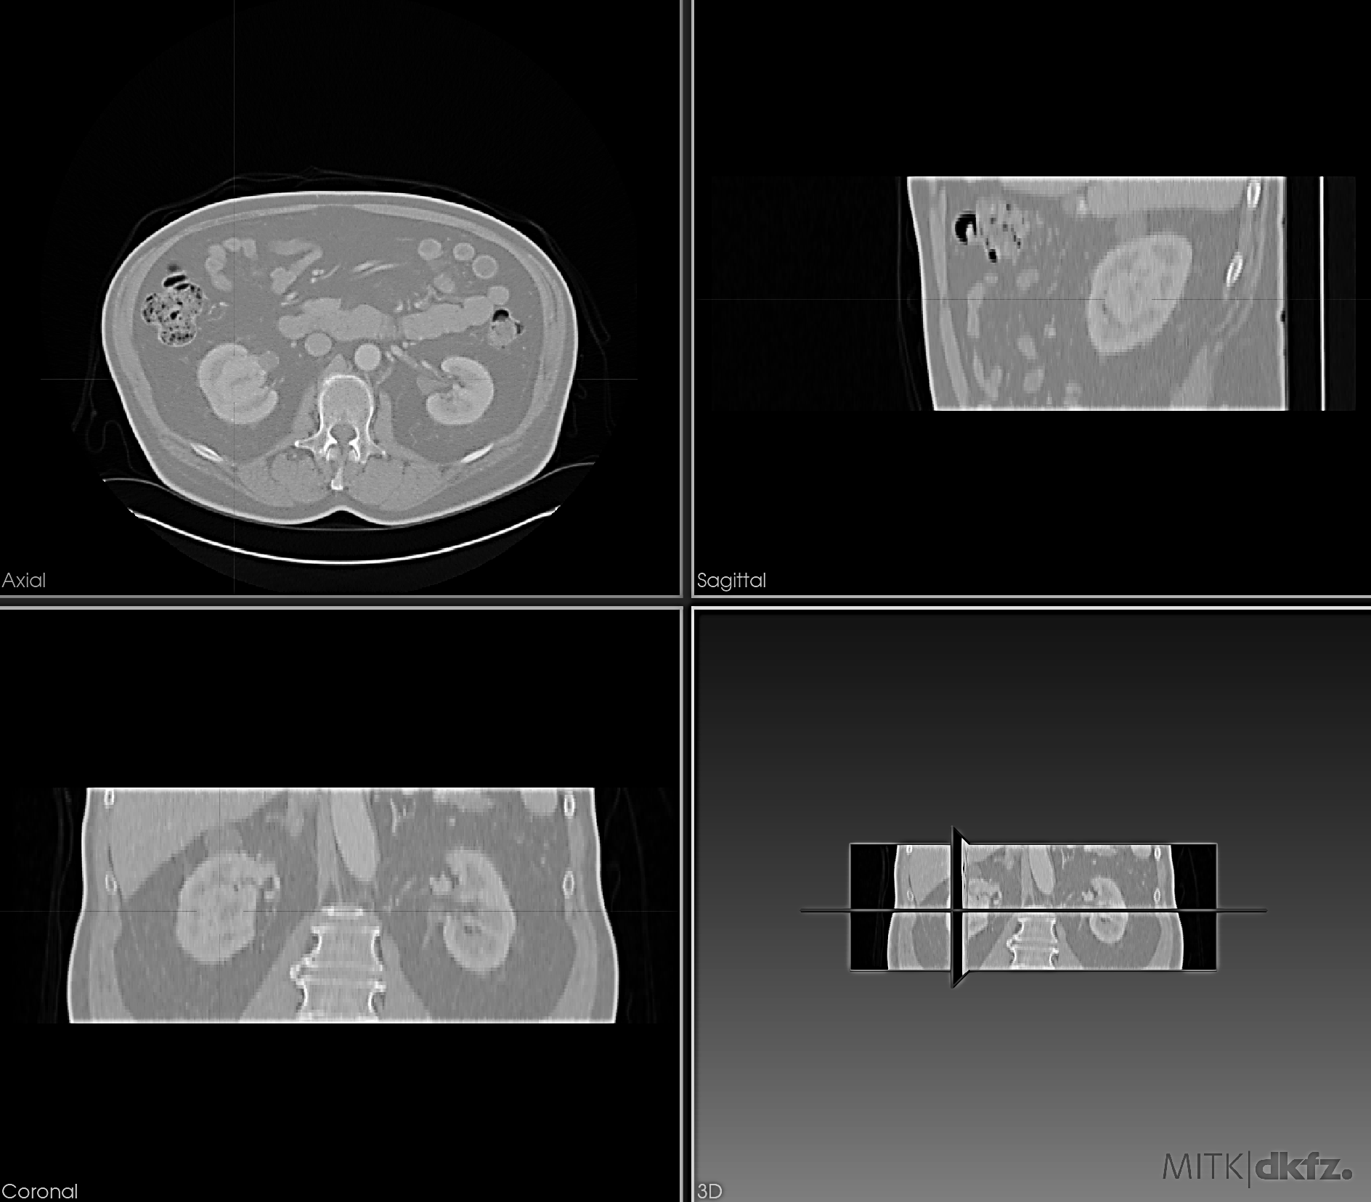
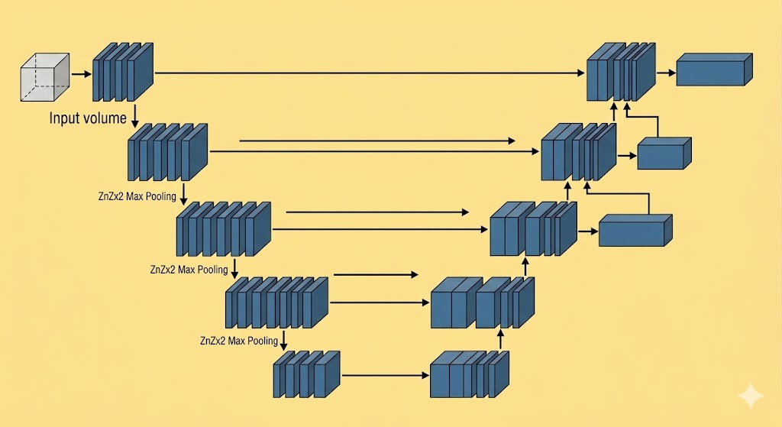
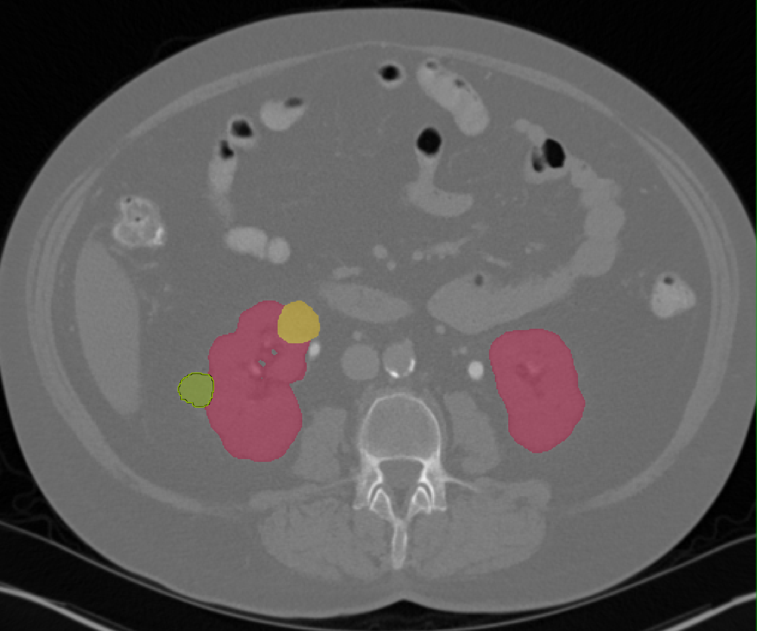
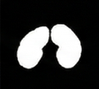
Segmentation and analysis support
KITS23
Training
Step1: Kidney ROI Localization
Step 2: Data Preprocessing
A
Utilize TotalSegmentator for robust, coarse kidney identification, to localize the ROI.
Crop to a fixed-size volume with extended padding to capture extra-renal tumors, then perform resampling and HU normalization.
Step3
Predictions: Kidney (Red), Tumor (Yellow), and Cyst (Green)
Input CT
Corewell Health
(Our Data)
Custom
nnU-Net Model
(KITS23 Trained)
B
Step4: Automatic Anatomical Refinement
Remove small false positive via connected component analysis, refine masks, enforce anatomically consistent object count and placement
Before
After
Segmentation Pipeline
Segmentation output
Whole-body and abdominal CT, with multiple contrast phases.
Kidney: red Tumor: yellow Cyst: green
Wasserthal et al. doi:10.1148/ryai.230024 | Isensee et al. doi:10.1038/s41592-020-01008-z
05
Notes:
Before extracting features, we needed to identify the kidneys and masses from CT images. We first used TotalSegmentator to find the kidney region.
We then cropped and prepared the images and used an nnU-Net model trained on KiTS23 to segment the kidney, tumor, and cyst. Finally, we cleaned up the masks to remove small, incorrect regions.

Slide 6
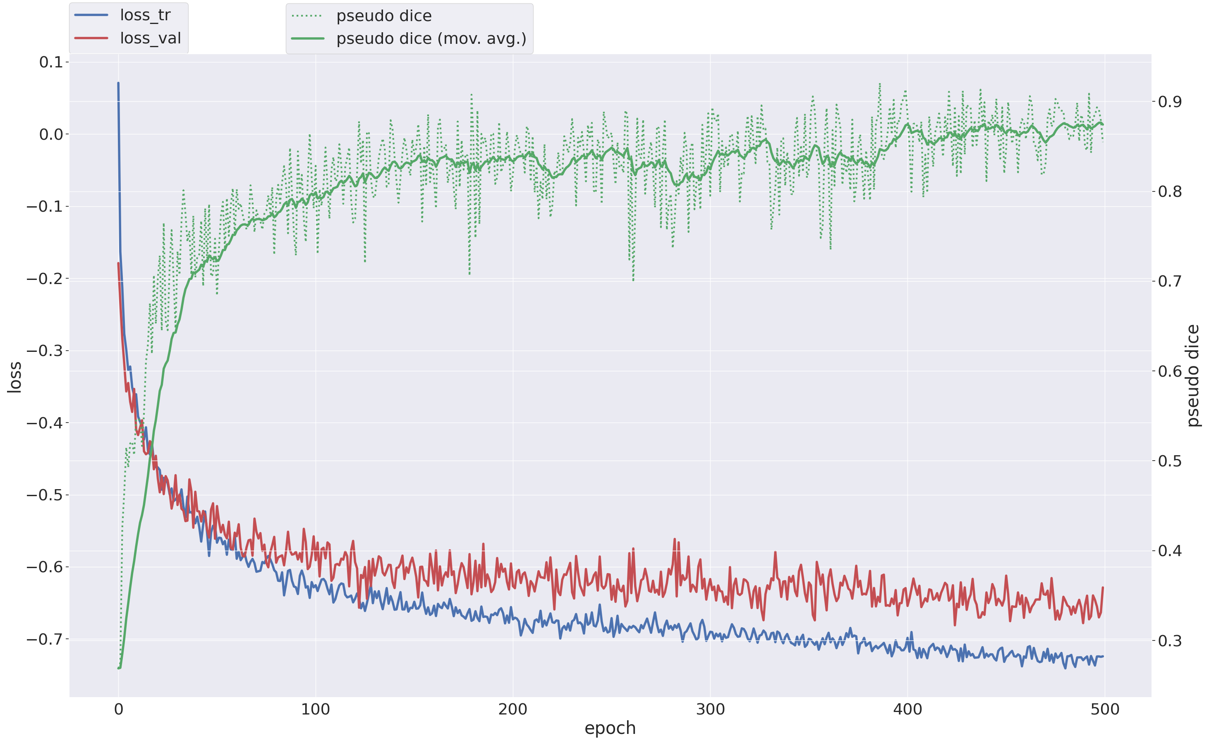
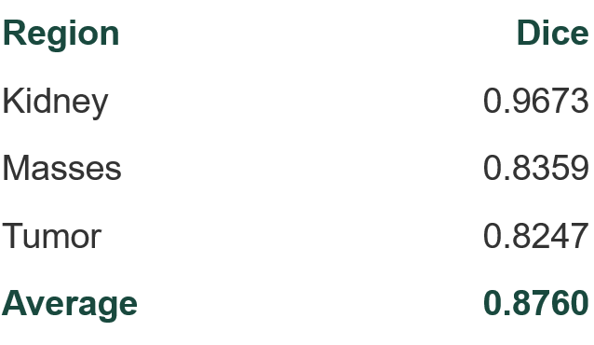
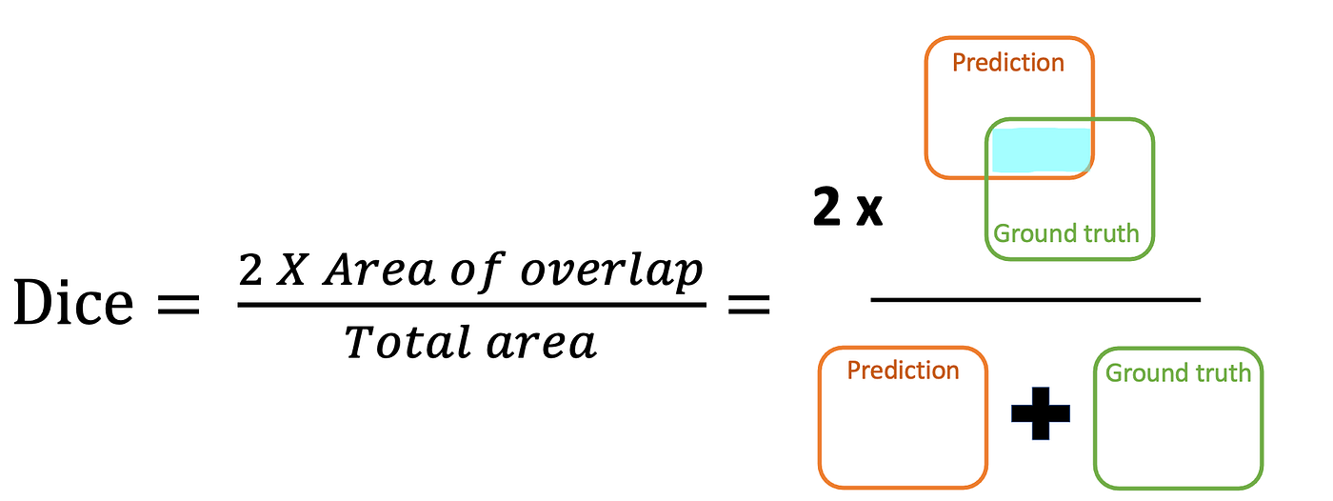
Segmentation training and testing
Training convergence
Loss and pseudo-Dice over 500 epochs
KiTS23 validation
Our segmentation pipeline
06
Notes:
On the KiTS23 validation set, the Dice score was about 0.97 for the kidney and 0.84 for renal masses.
These results supported using the segmentation pipeline for the next step of our analysis.

Slide 7
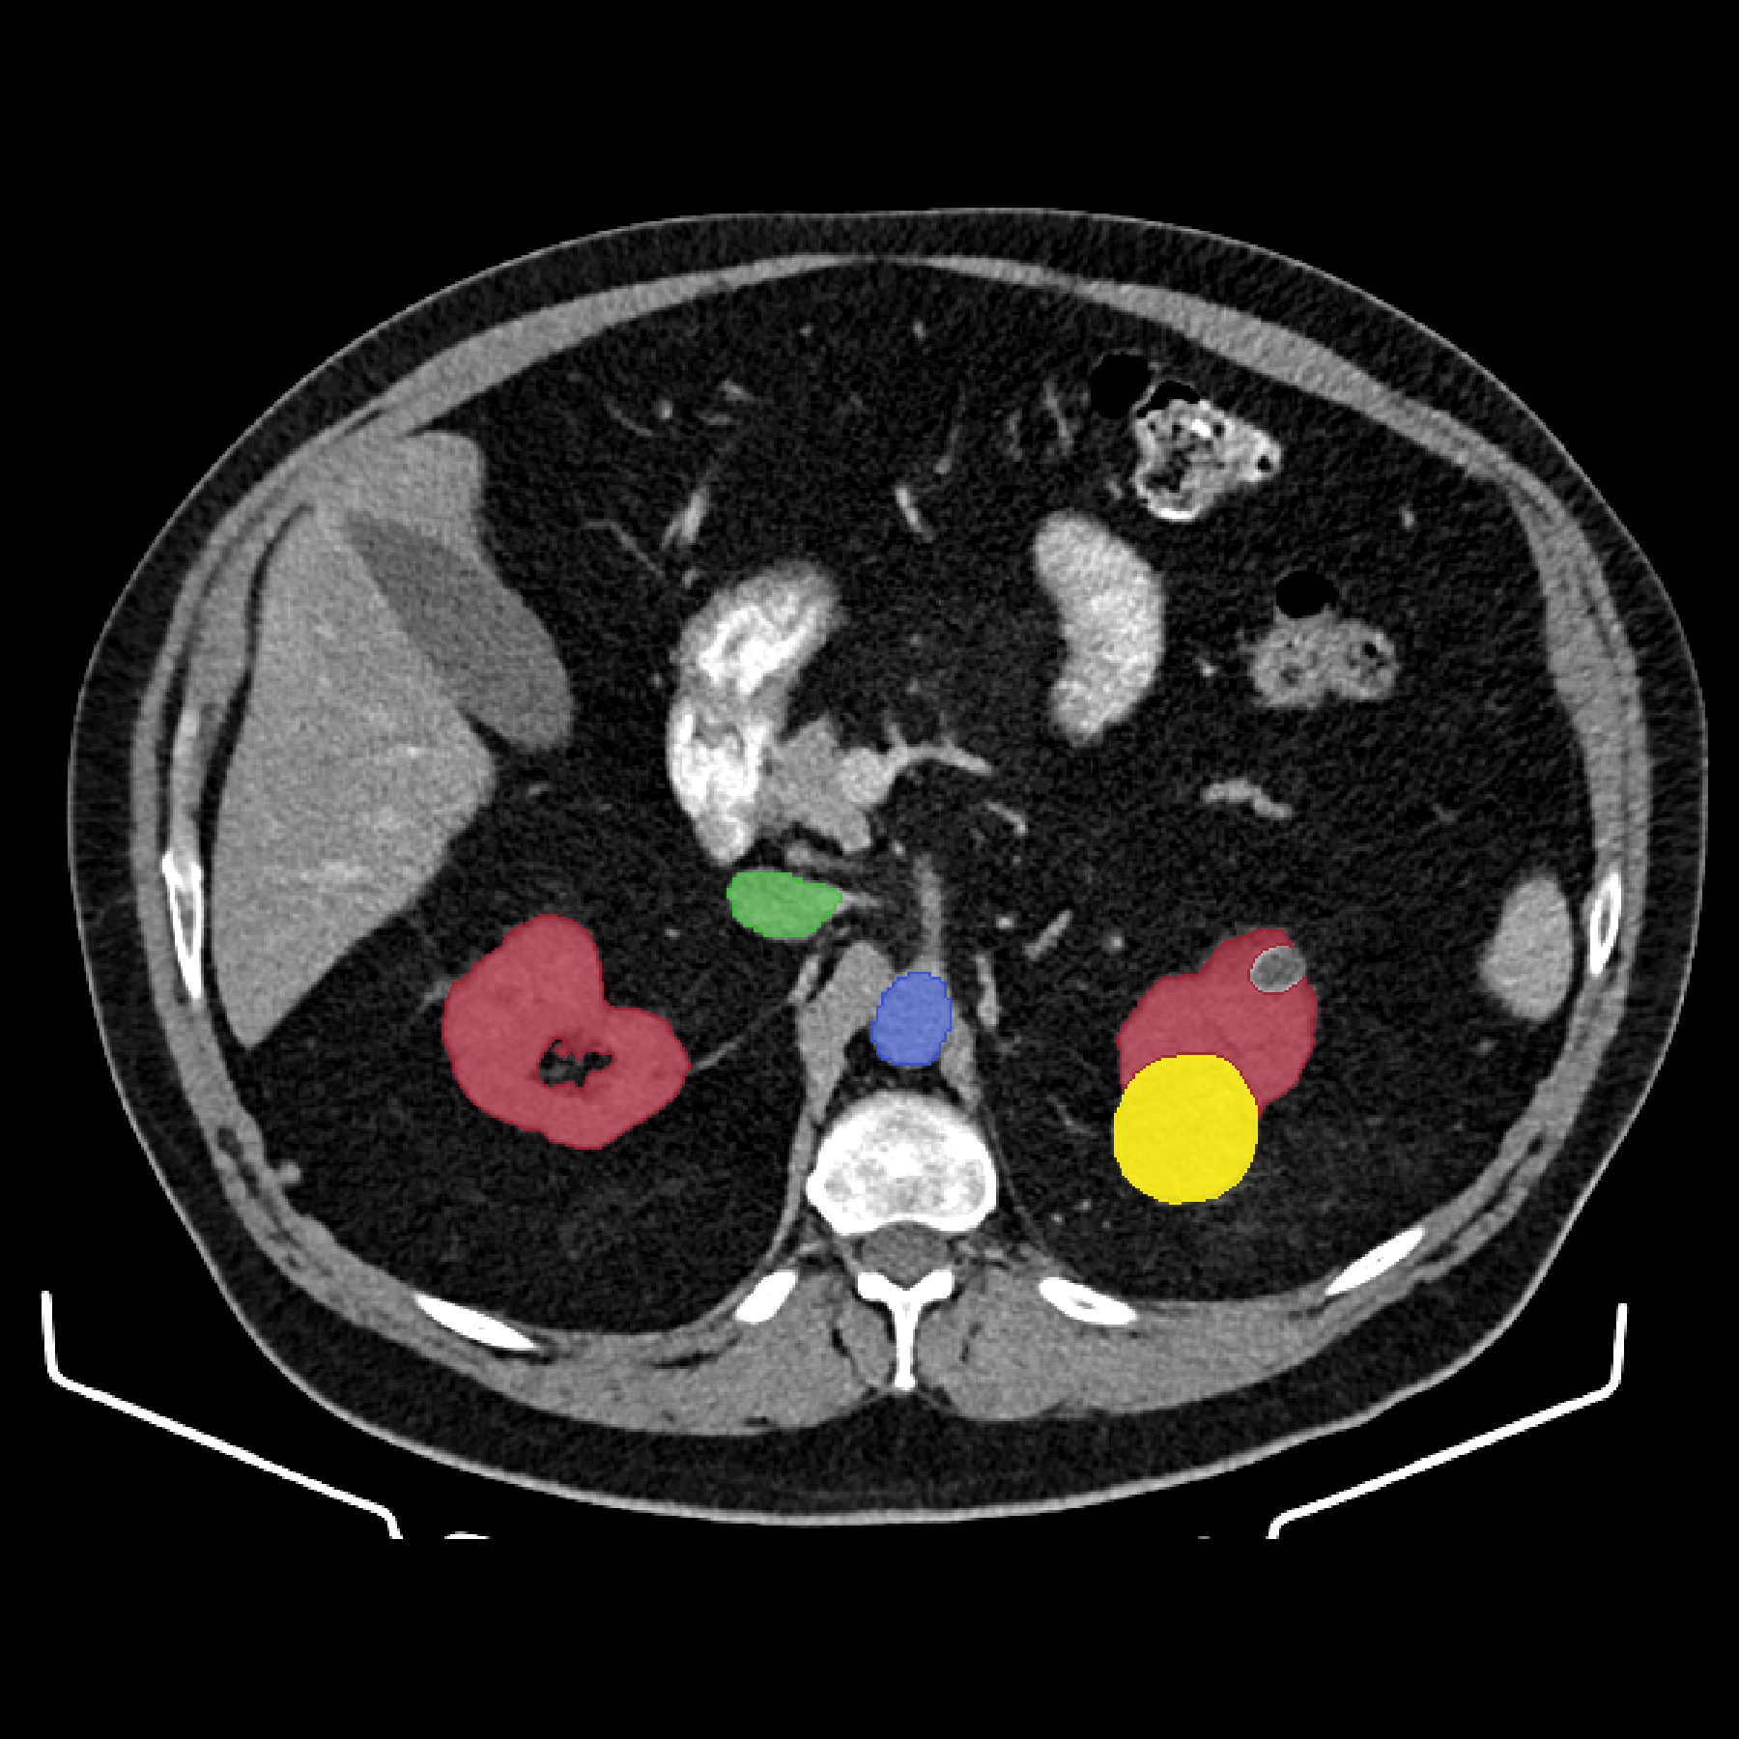
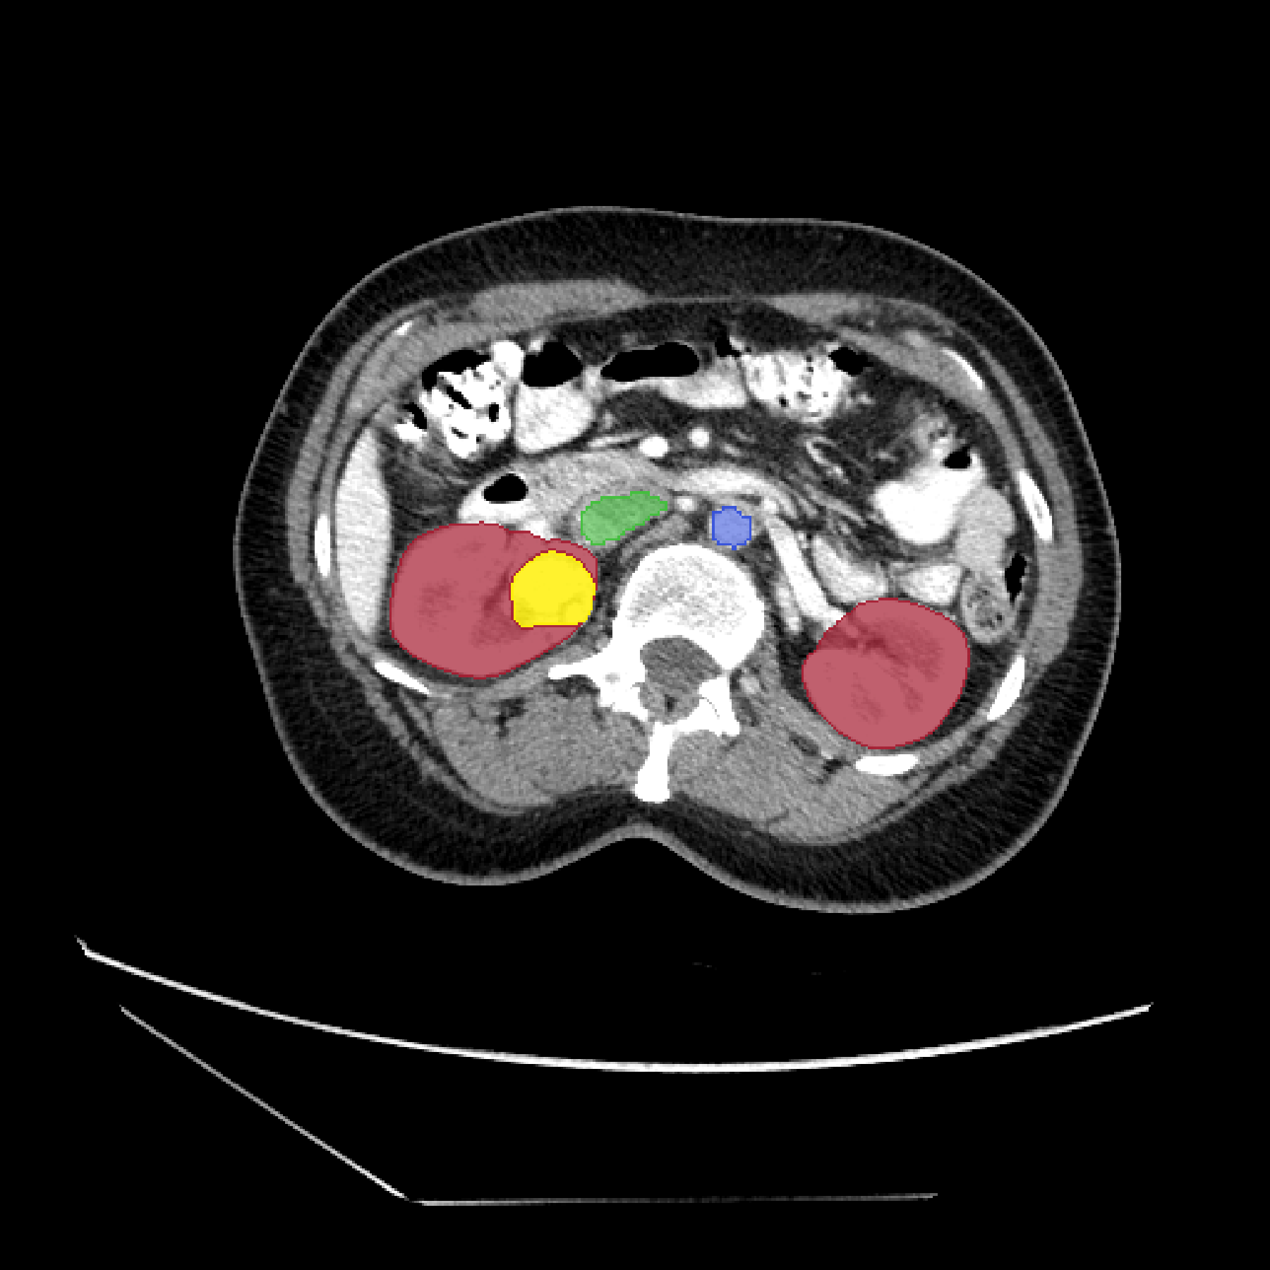
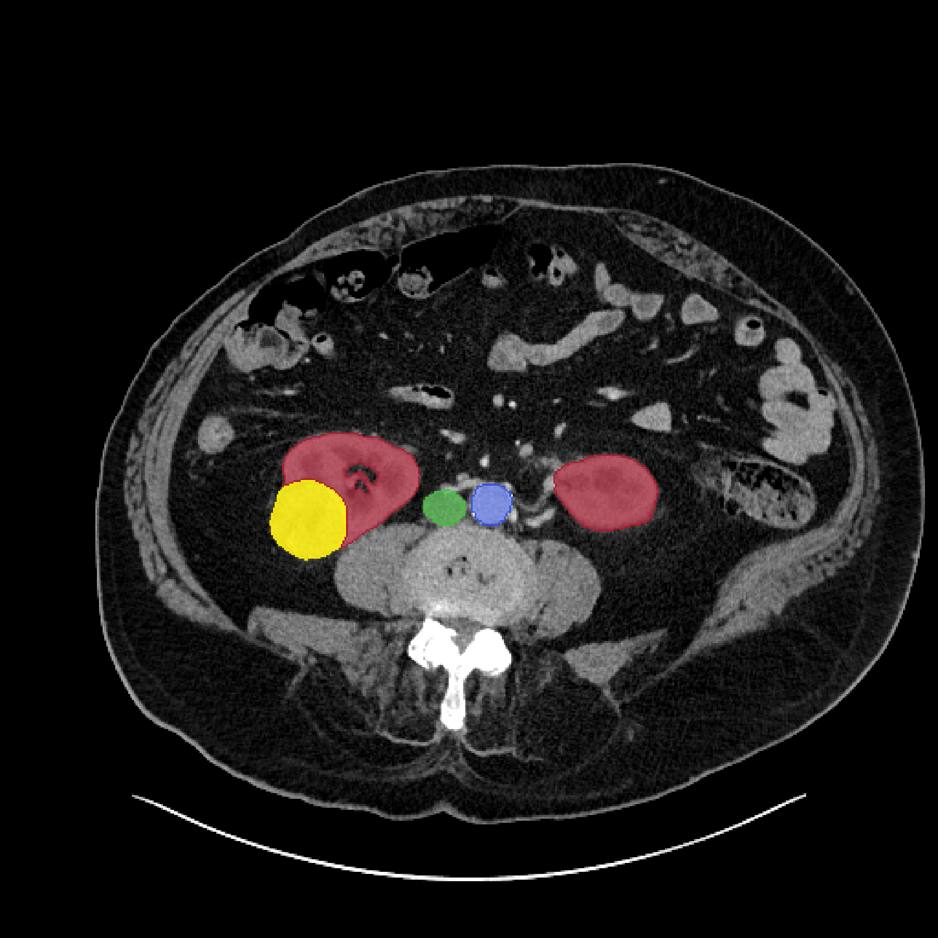
Examples of Segmentations
A.
B.
C.
IVC
Aorta
Kidney
Mass
Kidney
Representative axial slices at the tumor cross-section for benign (A), low-grade (B), and high-grade (C) renal masses. Segmentation overlays highlight the regions used for radiomics extraction, including the mass (yellow), normal kidney (red), aorta (blue), and inferior vena cava (green).
07
Notes:
Here are three examples: a benign mass, a low-grade tumor, and a high-grade tumor.
Yellow marks the mass, red marks the kidney, and blue and green mark the major blood vessels used as reference regions.

Slide 8
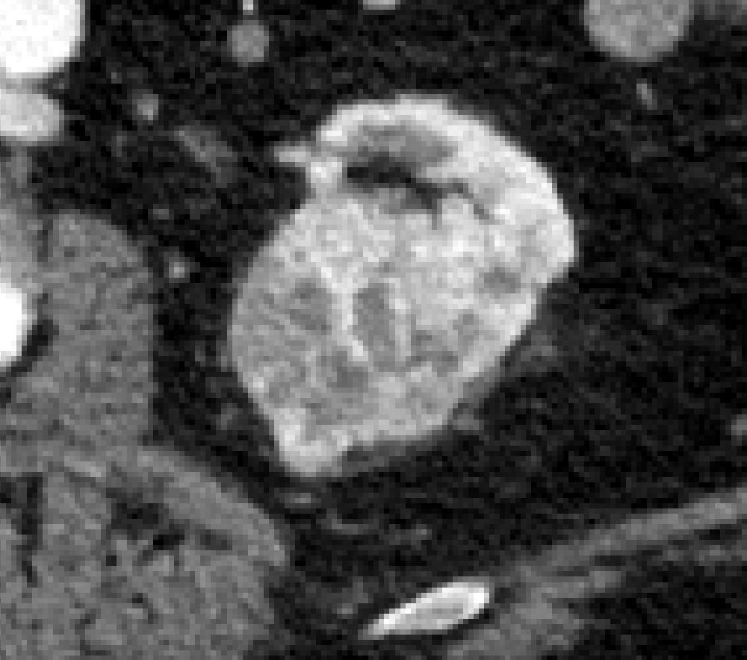
Experimental comparison
Does retaining spatial information improve classification of high-suspicion renal masses?
Feature Extraction Methods:
High-suspicion renal mass
A
Whole-mass baseline
One feature set for the complete mass
B
+
Reference normalization
Mass features with normal kidney & aorta regions to serve as references
C
Core and margin
Separate central and peripheral feature sets
D
27 local patches
Local features extracted from a 3 × 3 × 3 patch grid
Primary task: benign, low-grade and high-grade classification within a high-suspicion cohort.
08
Notes:
We compared four ways of describing each mass.
Approach A was our whole-mass baseline. Approach B added information from the normal kidney and aorta.
Approach C divided the mass into a central core and an outer margin. Approach D looked at smaller local regions using 27 patches.
The main goal was to see whether keeping more spatial detail would improve classification.

Slide 9
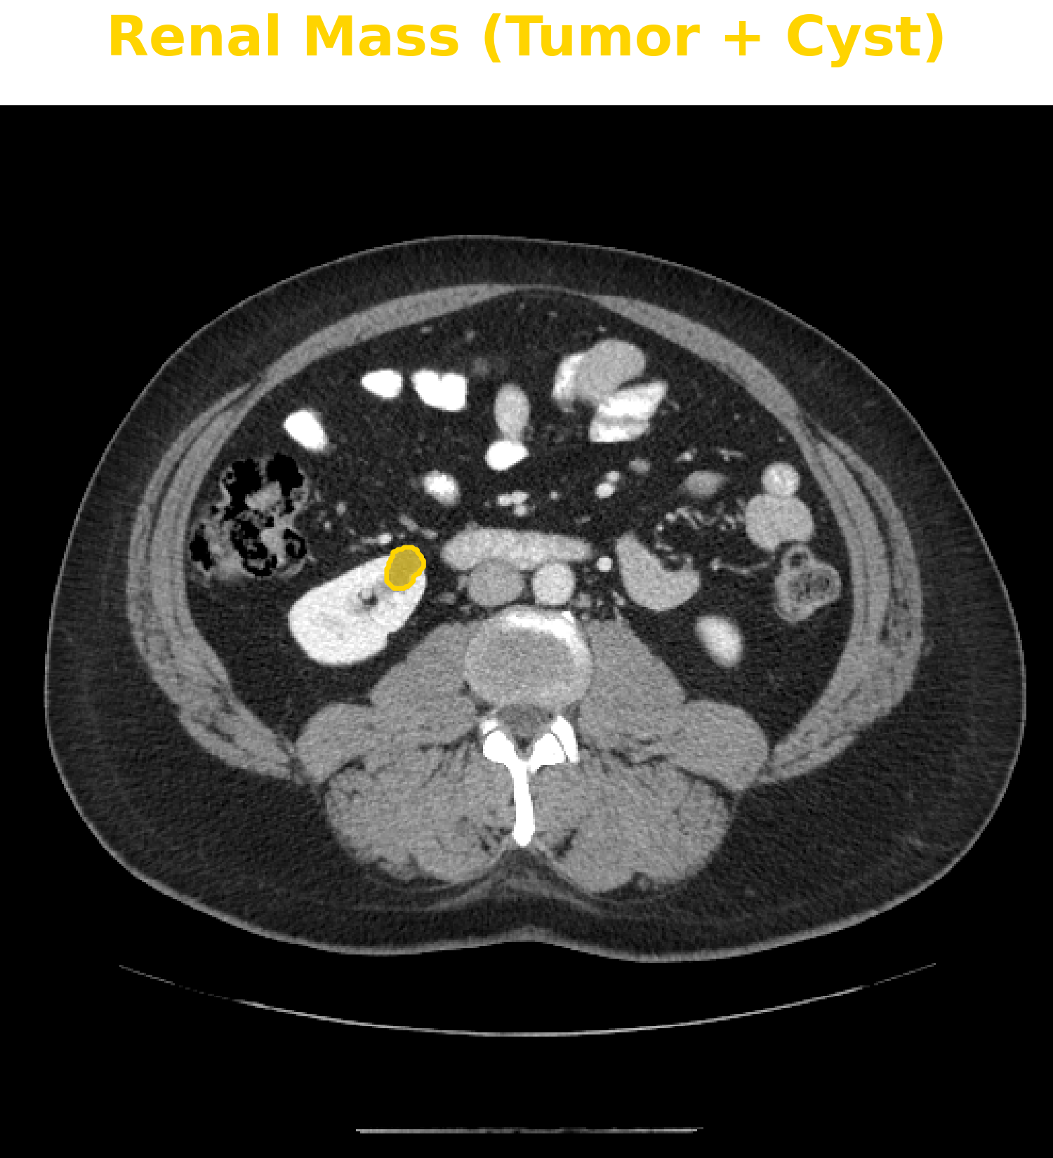
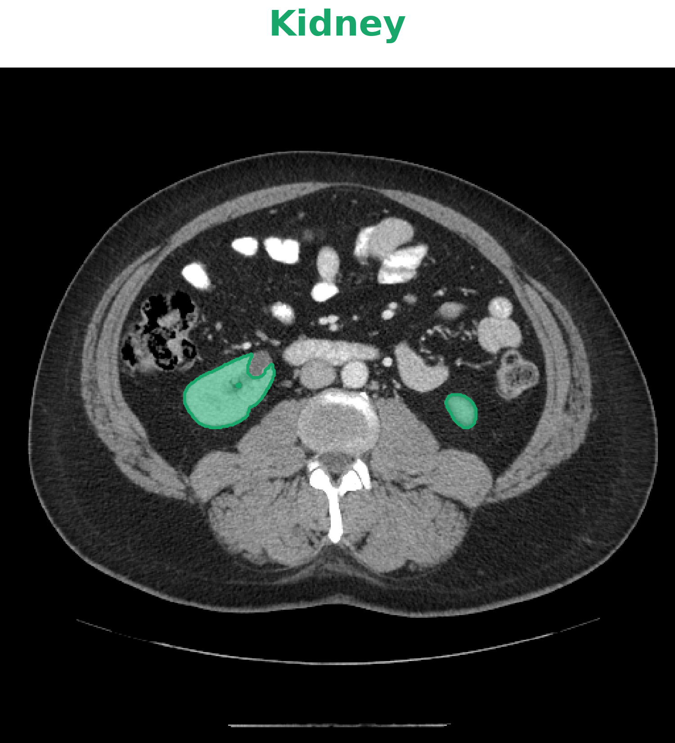
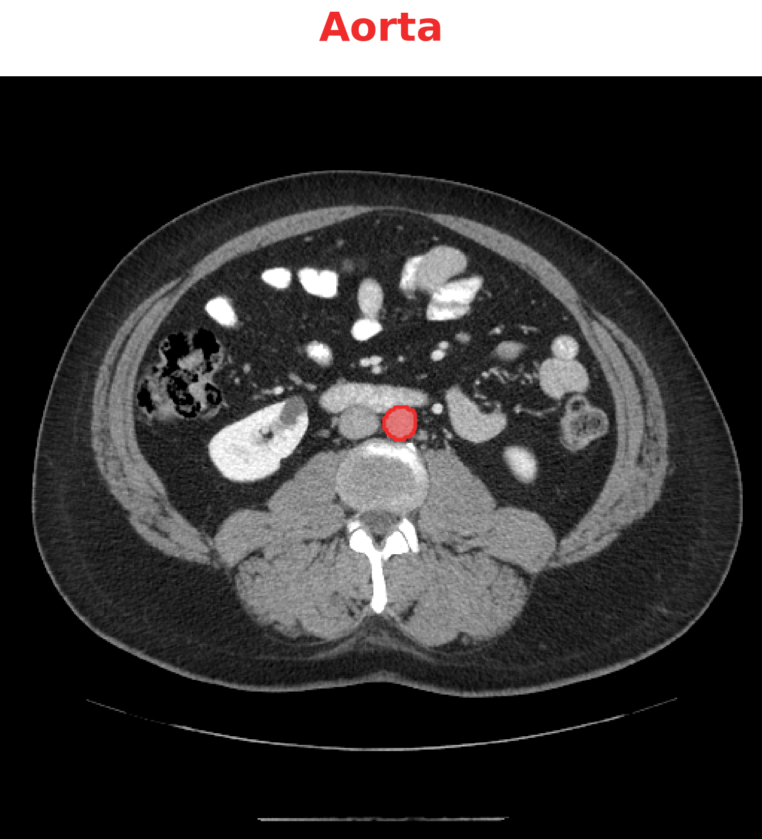
Whole-mass baseline and reference ROIs
Whole-mass baseline
Normal kidney reference
Aortic reference
A: Whole-mass Baseline
B: Kidney and Aorta References
Reference regions may help with tumor grading
09
Notes:
For the baseline, we extracted features from the entire mass.
We also tested adding measurements from the normal kidney and aorta.
These regions can provide some context, especially when CT images come from different contrast phases.

Slide 10
Whole-mass feature selection and model evaluation
Feature selection
107 whole-mass radiomic features extracted from unfiltered CT by Pyradiomics [1].
Unsupervised Spearman filtering across all 312 examinations, without classification labels.
Spearman correlation filtering (|ρ| ≥ 0.80) reduced feature redundancy
24 features retained after filtering and used across all five folds.
Whole-mass fractal dimension and 3D lacunarity were added, yielding 26 features across all five folds.
Reference variables
Normal kidney (3) | Median, variance, volume
Aorta (2) | Median, variance
[1] van Griethuysen et al., “Computational Radiomics System to Decode the Radiographic Phenotype,” Cancer Research, 2017.
10
Notes:
We started with 107 radiomic features from the whole mass.
Many features were strongly related to each other, so we used Spearman correlation filtering to reduce the numbers of features.
This left 24 features.
We also added two measurements of spatial complexity: fractal dimension and three-dimensional lacunarity.

Slide 11
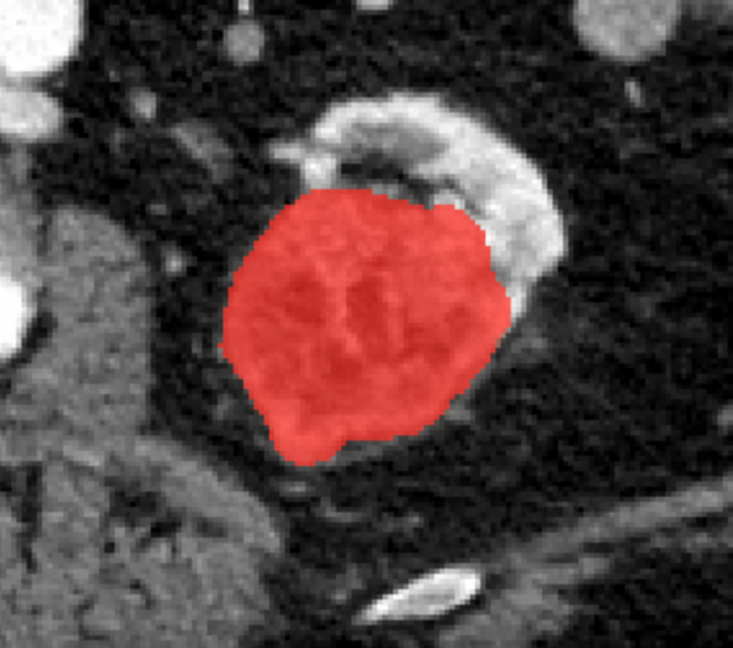
Fractal features from whole renal mass
We also extracted FD and 3D lacunarity features from whole renal mass.
Whole Renal Mass
Fractal dimension (FD)
Characterizes the structural complexity of the renal mass across spatial scales.
3D lacunarity
Relative variation of the sampled signal across local 3D windows.
Renal mass: red
[1]. Concept ImageJ FracL ac, Box Counting documentation. imagej .neti/plugins/fraclac/FLHelp/BoxCounting.htm
[2]. Allain & Cloitre, Phys Rev A. 1991;44:3552. ImageJ FracLac: Lacunarity.
11
Notes:
Fractal dimension describes how complex the mass structure is across different scales.
Lacunarity gives us another way to describe how unevenly image patterns are distributed.
We tested whether these measures added information beyond standard radiomic features.

Slide 12
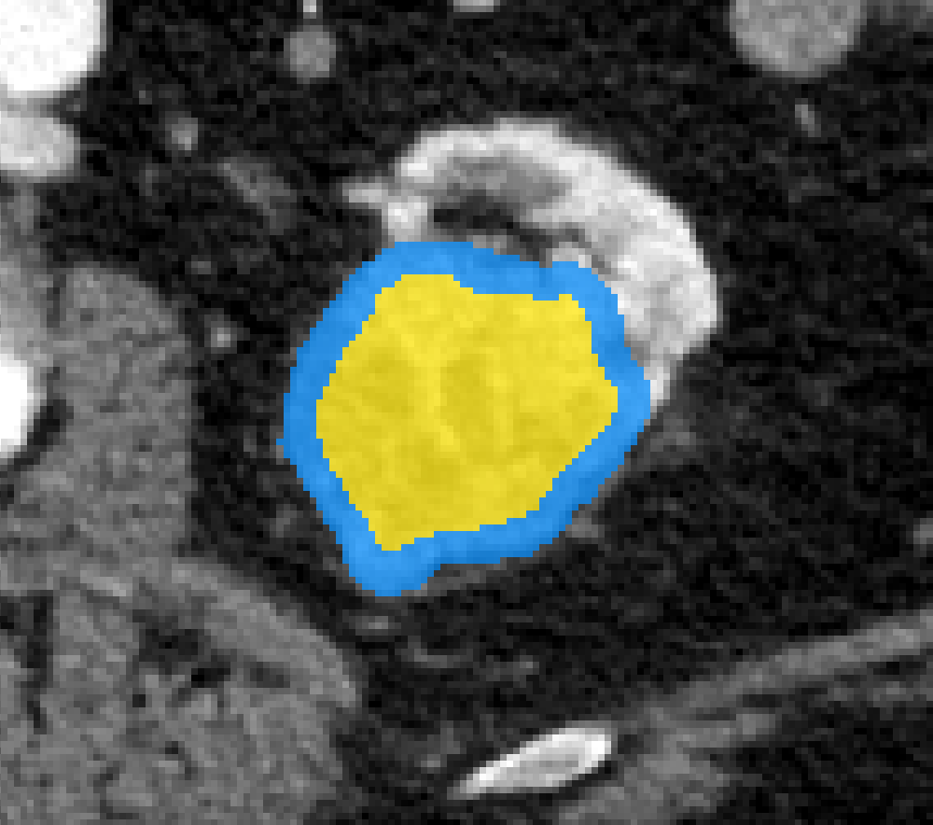
C. Core-to-margin regional profiling
C tests whether central and peripheral descriptors retain information lost by whole-mass pooling.
Original CT
Regional overlay
Features extracted from Core/Margin
Conventional radiomics
Shape, intensity, and texture features
Core and margin features are retained separately.
Core: yellow. Margin: blue.
The segmented mass is divided into an inner core and a peripheral margin, each containing approximately 50% of the total mass volume.
Approach C preserves central and peripheral feature sets instead of one pooled summary.
12
Notes:
This is one of the key parts of our study.
We divided each mass into two regions by volume: an inner core and an outer margin, each containing about half of the mass.
We extracted radiomic features from the two regions separately.
This way, the model could see differences between the center and the edge, rather than only one average description.

Slide 13
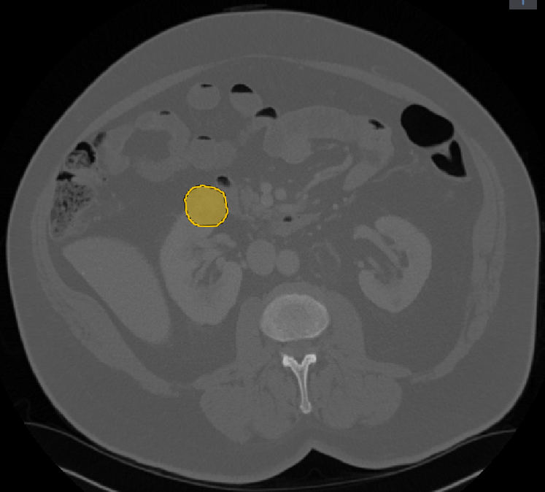
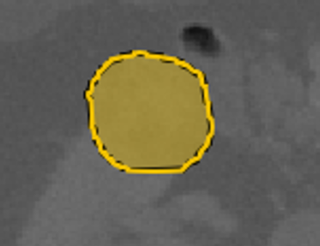

D. Local sampling with 27 patches
Explores finer spatial variation that a two-region representation may miss.
CT context
Local tumor region
Construction
1 Locate the mass centroid
2 Sample a 3 × 3 × 3 local grid
3 Extract mass features per patch
y
z
x
Illustrative 2D layer: 3 × 3. Full grid: 27 patches.
Finer spatial sampling is an alternative to test, rather than an assumed improvement.
13
Notes:
We also tested a finer way to look at local patterns.
Starting from the mass center, we placed a three-by-three-by-three grid, giving 27 patches.
The idea was to capture local changes that might be missed when we only use a core and a margin.

Slide 14
D. 27-patch feature aggregation
Initially, four Conventional Radiomics features are extracted from each patch
Aggregation reduces these 4x27 features to 16 features
27 local patches
4 features per patch
4 summaries per feature
Use the 27 values of one feature to calculate its four summaries.
Repeat for each feature.
Tumor fill rate
4 fill-rate summaries
Tumor fraction of the entire patch
Max / top-5 mean / top-5 SD / high-low
Lacunarity
4 lacunarity summaries
Spatial heterogeneity within each 3D patch
Max / top-5 mean / top-5 SD / high-low
Entropy
4 entropy summaries
Gray-level variability within the patch
Max / top-5 mean / top-5 SD / high-low
Mean CT attenuation
4 mean-HU summaries
3 x 3 x 3 grid
Mean HU of tumor voxels in the patch
Max / top-5 mean / top-5 SD / high-low
High-low: mean of highest 5 minus mean of lowest 5, for the same feature.
4 fill-rate + 4 lacunarity + 4 entropy + 4 mean-HU summaries = 16 inputs
14
Notes:
For each patch, we measured four things: how much of the patch was filled by tumor, lacunarity, entropy, and mean CT value.
Instead of feeding all 27 patches directly into the classifier, we summarized the patch values.
This gave us 16 features that describe the range and variation of local patterns.

Slide 15

Model training and validation
Selected feature set
Three-class model
Predicted class
Benign
Low-grade
High-grade
Separate fit for each of A–D
Same classifier [1] for all feature sets
Patient-grouped five-fold cross-validation
312 examinations; folds grouped by patient.
1
2
4 folds for training and 1 for validation.
3
4
Same five splits reused for all feature sets.
5
Five fitted models and five validation AUCs per feature set.
Training
Validation
Mean AUC (SD) across the five validation folds
[1] Prokhorenkova et al., “CatBoost: Unbiased Boosting with Categorical Features,” NeurIPS, 2018..
15
Notes:
For a fair comparison, we used CatBoost for all four approaches.
We performed five-fold cross-validation and kept examinations from the same patient in the same fold.
We also used the same splits across all approaches.
We report the average AUC across the five validation folds.

Slide 16
Multiclass (Benign, Low-, High- Grade) discrimination across approaches
Performance results compare whole-region, +reference and spatial feature approaches.
The four result groups correspond to approaches A–D defined on slide 8.
Core/margin analysis achieved the highest AUC. The 27-patches approach improved on whole-mass radiomics, achieving discrimination comparable to adding reference features.
16
Notes:
Now to the results.
For classifying benign, low-grade, and high-grade masses, whole-mass features gave an AUC of 0.62.
Adding kidney and aorta features increased it to 0.66.
The core-and-margin approach reached 0.71, the highest result in this analysis.
The 27-patch approach reached 0.67.
So, for the three-class task, keeping the core and margin separate worked best.

Slide 17
Binary discrimination analyses: Benign vs malignant
45 benign / 267 malignant. Same random seed and patient-grouped five-fold CV across all models. Balanced CatBoost.
Pooled out-of-fold ROC
Five-fold mean ± SD
Feature set | AUC | Accuracy
Whole mass | 0.69 ± 0.08 | 0.80 ± 0.05
Whole mass + kidney/aorta | 0.76 ± 0.08 | 0.83 ± 0.03
Core/margin | 0.77 ± 0.06 | 0.82 ± 0.02
27-patches | 0.79 ± 0.06 | 0.83 ± 0.04
Binary classification showed a similar pattern, with higher AUCs after adding kidney/aorta and regional features, and the highest mean AUC with 27-patch features.
17
Notes:
We also looked at a simpler question: benign versus malignant.
The whole-mass baseline had a mean AUC of 0.69.
Adding reference regions increased it to 0.76, and the core-and-margin approach reached 0.77.
The 27-patch approach was highest at 0.79, with an accuracy of about 0.83.
The exact ranking changed between the two tasks, but the overall pattern was similar: regional information helped compared with whole-mass features alone.

Slide 18
Study limitations and future directions
Study purposely enrolled only high-suspicion lesions that resulted in nephrectomy
Class imbalance and surgical selection should be considered when interpreting these findings
Class distribution in the surgical cohort
Limitations and next steps
312
Class imbalance
renal masses
Benign and high-grade masses are less represented.
Low-grade tumors account for 61% of cases
Evaluate per-class recall and balanced accuracy,
and expand recruitment of these groups.
45
190
77
Surgical selection
Benign
Low-grade
High-grade
This cohort includes masses selected for nephrectomy.
Validate across centers, including biopsy and surveillance cohorts.
Validation priorities
Multicenter validation
Acquisition and volume robustness
Calibration and clinical utility
18
Notes:
There are important limitations.
First, the classes are not balanced. Most cases are low-grade tumors, with fewer benign and high-grade masses.
Second, all masses came from patients who underwent surgery.
This is a selected group and may not reflect the broader patient population.
We need more data and validation at other hospitals, including patients managed without surgery.

Slide 19
Conclusions
The study tests whether preserving spatial information improves renal mass classification.
01
Clinical task
Classifying high-suspicion renal masses as benign, low-grade, or high-grade,
with additional benign-versus-malignant analysis.
02
Observed finding
In the original multiclass analysis, kidney/aorta reference increased AUC from 0.62 to 0.66. Core/margin achieved the highest reported AUC of 0.71, while 27-patches yielded 0.67.
In the updated binary analysis, reference features increased mean AUC from 0.69 to 0.76, followed by 0.77 with core/margin and 0.79 with 27-patches features.
03
Next steps
Assess class-specific performance, calibration, and generalizability through multicenter validation.
Preserving spatial information is promising; clinical benefit remains to be demonstrated
19
Notes:
To conclude, our results suggest that where a feature comes from inside the tumor can matter, not just its overall value.
The core-and-margin approach performed best for the three-class task, while local patches performed best for benign-versus-malignant classification.
These are encouraging early results, but we still need external validation before discussing clinical use.

Slide 20
Selected methodological references
Primary sources for segmentation, feature interpretation and reproducible reporting.
1
Wasserthal et al. TotalSegmentator. Radiology: AI. 2023.
doi:10.1148/ryai.230024
2
Isensee et al. nnU-Net. Nature Methods. 2021.
doi:10.1038/s41592-020-01008-z
3
Allain & Cloitre. Characterizing lacunarity. Physical Review A. 1991.
doi:10.1103/PhysRevA.44.3552
4
Zwanenburg et al. Image Biomarker Standardization Initiative. Radiology. 2020.
doi:10.1148/radiol.2020191145
5
ImageJ FracLac. Box counting and sliding-box documentation.
imagej.net/ij/plugins/fraclac/FLHelp/BoxCounting.htm
6
KiTS23. Kidney, tumor and cyst segmentation resource.
kits-challenge.org/kits23/
20
Notes:
These are the main references for our methods.

Slide 21



Tairan Song
Ph.D. Student, CMSE
MIDI Lab, Michigan State University
songtai1@msu.edu
Personal Website
My LinkedIn
tairan-song.github.io
linkedin.com/in/tairan-s
21

Slide 22


Acknowledgments
Advisor:
Prof. Adam M. Alessio
PhD Students:
Zenas A. Huang
Gabriel Maliakal
Research Assistants:
Michal Borek
Shuyan Zhou
Emre Alyamac
Emerson Lim, MD
Sabrina L Noyes
Robert D. Muterspaugh, MD
Midhhath Afza Munavar Ali, MD
Brian R. Lane, MD, PhD
In memory of Brian R. Lane, MD, PhD
With gratitude for his contributions to this work.
Funding
https://midilab.notion.site/
Corewell Health-MSU Alliance Pilot Program
Betz Family Endowment for Cancer Research
22
Notes:
Finally, I'd like to thank my advisor, our clinical collaborators, and everyone who supported this work.
We also remember Dr. Brian Lane and are grateful for his contributions to this study.
Thank you for listening.

