Slide 1






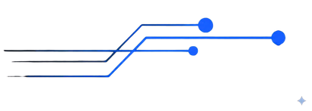
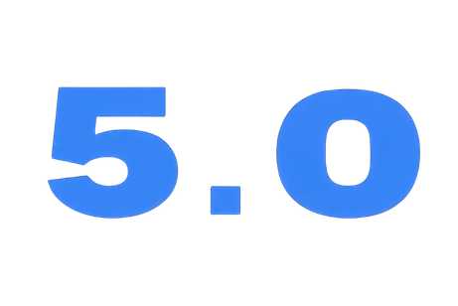


TCET’s NATIONAL LEVEL HACKATHON
Break The Loop, Create the future
Agentic AI
PPT Template
technicalteamtsdw@gmail.com

Slide 2

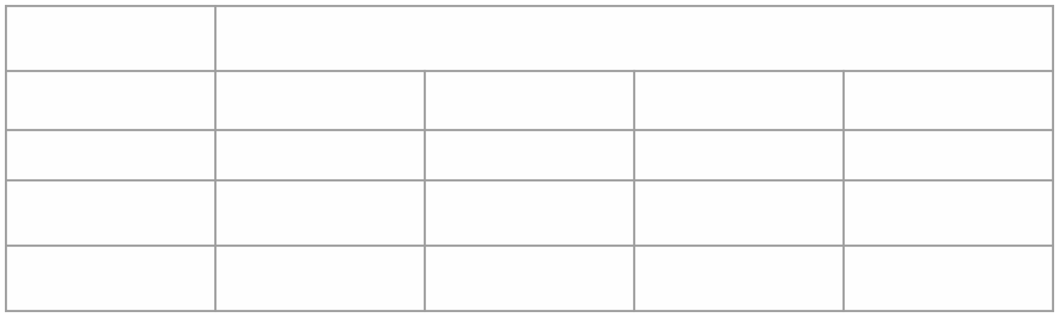


Team Name
Team Members >>
1 (Leader)
2
3
4
Name
Institute Name
Email

Slide 3




Slide 4


Slide 5


Slide 6


Slide 7


Slide 8



Slide 9
ArogyaSatya: Agentic AI Misinformation Verification
Template-based submission deck with architecture and flow diagrams

Slide 10
Problem and Objective
Healthcare misinformation propagates rapidly across text, images, and videos.
Objective: verify claims with evidence-backed, explainable, multi-agent reasoning.
Approach: orchestrated Agentic AI pipeline (LangGraph + retrieval + verification).

Slide 11
System Architecture Diagram
User
Next.js Frontend
FastAPI Gateway
LangGraph Orchestrator
Safety
Claim Extraction
Canonicalization
Evidence Retrieval
Verification Explainer
SQL Store
Vector DB
Groq LLM
Trusted Sources

Slide 12
Agentic Flow Diagram
Input
Preprocess
Safety Gate
Claim Extraction
Canonicalize
Evidence
PubMed + Web
Verify
Explain
Final Report
Conditional short-circuits: unsafe input -> safety response; no claims -> early exit summary.

Slide 13
System Outcomes and Value
Claim-level verdicts with evidence traces and human-readable explanation.
Multimodal support: text + image + video transcripts in one pipeline.
Reusable canonical memory for recurring misinformation narratives.
Hackathon-ready, production-leaning architecture.

Slide 14
Roadmap to Industry Grade
CI/CD with lint, tests, and security scanning gates.
Asynchronous queue for heavy multimodal jobs and p95 latency control.
Observability: per-agent latency, token cost, and quality metrics.
Governance: stronger policy controls and provenance UX.

