Slide 1

Project Final:
Traffic Lights
IOT Internet of Things
IOT102_SE1602_Group02

Slide 2
Table of Contents
Task assignment
Introduction
List of component
Demo
Feature of device

Slide 3
01
01
INTRODUCTION

Slide 4





Group 2
Phạm Minh Thư Võ Việt Nhân Nguyễn Đức Tài Trần Văn Tới Nguyễn T. Quang Duy
CE160859 CE160937 CE160859 CE160459 CE161080

Slide 5
Mentor
Trần Ngọc
Trần Ngọc Hoàng
Trần Ngọc Hoàng
Hoàng

Slide 6
Introduce About Traffic Lights
Without traffic lights?
Think about it, if one day you're walking on the street, suddenly you don't see any traffic lights.
Important in traffic
Traffic lights play a very important role in traffic, helping to regulate traffic.
How to program a traffic light?
Let's try to learn with our group how to program a traffic light. Let's go

Slide 7
02
02
TASK ASSIGNMENT

Slide 8
Task Assignment
Nhân
Tài
Tới
Powerpoint, Present, Code(Traffic Light for large vehicle).
Fitting the circuit,
Code(Photoresistor), Code explanation.
Thư
Fitting the circuit,
Code(Night_Mode).
Duy
Powerpoint, Comments code, format code, Code (Recode the old post).
Format code,
Code(7segment_led), Comments code.

Slide 9
03
03
LIST OF COMPONENT

Slide 10







List of components
Arduino Uno R3 | 1
7 Segment Display | 2
Breadboard Mini | 1
Resistor | 13
Photoresistor | 1
Red LED | 12
Yellow LED | 4
Green LED | 12

Slide 11
04
04
Feature of device

Slide 12
Feature of device
Old Code
Traffic lights for large vehicles
Pedestrian lights.
This traffic light is behind the main traffic light.
Night mode
Photoresistor
Day and night sensor and change mode when switching to night.
Flashing yellow light, slow going warning.

Slide 13
05
05
DEMO,
SHOW CIRCUIT

Slide 14
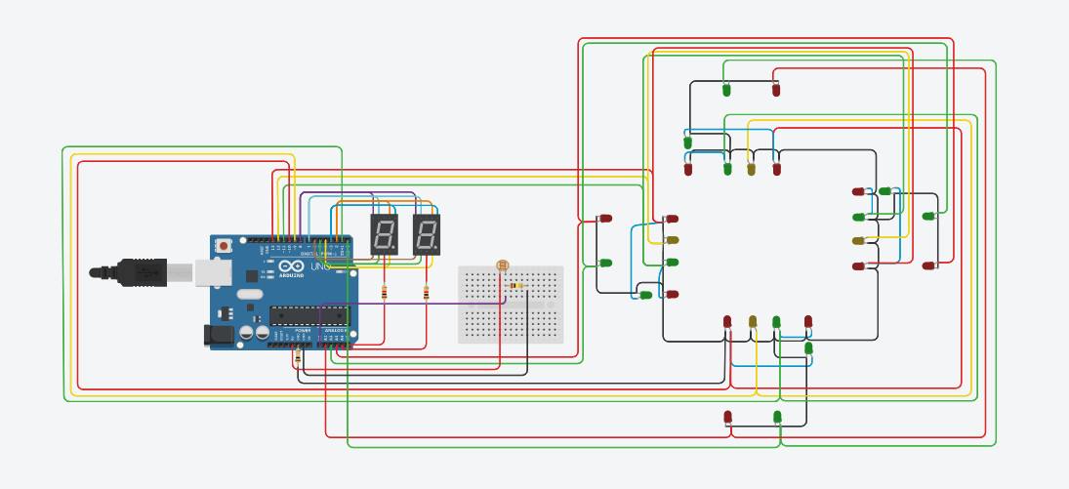
Show Circuit

Slide 15
Reference
https://vi.wikipedia.org/wiki/%C4%90%C3%A8n_giao_th%C3%B4ng
https://arduinokit.vn/mo-hinh-den-giao-thong-don-gian/
https://text.123docz.net/document/6969828-arduino-tap-1-den-giao-thong.htm

Slide 16
Thanks for your attention.

