Slide 1
Keras

Slide 2
Keras
Keras開發模式
Keras模組
Keras Callback

Slide 3
Keras

Slide 4
Keras
https://www.tensorflow.org/guide/keras/overview
tf.keras 是用於構建和訓練深度學習模型的 TensorFlow 高階 API。
利用此 API，可實現快速原型設計、先進的研究和生產，它具有以下三大優勢：
[1]方便用戶使用
Keras 具有針對常見用例做出優化的簡單而一致的介面。它可針對使用者錯誤提供切實可行的清晰回饋。
[2]模塊化和可組合
將可配置的構造塊組合在一起就可以構建 Keras 模型，並且幾乎不受限制。
[3]易於擴展
可以編寫自訂構造塊，表達新的研究創意；並且可以創建新層、指標、損失函數並開發先進的模型。

Slide 5
Keras vs tf.keras
https://zhuanlan.zhihu.com/p/89017996

Slide 6
Keras開發

Slide 7
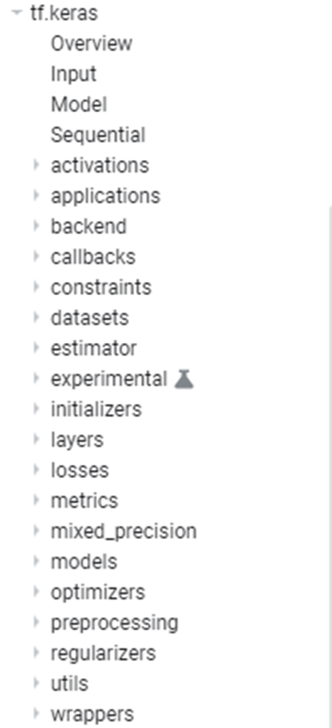

Slide 8
起手式
資料預處理
Data Preprocessing
構建模型
訓練模型
評估
預測
compile()
fit()
evaluate()
predict()
summary()
列出模型的結構
[1]Build the Model: Sequential or Functional API
[2]config the model with losses and metrics with model.compile()
[3]train the model with model.fit()
[4]use the model to do prediction with model.predict()

Slide 9
構建模型

Slide 10
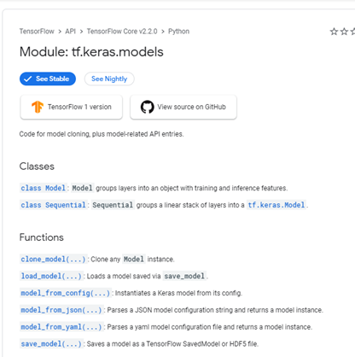
https://www.tensorflow.org/api_docs/python/tf/keras/models

Slide 11
Keras models[開發模式]
Keras models[開發模式]:
Sequential model
the Model class used with the functional API.
Subclass 模式
共同的方法與屬性[methods and attributes in common]
model.layers
…………..
model.summary()
…………..
model.to_json()
…………..
model.save_weights(filepath)
model.load_weights(filepath, by_name=False)

Slide 12
Keras Sequential model
https://www.tensorflow.org/versions/r2.2/api_docs/python/tf/keras/Sequential
The Sequential model is a linear stack of layers.
堆積木模式
from keras.models import Sequential
from keras.layers import Dense, Activation
model = Sequential([
Dense(32, input_shape=(784,)),
Activation('relu'),
Dense(10),
Activation('softmax'),
])
這是一個Sequential物件
擁有許多methods
add
get_layer
compile
evaluate
fit
predict
Pop:Removes the last layer in the model.
也可以這樣寫
model = Sequential()
model.add(Dense(32, input_dim=784))
model.add(Activation('relu'))
……………….

Slide 13
Model class API[Functional API]
from keras.models import Model
from keras.layers import Input, Dense
a = Input(shape=(32,))
b = Dense(32)(a)
model = Model(inputs=a, outputs=b)

Slide 14
tf.keras.Model類別
groups layers into an object with training and inference features
tf.keras.Model(
*args, **kwargs
)
Methods
Model.XXX now supports generators, so there is no longer any need to use this endpoint.
compile()
evaluate()
fit()
predict()
summary()
evaluate_generator()
fit_generator()
predict_generator()

Slide 15
Keras Sequential
from tensorflow.keras import Sequential
from tensorflow.keras.layers import Dense
model = Sequential()
model.add(Dense(512, activation='relu', input_dim=784))
model.add(Dense(10, activation='softmax'))
Model class API[Functional API]
from tensorflow.keras import Model
from tensorflow.keras.layers import Input, Dense
A = Input(shape=(784,)) # 將 Input 層的輸出張量 (傳回值) 指定給 A
B = Dense(512, activation='relu')(A)
C = Dense(10, activation='softmax')(B)
model = Model(A, C)
# 用【最初的輸入張量】和【最後的輸出張量】來建立模型

Slide 16
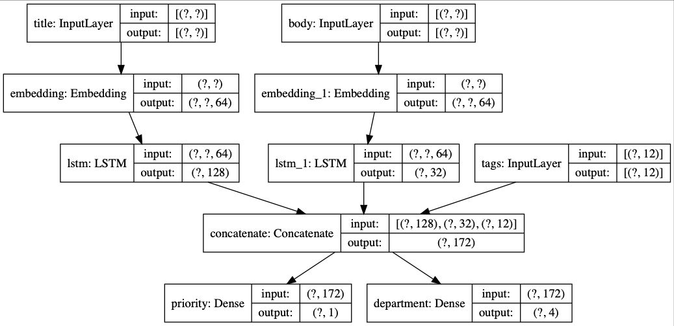
multi-input or multi-output models

Slide 17
from tensorflow.keras.models import Model
from tensorflow.keras.layers import (Input, Dense, Embedding, LSTM, Conv2D, MaxPooling2D, Flatten, concatenate)
att_in = Input(shape=(2,), name='att')
att = Dense(16, activation='relu')(att_in)
txt_in = Input(shape=(100,), name='txt')
txt = Embedding(1000, 32)(txt_in)
txt = LSTM(32)(txt)
img_in = Input(shape=(32, 32, 3), name='img') # 圖片的輸入 shape=(None, 32,32,3)
img = Conv2D(32, (3, 3), activation='relu')(img_in)
img = MaxPooling2D((2,2))(img)
img = Conv2D(32, (3, 3), activation='relu')(img)
img = MaxPooling2D((2,2))(img)
img = Flatten()(img)
out = concatenate([att, txt, img], axis=-1) # 用輔助函式串接 3 個張量
out = Dense(28, activation='relu')(out)
out = Dense(1)(out)
model = Model([att_in, txt_in, img_in], out)
model.compile(optimizer='rmsprop', loss='mse', metrics=['mae'])
model.summary()

Slide 18
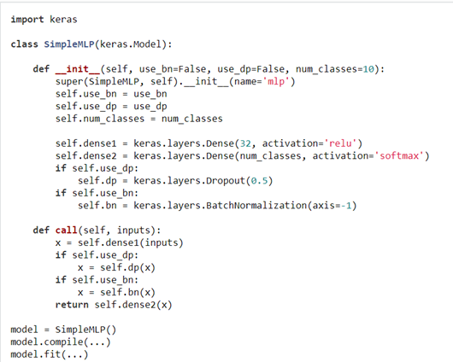
使用Model開發自己的程式
https://keras.io/models/about-keras-models/

Slide 19
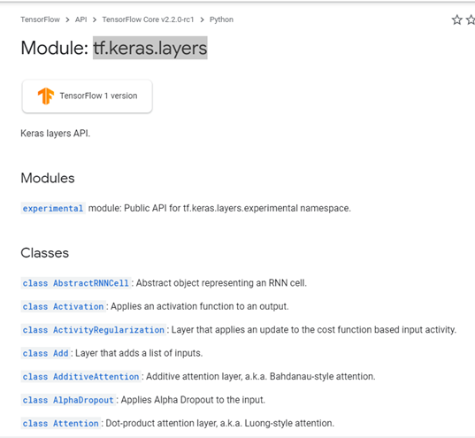
tf.keras.layers
https://www.tensorflow.org/versions/r2.2/api_docs/python/tf/keras/layers

Slide 20
tf.keras.layers.Dense 全連接層
tf.keras.layers.Dense(
units,
activation=None,
use_bias=True,
kernel_initializer='glorot_uniform',
bias_initializer='zeros',
kernel_regularizer=None,
bias_regularizer=None,
activity_regularizer=None,
kernel_constraint=None,
bias_constraint=None,
**kwargs
)
Positive integer, dimensionality of the output space
tf.keras.initializers
tf.keras.regularizers

Slide 21
# as first layer in a sequential model:
model = Sequential()
model.add(Dense(32, input_shape=(16,)))
# now the model will take as input arrays of shape (*, 16)
# and output arrays of shape (*, 32)
# after the first layer, you don't need to specify
# the size of the input anymore:
model.add(Dense(32))

Slide 22
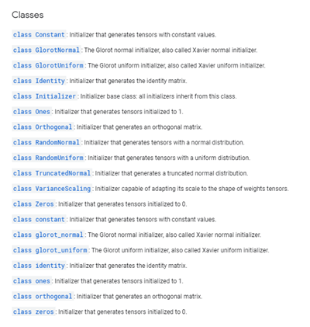
tf.keras.initializers
https://www.tensorflow.org/versions/r2.2/api_docs/python/tf/keras/initializers

Slide 23
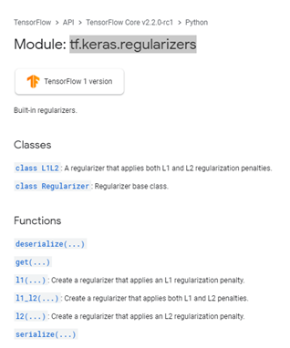
tf.keras.regularizers
https://www.tensorflow.org/versions/r2.2/api_docs/python/tf/keras/regularizers

Slide 24
設定
compile(
optimizer='rmsprop',
loss=None,
metrics=None,
loss_weights=None,
sample_weight_mode=None,
weighted_metrics=None,
**kwargs
)
tf.keras.optimizers
指定優化器
指定損失函數
tf.keras.losses
指定評估指標
tf.keras.metrics

Slide 25
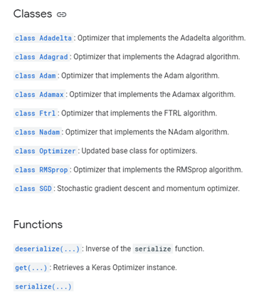
tf.keras.optimizers
https://www.tensorflow.org/versions/r2.2/api_docs/python/tf/keras/optimizers

Slide 26
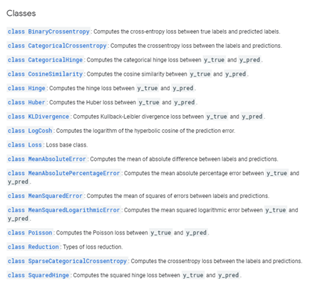
tf.keras.losses
https://www.tensorflow.org/versions/r2.2/api_docs/python/tf/keras/losses

Slide 27
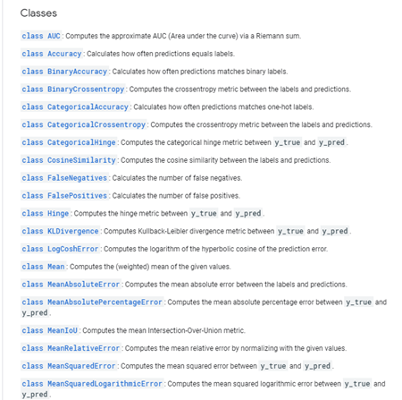
tf.keras.metrics
A metric is a function that is used to judge the performance of your model.
Metric functions are to be supplied in the metrics parameter when a model is compiled.
https://www.tensorflow.org/versions/r2.2/api_docs/python/tf/keras/metrics

Slide 28
訓練模型

Slide 29
fit(
x=None, y=None,
batch_size=None, epochs=1, verbose=1,
callbacks=None,
validation_split=0.0, validation_data=None,
shuffle=True, class_weight=None,
sample_weight=None,
initial_epoch=0, steps_per_epoch=None,
validation_steps=None,
validation_batch_size=None,
validation_freq=1,
max_queue_size=10, workers=1,
use_multiprocessing=False,
**kwargs
)
https://www.tensorflow.org/versions/r2.2/api_docs/python/tf/keras/Sequential

Slide 30
模型的準確度
Evaluate accuracy

Slide 31
https://www.tensorflow.org/versions/r2.2/api_docs/python/tf/keras/Sequential
Returns the loss value & metrics values for the model in test mode.
evaluate(
x=None, y=None,
batch_size=None,
verbose=1,
sample_weight=None,
steps=None,
callbacks=None,
max_queue_size=10,
workers=1,
use_multiprocessing=False,
return_dict=False
)
verbose: 0 or 1. Verbosity mode.
0 = silent, 1 = progress bar.

Slide 32
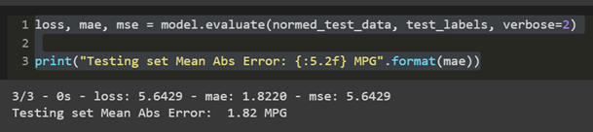
通過使用 測試集 來檢驗模型的效果如何
這告訴我們，當我們在現實世界中使用這個模型時，我們可以期望它預測得有多好
loss, mae, mse = model.evaluate(normed_test_data, test_labels, verbose=2)
print("Testing set Mean Abs Error: {:5.2f} MPG".format(mae))

Slide 33
預測

Slide 34
predict(
x,
batch_size=None,
verbose=0,
steps=None,
callbacks=None,
max_queue_size=10,
workers=1,
use_multiprocessing=False
)

Slide 35
probability_model = tf.keras.Sequential([model,
tf.keras.layers.Softmax()])
predictions = probability_model.predict(test_images)
np.argmax(predictions[0])
test_labels[0]

Slide 36
Keras模組

Slide 37
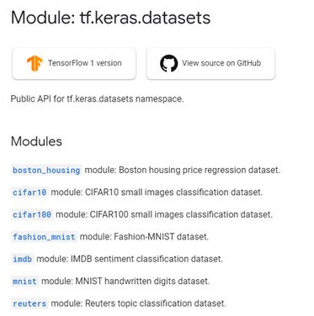
Keras built-in Datasets[內建的資料集]
https://www.tensorflow.org/api_docs/python/tf/keras/datasets

Slide 38

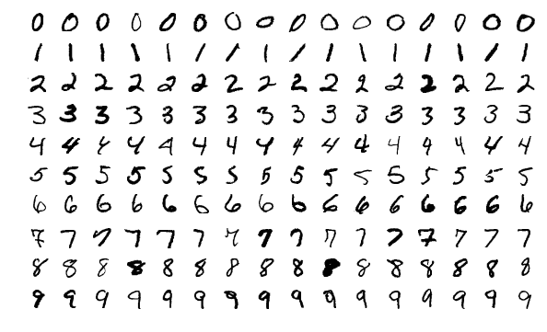

Slide 39
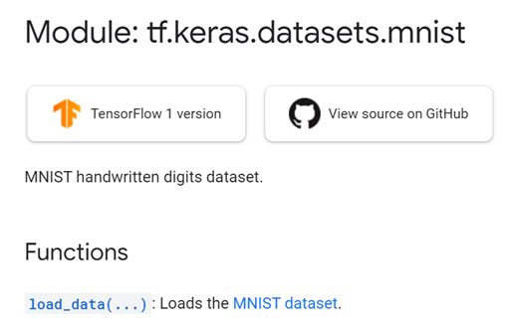
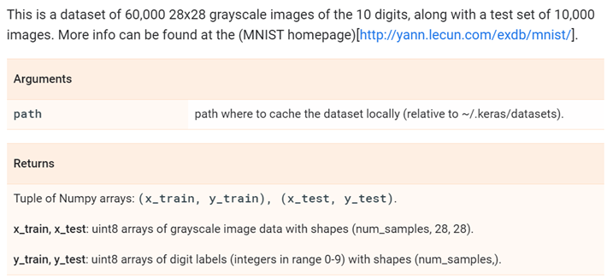
https://www.tensorflow.org/api_docs/python/tf/keras/datasets/mnist/load_data
tf.keras.datasets.mnist.load_data(
path='mnist.npz'
)

Slide 40
tf.keras.datasets.mnist.load_data() 實測
import tensorflow as tf
(x_train, y_train), (x_test, y_test) =
tf.keras.datasets.mnist.load_data()
# 28 x 28 images of hand-written digits 0-9
import matplotlib.pyplot as plt
plt.imshow(x_train[0])
print(x_train[0])
plt.imshow(x_train[0],cmap=plt.cm.binary)

Slide 41
Keras Preprocessing預處理
https://www.tensorflow.org/api_docs/python/tf/keras/preprocessing
Image Preprocessing | Set of tools for real-time data augmentation on image data. keras.preprocessing.image.ImageDataGenerator() https://keras.io/preprocessing/image/
Sequence Preprocessing | Utilities for preprocessing sequence data https://www.tensorflow.org/api_docs/python/tf/keras/preprocessing/sequence
Text Preprocessing | Utilities for text input preprocessing. https://www.tensorflow.org/api_docs/python/tf/keras/preprocessing/text

Slide 42
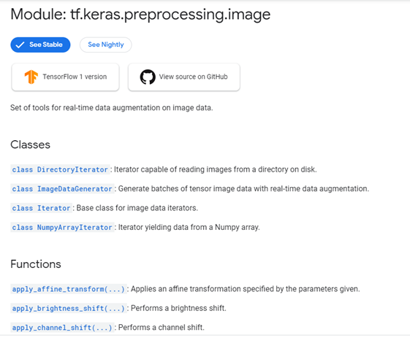
https://www.tensorflow.org/api_docs/python/tf/keras/preprocessing/image
使用 ImageDataGenerator
做資料擴增

Slide 43
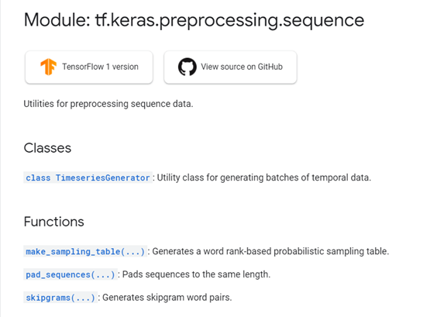
https://www.tensorflow.org/api_docs/python/tf/keras/preprocessing/sequence

Slide 44
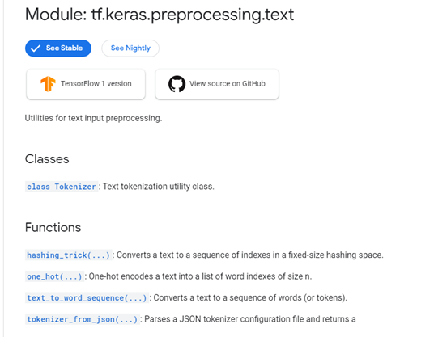
https://www.tensorflow.org/api_docs/python/tf/keras/preprocessing/text

Slide 45
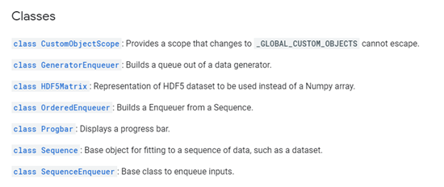
tf.keras.utils

Slide 46
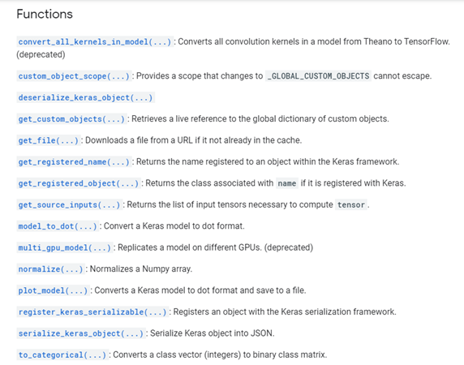

Slide 47
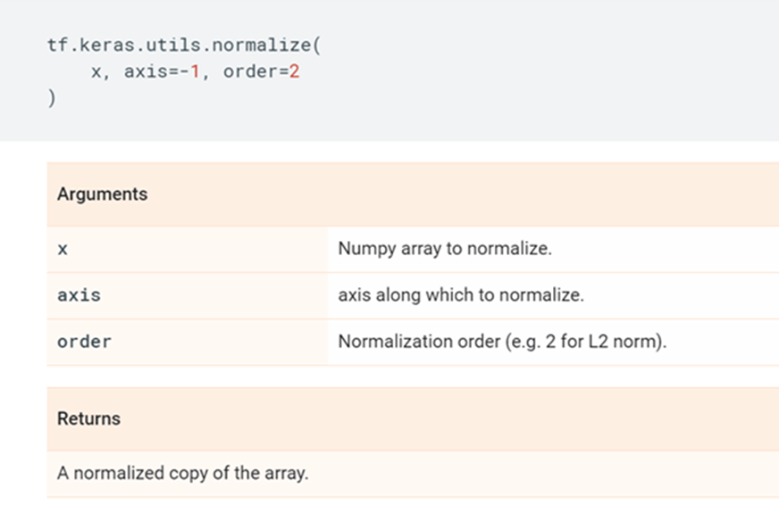
tf.keras.utils.normalize()
https://www.tensorflow.org/api_docs/python/tf/keras/utils/normalize

Slide 48
tf.keras.utils.normalize()實測
import tensorflow as tf
(x_train, y_train), (x_test, y_test) =
tf.keras.datasets.mnist.load_data()
# 28 x 28 images of hand-written digits 0-9
import matplotlib.pyplot as plt
plt.imshow(x_train[0])
print(x_train[0])
plt.imshow(x_train[0],cmap=plt.cm.binary)
x_train = tf.keras.utils.normalize(x_train,axis = 1)
x_test = tf.keras.utils.normalize(x_test, axis = 1)
plt.imshow(x_train[0])
print(x_train[0])
plt.imshow(x_train[0],cmap=plt.cm.binary)

Slide 49
Keras Callback

Slide 50
tf.keras.callbacks
用Callback 監控訓練過程
utilities called at certain points during model training
https://www.tensorflow.org/api_docs/python/tf/keras/callbacks
透過某些Callback 在訓練過程中不斷監控神經網路的狀態，一旦逹到最佳狀態即可自動停止訓練，
訓練過程
mode1.fit(x_train, y_train,
batch_size=l28, epochs=20,verbose=0,
callbacks=[callbackl, callback2,... ] )
把要使用的Callback 用Iist 打包起來做為引
數，透過指名參數callbacks傳遞給model.fit()

Slide 51
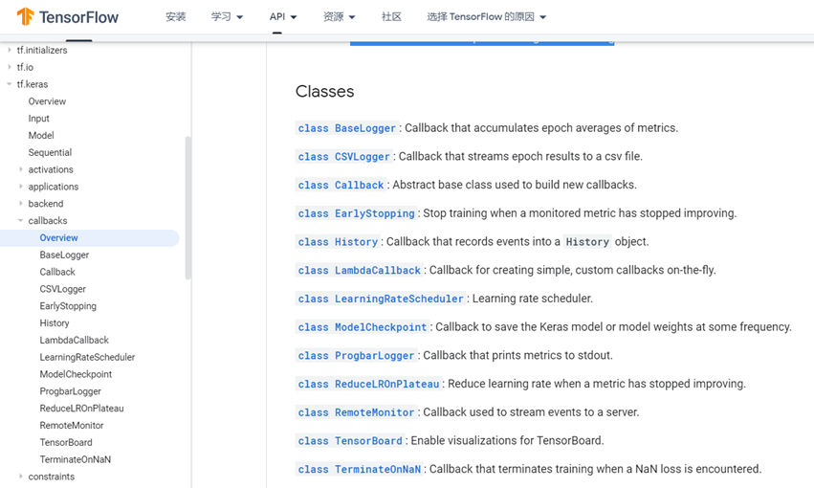
tf.keras.callbacks
tf. keras 提供了多種不同功能的Callback
可以撰寫自已的Callback
utilities called at certain points during model training
https://www.tensorflow.org/api_docs/python/tf/keras/callbacks

Slide 52
EarlyStopping
class
Stop training when a monitored metric has stopped improving.
https://www.tensorflow.org/versions/r2.2/api_docs/python/tf/keras/callbacks/EarlyStopping
from tensorflow.keras.callbacks import EarlyStopping
early_stopping = EarlyStopping(
monitor='val_loss',
min_delta=0,
patience=0,
verbose=0,
mode='auto ' ,
baseline=None,
restore_best_weights=False)
透過此指名參數告訴EarlyStopping
要監控什麼數據
Number of epochs with no improvement after which training will be stopped
Minimum change in the monitored quantity to qualify as an improvement, i.e. an absolute change of less than min_delta, will count as no improvement.
被監控的評量數據低於baseline 的設定值，則會立即中斷訓練
若此參數設定為True, 會在發生EarlyStopping 時，將神經網路的權重恢復至最佳的時刻，[被監控的評量數據有最佳表現的那次訓練
(epoch)]
設定EealyStopping 會在驗證準確率低於0.8 時(80%)就中斷訓練:
early_stopping = EarlyStopping(monitor='val_acc', baseline=0.8)

Slide 53
沒有達到進步要求的容忍度（次數）
callback = tf.keras.callbacks.EarlyStopping(monitor='loss', patience=3)
# This callback will stop the training when there is no improvement in
# the validation loss for three consecutive epochs.
model = tf.keras.models.Sequential([tf.keras.layers.Dense(10)])
model.compile(tf.keras.optimizers.SGD(), loss='mse')
history = model.fit(np.arange(100).reshape(5, 20), np.zeros(5),
epochs=10, batch_size=1, callbacks=[callback],
verbose=0)
len(history.history['loss']) # Only 4 epochs are run.
verbose: 0 或 1
若設定1 則會在EarlyStopping 發生後，以文字顯示在哪個訓練週期發生·
若設定0 則不顯示。
Epoch 00019: earIy stopping

Slide 54
tf.keras.callbacks.ModelCheckpoint
https://www.tensorflow.org/versions/r2.2/api_docs/python/tf/keras/callbacks/ModelCheckpoint
Callback to save the Keras model or model weights at some frequency.
tf.keras.callbacks.ModelCheckpoint(
filepath,
monitor='val_loss',
verbose=0,
save_best_only=False,
save_weights_only=False,
mode='auto',
save_freq='epoch',
**kwargs
)
設成True 時，只會在所監控的monitor有最佳成效時，才會進行模型的儲存。
會將模型的結構與權重都一併儲存
此參數預設為'epoch'，
這代表會在每個訓練週期結束時，儲存模型
若設定save_freq=lOOOO, 這會在每個訓練
批次結束時，判斷模型是否看（訓練）超過10000 筆訓練資料，若是則儲存模型。

Slide 55
EarlyStopping 常搭配ModelCheckpoint一起用
from tensorflow. keras.callbacks import ModelCheckpoint, EarlyStopping
early_stopping = EarlyStopping(monitor= ' val_acc' , min_delta=0.01,
patience=0, verbose=1)
model_checkpoint = ModelCheckpoint(
filepath='weights. {epoch: 02d}-{val_acc:. 2f}. h5',
monitor='val_acc',verbose=1, save_best_only=True)
history=model.fit(x_train, y_train,
epochs=S, batch_size=500,
validation_split=0.2,
callbacks=[early_stopping, model_checkpoint])

