Slide 1
NLTK

Slide 2
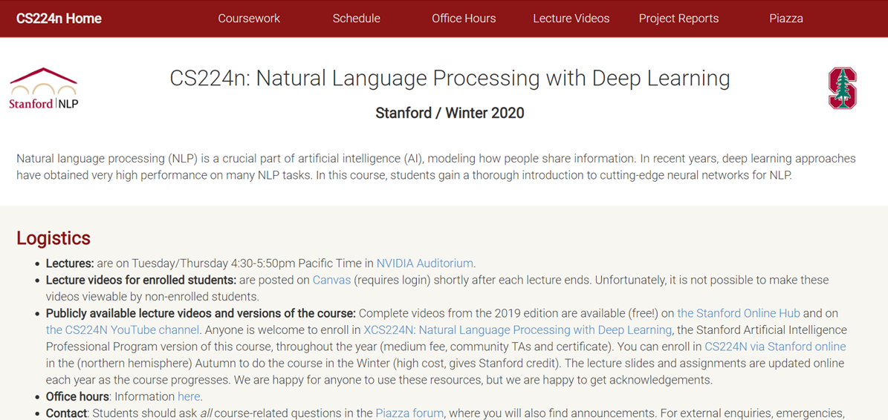
http://web.stanford.edu/class/cs224n/index.html

Slide 3
Assignments (54%)
Assignment 1 (6%): Introduction to word vectors
Assignment 2 (12%): Derivatives and implementation of word2vec algorithm
Assignment 3 (12%): Dependency parsing and neural network foundations
Assignment 4 (12%): Neural Machine Translation with sequence-to-sequence and attention
Assignment 5 (12%): Neural Machine Translation with ConvNets and subword modeling
https://github.com/youngmihuang/cs224n_exercise

Slide 4
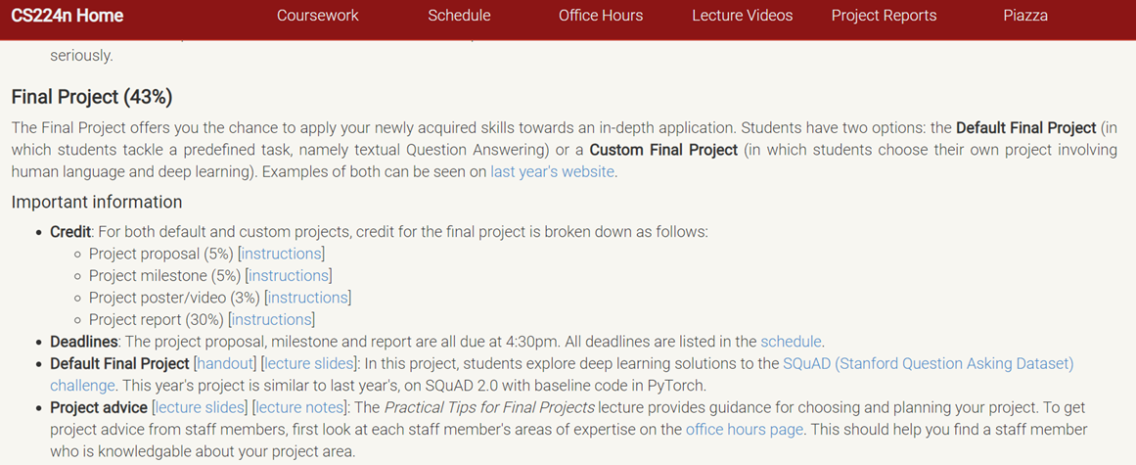

Slide 5
如何在線上廣告系統 ( Online Advertisement System ) 偵測惡意廣告
Detecting Adversarial Advertisements in the Wild—
來自 Google 早期的論文：偵測惡意廣告所使用的方法綜述
https://blog.csdn.net/wangyaninglm/article/details/62238361

Slide 6
惡意廣告帶來的挑戰包含以下：
成本高：不管是 False Positive ( FP ) 或是 False Negative ( FN ) 的誤判，對他們來說，成本都很高，因此需要構建兼顧降低此兩種情況的算法。
資料不平衡的問題：大多數都是好廣告，惡意廣告有樣本少、行為鬼怪多端的問題。舉例：賣假商品、連結到假的用戶登入頁面、釣魚網站（引導到假的登入支付金流頁面，騙取帳號密碼）、惡意軟體下載的連結等。
這是一個工程化、規模化的問題。

Slide 7
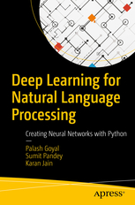
Introduction to Natural Language Processing and Deep Learning
Word Vector Representations
Unfolding Recurrent Neural Networks
Developing a Chatbot
Research Paper Implementation: Sentiment Classification
https://github.com/Apress/deep-learning-for-natural-language-processing

Slide 8
https://pythonprogramming.net/wordnet-nltk-tutorial/?completed=/nltk-corpus-corpora-tutorial/

Slide 9
agenda

Slide 10
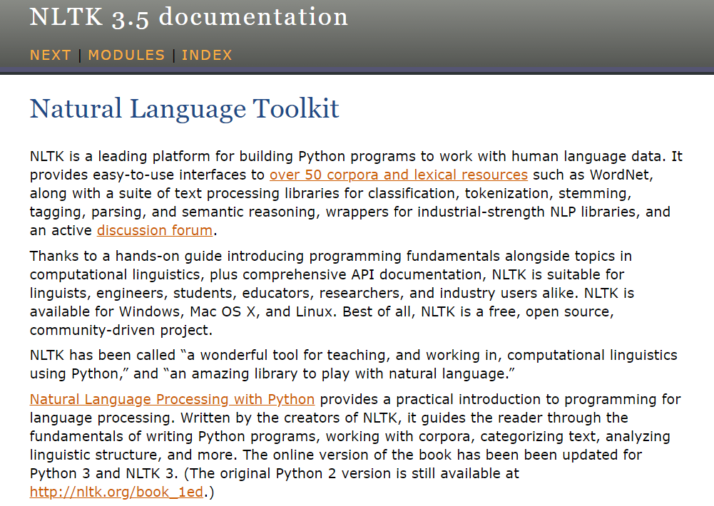
NLTK
https://www.nltk.org/

Slide 11
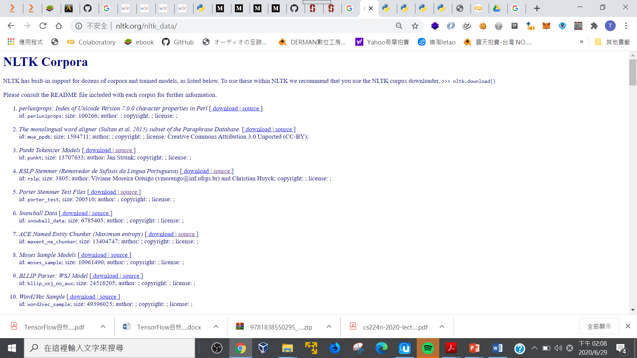
NLTK Corpora
http://www.nltk.org/nltk_data/

Slide 12
Corpus - Body of text, singular. Corpora is the plural of this. Example: A collection of medical journals.
Lexicon - Words and their meanings. Example: English dictionary. Consider, however, that various fields will have different lexicons. For example: To a financial investor, the first meaning for the word "Bull" is someone who is confident about the market, as compared to the common English lexicon, where the first meaning for the word "Bull" is an animal. As such, there is a special lexicon for financial investors, doctors, children, mechanics, and so on.
Token - Each "entity" that is a part of whatever was split up based on rules. For examples, each word is a token when a sentence is "tokenized" into words. Each sentence can also be a token, if you tokenized the sentences out of a paragraph.

Slide 13
Tokenization
import nltk
sent_ = "I am almost dead this time"
tokens_ = nltk.word_tokenize(sent_)
tokens_

Slide 14
Synonyms
from nltk.corpus import wordnet
word_ = wordnet.synsets("spectacular")
print(word_)

Slide 15
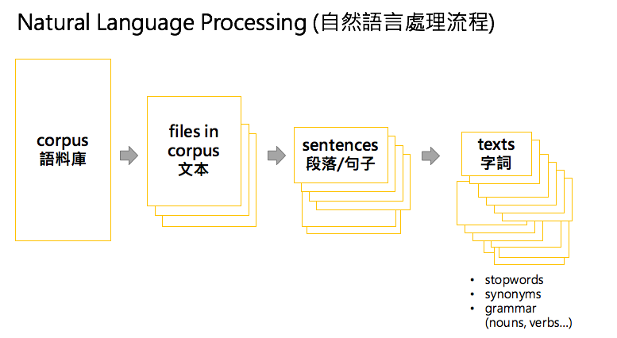

Slide 16
Almost all of the files in the NLTK corpus follow the same rules for accessing them by using the NLTK module, but nothing is magical about them. These files are plain text files for the most part, some are XML and some are other formats, but they are all accessible by you manually, or via the module and Python.

Slide 17
from nltk.tokenize import sent_tokenize, word_tokenize
EXAMPLE_TEXT = "Hello Mr. Smith, how are you doing today? The weather is great, and Python is awesome. The sky is pinkish-blue. You shouldn't eat cardboard."
print(sent_tokenize(EXAMPLE_TEXT))
https://pythonprogramming.net/tokenizing-words-sentences-nltk-tutorial/

Slide 18
nltk.corpus

Slide 19
Write a Python NLTK program to list down all the corpus names
import nltk.corpus
dir(nltk.corpus)
print("\nAvailable corpus names:")
print(dir(nltk.corpus))
https://www.w3resource.com/python-exercises/nltk/nltk-corpus-exercise-1.php

Slide 20
Available corpus names:
['AlignedCorpusReader', 'AlpinoCorpusReader', 'BNCCorpusReader', 'BracketParseCorpusReader', 'CHILDESCorpusReader', 'CMUDictCorpusReader', 'CategorizedBracketParseCorpusReader', 'CategorizedCorpusReader', 'CategorizedPlaintextCorpusReader', 'CategorizedSentencesCorpusReader', 'CategorizedTaggedCorpusReader', 'ChasenCorpusReader', 'ChunkedCorpusReader', 'ComparativeSentencesCorpusReader', 'ConllChunkCorpusReader', 'ConllCorpusReader', 'CorpusReader', 'CrubadanCorpusReader', 'DependencyCorpusReader', 'EuroparlCorpusReader', 'FramenetCorpusReader', 'IEERCorpusReader', 'IPIPANCorpusReader', 'IndianCorpusReader', 'KNBCorpusReader', 'LazyCorpusLoader', 'LinThesaurusCorpusReader', 'MTECorpusReader', 'MWAPPDBCorpusReader', 'MacMorphoCorpusReader', 'NKJPCorpusReader', 'NPSChatCorpusReader', 'NombankCorpusReader', 'NonbreakingPrefixesCorpusReader', 'OpinionLexiconCorpusReader', 'PPAttachmentCorpusReader', 'PanLexLiteCorpusReader', 'Pl196xCorpusReader', 'PlaintextCorpusReader', 'PortugueseCategorizedPlaintextCorpusReader', 'PropbankCorpusReader', 'ProsConsCorpusReader', 'RTECorpusReader', 'RegexpTokenizer', 'ReviewsCorpusReader', 'SemcorCorpusReader', 'SensevalCorpusReader', 'SentiSynset', 'SentiWordNetCorpusReader', 'SinicaTreebankCorpusReader', 'StringCategoryCorpusReader', 'SwadeshCorpusReader', 'SwitchboardCorpusReader', 'SyntaxCorpusReader', 'TEICorpusView', 'TaggedCorpusReader', 'TimitCorpusReader', 'TimitTaggedCorpusReader', 'ToolboxCorpusReader', 'TwitterCorpusReader', 'UdhrCorpusReader', 'UnicharsCorpusReader', 'VerbnetCorpusReader', 'WordListCorpusReader', 'WordNetCorpusReader', 'WordNetICCorpusReader', 'XMLCorpusReader', 'YCOECorpusReader', '_LazyModule__lazymodule_globals', '_LazyModule__lazymodule_import', '_LazyModule__lazymodule_init', '_LazyModule__lazymodule_loaded', '_LazyModule__lazymodule_locals', '_LazyModule__lazymodule_name', '__builtins__', '__cached__', '__class__', '__delattr__', '__dict__', '__dir__', '__doc__', '__eq__', '__file__', '__format__', '__ge__', '__getattr__', '__getattribute__', '__gt__', '__hash__', '__init__', '__init_subclass__', '__lazymodule_loaded', '__le__', '__loader__', '__lt__', '__module__', '__name__', '__ne__', '__new__', '__package__', '__path__', '__reduce__', '__reduce_ex__', '__repr__', '__setattr__', '__sizeof__', '__spec__', '__str__', '__subclasshook__', '__weakref__', 'abc', 'alpino', 'brown', 'cess_cat', 'cess_esp', 'cmudict', 'comparative_sentences', 'comtrans', 'conll2000', 'conll2002', 'conll2007', 'crubadan', 'demo', 'dependency_treebank', 'find_corpus_fileids', 'floresta', 'framenet', 'framenet15', 'gazetteers', 'genesis', 'gutenberg', 'ieer', 'inaugural', 'indian', 'jeita', 'knbc', 'lin_thesaurus', 'mac_morpho', 'machado', 'masc_tagged', 'movie_reviews', 'multext_east', 'names', 'nombank', 'nombank_ptb', 'nonbreaking_prefixes', 'nps_chat', 'opinion_lexicon', 'perluniprops', 'ppattach', 'product_reviews_1', 'product_reviews_2', 'propbank', 'propbank_ptb', 'pros_cons', 'ptb', 'qc', 're', 'reader', 'reuters', 'rte', 'semcor', 'senseval', 'sentence_polarity', 'sentiwordnet', 'shakespeare', 'sinica_treebank', 'state_union', 'stopwords', 'subjectivity', 'swadesh', 'swadesh110', 'swadesh207', 'switchboard', 'tagged_treebank_para_block_reader', 'teardown_module', 'timit', 'timit_tagged', 'toolbox', 'treebank', 'treebank_chunk', 'treebank_raw', 'twitter_samples', 'udhr', 'udhr2', 'universal_treebanks', 'util', 'verbnet', 'webtext', 'wordnet', 'wordnet_ic', 'words']

Slide 21
nltk.tokenize方法代碼示例
https://vimsky.com/zh-tw/examples/detail/python-method-nltk.tokenize.html

Slide 22
Write a Python NLTK program to split the text sentence/paragraph into a list of words.
https://www.w3resource.com/python-exercises/nltk/nltk-tokenize-exercise-1.php
text = ''' Joe waited for the train. The train was late. Mary and Samantha took the bus. I looked for Mary and Samantha at the bus station. '''
print("\nOriginal string:")
print(text)
from nltk.tokenize import sent_tokenize
token_text = sent_tokenize(text)
print("\nSentence-tokenized copy in a list:") print(token_text)
print("\nRead the list:")
for s in token_text:
print(s)

Slide 23
# Make sure to install wordnet, if not done already so
# import nltk
# nltk.download('wordnet')

