Slide 1
Transfer learning with a pretrained ConvNet

Slide 2
Data preprocessing
Data download
Format the Data
Create the base model from the pre-trained convnets
Feature extraction
Freeze the convolutional base
Add a classification head
Compile the model
Train the model
Learning curves
Fine tuning
Un-freeze the top layers of the model
Compile the model
Continue training the model
Summary:

Slide 3
Examine and understand the data
Build an input pipeline using Keras ImageDataGenerator
Compose the model
Load in the pretrained base model (and pretrained weights)
Stack the classification layers on top
Train the model
Evaluate model

Slide 4
import os
import numpy as np
import matplotlib.pyplot as plt
import tensorflow as tf

Slide 5
import tensorflow_datasets as tfds
tfds.disable_progress_bar()

Slide 6
(raw_train, raw_validation, raw_test), metadata =
tfds.load(
'cats_vs_dogs',
split=['train[:80%]',
'train[80%:90%]', 'train[90%:]'],
with_info=True,
as_supervised=True,
)

Slide 7
print(raw_train)
print(raw_validation)
print(raw_test)

Slide 8
get_label_name = metadata.features['label'].int2str
for image, label in raw_train.take(2):
plt.figure()
plt.imshow(image)
plt.title(get_label_name(label))

Slide 9
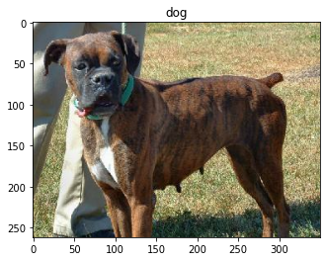
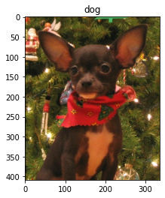

Slide 10
Format the Data
Use the tf.image module to format the images for the task.
Resize the images to a fixed input size, and rescale the input channels to a range of [-1,1]
IMG_SIZE = 160 # All images will be resized to 160x160
def format_example(image, label):
image = tf.cast(image, tf.float32)
image = (image/127.5) - 1
image = tf.image.resize(image, (IMG_SIZE, IMG_SIZE))
return image, label

Slide 11
train = raw_train.map(format_example)
validation = raw_validation.map(format_example)
test = raw_test.map(format_example)

Slide 12
BATCH_SIZE = 32
SHUFFLE_BUFFER_SIZE = 1000
train_batches = train.shuffle(SHUFFLE_BUFFER_SIZE).batch(BATCH_SIZE)
validation_batches = validation.batch(BATCH_SIZE)
test_batches = test.batch(BATCH_SIZE)

Slide 13
for image_batch, label_batch in train_batches.take(1):
pass
image_batch.shape
TensorShape([32, 160, 160, 3])

Slide 14
feature extraction
特徵萃取法

Slide 15
IMG_SHAPE = (IMG_SIZE, IMG_SIZE, 3)
# Create the base model from the pre-trained model
# MobileNet V2
base_model =
tf.keras.applications.MobileNetV2(
input_shape=IMG_SHAPE,
include_top=False,
weights='imagenet')

Slide 16
feature_batch = base_model(image_batch)
print(feature_batch.shape)
(32, 5, 5, 1280)

Slide 17
Feature extraction
base_model.trainable = False
base_model.summary()

Slide 18
Add a classification head
global_average_layer =
tf.keras.layers.GlobalAveragePooling2D()
feature_batch_average =
global_average_layer(feature_batch)
print(feature_batch_average.shape)
(32, 1280)

Slide 19
prediction_layer = tf.keras.layers.Dense(1)
prediction_batch =
prediction_layer(feature_batch_average)
print(prediction_batch.shape)
(32, 1)

Slide 20
model = tf.keras.Sequential([
base_model,
global_average_layer,
prediction_layer
])

Slide 21
base_learning_rate = 0.0001
model.compile(
optimizer=tf.keras.optimizers.RMSprop(
lr=base_learning_rate),
loss=tf.keras.losses.BinaryCrossentropy(
from_logits=True),
metrics=['accuracy']
)
len(model.trainable_variables)
2

Slide 22
initial_epochs = 10
validation_steps=20
loss0,accuracy0 = model.evaluate(
validation_batches,
steps = validation_steps)

Slide 23
print("initial loss: {:.2f}".format(loss0))
print("initial accuracy: {:.2f}".format(accuracy0))
initial loss: 0.91
initial accuracy: 0.48

Slide 24
history = model.fit(
train_batches,
epochs=initial_epochs,
validation_data=validation_batches)

Slide 25
Learning curves
acc = history.history['accuracy']
val_acc = history.history['val_accuracy']
loss = history.history['loss']
val_loss = history.history['val_loss']

Slide 26
plt.figure(figsize=(8, 8))
plt.subplot(2, 1, 1)
plt.plot(acc, label='Training Accuracy')
plt.plot(val_acc, label='Validation Accuracy')
plt.legend(loc='lower right')
plt.ylabel('Accuracy')
plt.ylim([min(plt.ylim()),1])
plt.title('Training and Validation Accuracy')
plt.subplot(2, 1, 2)
plt.plot(loss, label='Training Loss')
plt.plot(val_loss, label='Validation Loss')
plt.legend(loc='upper right')
plt.ylabel('Cross Entropy')
plt.ylim([0,1.0])
plt.title('Training and Validation Loss')
plt.xlabel('epoch')
plt.show()

Slide 27
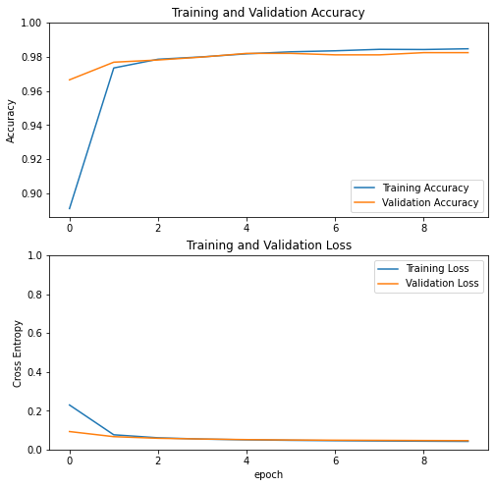

Slide 28
Note: If you are wondering why the validation metrics are clearly better than the training metrics, the main factor is because layers like tf.keras.layers.BatchNormalization and tf.keras.layers.Dropout affect accuracy during training. They are turned off when calculating validation loss.
To a lesser extent, it is also because training metrics report the average for an epoch, while validation metrics are evaluated after the epoch, so validation metrics see a model that has trained slightly longer.

Slide 29
Fine tuning
微調

Slide 30
選擇要微調部分
base_model.trainable = True
# Let's take a look to see how many layers
# are in the base model
print("Number of layers in the base model: ",
len(base_model.layers))
# Fine-tune from this layer onwards
fine_tune_at = 100
# Freeze all the layers before the `fine_tune_at` layer
for layer in base_model.layers[:fine_tune_at]:
layer.trainable = False

Slide 31
model.compile(loss=tf.keras.losses.BinaryCrossentropy(from_logits=True),
optimizer = tf.keras.optimizers.RMSprop(lr=base_learning_rate/10),
metrics=['accuracy'])

Slide 32
model.summary()

Slide 33
len(model.trainable_variables)

Slide 34
fine_tune_epochs = 10
total_epochs = initial_epochs + fine_tune_epochs
history_fine = model.fit(
train_batches,
epochs=total_epochs,
initial_epoch = history.epoch[-1],
validation_data=validation_batches)

Slide 35
acc += history_fine.history['accuracy']
val_acc += history_fine.history['val_accuracy']
loss += history_fine.history['loss']
val_loss += history_fine.history['val_loss']

Slide 36
plt.figure(figsize=(8, 8))
plt.subplot(2, 1, 1)
plt.plot(acc, label='Training Accuracy')
plt.plot(val_acc, label='Validation Accuracy')
plt.ylim([0.8, 1])
plt.plot([initial_epochs-1,initial_epochs-1],
plt.ylim(), label='Start Fine Tuning')
plt.legend(loc='lower right')
plt.title('Training and Validation Accuracy')
plt.subplot(2, 1, 2)
plt.plot(loss, label='Training Loss')
plt.plot(val_loss, label='Validation Loss')
plt.ylim([0, 1.0])
plt.plot([initial_epochs-1,initial_epochs-1],
plt.ylim(), label='Start Fine Tuning')
plt.legend(loc='upper right')
plt.title('Training and Validation Loss')
plt.xlabel('epoch')
plt.show()

Slide 37
