Slide 1
PyTorch 深度學習實作班
遞歸神經網絡Recurrent
Neural Network
from IPython.display import YouTubeVideo
YouTubeVideo('m_dBwwDJ4uo')

Slide 2
遞歸神經網絡
Recurrent
Neural Network
模型

Slide 3
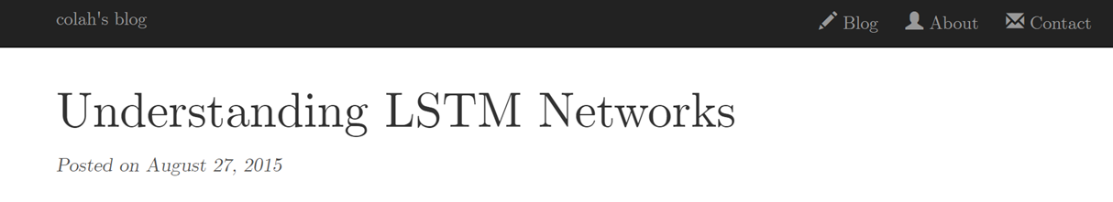
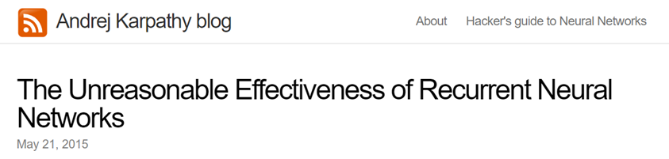
http://colah.github.io/posts/2015-08-Understanding-LSTMs/
https://blog.csdn.net/menc15/article/details/71271566
https://blog.csdn.net/Jerr__y/article/details/58598296
http://karpathy.github.io/2015/05/21/rnn-effectiveness/
https://github.com/karpathy/char-rnn

Slide 4
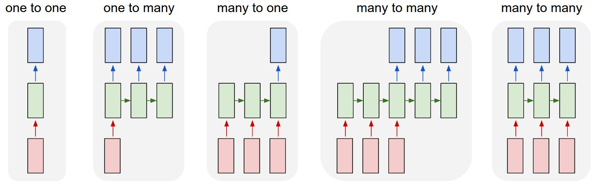
http://karpathy.github.io/2015/05/21/rnn-effectiveness/

Slide 5
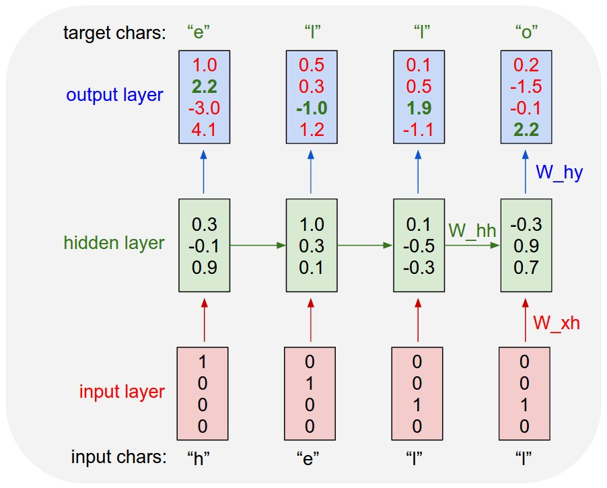
An example RNN with 4-dimensional input and output layers, and a hidden layer of 3 units (neurons)
http://karpathy.github.io/2015/05/21/rnn-effectiveness/

Slide 6
人們思考問題往往不是從零開始的。就好像你現在閱讀這篇文章一樣，你對每個詞的理解都會依賴於你前面看到的一些詞，而不是把你前面看的內容全部拋棄了，忘記了，再去理解這個單詞。也就是說，人們的思維總是會有延續性的。
傳統的神經網路是做不到這樣的延續性（它們沒辦法保留對前文的理解），這似乎成了它們一個巨大的缺陷。舉個例子，在觀看影片中，你想辦法去對每一幀畫面上正在發生的事情做一個分類理解。目前還沒有明確的辦法利用傳統的網路把對影片中前面發生的事件添加進來説明理解後面的畫面。
但是，迴圈神經網路可以做到。在RNNs的網路中，有一個迴圈的操作，使得它們能夠保留之前學習到的內容。

Slide 7
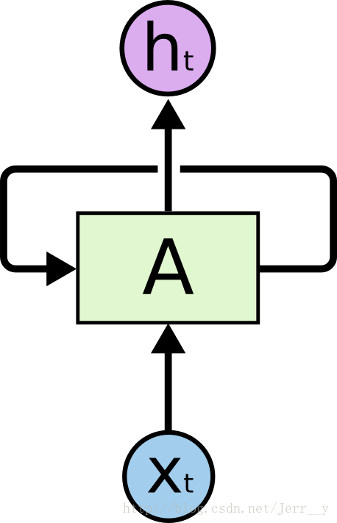
輸出一個結果 h_t $
（t時刻的狀態或者輸出）
網路中的迴圈結構使得某個時刻的狀態能夠傳到下一個時刻
A loop allows information to be passed from one step of the network to the next
輸入$ x_t （t時刻的特徵向量）

Slide 8

A recurrent neural network can be thought of as multiple copies of the same network, each passing a message to a successor.
This chain-like nature reveals that recurrent neural networks are intimately related to sequences and lists.
They’re the natural architecture of neural network to use for such data.

Slide 9
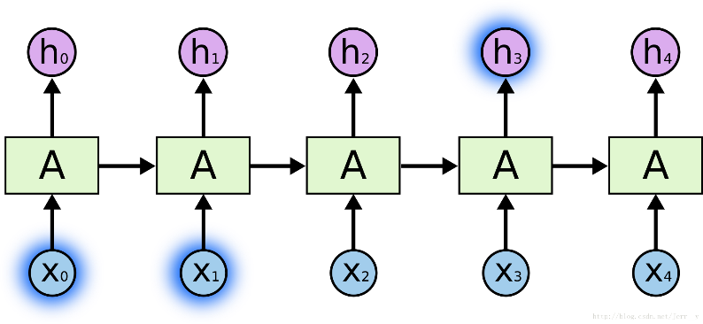
The Problem of Long-Term Dependencies
長時期依賴的問題
consider a language model trying to predict the next word based on the previous ones.
the clouds are in the ?
the clouds are in the sky
不需要更多的資訊，我們就能夠自然而然的想到下一個詞應該是“sky”。
所要預測的內容和相關資訊之間的間隔很小，這種情況下 RNNs 就能夠利用過去的資訊， 很容易的實現

Slide 10
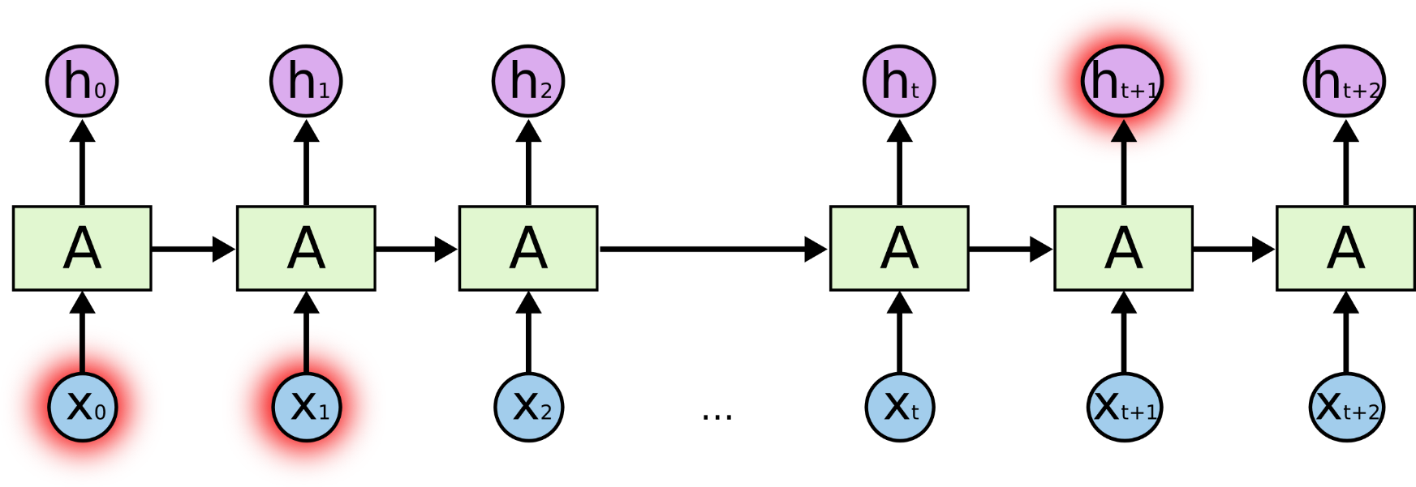
The Problem of Long-Term Dependencies
長時期依賴的問題
預測“I grew up in France … (此處省略1萬字)… I speak ?”
“I grew up in France… I speak fluent French.”
預測資訊和相關資訊間的間隔增大， RNNs 很難去把它們關聯起來

Slide 11

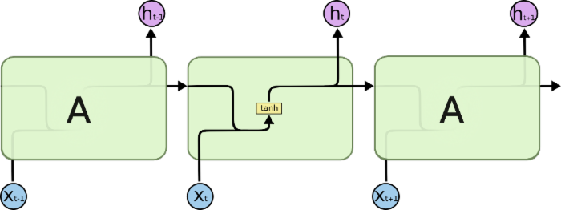
SimpleRNN
所有迴圈神經網路結構都是由完全相同結構的（神經網路）模組進行複製而成的。
在普通的RNNs 中，這個模組結構非常簡單，比如僅是一個單一的 tanh 層

Slide 12
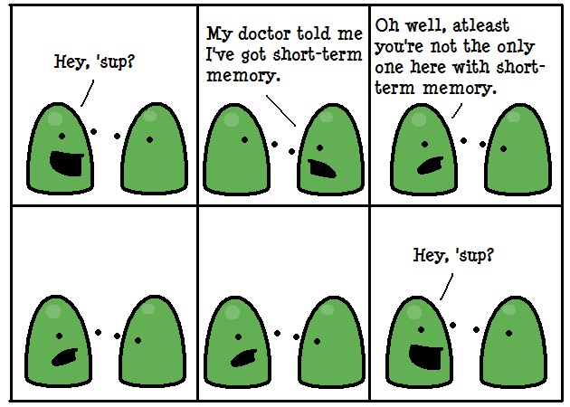
https://www.deviantart.com/toxicpaprika/art/Short-term-memory-88267010

Slide 13
設計初衷是希望能夠解決神經網路中的長期依賴問題，讓記住長期資訊成為神經網路的預設行為，而不是需要很大力氣才能學會。

Slide 14

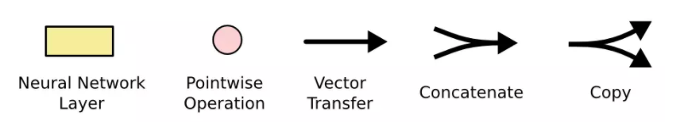
LSTM
LSTMs 也有類似的結構,但是它們不再只是用一個單一的 tanh 層，而是用了四個相互作用的層
https://brohrer.mcknote.com/zh-Hant/how_machine_learning_works/how_rnns_lstm_work.html
https://blog.csdn.net/fendouaini/article/details/80198994

Slide 15
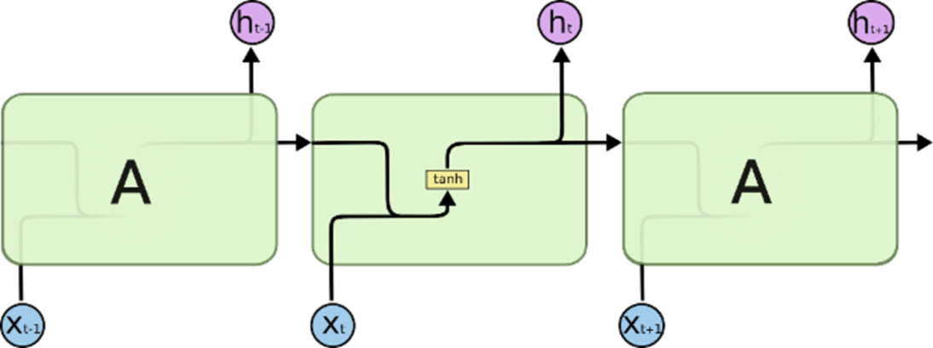

Slide 16
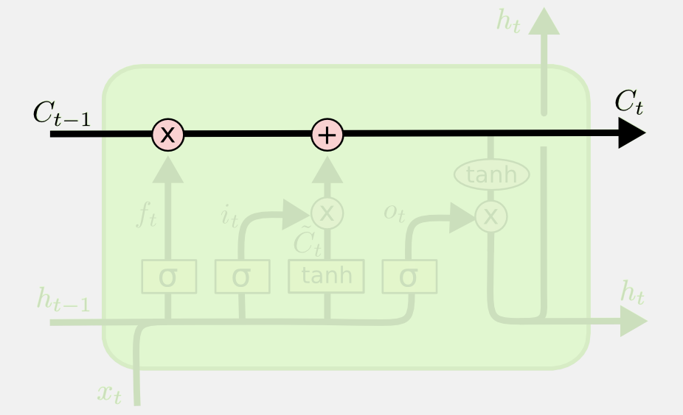
cell state
長時期的記憶保留
LSTMs 最關鍵的地方在於 cell 狀態 和 結構圖上面的那條橫穿的水平線。
cell 狀態的傳輸就像一條傳送帶，向量從整個 cell 中穿過，只是做了少量的線性操作。這種結構能夠很輕鬆地實現資訊從整個 cell 中穿過而不做改變。（這樣就可以實現長時期的記憶保留）
傳送帶結構
使用Gate來添加或者刪除資訊
每個 LSTM 有三個這樣的門結構，來實現保護和控制資訊。
（分別是 “forget gate layer”, 遺忘門； “input gate layer”，傳入門； “output gate layer”, 輸出門）

Slide 17
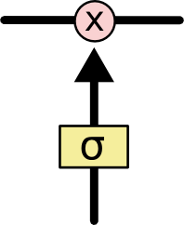
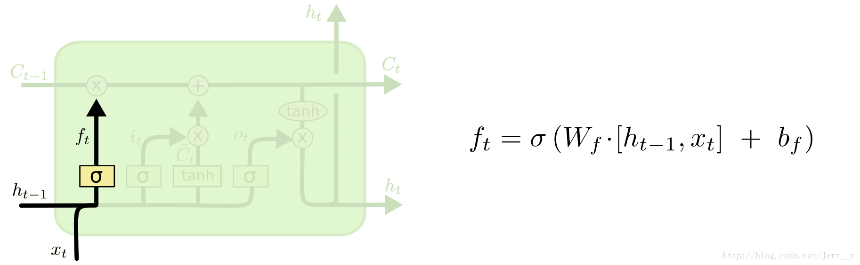
決定要讓那些資訊繼續通過這個 cell?
遺忘門 (forget gates)
sigmoid 神經層
輸出是一個數值都在 0，1 之間的向量（向量長度和 cell 的狀態 $ C_{t-1} $ 一樣），表示讓 $C_{t-1} $ 的各部分資訊通過的比重。
0 表示“不讓任何資訊通過”， 1 表示“讓所有資訊通過”。
pointwise multiplication operation
sigmoid 神經層

Slide 18
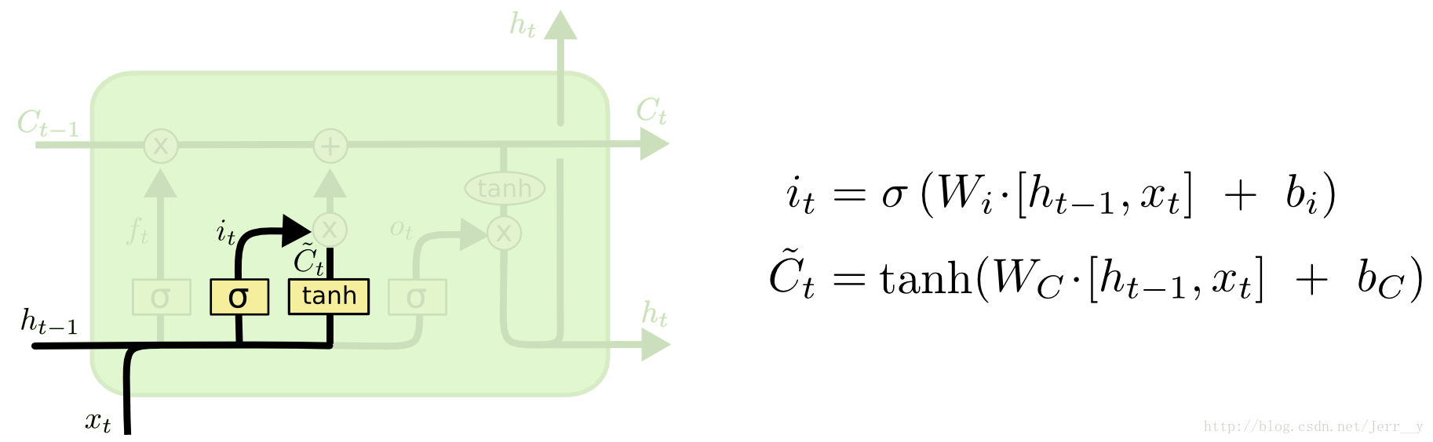
傳入門 (input gates)
決定讓多少新的資訊加入到 cell 狀態
[1]a sigmoid layer called the “input gate layer” decides which values we’ll update.
[2]a tanh layer creates a vector of new candidate values, C~t, that could be added to the state

Slide 19
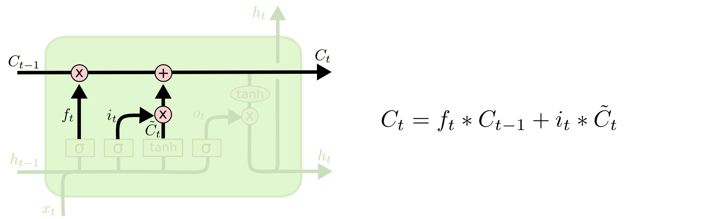
combine these two to create an update to the state

Slide 20
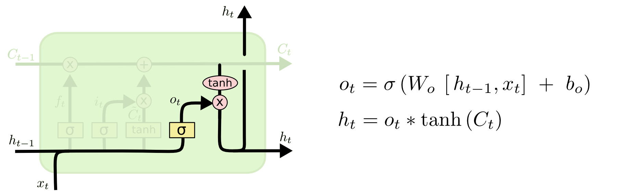
輸出門
This output will be based on our cell state, but will be a filtered version
決定輸出什麼值
First, we run a sigmoid layer which decides what parts of the cell state we’re going to output.
Then, we put the cell state through tanh (to push the values to be between −1 and 1) and multiply it by the output of the sigmoid gate, so that we only output the parts we decided to.

Slide 21
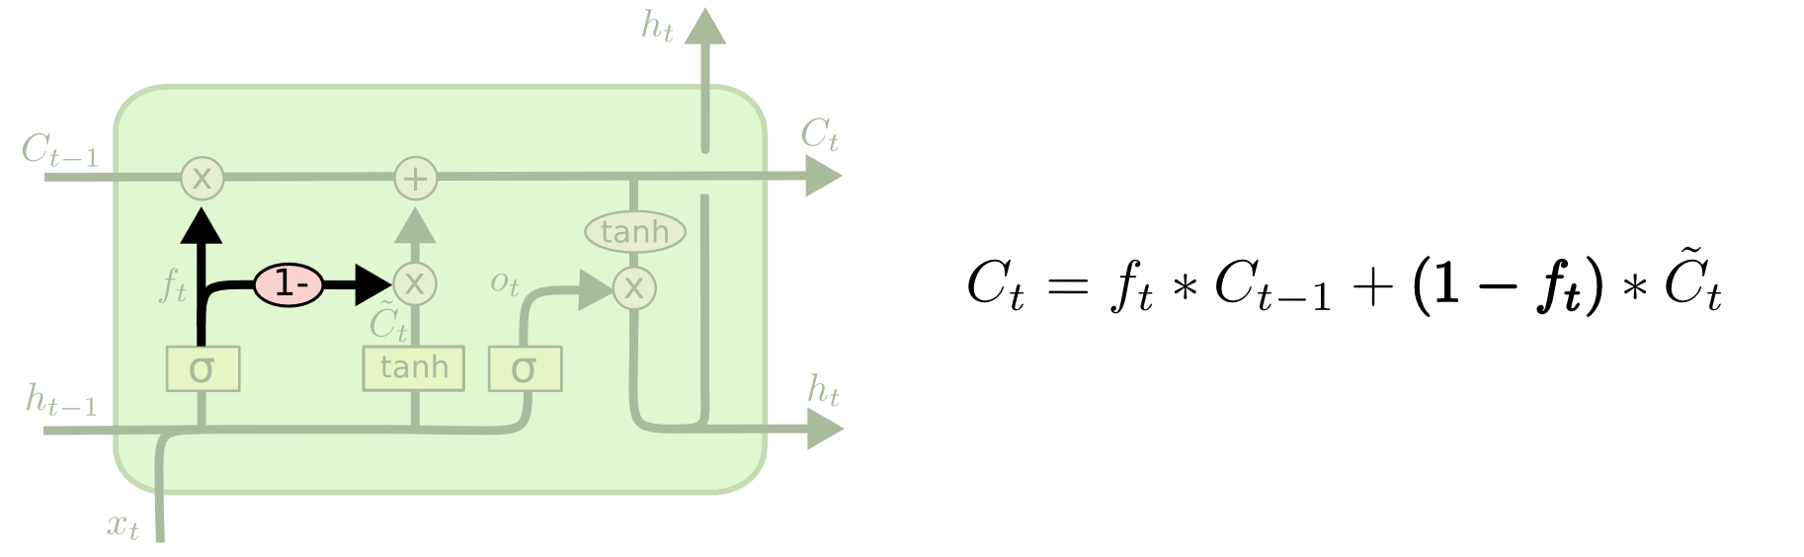
Depth-Gated Recurrent Neural Networks

Slide 22
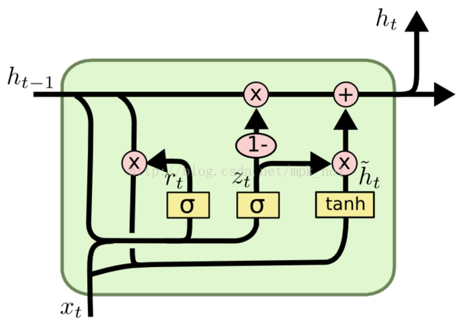
GRU
https://blog.csdn.net/mpk_no1/article/details/72875185

Slide 23
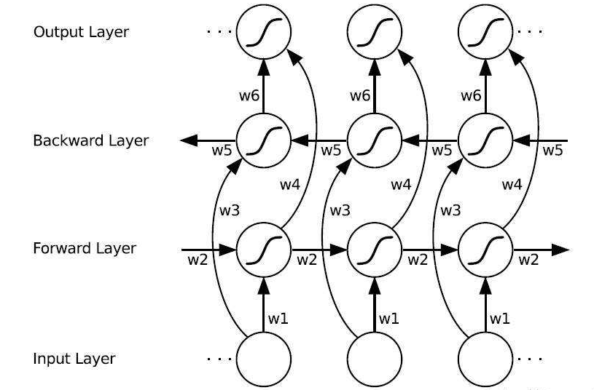
雙向LSTM(Bi-directional LSTM)
https://blog.csdn.net/fendouaini/article/details/80198994

Slide 24
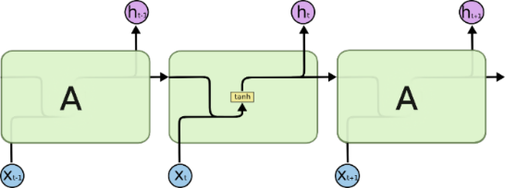

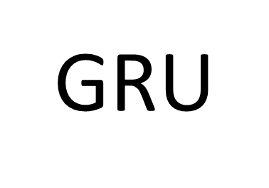

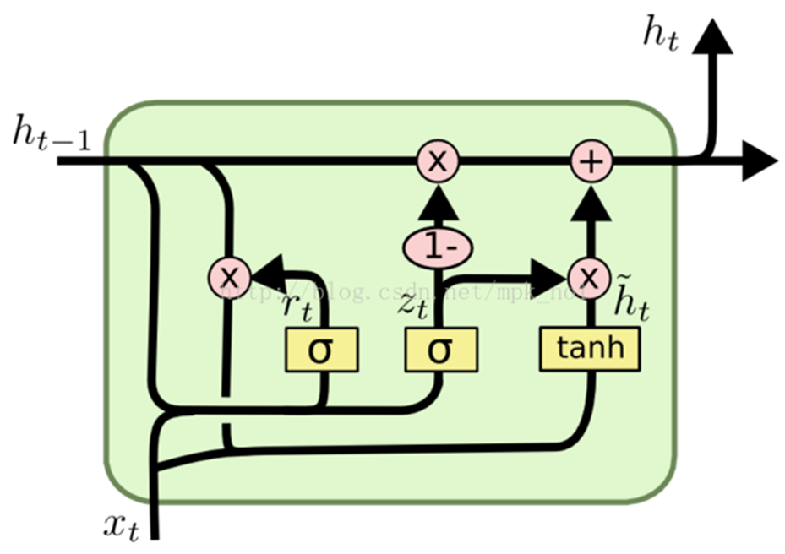
SimpleRNN
LSTM
LSTMs 也有類似的結構,但是它們不再只是用一個單一的 tanh 層，而是用了四個相互作用的層
所有迴圈神經網路結構都是由完全相同結構的（神經網路）模組進行複製而成的。
在普通的RNNs 中，這個模組結構非常簡單，比如僅是一個單一的 tanh 層
雙向LSTM(Bi-directional LSTM)

Slide 25
遞歸神經網絡
Recurrent
Neural Network
PRE-TRAINED MODEL

Slide 26
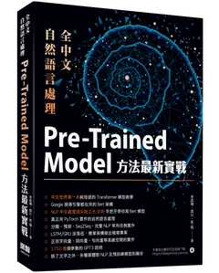
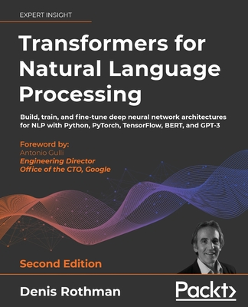

Slide 27
機器翻譯 Machine Translation
Transformer(2017)
BERT(2018)
XLNet(2019)
ELMO, BERT, GPT
https://www.youtube.com/watch?v=UYPa347-DdE

Slide 28
Seq2Seq(2014)

Slide 29
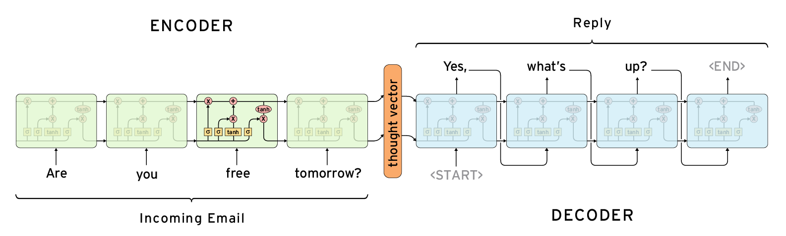
Sequence to Sequence 是由 Encoder 與 Decoder 兩個 RNN 構成
運作原理:當看到一段話時，會先將這句話理解吸收，再根據我們理解的內容說出回覆，Sequence to Sequence 就是在模擬這個過程。
https://zake7749.github.io/2017/09/28/Sequence-to-Sequence-tutorial/#Sequence_to_Sequence

Slide 30
Google Transformer(2017)
Attention Is All You Need
Ashish Vaswani, Noam Shazeer, Niki Parmar, Jakob Uszkoreit, Llion Jones, Aidan N. Gomez, Lukasz Kaiser, Illia Polosukhin
(Submitted on 12 Jun 2017 (v1), last revised 6 Dec 2017 (this version, v5))
The dominant sequence transduction models are based on complex recurrent or convolutional neural networks in an encoder-decoder configuration. The best performing models also connect the encoder and decoder through an attention mechanism.
We propose a new simple network architecture, the Transformer, based solely on attention mechanisms, dispensing with recurrence and convolutions entirely.
Experiments on two machine translation tasks show these models to be superior in quality while being more parallelizable and requiring significantly less time to train. Our model achieves 28.4 BLEU on the WMT 2014 English-to-German translation task, improving over the existing best results, including ensembles by over 2 BLEU. On the WMT 2014 English-to-French translation task, our model establishes a new single-model state-of-the-art BLEU score of 41.8 after training for 3.5 days on eight GPUs, a small fraction of the training costs of the best models from the literature. We show that the Transformer generalizes well to other tasks by applying it successfully to English constituency parsing both with large and limited training data.

Slide 31
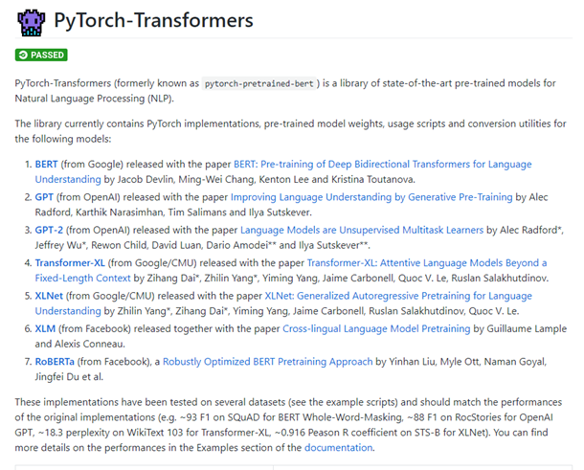
pytorch-transformers
https://github.com/huggingface/pytorch-transformers

Slide 32
pytorch-transformers
!pip install pytorch-transformers
import torch
from pytorch_transformers import *
MODELS = [ (BertModel, BertTokenizer, 'bert-base-uncased'),
(OpenAIGPTModel, OpenAIGPTTokenizer, 'openai-gpt'),
(GPT2Model, GPT2Tokenizer, 'gpt2'),
(TransfoXLModel, TransfoXLTokenizer, 'transfo-xl-wt103'),
(XLNetModel, XLNetTokenizer, 'xlnet-base-cased'),
(XLMModel, XLMTokenizer, 'xlm-mlm-enfr-1024'),
(RobertaModel, RobertaTokenizer, 'roberta-base')]
for model_class, tokenizer_class, pretrained_weights in MODELS:
print(model_class)

