Slide 1
IPE 300
Product Design Sessional I
A Presentation On
Convenient Bamboo Cutter
Presented By: Group-A24
Bristy Rani Sarker – 1908045
Md. Masud Rana – 1908046
An-Nur Taiweb Rahman – 1908047
Shovon Biswas – 1908048
Sumaya Tasnim Sweety – 1908049
Muhammad Shadab Sakib - 1908050

Slide 2
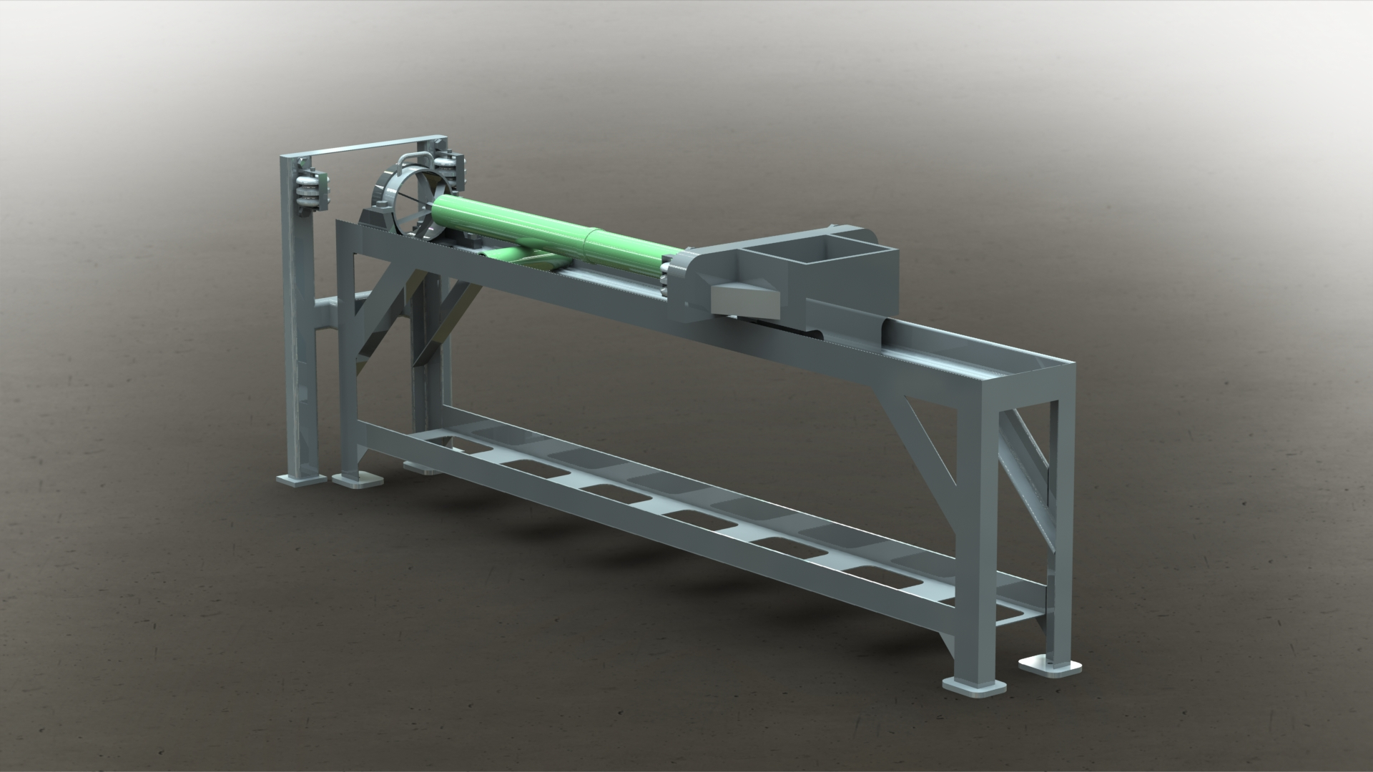
Convenient Bamboo Cutter

Slide 3
Proposed Ideas
Our Proposed Products:
  Coconut Cutting Machine
  Stairs Cleaning Machine
  Wheel Controlled Pesticide Sprayer
  Convenient Stair-Climbing Trolley
  One-Wheel Seed Planter
  Adjustable Umbrella Holder Backpack
  Convenient Bamboo Cutter
  Height Adjustable Table
Selected Product:
Convenient Bamboo Cutter

Slide 4
Features
Pulley Mechanism
Semi-Automatic
Versatile
Safety Features
High Production Rates

Slide 5
Causes for Selection
  Innovative Design:
    Semi-automated device with pulley mechanisms
    Ensures safety
    Reduces human effort, time, and cost
  High Production, Low Maintenance:
    Less force is required
    Reduction in time leads to high production rates
    Minimal maintenance cost due to availability of parts

Slide 6

Understanding Customer Needs

Slide 7
Customer Segmentation
Customer Selection
Artisans and Craftsmen
Bamboo Furniture Manufacturers
Construction Companies
Bamboo Handicraft Products
Agricultural and Farming Communities

Slide 8


Location of surveys
Kotchandpur Bazar, Jhenaidah, Bangladesh
Ibrahimpur Bazar, Nabinagar, Brahmanbaria
Harong, Chandina, Cumilla
Mollapara Bazar, Agailjhara, Barishal

Slide 9
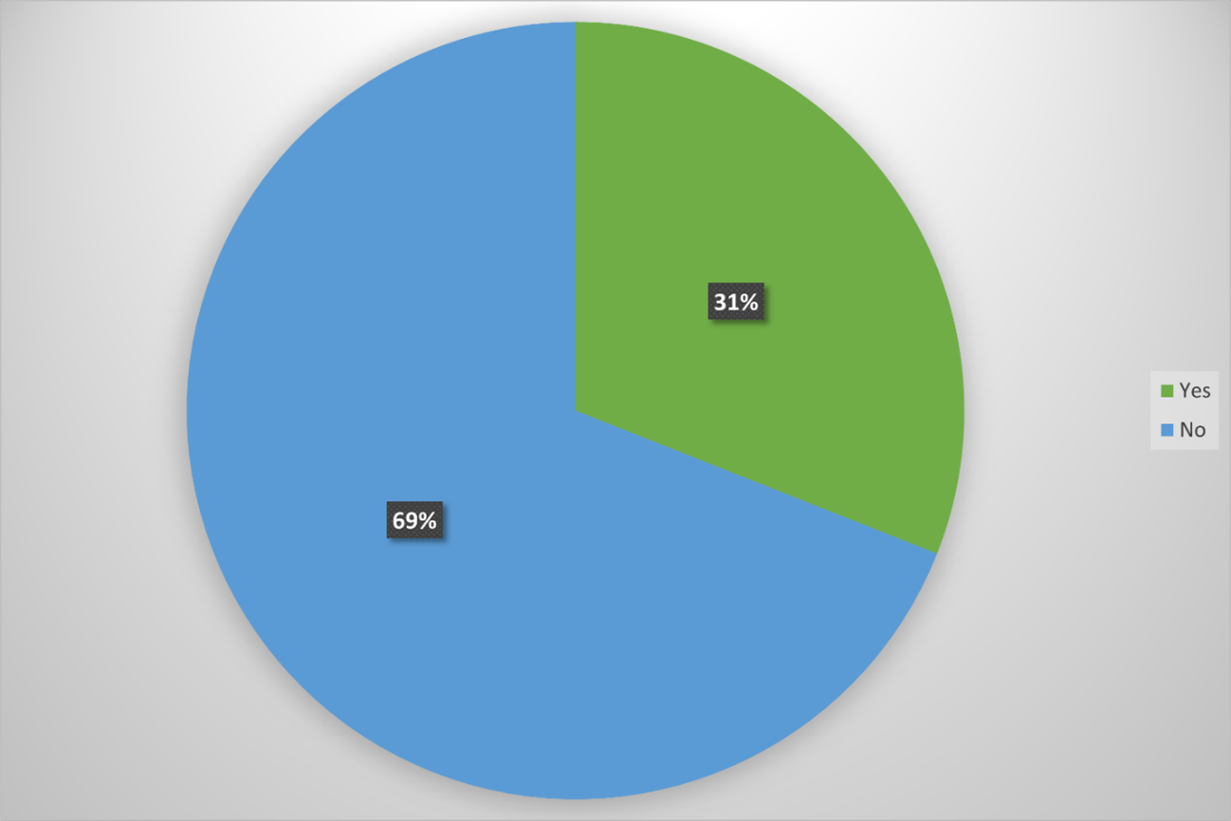
Are you aware of the benefits of using a bamboo cutting machine over traditional manual methods?
Yes
No
Option | Response Count | Response Percent (%)
Yes | 10 | 31
No | 22 | 69

Slide 10
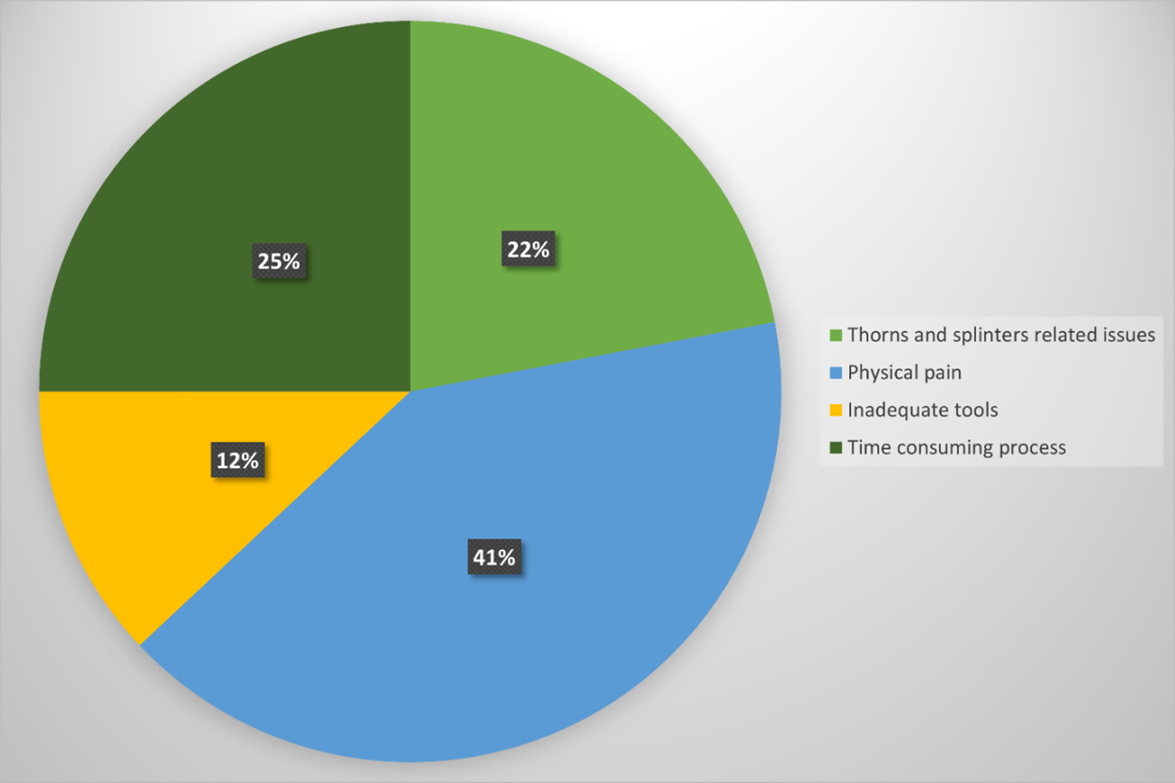
From the list below, what problem you have faced the most while cutting bamboo?
Thorns and splinters related issues.
Physical pain
Inadequate tools
Time consuming process
Option | Response Count | Response Percent (%)
Thorns and splinters related issues | 7 | 22
Physical pain | 13 | 41
Inadequate tools | 4 | 12
Time Consuming Process | 8 | 25

Slide 11
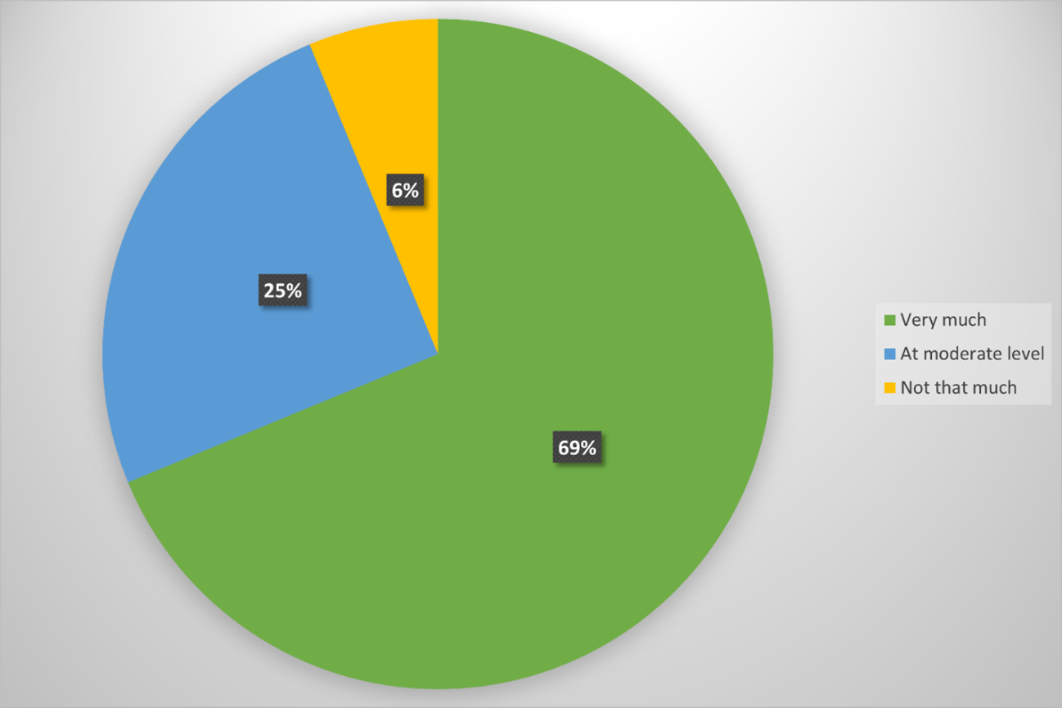
How important is the safety feature of a bamboo cutting machine to you?
Very much
At moderate level
Not that much
Option | Response Count | Response Percent (%)
Very much | 22 | 68.75
At moderate level | 8 | 25
Not that much | 2 | 6.25

Slide 12
Customer’s Requirement Evaluation
Customer Requirement | Relative Weight/ Importance (Scale of 10)
Easy to Move | 07
Safety Features | 09
Time Saving | 09
Precision and Accuracy | 07
Variety of Functions | 08
Low Cost | 10
Easy To Maintain/Repair | 08
Durability and Reliability | 07
Ramming Force | 09

Slide 13

Quality Function Deployment (QFD)

Slide 14
Voice of the Customer (VOC)
Discussion through interviews
Survey data
Focus groups
Opinions from experts
Educated Guess
Other means of market research

Slide 15
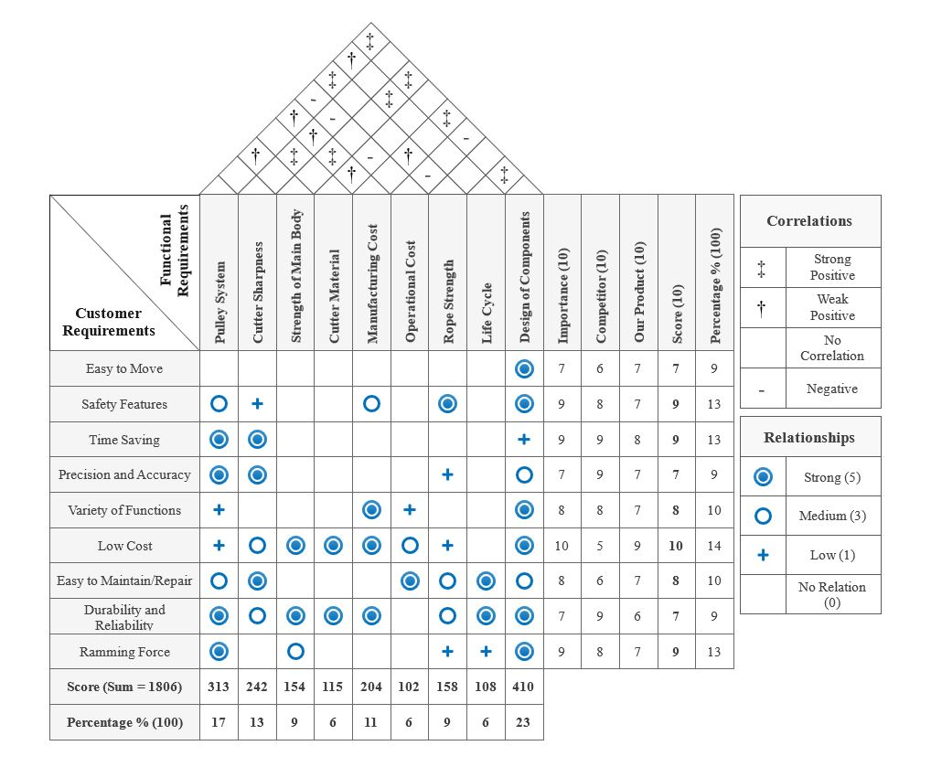
House of Quality
Sum= 74

Slide 16
Importance Rating Table
Rank | Functional Requirement | Importance Rating (%)
1 | Design of Components | 23
2 | Pulley System | 17
3 | Cutter Sharpness | 13
4 | Manufacturing Cost | 11
5 | Rope Strength | 9
6 | Strength of Main Body | 9
7 | Cutter Material | 6
8 | Life Cycle | 6
9 | Operational Cost | 6

Slide 17
Functional Decomposition

Slide 18
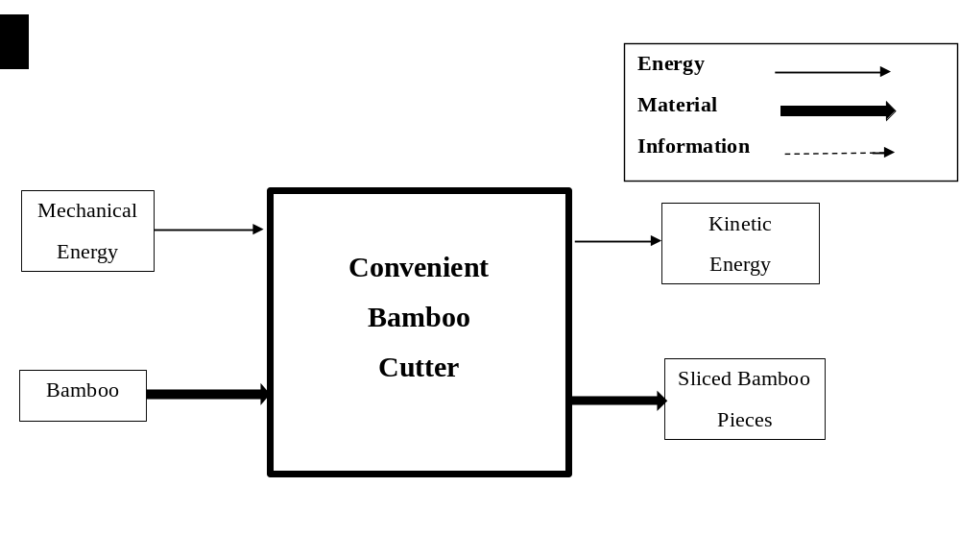
The Black Box Model

Slide 19
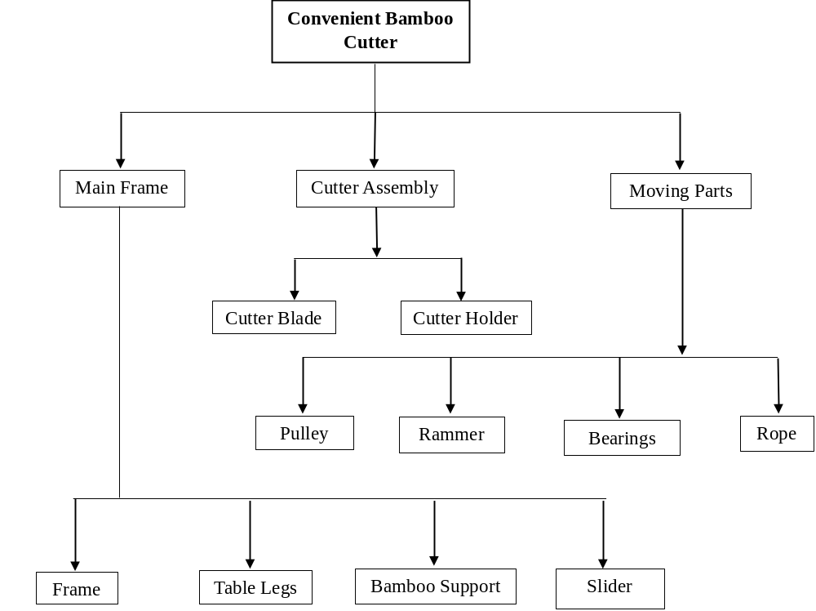
Component Hierarchy

Slide 20
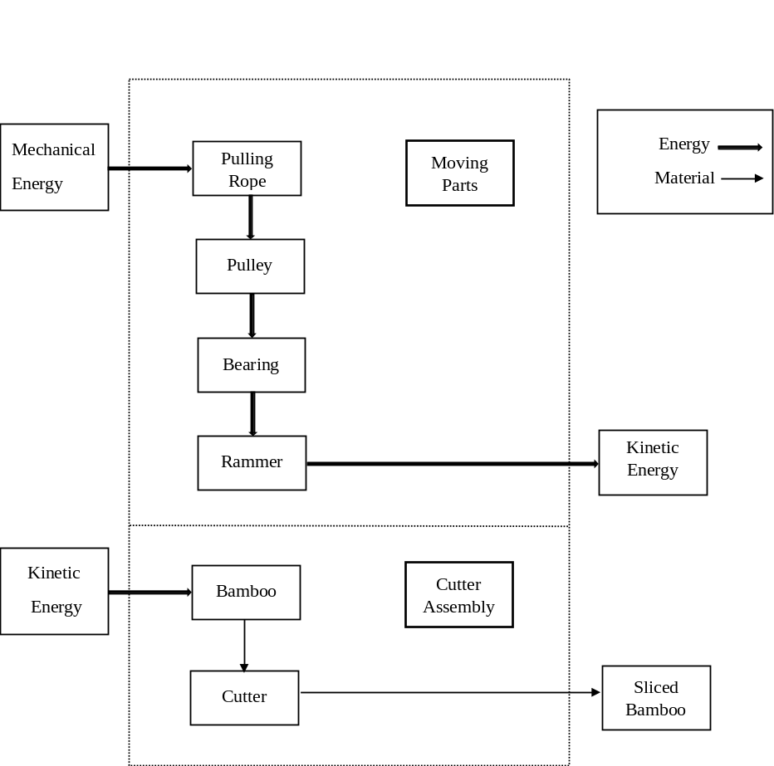
Cluster Function Structure

Slide 21
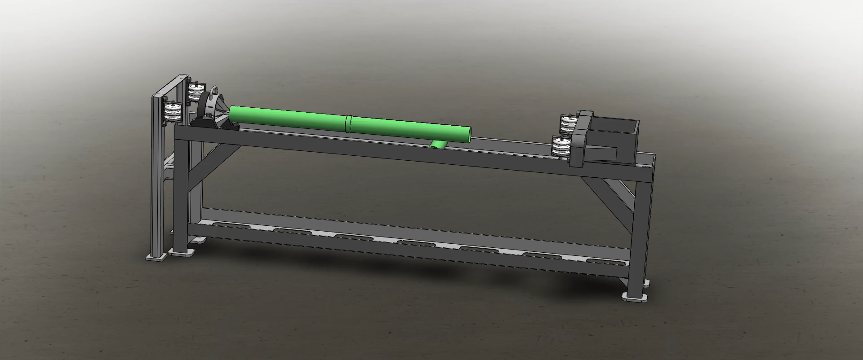
Motion Study

Slide 22
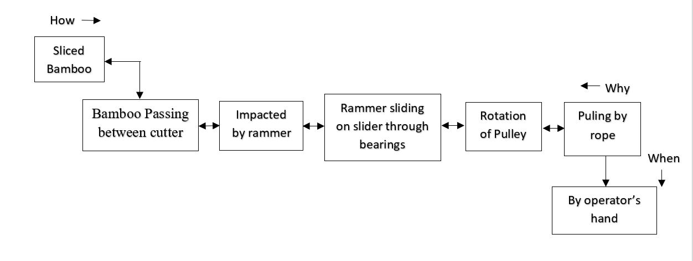
FAST Diagram

Slide 23

Qualitative Analysis

Slide 24
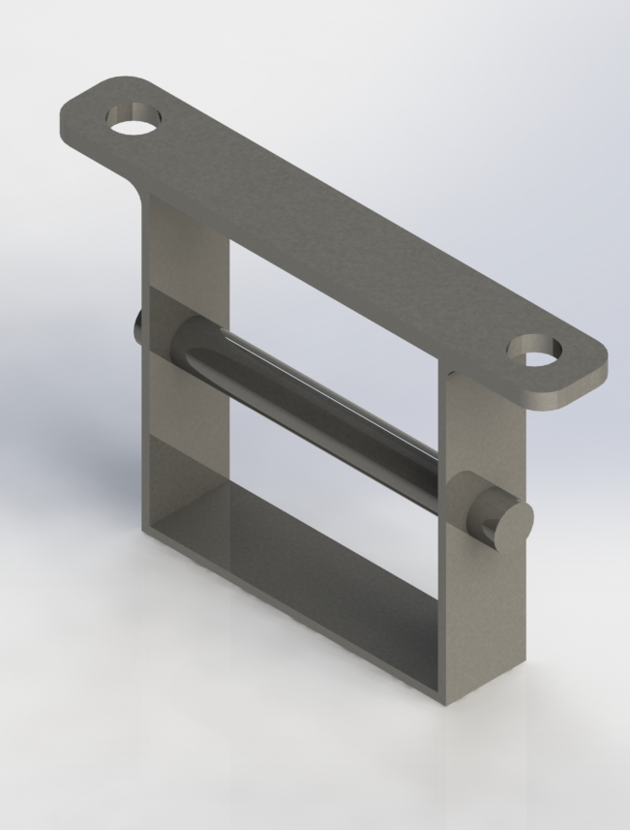
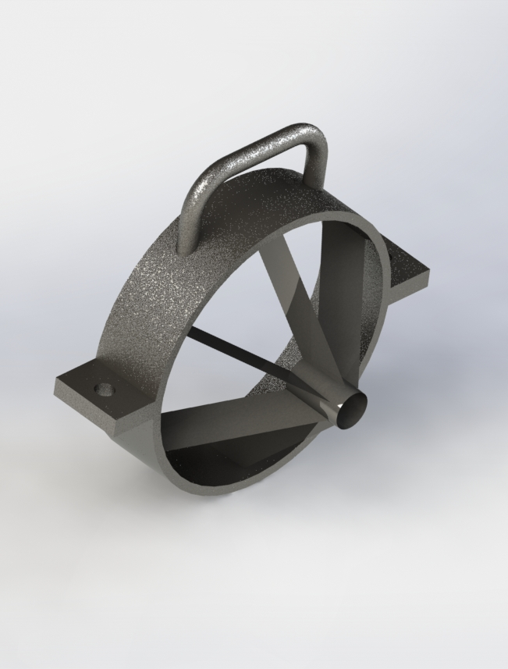
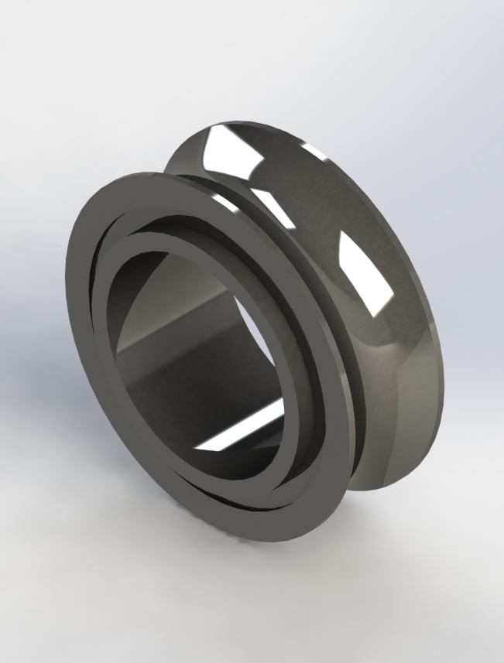
Design of Parts
Pulley Holder
Cutter
V-Groove Bearing

Slide 25
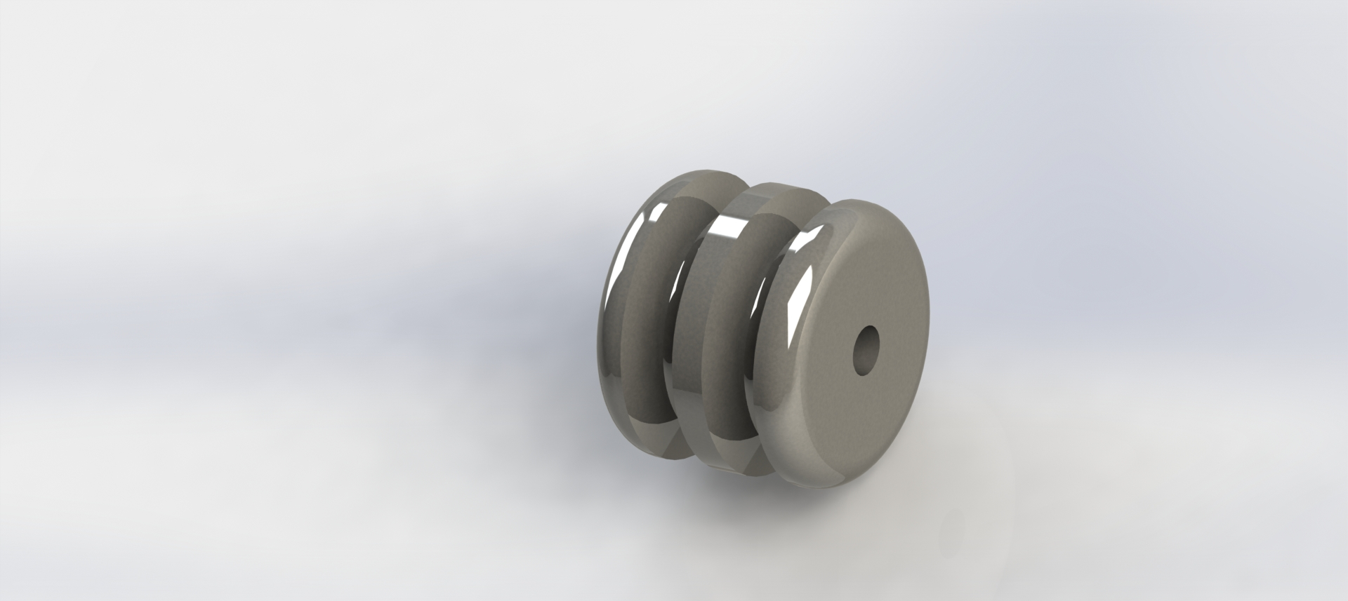
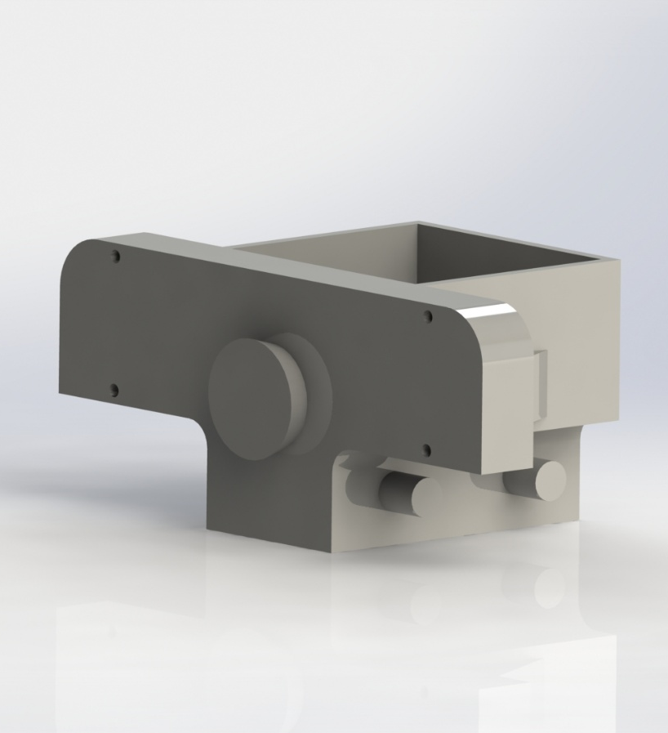
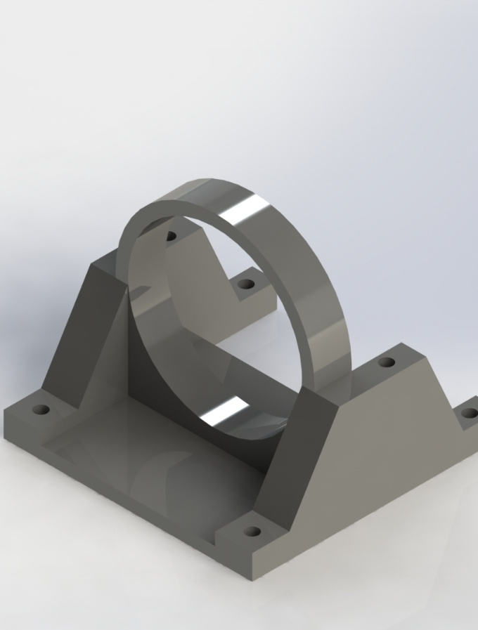
Design of Parts
Pulley
Rammer
Cutter Holder

Slide 26
Material Selection
Rammer
Steel + Concrete ✅
Cast Iron ❌
Rope
Nylon ✅
Polypropylene ❌
Pulley
Cast Iron ✅
Aluminium ❌
Cutter Holder
Cast Iron ✅
Steel ❌
Cutter Blade
High Speed Steel ✅
Carbide ❌
Frame
Mild Steel ✅
Aluminium ❌
Bamboo Support
Bamboo ✅
Steel ❌
Bamboo Storage
Wood ✅
Steel ❌
Supporting Feet
Rubber ✅
Leather ❌
Table Legs
Mild Steel ✅
Stainless Steel ❌
Bearings
Carbon Steel ✅
Stainless Steel ❌

Slide 27
Manufacturing & Joining Process Selection
Selected Joining Processes
Arc Welding
TIG Welding
Epoxy Adhesive
Nut-Bolt
Rivet
Slide
Selected Manufacturing Processes
Forging
Machining
Casting
Outsourcing

Slide 28
QUANTITATIVE ANALYSIS
The Digital Logic Method Approach

Slide 29
Material Selection for Frame
List of selection criteria with numerical values
Selection Criteria | Mild Steel | Aluminum Alloy | Stainless Steel
Strength (MPa) | 550 | 310 | 621
Density (kg/m^3) | 7680 | 2810 | 8000
Cost (BDT/ per kg) | 80 | 350 | 317
List of Selection criteria with Likert scale
Selection Criteria | Mild Steel | Aluminum Alloy | Stainless Steel
Corrosion Resistance | 2 | 4 | 5
Durability | 3 | 4 | 5
Availability | 5 | 3 | 3

Slide 30
Material Selection for Frame
Determination of relative importance of material selection criteria for Frame
Selection Criteria | Numbers of positive decision, n(n-1)/2=6(6-1)/2=15 |  |  |  |  |  |  |  |  |  |  |  |  |  |  | Positive Decisions | Relative Emphasis Coefficient, α
 | 1 | 2 | 3 | 4 | 5 | 6 | 7 | 8 | 9 | 10 | 11 | 12 | 13 | 14 | 15
Strength | 1 | 0 | 1 | 0 | 0 |  |  |  |  |  |  |  |  |  |  | 2 | 0.133
Density | 0 |  |  |  |  | 0 | 1 | 0 | 0 |  |  |  |  |  |  | 1 | 0.067
Cost |  | 1 |  |  |  | 1 |  |  |  | 1 | 0 | 1 |  |  |  | 4 | 0.267
Corrosion Resistance |  |  | 0 |  |  |  | 0 |  |  | 0 |  |  | 1 | 0 |  | 1 | 0.067
Durability |  |  |  | 1 |  |  |  | 1 |  |  | 1 |  | 0 |  | 0 | 3 | 0.2
Availability |  |  |  |  | 1 |  |  |  | 1 |  |  | 0 |  | 1 | 1 | 4 | 0.266
Total Numbers of Positive Decisions |  |  |  |  |  |  |  |  |  |  |  |  |  |  |  | 15 | Σα=1

Slide 31
Material Selection for Frame
Calculation of the performance index for material selection of Frame
Selection Criteria | Relative Emphasis Coefficient α | Mild Steel |  | Aluminum Alloy |  | Stainless Steel
 |  | Scaled property β | Weighted score αβ | Scaled property β | Weighted score αβ | Scaled property β | Weighted score αβ
Strength | 0.133 | 88.57 | 11.78 | 49.92 | 6.64 | 100 | 13.3
Density | 0.067 | 36.59 | 2.45 | 100 | 6.7 | 35.13 | 2.35
Cost | 0.267 | 100 | 26.7 | 22.86 | 6.1 | 25.24 | 6.74
Corrosion Resistance | 0.067 | 40 | 2.68 | 80 | 5.36 | 100 | 6.7
Durability | 0.2 | 60 | 12 | 80 | 16 | 100 | 20
Availability | 0.266 | 100 | 26.6 | 60 | 15.96 | 60 | 15.96
Material Performance Index |  |  | 82.21 |  | 56.76 |  | 65.05

Slide 32
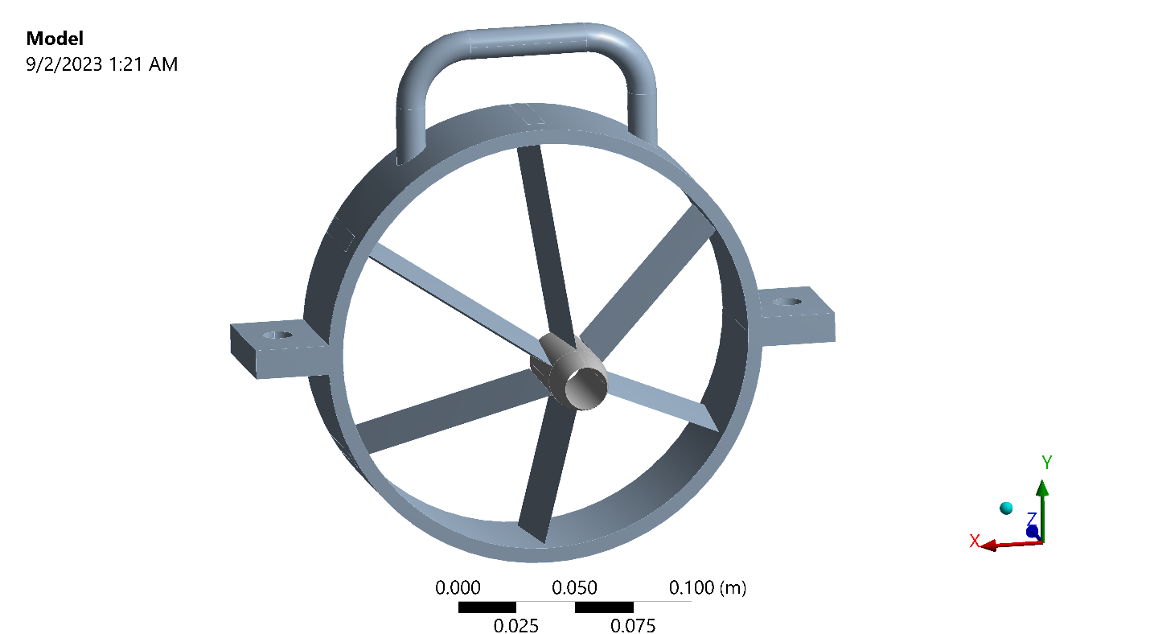
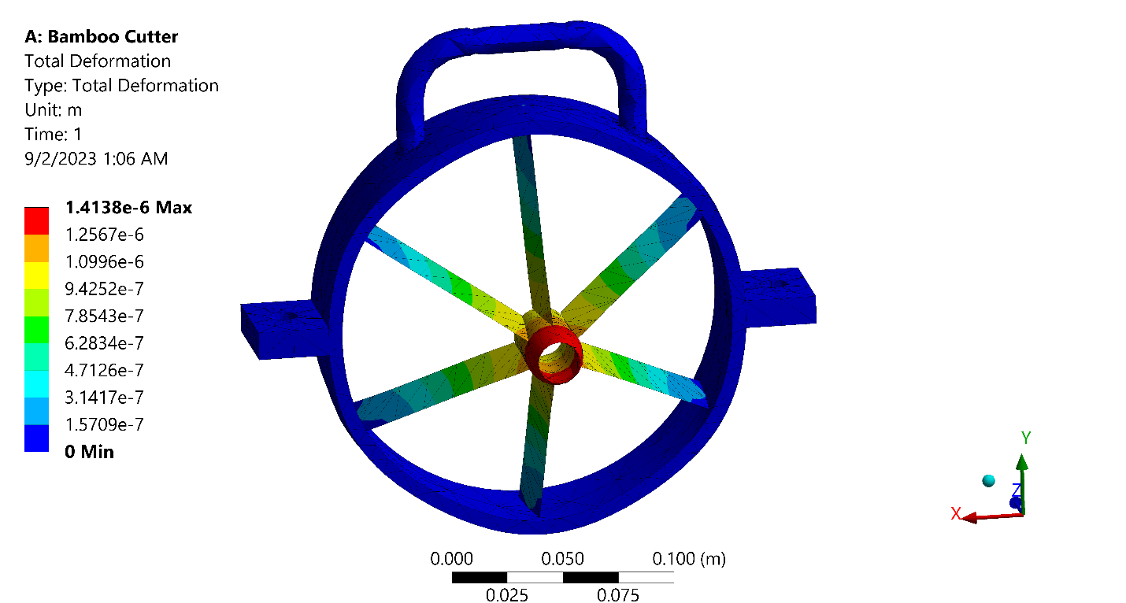
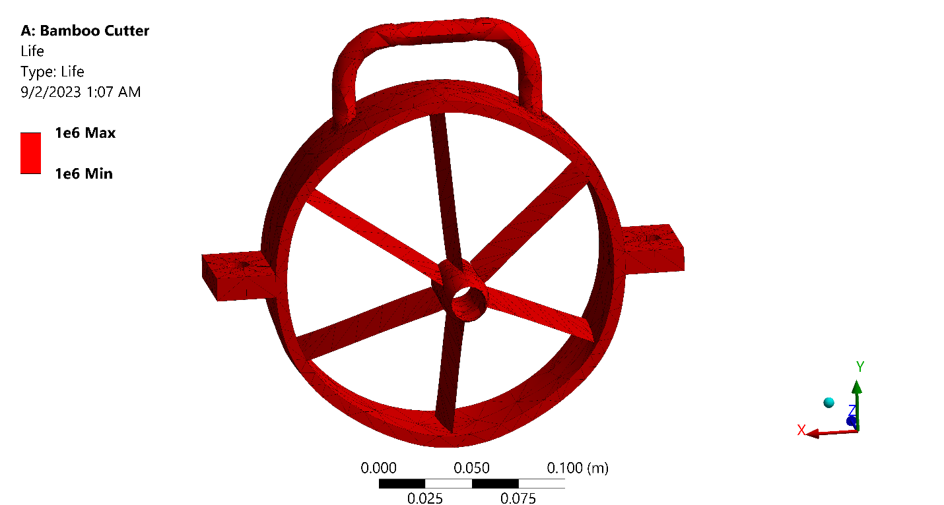
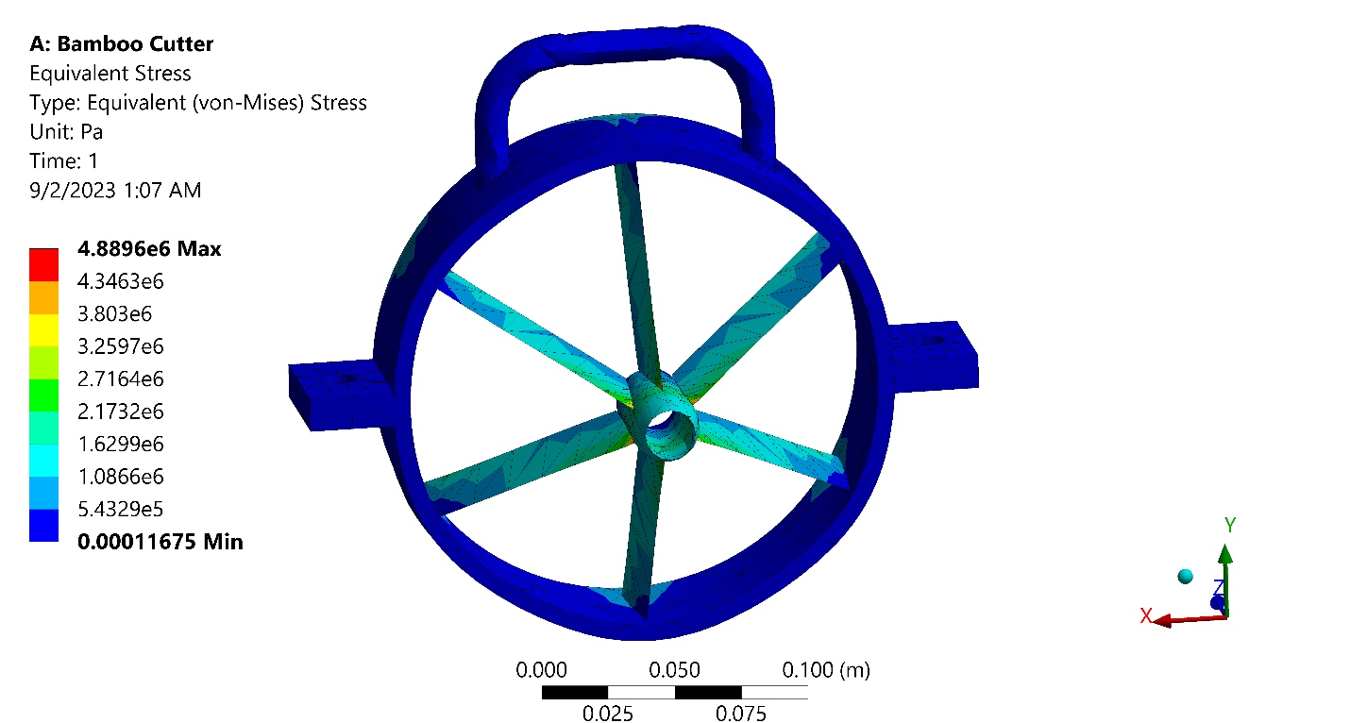
Static Structural Analysis of Cutter
Condition and Result of Analysis
Force | Maximum | 500 N
Total Deformation | Maximum | 0.0014138mm
 | Minimum | 0
Equivalent Stress | Maximum | 4.8896 MPa
 | Minimum | 1.1675e-10 MPa
Safety Factor | Maximum | 15
 | Minimum | 15
Fatigue Life | Maximum | 1e6
 | Minimum | 1e6
Equivalent Alternating Stress | Maximum | 2.4448 MPa
 | Minimum | 5.8375e-11MPa

Slide 33
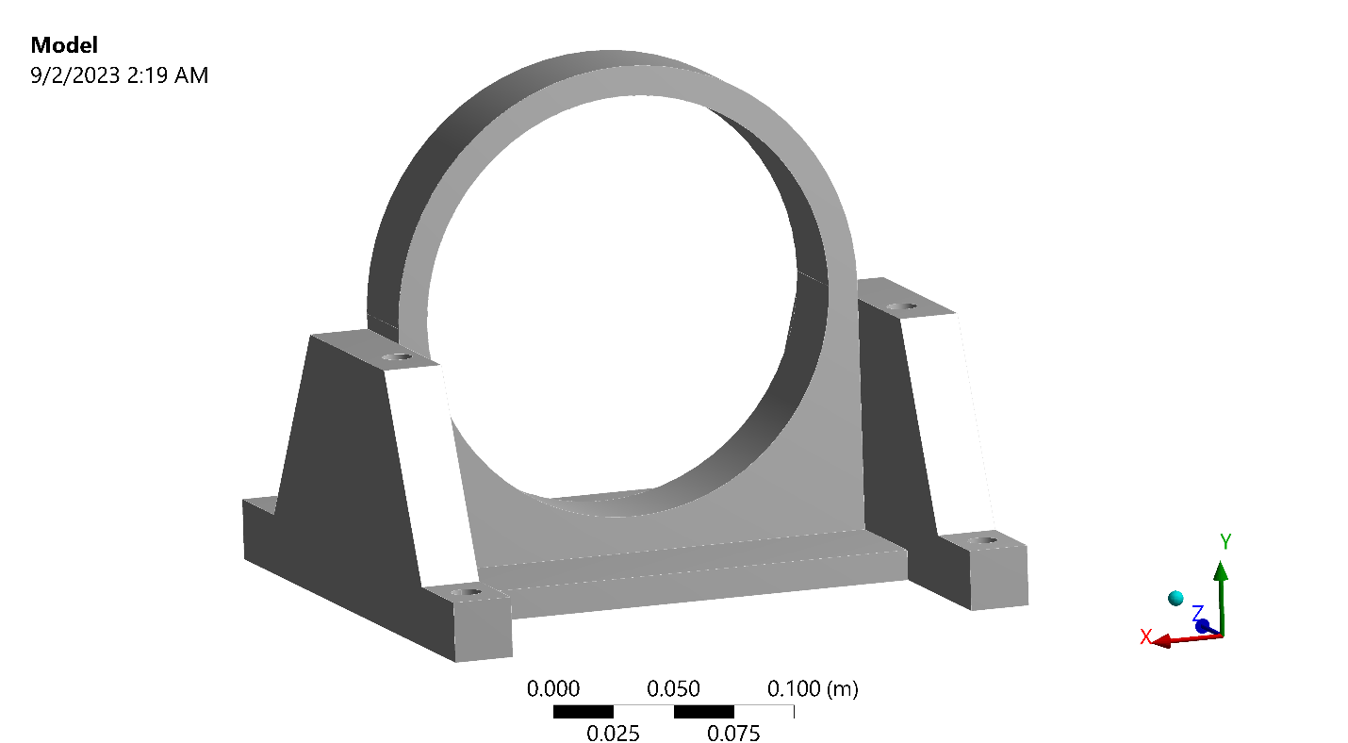
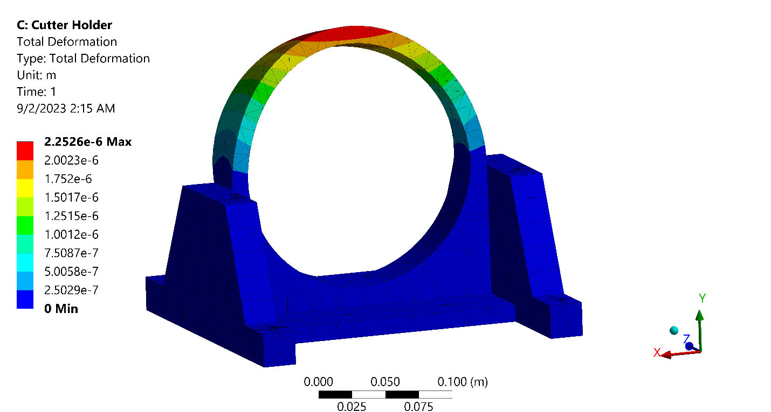
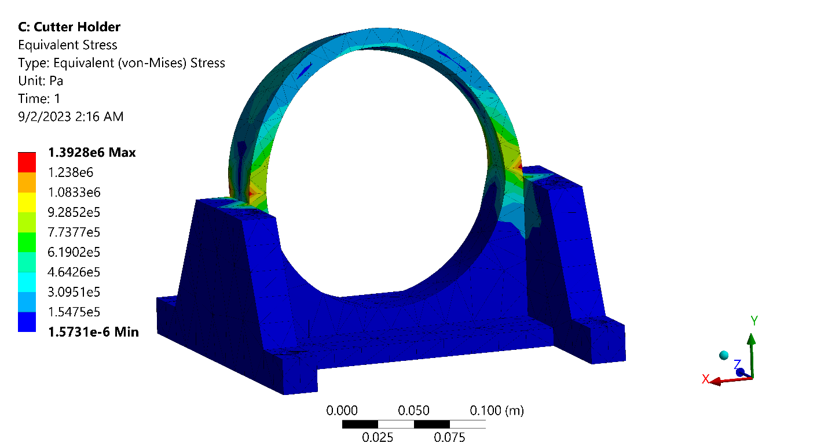
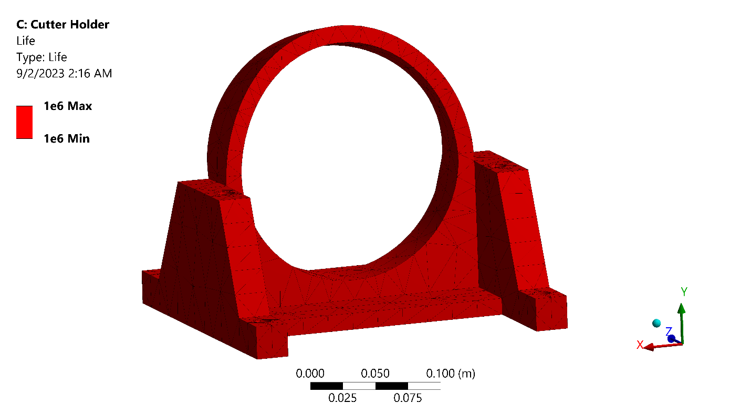
Static Structural Analysis of Cutter Holder
Condition and Result of Analysis
Force | Maximum | 500 N
Total Deformation | Maximum | 0.0014138mm
 | Minimum | 0
Equivalent Stress | Maximum | 1.3928 MPa
 | Minimum | 1.5731e-12 MPa
Safety Factor | Maximum | 15
 | Minimum | 15
Fatigue Life | Maximum | 1e6
 | Minimum | 1e6
Equivalent Alternating Stress | Maximum | 0.69639 MPa
 | Minimum | 7.865e-13 MPa

Slide 34
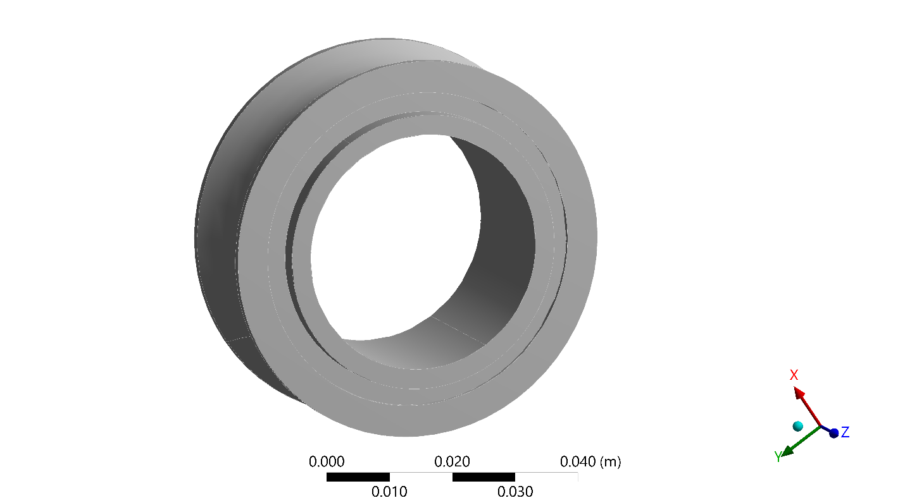
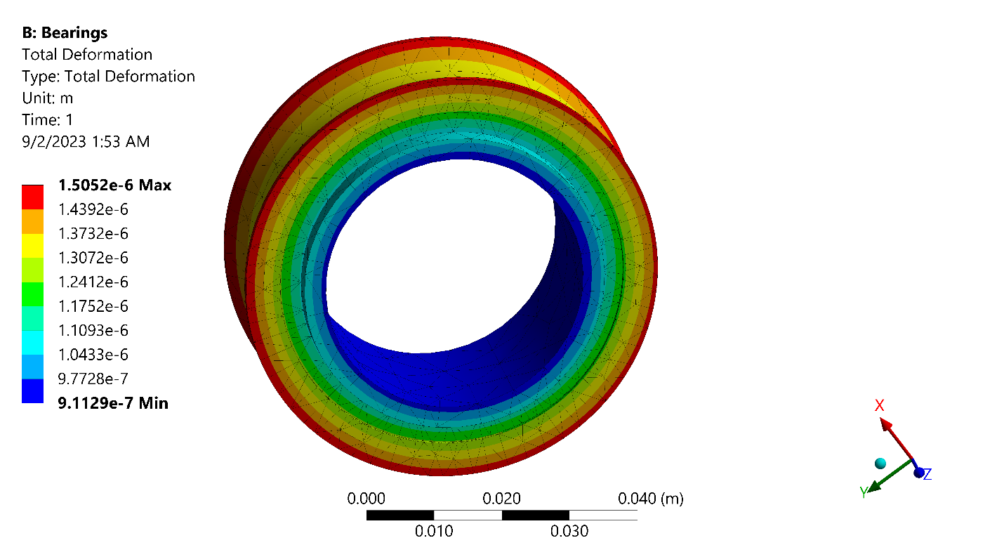
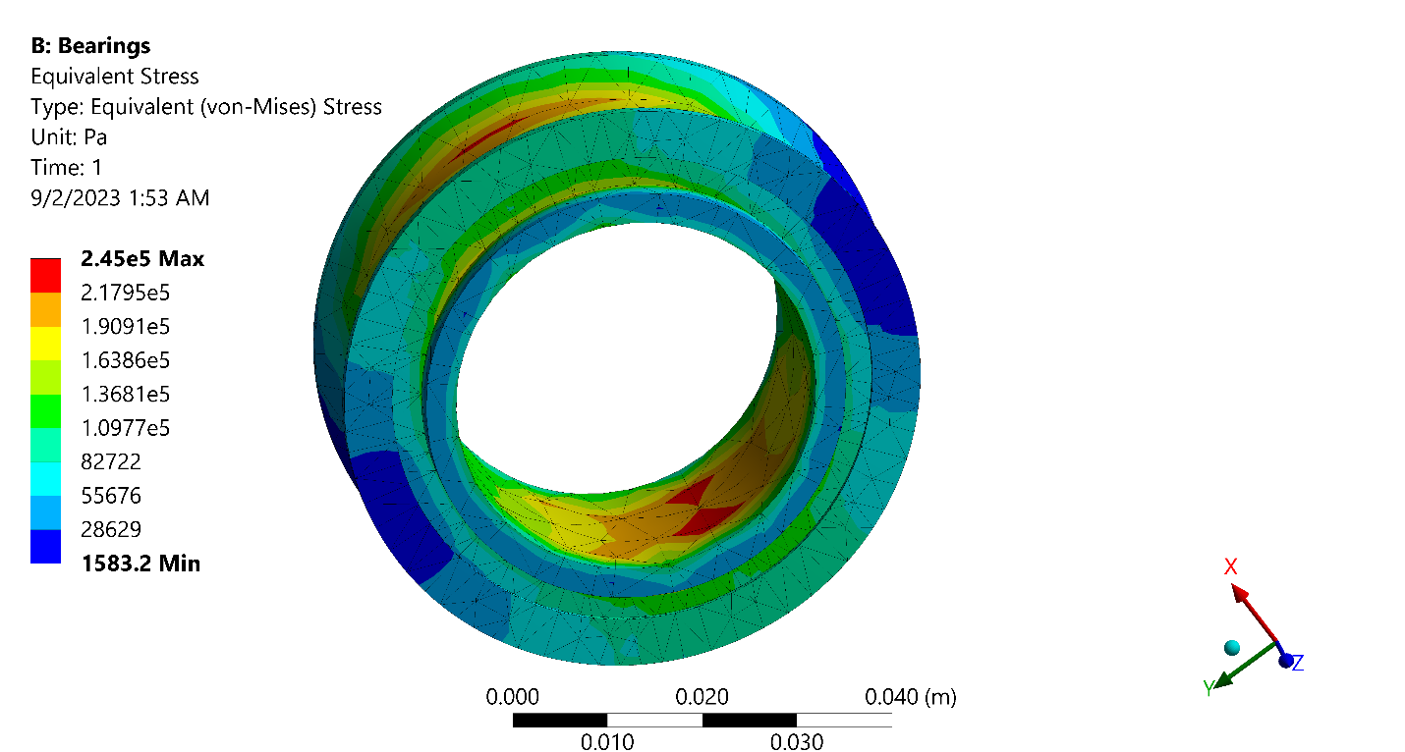
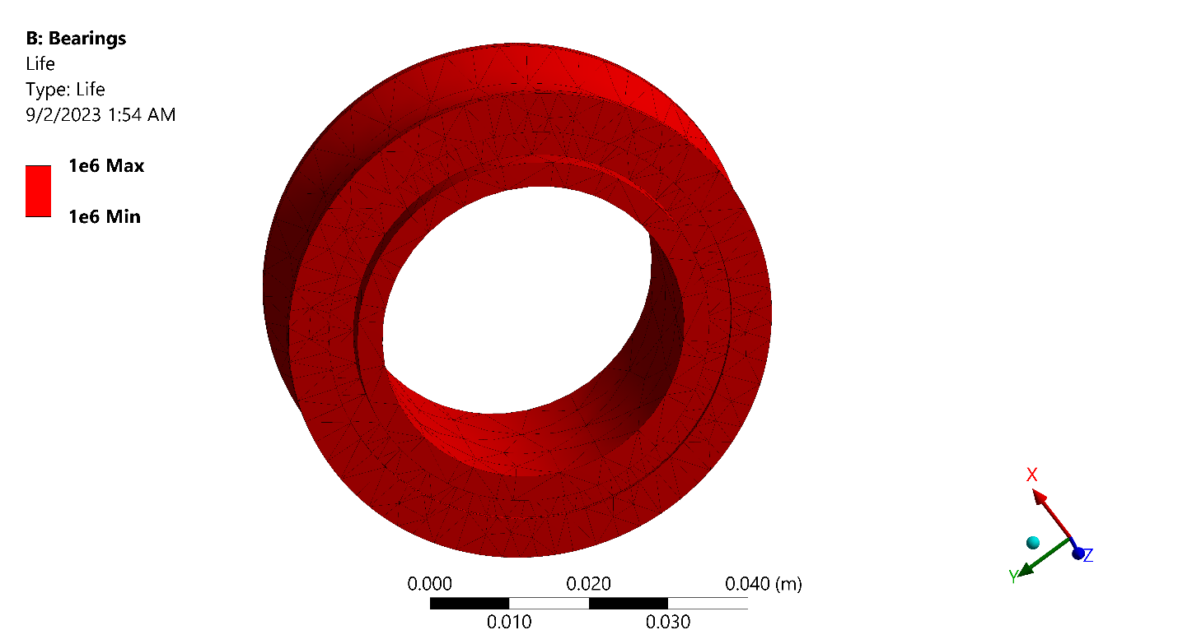
Static Structural Analysis of Bearings
Condition and Result of Analysis
Force | Maximum | 200 N
Total Deformation | Maximum | 0.0015052 mm
 | Minimum | 0.00091129mm
Equivalent Stress | Maximum | 0.245 MPa
 | Minimum | 0.0015832 MPa
Safety Factor | Maximum | 15
 | Minimum | 15
Fatigue Life | Maximum | 1e6
 | Minimum | 1e6
Equivalent Alternating Stress | Maximum | 0.1225 Ma
 | Minimum | 7.9158e-4 MPa

Slide 35
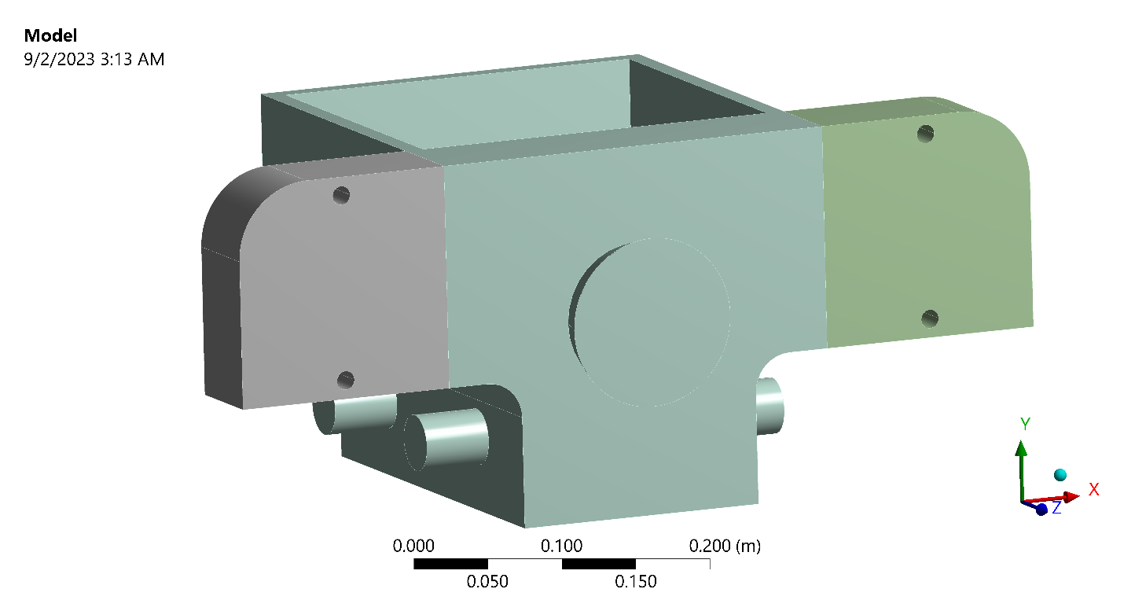
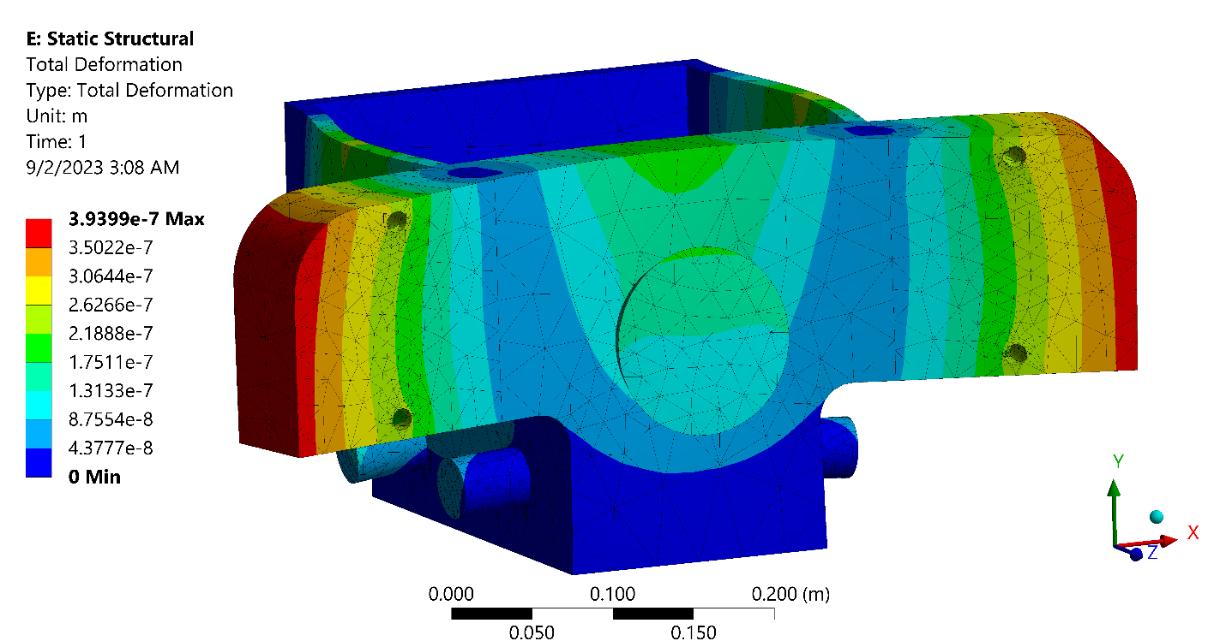
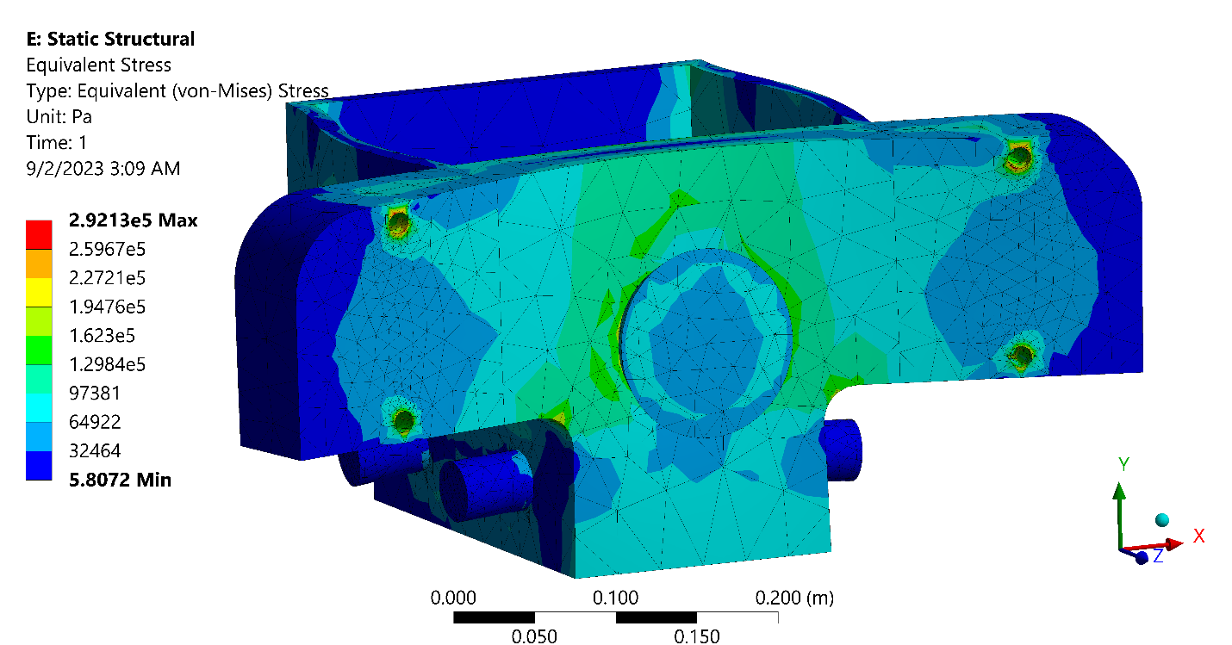
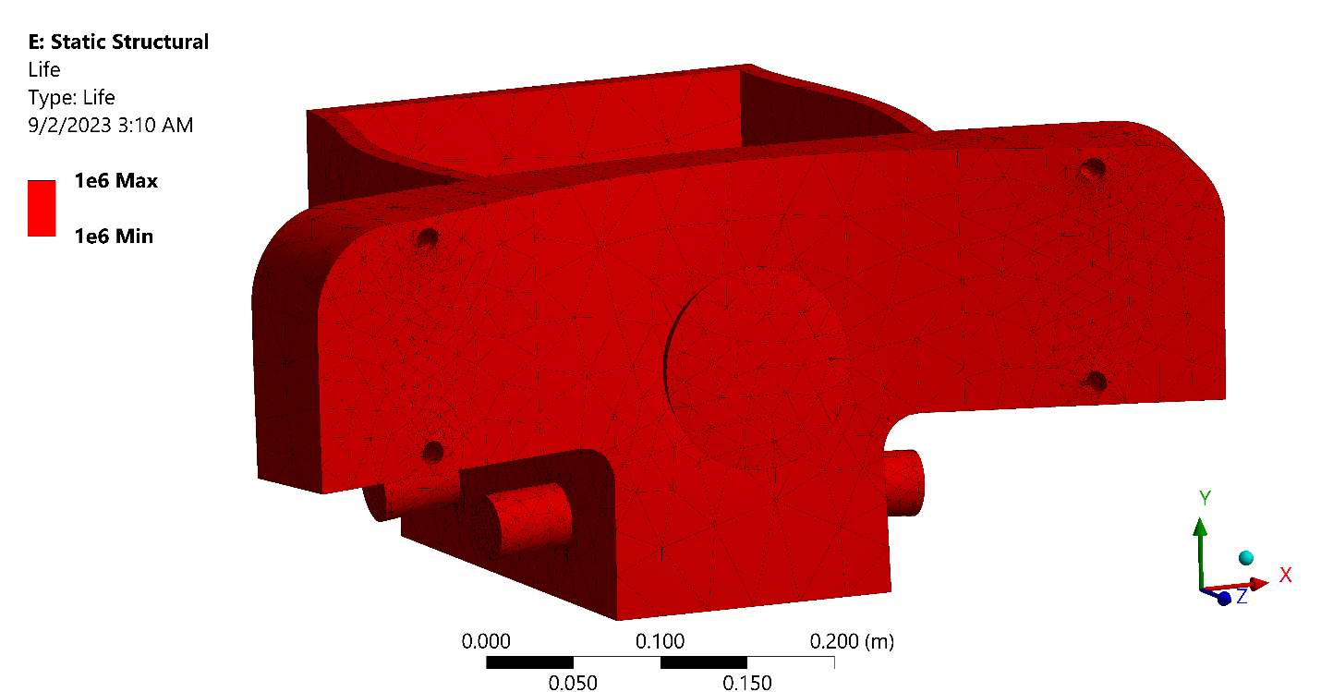
Static Structural Analysis of Rammer
Condition and Result of Analysis
Force | Maximum | 1000 N
Total Deformation | Maximum | 0.00039399mm
 | Minimum | 0
Equivalent Stress | Maximum | 0.29213 MPa
 | Minimum | 5.807e-6 MPa
Safety Factor | Maximum | 15
 | Minimum | 15
Fatigue Life | Maximum | 1e6
 | Minimum | 1e6
Equivalent Alternating Stress | Maximum | 0.14607 MPa
 | Minimum | 2.9036e-6 MPa

Slide 36
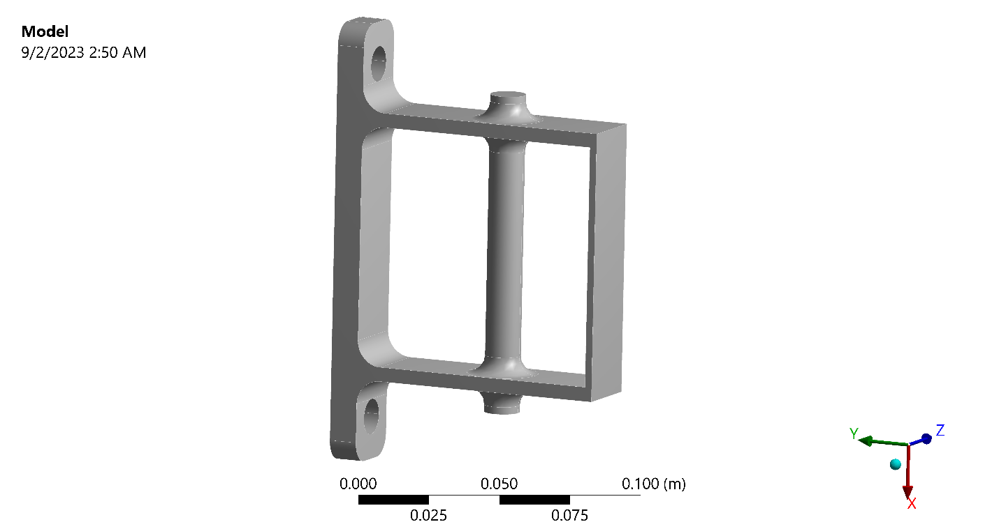
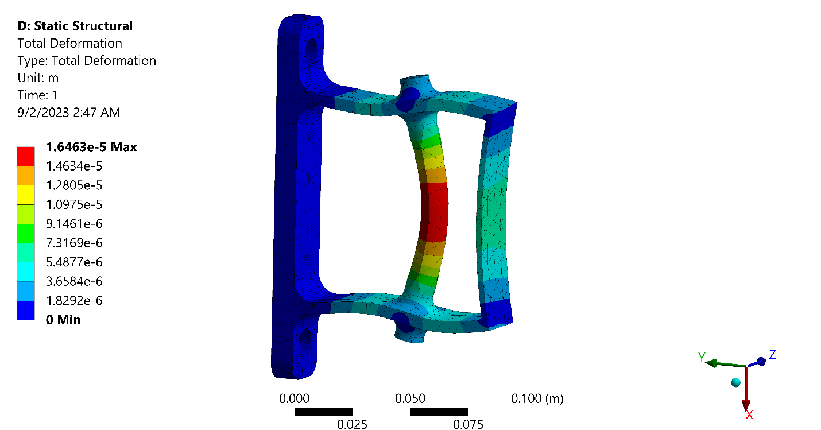
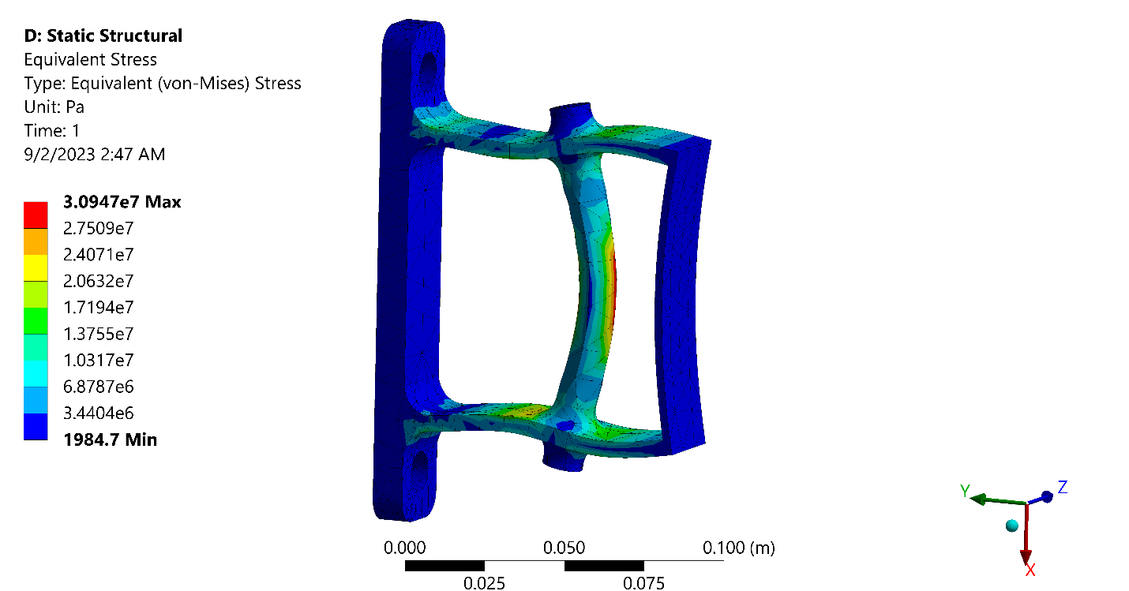
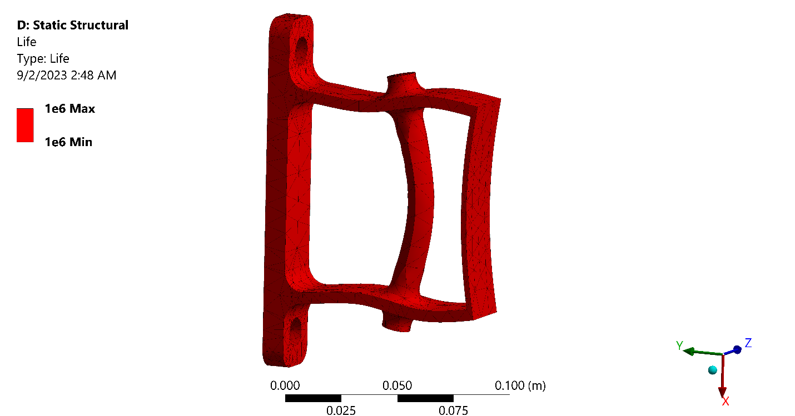
Static Structural Analysis of Pulley Holder
Condition and Result of Analysis
Force | Maximum | 1000 N
Total Deformation | Maximum | 0.01646 mm
 | Minimum | 0
Equivalent Stress | Maximum | 30.947 MPa
 | Minimum | 0.001984
Safety Factor | Maximum | 15
 | Minimum | 5.5708
Fatigue Life | Maximum | 1e6
 | Minimum | 1e6
Equivalent Alternating Stress | Maximum | 15.474 MPa
 | Minimum | 9.923e-4 MPa

Slide 37
Cost Analysis
Machinery Cost | 2,69,560/-
Raw Materials Cost | 23,37,000/-
Outsourcing Parts Cost | 5,47,500/-
Labor Cost | 14,76,000/-
Manufacturing overhead Cost | 20,40,000/-
Annual Manufacturing Cost | 64,00,500/-
Total Administrative Cost | 19,02,000/-
Total Selling and Marketing Cost | 4,20,000/-
Annual Non-Manufacturing Cost | 23,22,000/-

Slide 38
Cost Analysis
Bank Loan of 1,00,00,000 & 15% interest rate with repayment of 20 years Early Repayment 15,97,615/-
Total Manufacturing Cost | 64,00,500/-
Total Non-manufacturing Cost | 23,22,000/-
Total Bank Loan Repayment | 15,97,615/-
Annual Expenses | 1,03,20,115/-
Selling Price per Unit | 20,000/-
Variable Cost per Unit | 14,535/-
Profit per Unit | 5,465/-

Slide 39
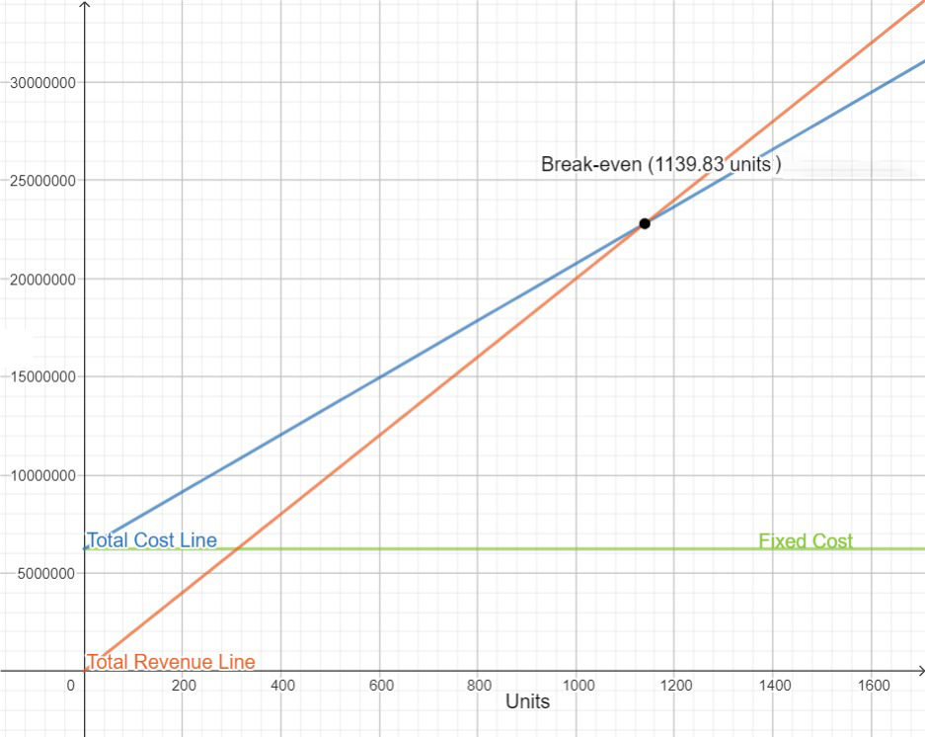
Break-Even Analysis
Cost & Revenue

Slide 40
Sensitivity Analysis
Sensitivity of | % Increase | Initial Q_{BEP} | Final Q_{BEP} | % ΔQ_{BEP}
Direct Material Cost | 10 % | 1,140 | 1,384 | 21.4%
Direct Labor Cost | 10 % | 1,140 | 1,253 | 9.9%
Manufacturing Overhead | 10% | 1,140 | 1,178 | 3.3%
Administrative Cost | 10 % | 1,140 | 1,175 | 3.07%
Sales and Marketing Expense | 10 % | 1,140 | 1,148 | 0.7%

Slide 41






Our Team
Bristy Rani Sarker
An-Nur Taiweb Rahman
Sumaya Tasnim Sweety
Md. Masud Rana
Shovon Biswas
Md. Shadab Sakib
1908045
1908047
1908049
1908046
1908048
1908050

Slide 42
Thank You

