Slide 1
IPE 300
Industrial Practice
A presentation on
Industrial Attachment at Knit Asia Ltd
Presented To
Dr. Nikhil Ranjan Dhar
Professor, Department of IPE, BUET
Rashik Ahnaf
Lecturer, Department of IPE, BUET
Md. Tariqul Islam
DGM, HR, Knit Asia Ltd.
Presented By
1908021 - Abrar Hamim Masih
1908029 - Narayon Dey Noyon
1908047 - An-Nur Taiweb Rahman
1908050 - Muhammad Shadab Sakib

Slide 2
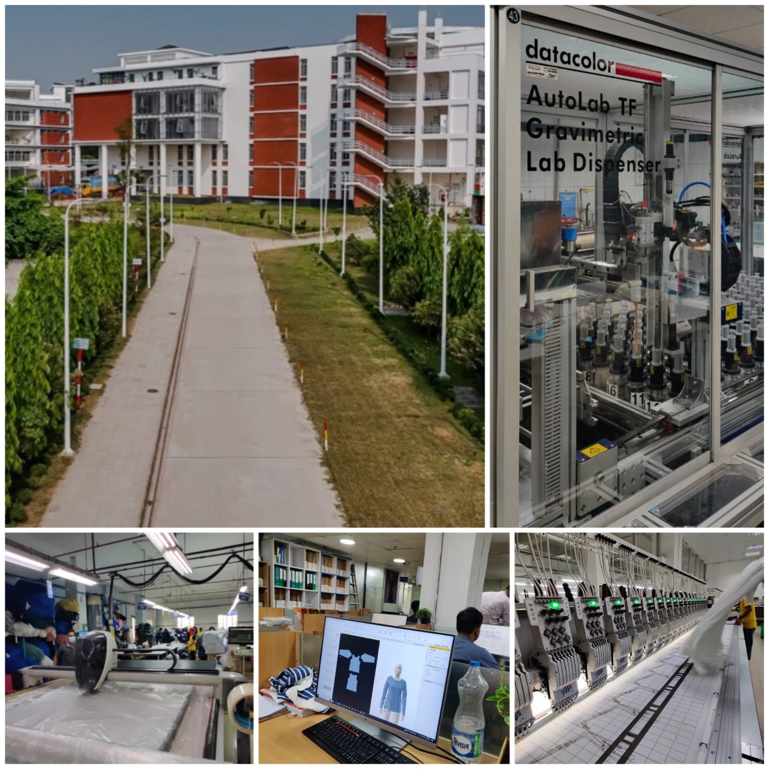
Knit Asia Ltd
Founded in 1999, leading garment manufacturer in Bangladesh.
LEED-certified green factory, uses 50% solar power.
Supplies brands like Zara, Decathlon, and American Eagle; 200,000 garments/day.
Certified by WRAP, OEKO-TEX, and GOTS for sustainability.
Uses advanced 3D design tools like CLO and Optitex.

Slide 3
Departmental Overview: Knit Asia Ltd.
Administration
Manages office logistics and supplies.
Coordinates communication and workflow between departments.
Implements and oversees company policies.
Organizes meetings and internal events.
Maintains office infrastructure and equipment.

Slide 4
Departmental Overview: Knit Asia Ltd.
Human Resource and Compliance
Maintains and updates employee records and databases.
Ensures adherence to labor laws and regulations.
Manages employee wages, benefits, and compensation.
Facilitates training and development programs.
Handles employee grievances and disciplinary actions.

Slide 5
Departmental Overview: Knit Asia Ltd.
Marketing and Merchandising
Liaises with buyers and clients to showcase company capabilities and products.
Develops and implements pricing strategies.
Manages sample testing and product quality assessments.
Negotiates and finalizes order agreements.
Develops marketing materials and promotional strategies.

Slide 6
Production Process Flowchart: Knit Asia Ltd.
Spinning
Knitting
Dyeing
Cutting
Sewing
Finishing
Packaging

Slide 7

Key insights from workers survey

Slide 8


Positive & Negative Aspects
Familiar with the emergency evacuation procedures
POSITIVES
Experience health issues, such as: back pain, neck pain due to prolonged sitting
Management address the safety concerns of the workers
NEGATIVES
Reluctant to use safety equipment
Machines and different tools are well-maintained

Slide 9
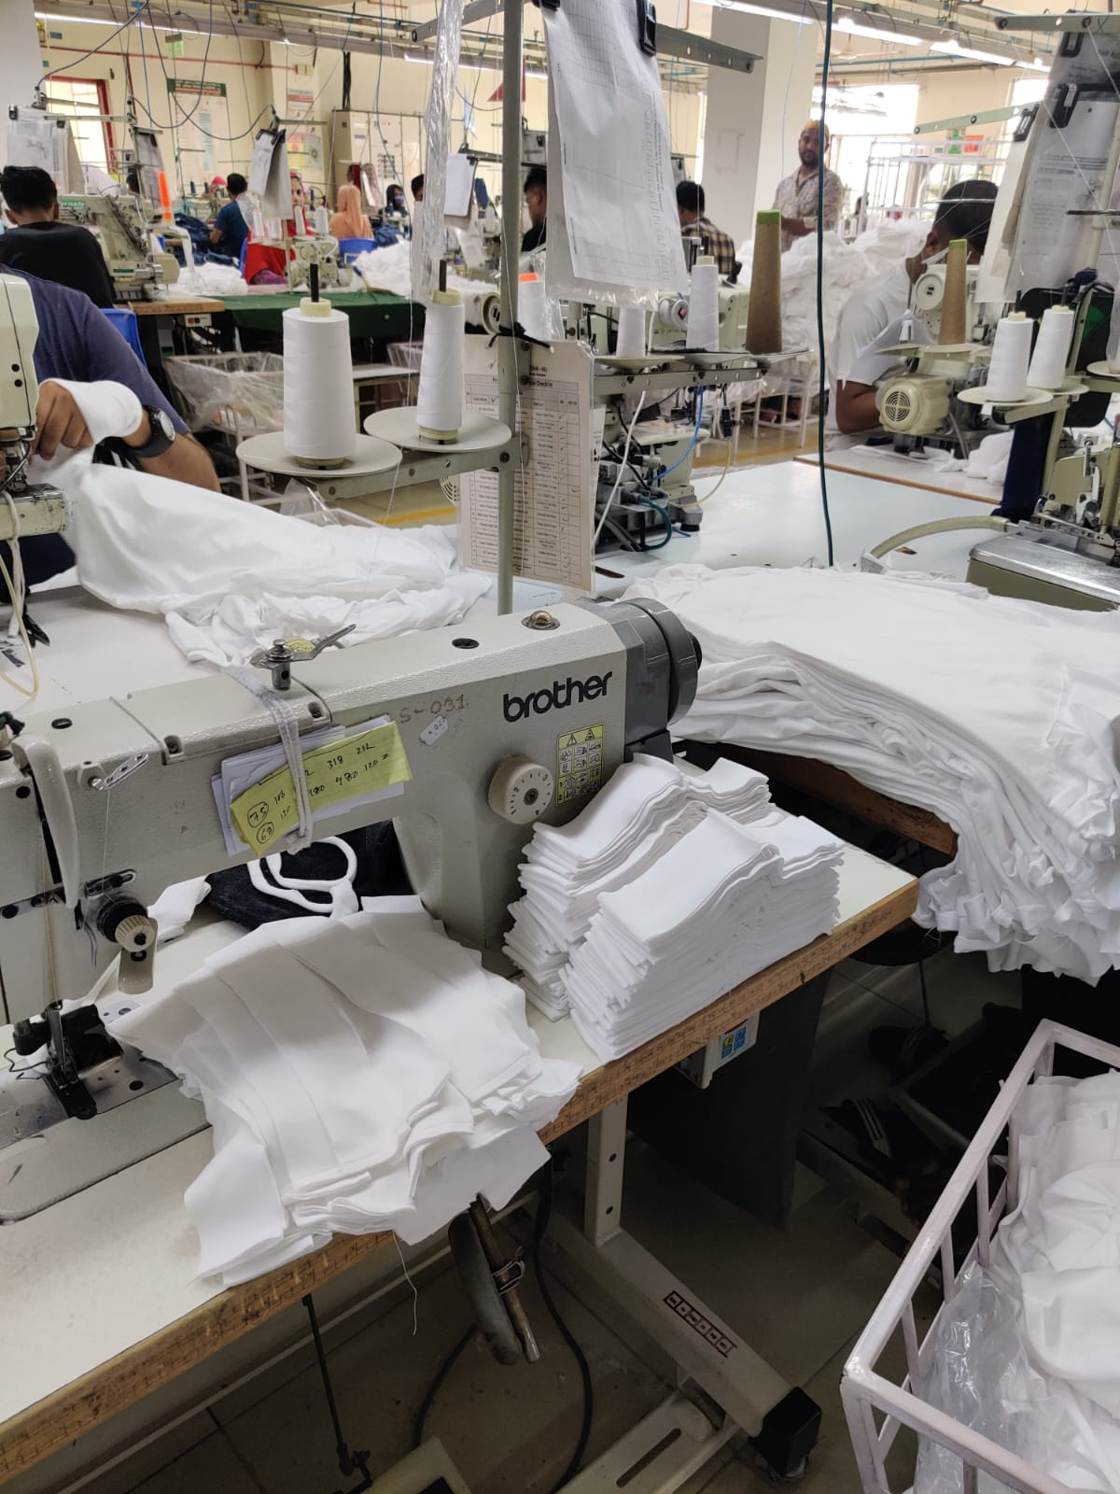
manpower utilization and removing bottleneck in a sewing line

Slide 10
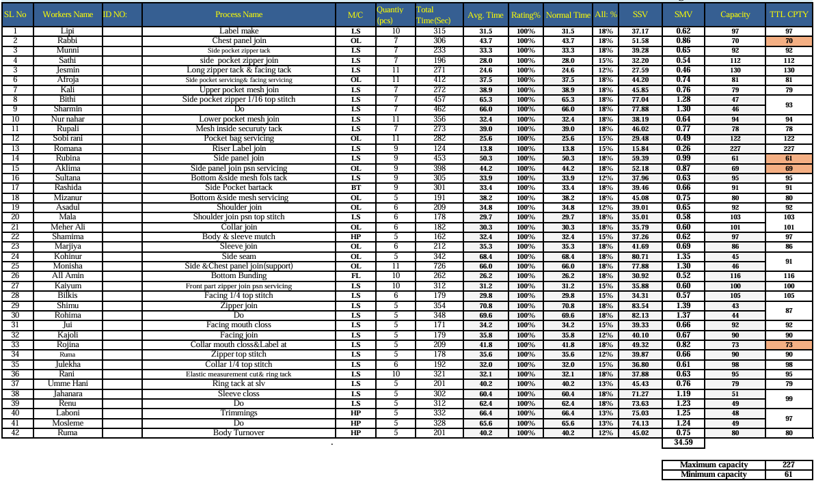
Time study
Table. Unbalanced time study sheet
Average cycle time was calculated per operation
Normal time = Avg. cycle time * rating
SMV = Normal time + Normal time * Allowance
Capacity = 60/SMV

Slide 11
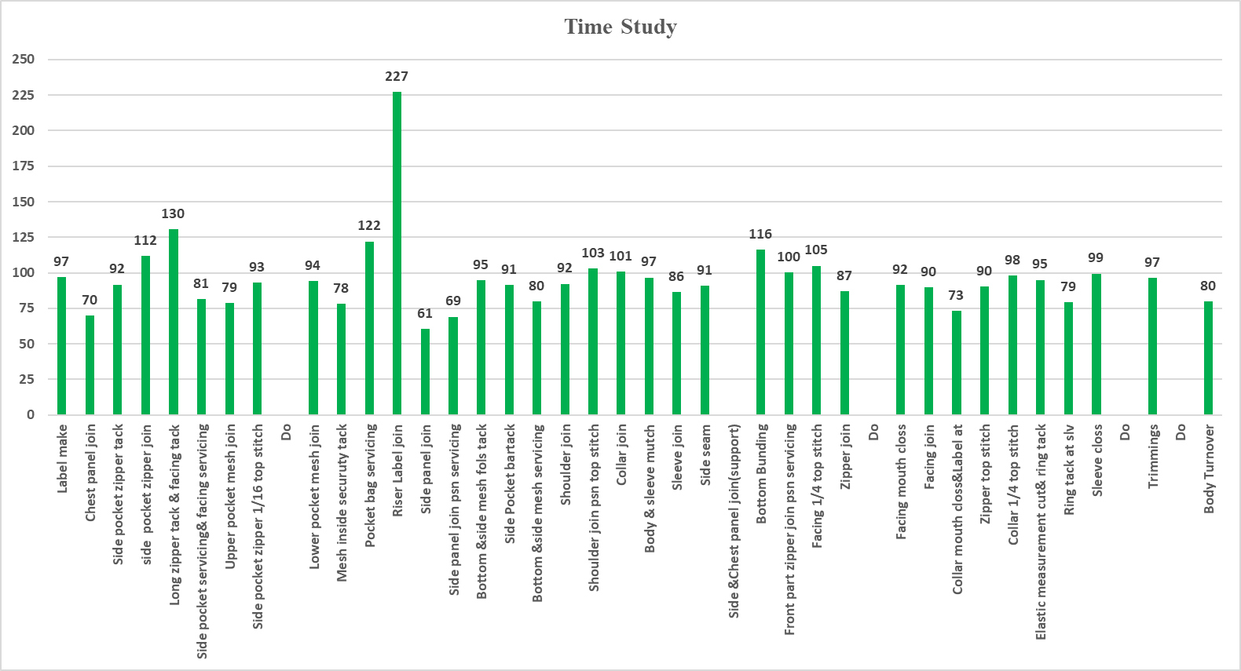
Finding bottleneck
Hourly production target 75 pcs/hr
Bottleneck occurs in 2nd, 14th,15th and 33rd process, where capacity is below 75pcs/hr
Fig. Unbalanced time study bar chart

Slide 12
Proposed solution to remove bottleneck and utilize manpower
Workstation
Work-share
U-shape layout
Replace worker in the bottleneck process
Change the machine layout
Assign an additional worker to the bottleneck area
Product flow
Out
In
Product flow
Fig. U-shaped Sewing line

Slide 13
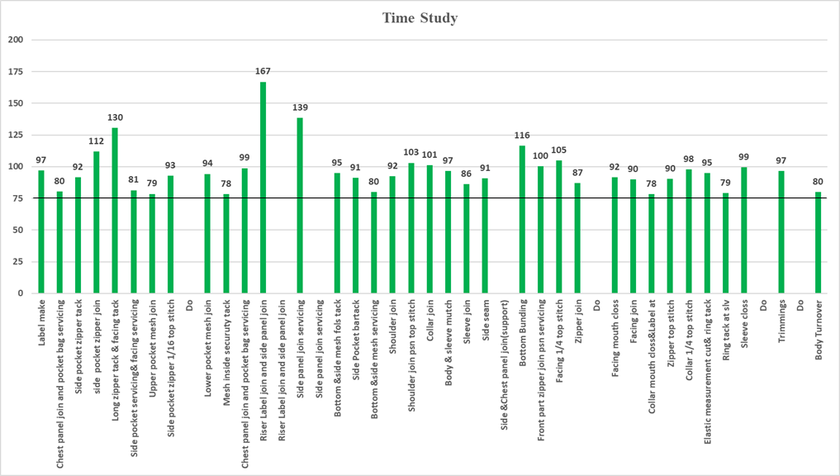
After implementing aforementioned steps
Bottleneck removed
Processes have capacity more than 75 pcs/hr
Extra capacity is used
Fig. Balanced time study bar chart

Slide 14
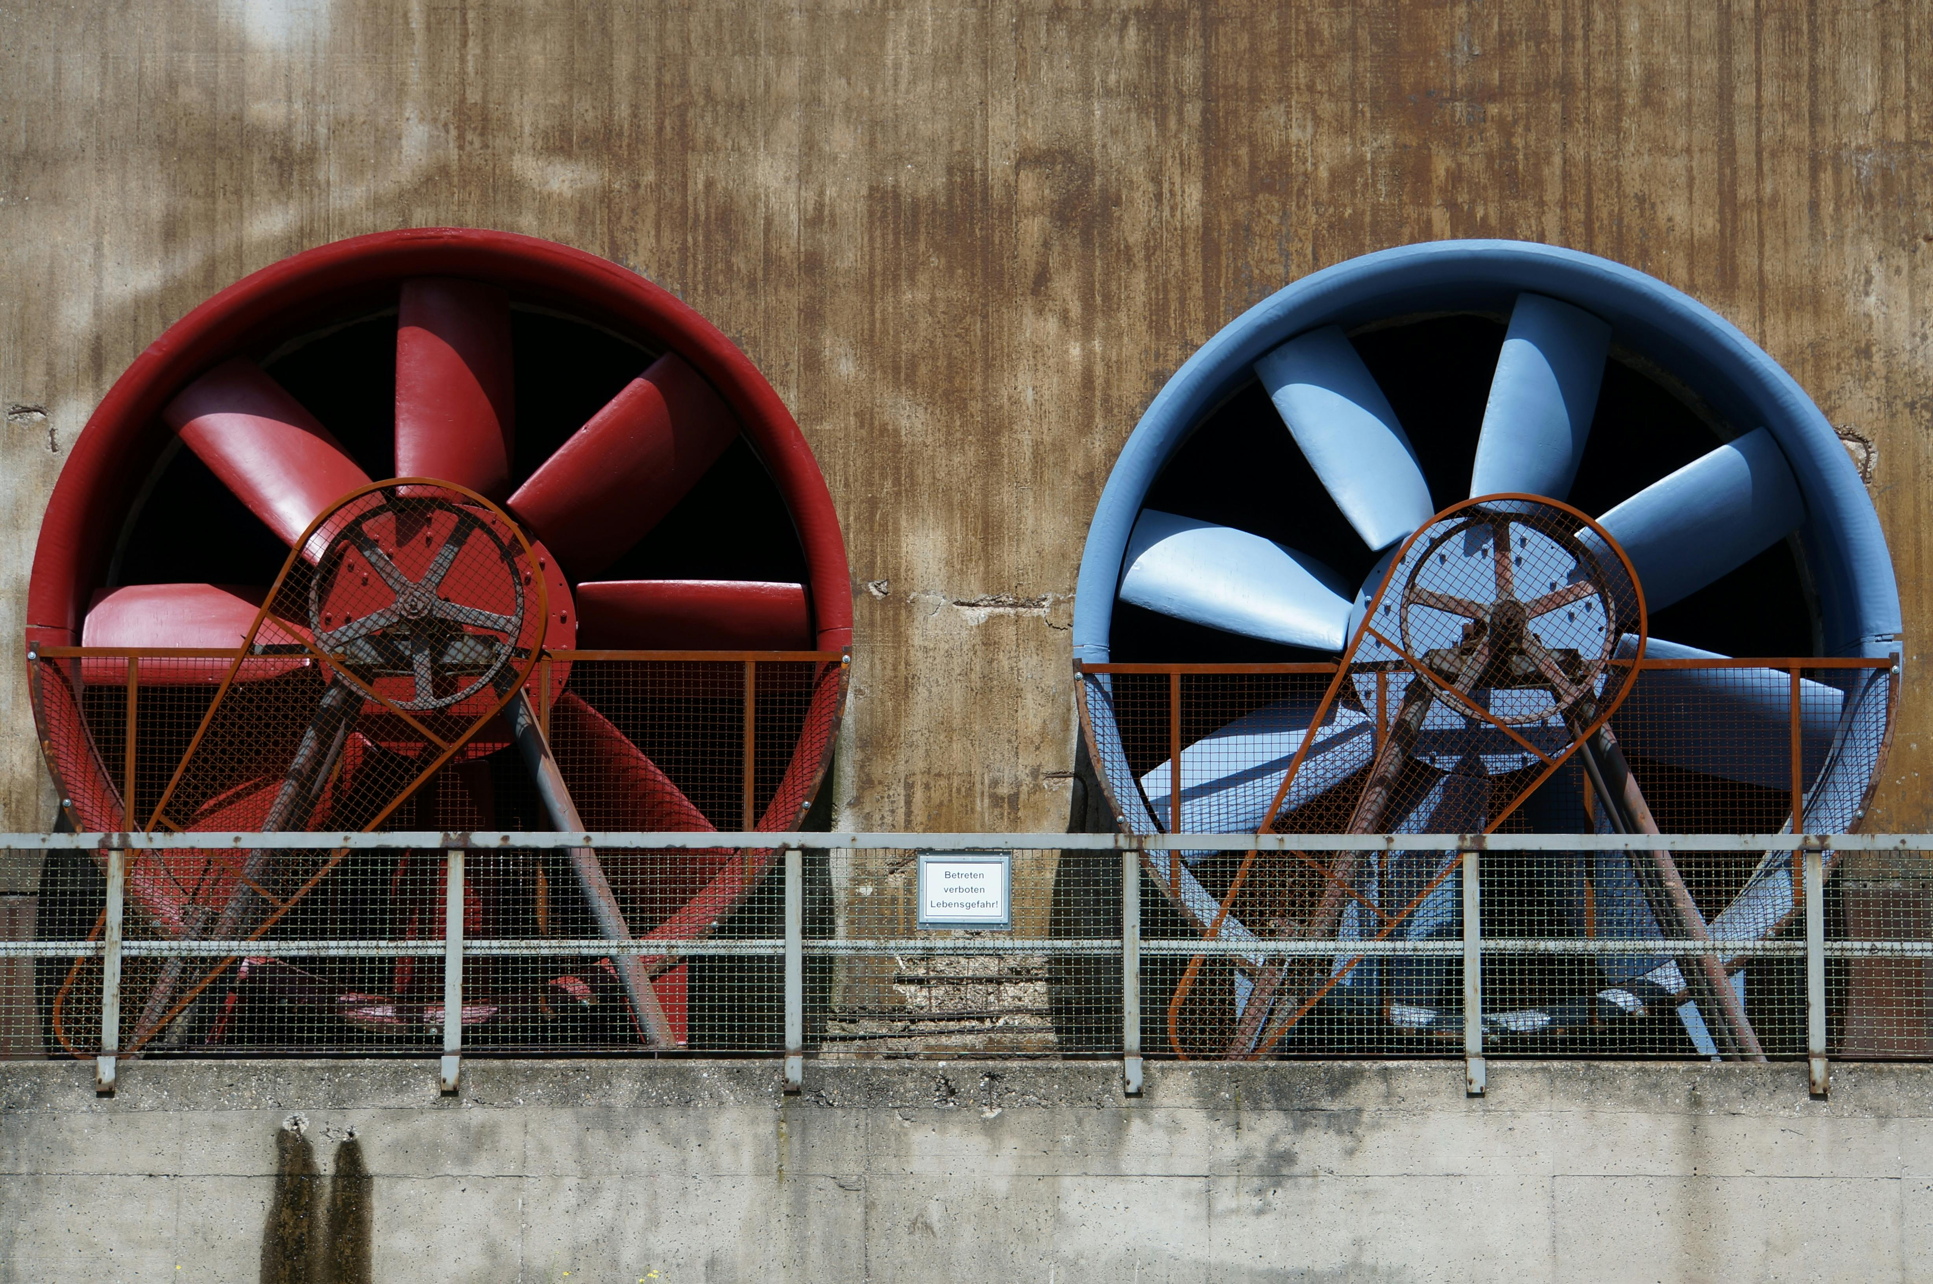
Ventilation sufficiency evaluation and eliminating dead spots on a sewing floor

Slide 15



Importance of a comfortable work environment
Air Quality
Efficiency
Thermal Comfort

Slide 16
Evaluating the ventilation system
Production (Sewing) Line Area (Usually well-ventilated and Controlled Temperature)
Packaging Area
U-shaped Sewing Line
Quantity:
Ceiling Fans | Exhaust Fans | Air Coolers
168 | 14 | 6
Air Cooler
Capacities in CFM:
Ceiling Fans | Exhaust Fans | Air Coolers
2,000 | 3,000 | 18,000
Exhaust Fans
Ceiling Fans
Total Available CFM = 371,000 CFM
Floor Volume = 880,000 cu. ft
Total Number of People at a time = 1130
Packaging Platforms
Figure: An Approximate Layout of the Sewing Floor
16

Slide 17


Evaluating the ventilation system
Production (Sewing) Line Area (Usually well-ventilated and Controlled Temperature)
Packaging Area
Exhaust Fans
U-shaped Sewing Line
Air Changes Per Hour
A$CH=\frac{Total CFM ×60}{Volume of the Sewing Floor \left(in cubic feet\right)}$
Air Cooler
= 25.3 (well over standard range of 6-12, ASHRAE 62.1)
Required & Actual Ventilation
Ceiling Fans
$$Required Ventilation Capacity$$
= 28,250 CFM (<<371,000 CFM)
Packaging Platforms
Figure: An Approximate Layout of the Sewing Floor
17

Slide 18
Presence of dead spots
Production (Sewing) Line Area (Usually well-ventilated and Controlled Temperature)
Packaging Area (Many Dead Spots)
Dead Spots
Several dead spots and hotter regions with lower airflow were observed on the sewing floor, particularly affecting workers in packaging and product handling areas.
Workers reported frequent discomfort and the need to pause and move to relieve heat-related stress.
U-shaped Sewing Line
Air Cooler
Exhaust Fans
Ceiling Fans
Packaging Platforms
Figure: An Approximate Layout of the Sewing Floor
18

Slide 19
Potential changes to deal with dead spot issues
Production (Sewing) Line Area (Usually well-ventilated and Controlled Temperature)
Packaging Area
U-shaped Sewing Line
Additional Ventilation
Fan Repositioning
Air Cooler
Air Cooler Repositioning
Exhaust Fan Optimization
Exhaust Fans
Ceiling Fans
Regular Maintenance
Packaging Platforms
Figure: A Potential Updated Layout
19

Slide 20
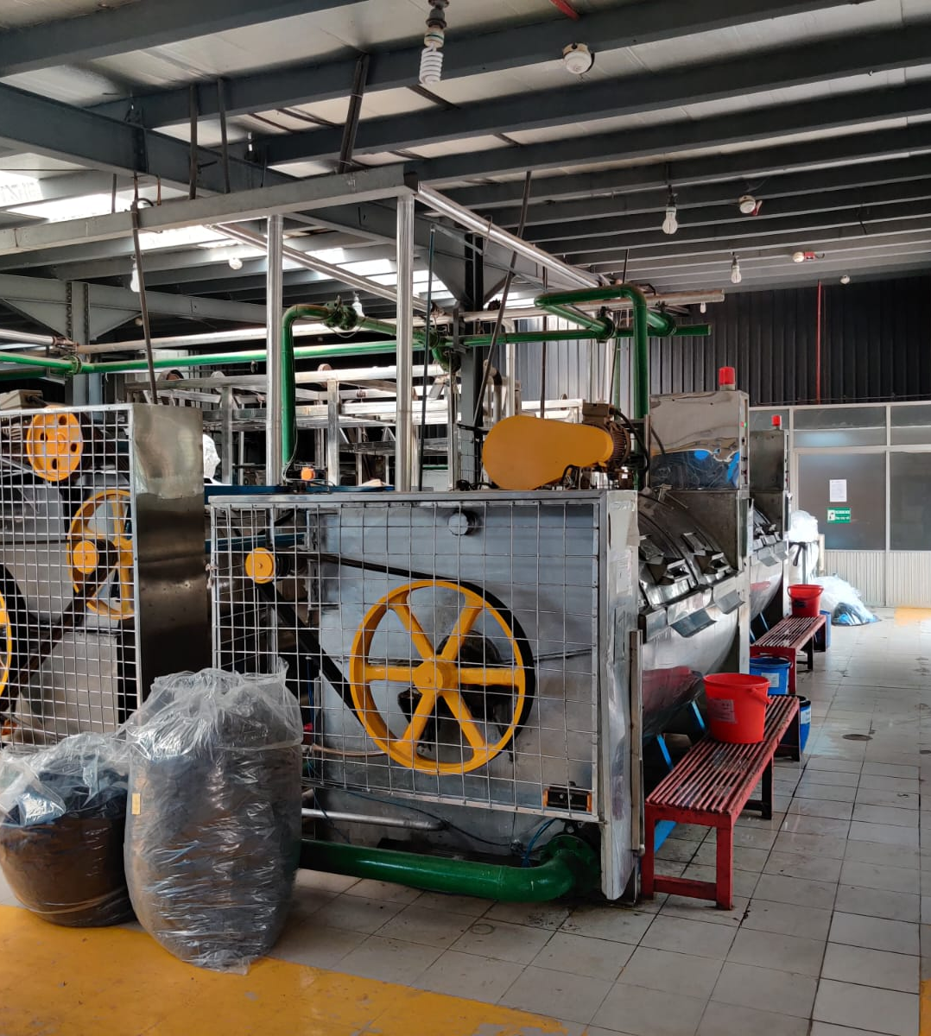
Layout Challenges in Washing & Dyeing Section

Slide 21
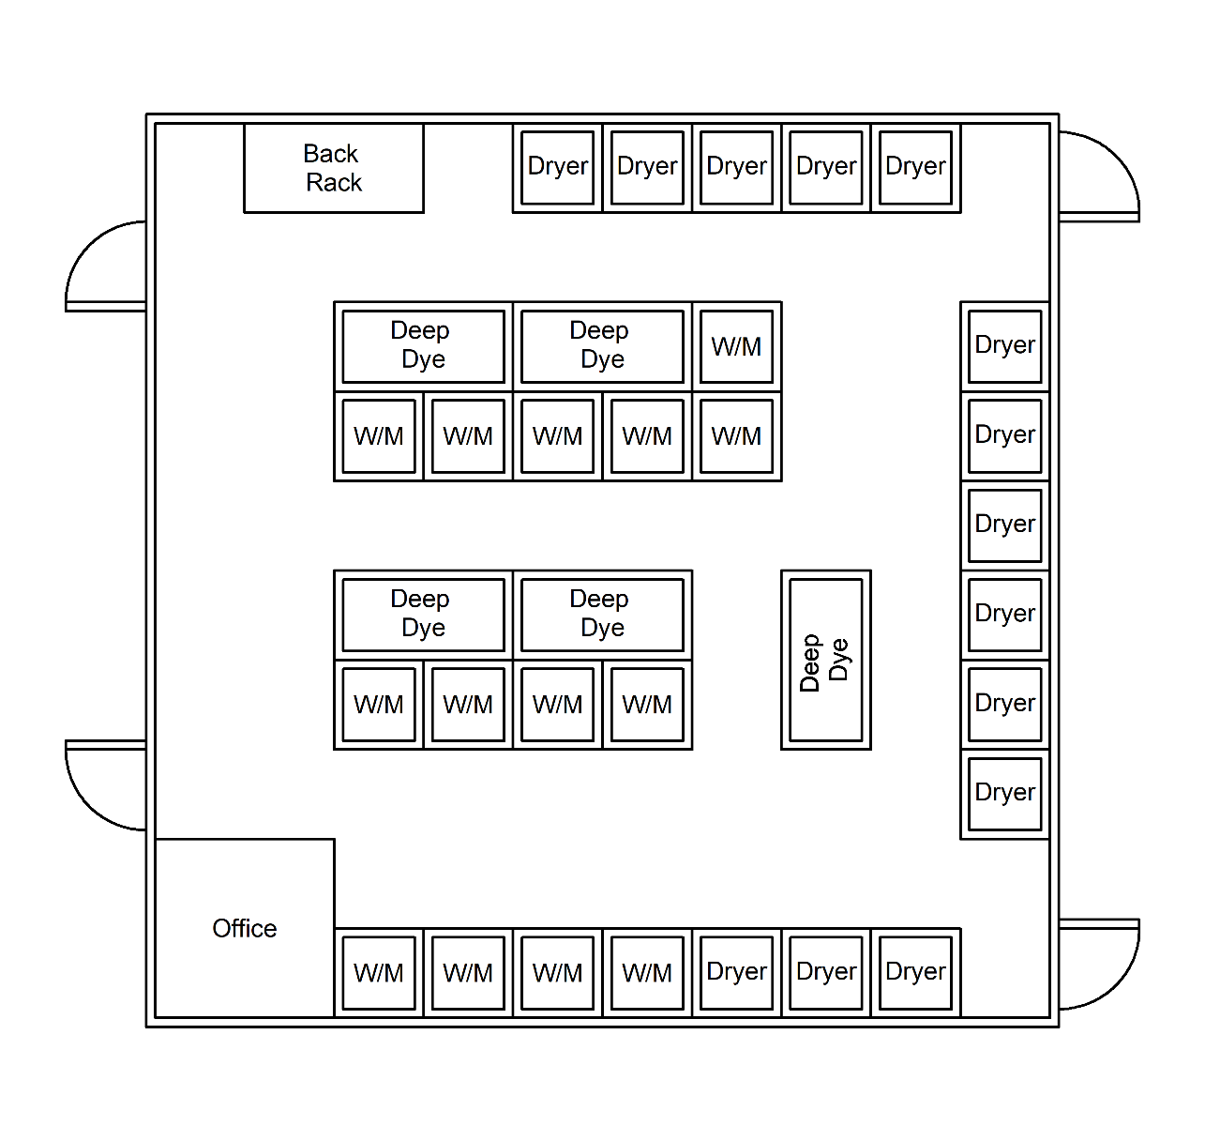
Current Layout
14 Washing Machines
5 Deep Dyeing Machines
14 Drying machines

Slide 22
Current Layout Challenges
Space Congestion
Material Handling
Deep Dyeing Machine Proximity
Heat Transfer
Water Pollution

Slide 23
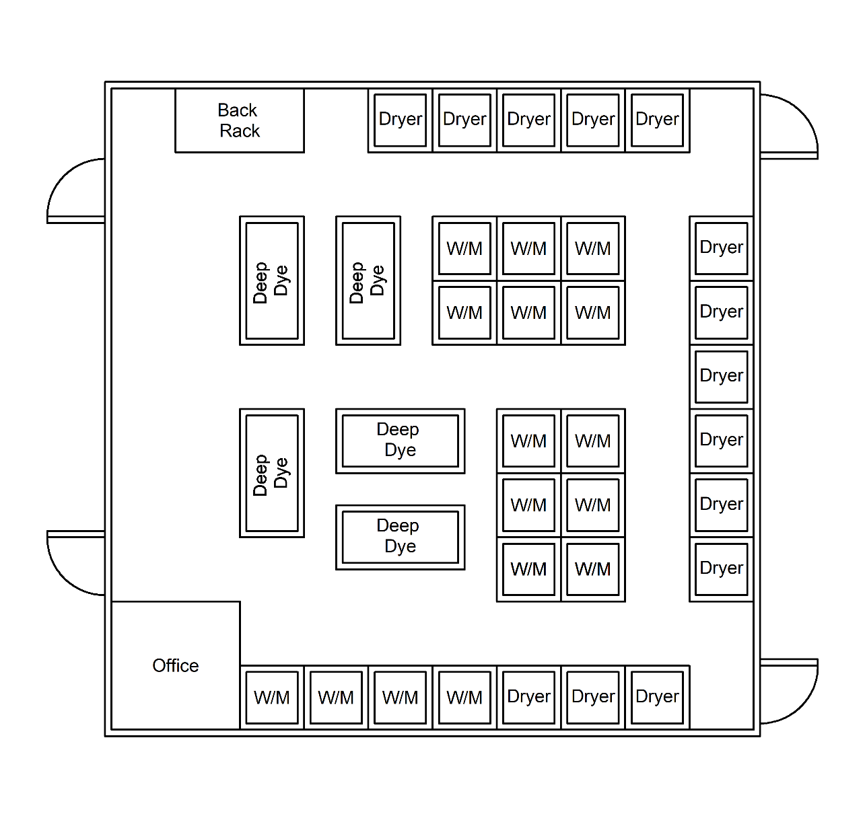
Proposed Layout
Average distance between Deep Dyeing and Washing: 36.42 to 41.94 meters
Average distance between Washing and Drying: 61.24 to 51.29 meters

Slide 24
Proposed Layout Features
Lower Material Handling Cost
Improved Spacing
Line/Process Layout
Flow Efficiency

Slide 25
Conclusion
Gained comprehensive understanding of RMG sector operations.
Developed communication, teamwork, and leadership skills.
Applied theoretical knowledge in real-world production scenarios.
Grateful to BUET and Knit Asia Ltd. for invaluable experience.

Slide 26
Thank you

Slide 27
Appendix

Slide 28
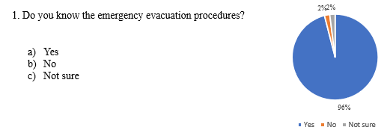
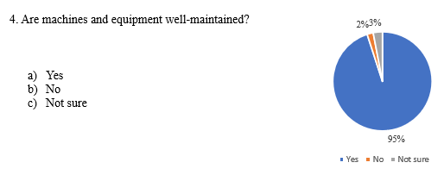
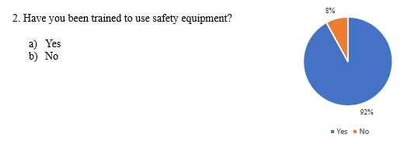
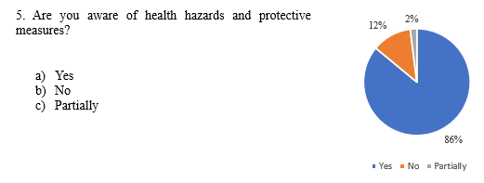
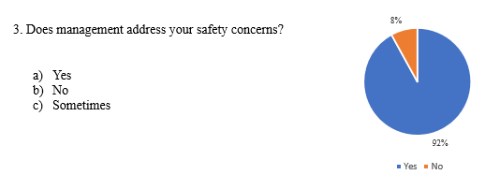
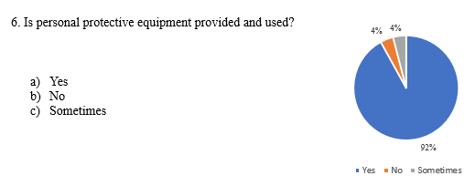
Appendix A: Questionnaire for survey and the response

Slide 29
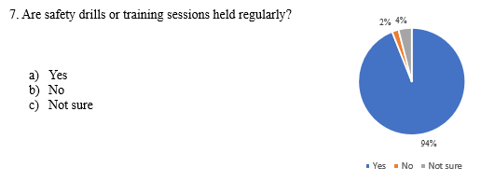
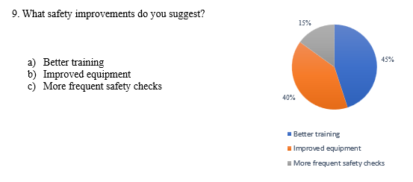
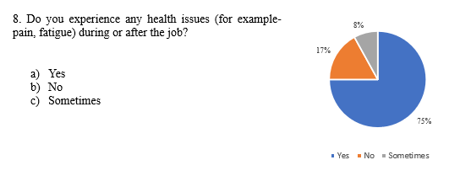
Appendix A: Questionnaire for survey and the response

Slide 30
Appendix B: Sample calculation of time study
For the 4th process which is side pocket zipper join-
Machine – Lock stich
Quantity processed = 7 pcs
Total time required = 196 sec
Average time =(Total time required)/(Quantity processed) =196/7 =28.0 sec
Worker rating = 100%
Normal time =Avg. time × worker rating =28.0×100% =28.0 sec
Allowance = 15%
Standard second value (SSV) =Normal time + Normal time ×Allowance (Niebel, 2009)
=28.0+28.0×15%
=32.20 sec
Standard minute value (SMV) =SSV/60 =32.20/60 =0.54 min
Capacity =3600/SSV =3600/0.54 =112 pcs/hr

Slide 31
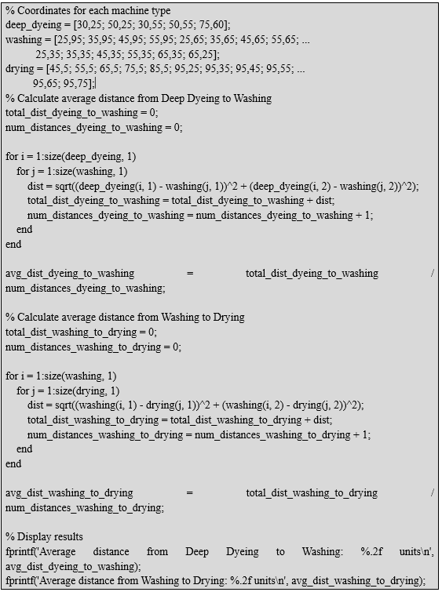
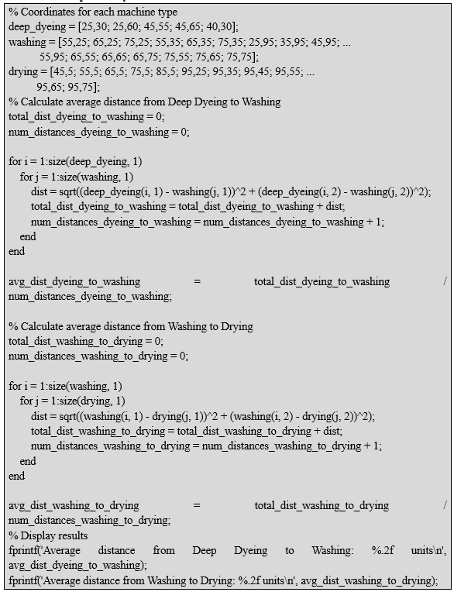
Appendix C: Matlab code
For current layout
For proposed layout

