Slide 1
EXPERIMENT - 4
Aim : Build an Artificial Neural Network by implementing the Backpropagation
algorithm and test the same using appropriate data sets
Input ( Training Example) : Dataset with 784 input attributes(features)
Output : Probability that image is a digit(Classification)

Slide 2
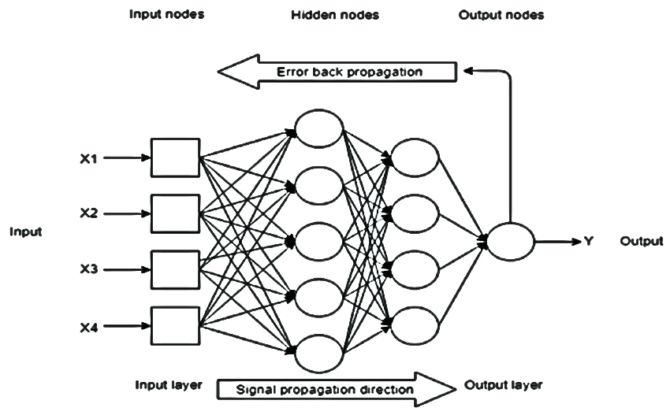
Backpropagation Algorithm :

Slide 3
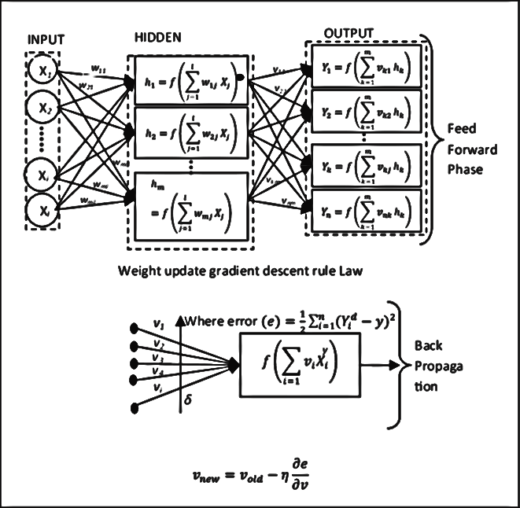
FeedForward:

Slide 4
FeedBackward :

Slide 5
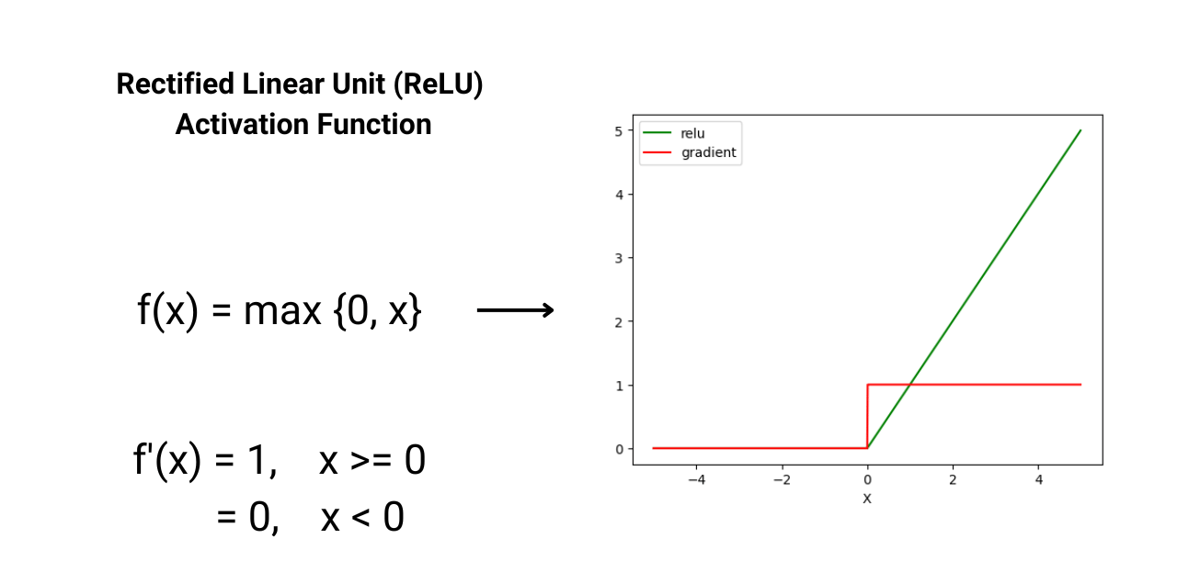

Slide 6
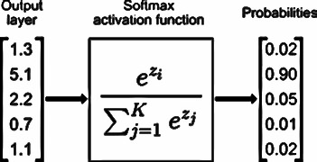

Slide 7
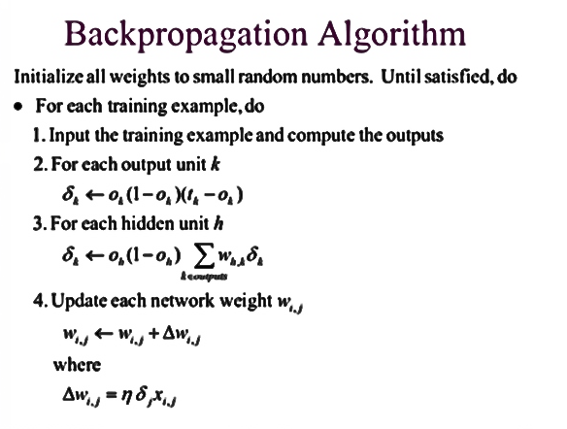
Backpropagation Algorithm :

Slide 8
Program:
import numpy as np
import pandas as pd
import matplotlib.pyplot as plt
from tensorflow import keras
from sklearn.model_selection import train_test_split
mnist = pd.read_csv('mnist.csv’)
X = mnist.iloc[:,:-1].values
y = mnist.iloc[:,784].values
X_train, X_test, y_train, y_test = train_test_split(X, y, test_size=0.2, random_state=50)

Slide 9
X_train = X_train.reshape(-1, 784).astype('float32') / 255
X_test = X_test.reshape(-1, 784).astype('float32') / 255
y_train = keras.utils.to_categorical(y_train, 10)
y_test = keras.utils.to_categorical(y_test, 10)

Slide 10
model = keras.Sequential([keras.Input(shape=(784,)),
keras.layers.Dense(110, activation='relu'),
keras.layers.Dropout(0.3),
keras.layers.Dense(10, activation='softmax’)])
model.compile(optimizer='adam', loss='categorical_crossentropy', metrics=['accuracy'])

Slide 11
model.fit(X_train, y_train, epochs=10, batch_size=32)
loss, accuracy = model.evaluate(X_test, y_test, verbose=0)
print(f"Test Loss: {loss}\nTest Accuracy: {accuracy}")

Slide 12
num_images = 10
indices = np.random.choice(len(X_test), num_images, replace=False)
X_test_vis = X_test[indices].reshape(-1, 28, 28) # Reshape for display
true_labels_vis = np.argmax(y_test[indices], axis=1)
predicted_labels_vis = np.argmax(model.predict(X_test[indices]), axis=1)
print((model.predict(X_test[indices])))
fig, axes = plt.subplots(1, num_images, figsize=(15, 3))
for i, ax in enumerate(axes):
ax.imshow(X_test_vis[i], cmap='gray')
ax.set_title(f"True: {true_labels_vis[i]}\nPred: {predicted_labels_vis[i]}")
ax.axis('off')plt.show()

Slide 13
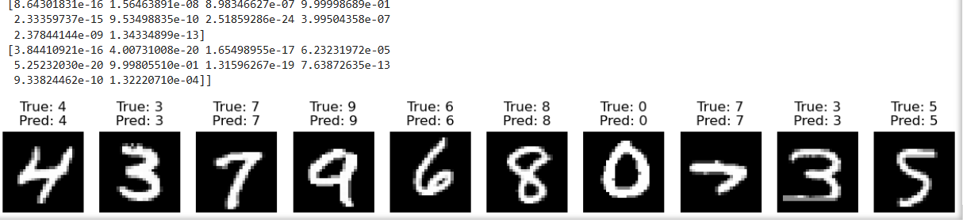
Output

