Slide 1
EXPERIMENT - 2
Aim : Develop a program to apply K-means algorithm to cluster a set of data. Use the same data set for clustering using EM algorithm. Compare the results of these two algorithms and comment on the quality of clustering.
Input ( Training Example) : Iris Plants Dataset
Output : Cluster the Unknown iris data set
[Iris-versicolor, Iris-setosa, Iris-virginica]

Slide 2
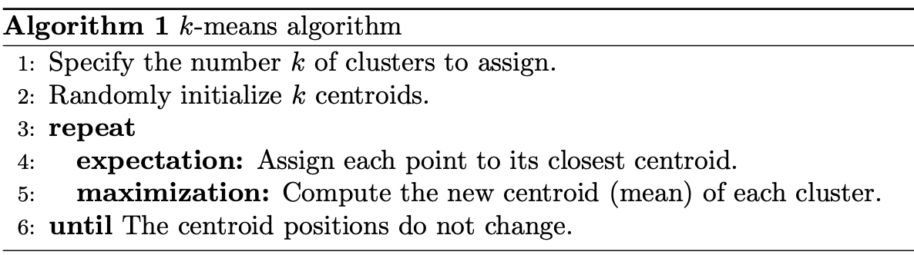
K-Means Algorithm :

Slide 3
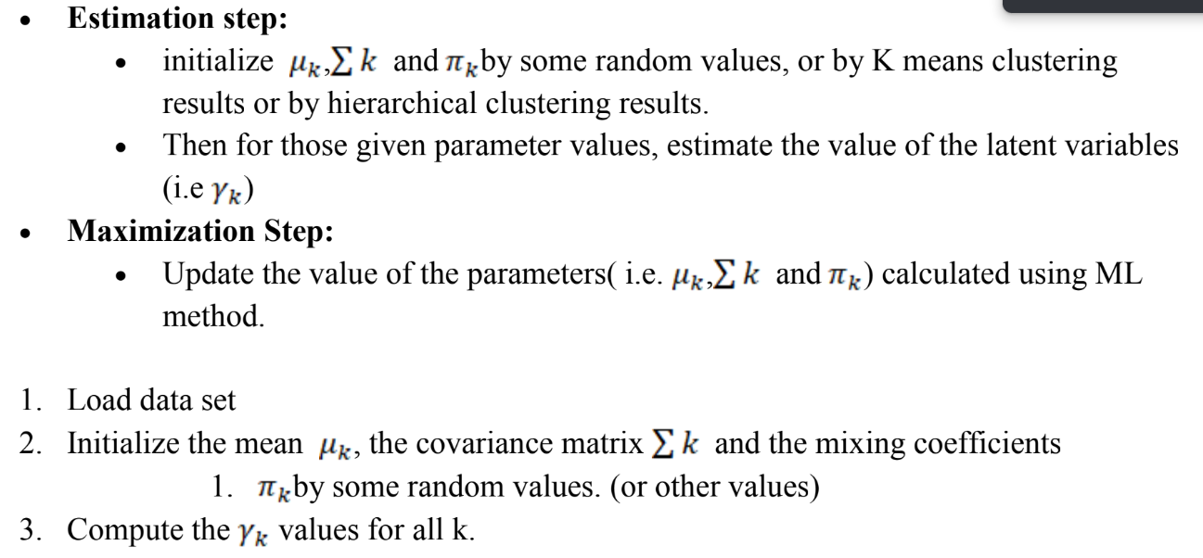
EM-Algorithm :

Slide 4
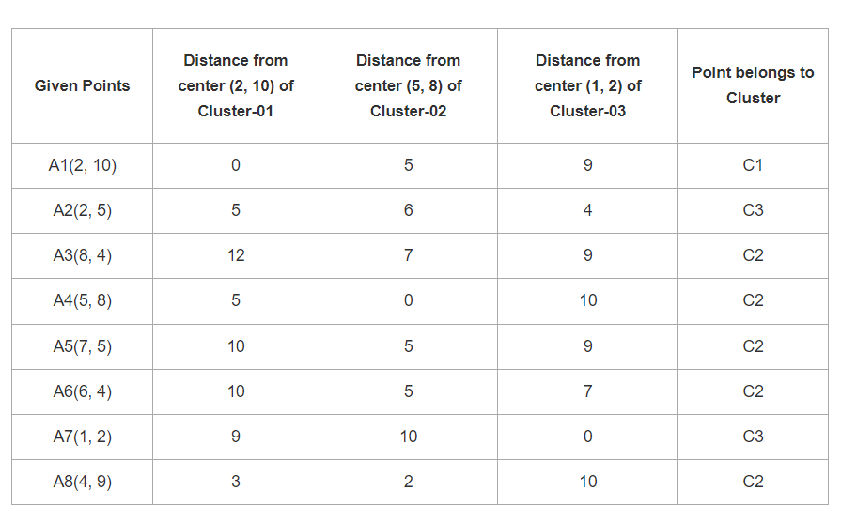
Example :

Slide 5
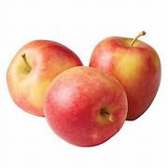
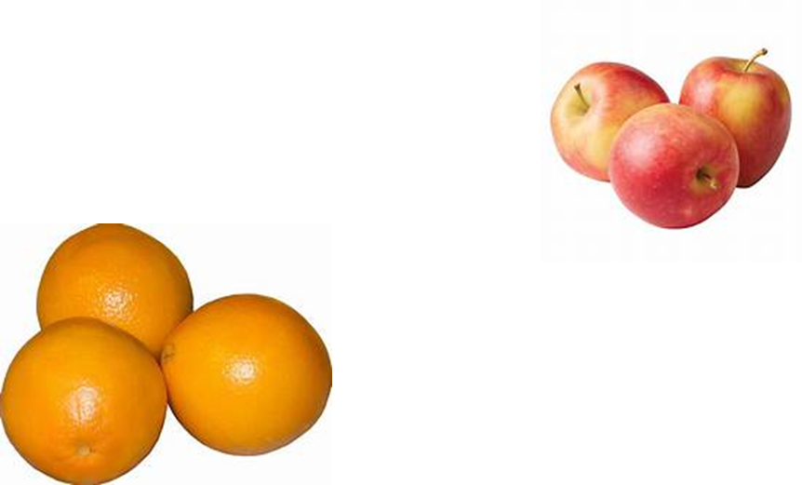
Gaussian Mixture Mode Example :
Imagine you have data points= weights (kg) of apples and oranges.
2 distinct clusters: lighter fruits and heavier fruits.
Weights (kg): [150, 160, 170, 180, 190, 200, 210, 220]

Slide 6
Gaussian Mixture Mode Example :
Iteratively model will,
To best fit the data adjust parameters of these two Gaussians
means
standard deviations
Also determines probability of a weight belonging to "apple" : lower weights
"orange" : higher weights

Slide 7
Gaussian Mixture Mode Example :
Gaussian would represent
"apple" : lower weights
Mean = 160 kg,
Std= 10 kg
Probability=0.5
"orange" : higher weights
Mean = 200 kg,
Std= 10 kg
Probability=0.5
Weights (kg): 150 160 170 180 190 200 210 220
|----Apple Gaussian----||--Orange Gaussian----|

Slide 8
"apple" : lower weights
Mean = 160 kg,
Std= 10 kg
Probability=0.5
"orange" : higher weights
Mean = 200 kg,
Std= 10 kg
Probability=0.5
Pdf(new fruit with a weight of 175 kg)= ?
[0.8, 0.2]

Slide 9
Program:
import matplotlib.pyplot as plt
from sklearn import datasets
from sklearn.cluster import KMeans
import pandas as pd
import numpy as np
# import some data
iris = datasets.load_iris()
X = pd.DataFrame(iris.data)
X.columns = ['Sepal_Length','Sepal_Width','Petal_Length','Petal_Width']
y = pd.DataFrame(iris.target)
y.columns = ['Targets']

Slide 10
#Build the K Means Model
model = KMeans(n_clusters=3)
model.fit(X)
# Visualise the clustering results
plt.figure(figsize=(14,7))
colormap = np.array(['red', 'lime', 'black'])
# Plot the Original Classifications using Petal features
plt.subplot(1, 3, 1)
plt.scatter(X.Petal_Length, X.Petal_Width, c=colormap[y.Targets], s=40)
plt.title('Real Clusters')
plt.xlabel('Petal Length')
plt.ylabel('Petal Width')
# Plot the Models Classifications
plt.subplot(1, 3, 2)
plt.scatter(X.Petal_Length, X.Petal_Width, c=colormap[model.labels_], s=40)
plt.title('K-Means Clustering')
plt.xlabel('Petal Length')
plt.ylabel('Petal Width')

Slide 11
# transform your data such that its distribution will have a # mean value 0 and standard dev of 1.
from sklearn import preprocessing
scaler = preprocessing.StandardScaler()
scaler.fit(X)
xsa = scaler.transform(X)
xs = pd.DataFrame(xsa, columns = X.columns)
from sklearn.mixture import GaussianMixture
gmm = GaussianMixture(n_components=3)
gmm.fit(xs)
gmm_y=gmm.predict(xs)
plt.subplot(1, 3, 3)
plt.scatter(X.Petal_Length, X.Petal_Width, c=colormap[gmm_y], s=40)
plt.title('GMM Clustering')
plt.xlabel('Petal Length')
plt.ylabel('Petal Width')
print('Observation: The GMM using EM algorithm based clustering matched the true labels more closely than the Kmeans.')
print('The accuracy score of K-Mean: ', metrics.accuracy_score(y, model.labels_))
print('The accuracy score of EM: ', metrics.accuracy_score(y, gmm_y))

Slide 12
Output
Iris Data set loaded...
Label 0 - setosa
Label 1 - versicolor
Label 2 - virginica
Results of Classification using K-nn with K=2
-------------------------------------------------------------------------
Original Label Predicted Label Correct/Wrong
-------------------------------------------------------------------------
1 1 Correct
2 2 Correct
2 2 Correct
0 0 Correct
2 1 Wrong
2 2 Correct
1 1 Correct ------------------------------------------------------------------------
Accuracy of the classifier is 0.93

