Slide 1
EXP-1
Write a program to demonstrate the working of following algorithms:
(i) k-Nearest Neighbor algorithm
(ii) SVC classifier for a suitable data set

Slide 2
Understanding K-Nearest Neighbors (KNN)
The algorithm finds the "K" nearest neighbors to a new data point and
predicts its class based on the majority class of its neighbors.

Slide 3
Understanding K-Nearest Neighbors (KNN)
Basic idea: Classify a data point based on the classes of its
'k' nearest neighbors.
The algorithm assigns a class to a new data point by calculating the distance to its k nearest neighbors and selecting the most frequent class among them.
Movie recommendation.
Choose K
Calculate Distance (Eg: Euclidean Dist, Manhattan Dist)
Find Nearest Neighbors
Vote (Weighted-Avg)

Slide 4
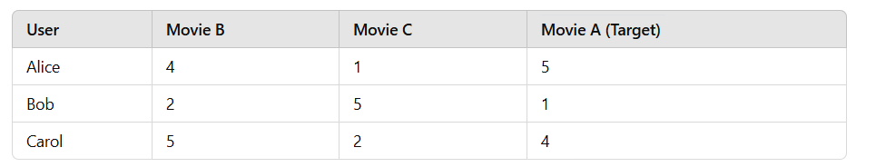
KNN ILLUSTRATION
The algorithm assigns a class to a new data point by calculating the distance to its k nearest neighbors and selecting the most frequent class among them.
(X_test): [4, 1, ?,]

Slide 5
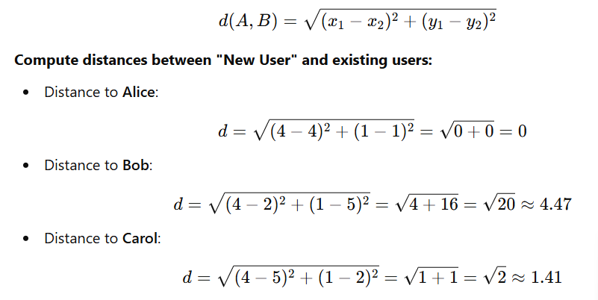

KNN ILLUSTRATION
(X_test): [4, 1, ?,]
1.choose k = 2
2. K-NN
Alice (0.0 dist
Carol (1.41 dist)
3.
4. New User’s predicted rating for Movie A is 4.5.
The algorithm assigns a class to a new data point by calculating the distance to its k nearest neighbors and selecting the most frequent class among them.

Slide 6
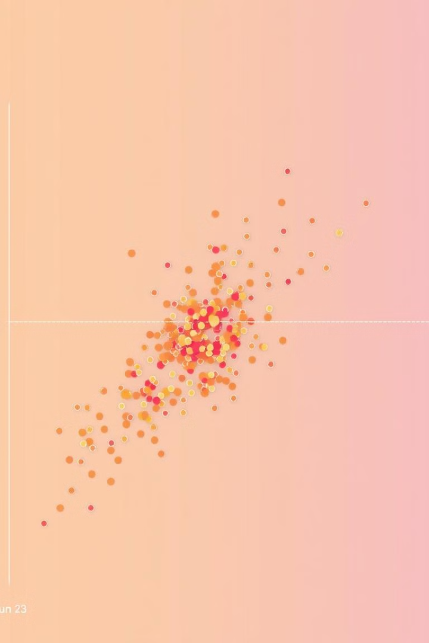
Support Vector Classifier (SVC)
Margin Maximization
Support Vectors
SVC aims to find the best hyperplane that separates data points into distinct classes with the maximum margin.
The points closest to the hyperplane, called support vectors, play a crucial role in determining the hyperplane's position.
Kernel Trick
SVC can be extended to handle non-linear data by using kernel functions that transform the data into a higher-dimensional space.

Slide 7
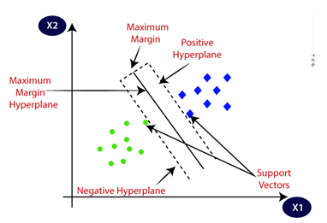
Illustrating the Hyperplane in SVC
1
Imagine two groups of data points, like red and blue dots on a 2D plot.
2
SVC finds a line, called a hyperplane, that separates the two groups with the largest possible margin.
3
The hyperplane is positioned so that it's equidistant to the closest points from each group, known as support vectors.

Slide 8
Using SVC determine whether patient is Diseased or Not
Hyperplane computed using RBF kernel.
SVM optimized using Quadratic Programming.
Decision function used for prediction.
New patient classified as "Yes" (Disease detected).

Slide 9
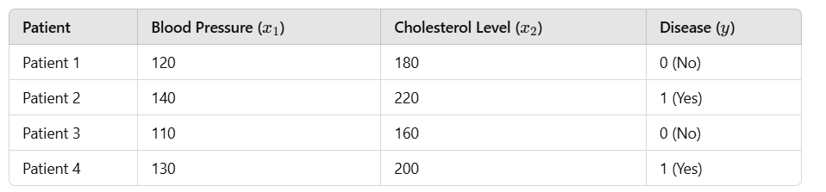
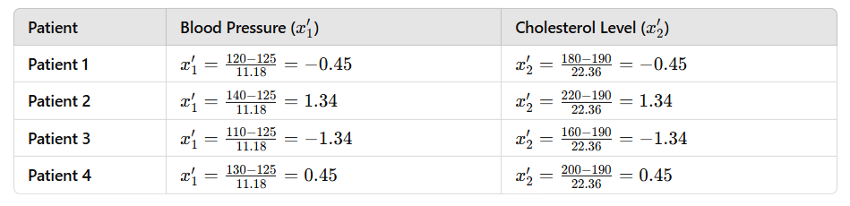
ILLUSTRATION: SVC determine whether patient is Diseased or Not
apply Z-score normalization
Apply Z-score normalization

Slide 10

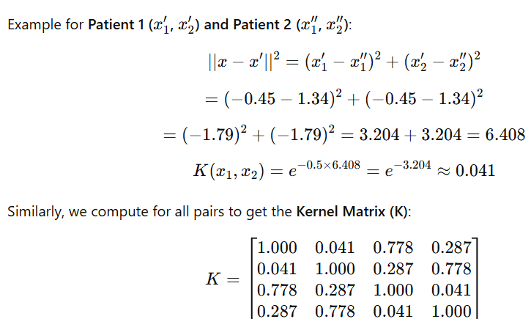
ILLUSTRATION: SVC determine whether patient is Diseased or Not

Slide 11
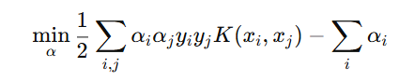

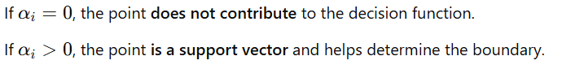


Illustrating the Hyperplane in SVC
SVM find w and b :
"The decision function is a weighted sum of kernel evaluations between support vectors x2 and x4, adjusted by a bias term of minus 0.2."

Slide 12
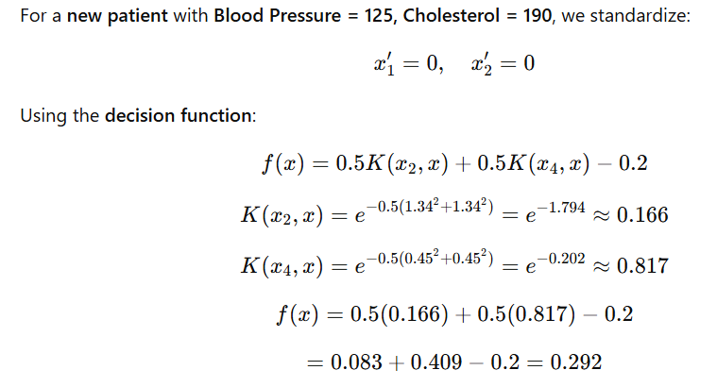
Illustrating the Hyperplane in SVC
Since f(x)>0, classify the patient as Disease (Yes).

Slide 13


Comparing KNN and SVC Performance
Computational Complexity
Flexibility
KNN can be computationally expensive for large datasets, while SVC is generally faster for large datasets.
SVC is more flexible than KNN as it can handle non-linear data using kernels, whereas
KNN is limited to linear data.

Slide 14

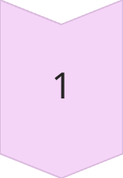
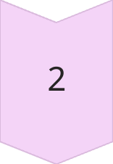
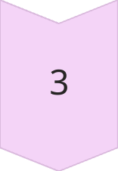
Real-World Applications of KNN and SVC
Image Classification
Both algorithms can be used to classify images into different categories.
SVC can be used to filter spam emails by identifying patterns in spam emails and classifying new emails accordingly.
Spam Detection
KNN can be used to assist in medical diagnosis by predicting the likelihood of a disease based on patient symptoms.
Medical Diagnosis

Slide 15
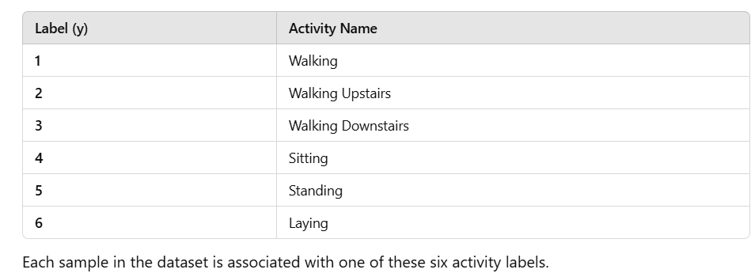
Input Dataset
Analysis of Human physical activities through the examination and can be applied in fields such as health monitoring, sports science, and human-computer interaction. Comprehensive dataset extracted from accelerometer and gyroscope data.
Type of Activities

Slide 16
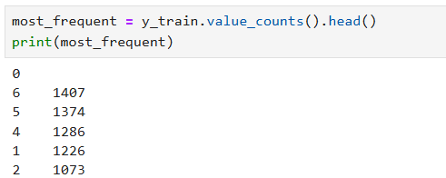
Feature Statistics
Classify different physical activities.
Monitor physical health and fitness levels.
In sports science for performance enhancement and in rehabilitation settings to track recovery progress.
7,352 : X_train.txt
2,947 X_test.txt
KNN and SVC are powerful machine learning algorithms that are widely used in various applications. Understanding their strengths and weaknesses can help you choose the best algorithm for your specific problem.
https://archive.ics.uci.edu/dataset/240/human+activity+recognition+using+smartphones

