Slide 1
Pointers
and
dynamic objects

Slide 2
Topics
Pointers
Memory addresses
Declaration
Dereferencing a pointer
Pointers to pointer
Static vs. dynamic objects
new and delete

Slide 3
Computer Memory
Each variable is assigned a memory slot (the size depends on the data type) and the variable’s data is stored there
Memory address:
1020
1024
1032
…
…
100
…
1024
…
a
Variable a’s value, i.e., 100, is
stored at memory location 1024
int a = 100;

Slide 4
Pointers
A pointer is a variable used to store the address of a memory cell.
We can use the pointer to reference this memory cell
Memory address:
1020
1024
1032
…
…
100
…
1024
…
integer
pointer

Slide 5
Pointer Types
Pointer
C++ has pointer types for each type of object
Pointers to int objects
Pointers to char objects
Pointers to user-defined objects
(e.g., RationalNumber)
Even pointers to pointers
Pointers to pointers to int objects

Slide 6
Pointer Variable
Declaration of Pointer variables
type* pointer_name;
//or
type *pointer_name;
where type is the type of data pointed to (e.g. int, char, double)
Examples:
int *n;
RationalNumber *r;
int **p; // pointer to pointer

Slide 7
Address Operator &
The "address of " operator (&) gives the memory address of the variable
Usage: &variable_name
Memory address:
1020
1024
…
…
100
…
…
…
a
int a = 100;
//get the value,
cout << a; //prints 100
//get the memory address
cout << &a; //prints 1024

Slide 8
Address Operator &
Memory address:
1020
1024
1032
…
88
100
…
…
…
#include <iostream>
using namespace std;
void main(){
int a, b;
a = 88;
b = 100;
cout << "The address of a is: " << &a << endl;
cout << "The address of b is: " << &b << endl;
}
a
b
Result is:
The address of a is: 1020
The address of b is: 1024

Slide 9
Pointer Variables
The value of pointer p is the address of variable a
A pointer is also a variable, so it has its own memory address
Memory address:
1020
1024
1032
…
88
100
…
1024
…
a
p
int a = 100;
int *p = &a;
cout << a << " " << &a <<endl;
cout << p << " " << &p <<endl;
Result is:
100 1024
1024 1032

Slide 10
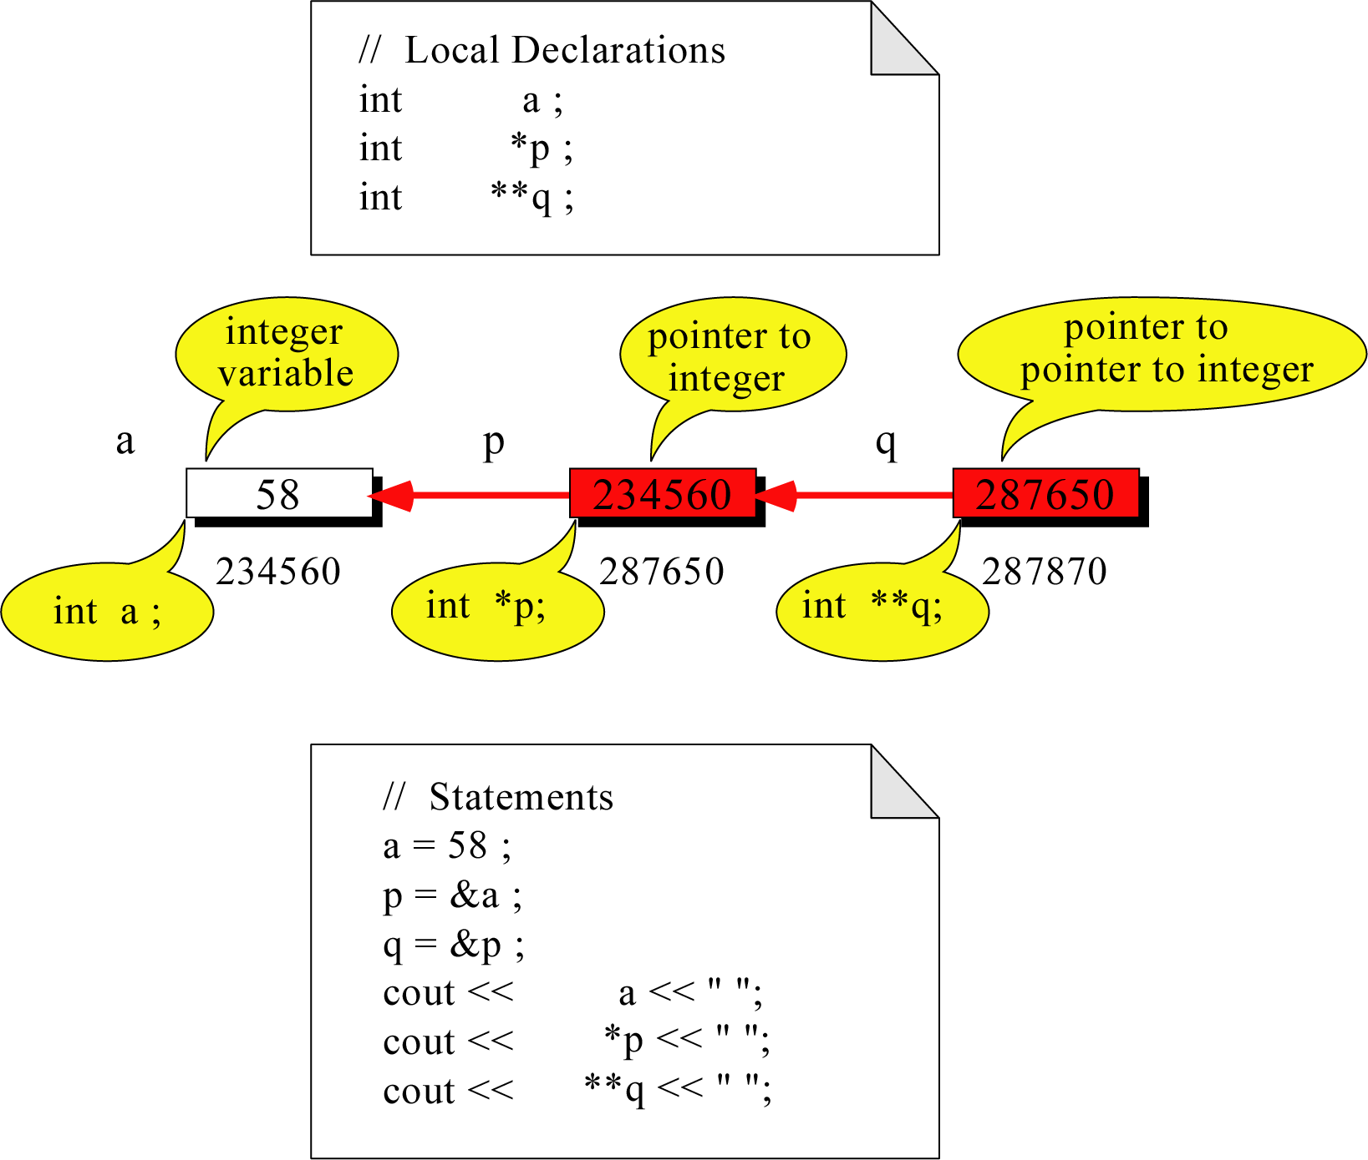
Pointer to Pointer
What is the output?
58 58 58

Slide 11
Dereferencing Operator *
We can access to the value stored in the variable pointed to by using the dereferencing operator (*),
Memory address:
1020
1024
1032
…
88
100
…
1024
…
a
p
int a = 100;
int *p = &a;
cout << a << endl;
cout << &a << endl;
cout << p << " " << *p << endl;
cout << &p << endl;
Result is:
100
1024
1024 100
1032

Slide 12
Don’t get confused
Declaring a pointer means only that it is a pointer: int *p;
Don’t be confused with the dereferencing operator, which is also written with an asterisk (*). They are simply two different tasks represented with the same sign
int a = 100, b = 88, c = 8;
int *p1 = &a, *p2, *p3 = &c;
p2 = &b; // p2 points to b
p2 = p1; // p2 points to a
b = *p3; //assign c to b
*p2 = *p3; //assign c to a
cout << a << b << c;
Result is:
888

Slide 13
A Pointer Example
Memory Layout
The code
void doubleIt(int x, int * p)
{
*p = 2 * x;
}
int main(int argc, const char * argv[])
{
int a = 16;
doubleIt(9, &a);
return 0;
}
Box diagram
main
16
p (8200)
8192
a
doubleIt
x (8196)
9
a (8192)
16
main
doubleIt
x
9
a gets 18
p
Notes:
Note the signature of main() – it’s an array parameter. And, like other examples we’ve given, it takes the number of elements as a parameter. Why?

Slide 14
Another Pointer Example
Let’s figure out:
value1==? / value2==?
Also, p1=? p2=?
#include <iostream>
using namespace std;
int main (){
int value1 = 5, value2 = 15;
int *p1, *p2;
p1 = &value1; // p1 = address of value1
p2 = &value2; // p2 = address of value2
*p1 = 10; // value pointed to by p1=10
*p2 = *p1; // value pointed to by p2= value // pointed to by p1
p1 = p2; // p1 = p2 (pointer value copied)
*p1 = 20; // value pointed to by p1 = 20
cout << "value1==" << value1 << "/ value2==" << value2;
return 0;
}

Slide 15
Another Pointer Example
int a = 3;
char s = ‘z’;
double d = 1.03;
int *pa = &a;
char *ps = &s;
double *pd = &d;
% sizeof returns the # of bytes…
cout << sizeof(pa) << sizeof(*pa)
<< sizeof(&pa) << endl;
cout << sizeof(ps) << sizeof(*ps)
<< sizeof(&ps) << endl;
cout << sizeof(pd) << sizeof(*pd)
<< sizeof(&pd) << endl;

Slide 16
Reference Variables
A reference is an additional name to
an existing memory location
Pointer:
Reference:
x
9
x
ref
9
ref
int x=9;
int *ref;
ref = &x;
int x = 9;
int &ref = x;
Notes:
References fix some of those pointer problems.
If we wanted something called “ref” to point to a variable x, we’d declare a pointer variable and assign the address of x into it. With references, we’d attach an additional name – ref – to the same memory location as x.
Note how the pointer necessitates an extra variable, whereas the reference didn’t

Slide 17
Reference Variables
A reference variable serves as an alternative name for an object
int m = 10;
int &j = m; // j is a reference variable
cout << “value of m = “ << m << endl;
//print 10
j = 18;
cout << “value of m = “ << m << endl;
// print 18

Slide 18
Reference Variables
A reference variable always refers to the same object. Assigning a reference variable with a new value actually changes the value of the referred object.
Reference variables are commonly used for parameter passing to a function

Slide 19
Traditional Pointer Usage
void IndirectSwap(char *Ptr1, char *Ptr2){
char temp = *Ptr1;
*Ptr1 = *Ptr2;
*Ptr2 = temp;
}
int main() {
char a = 'y';
char b = 'n';
IndirectSwap(&a, &b);
cout << a << b << endl;
return 0;
}

Slide 20
Pass by Reference
void IndirectSwap(char& y, char& z) {
char temp = y;
y = z;
z = temp;
}
int main() {
char a = 'y';
char b = 'n';
IndirectSwap(a, b);
cout << a << b << endl;
return 0;
}

Slide 21
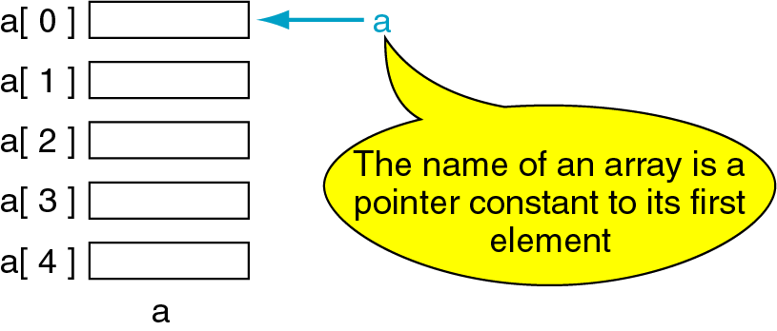
Pointers and Arrays
The name of an array points only to the first element not the whole array.
1000
1004
1008
1012
1016

Slide 22
Array Name is a pointer constant
#include <iostream>
using namespace std;
void main (){
int a[5];
cout << "Address of a[0]: " << &a[0] << endl
<< "Name as pointer: " << a << endl;
}
Result:
Address of a[0]: 0x0065FDE4
Name as pointer: 0x0065FDE4

Slide 23
Dereferencing An Array Name
This element is called a[0] or *a
#include <iostream>
using namespace std;
void main(){
int a[5] = {2,4,6,8,22};
cout << *a << " "
<< a[0];
} //main
a[0]
2
a
a[1]
4
a[2]
6
a[3]
8
a[4]
22
a

Slide 24

Array Names as Pointers
To access an array, any pointer to the first element can be used instead of the name of the array.
We could replace *p by *a
#include <iostream>
using namespace std;
void main(){
int a[5] = {2,4,6,8,22};
int *p = a;
cout << a[0] << " "
<< *p;
}
a
p
a[0]
2
2 2
a[1]
4
a[2]
6
a[3]
8
a[4]
22
a

Slide 25
Multiple Array Pointers
Both a and p are pointers to the same array.
#include <iostream>
using namespace std;
void main(){
int a[5] = {2,4,6,8,22};
int *p = &a[1];
cout << a[0] << " "
<< p[-1];
cout << a[1] << " "
<< p[0];
}
a[0]
a[0]
2 2
4 4
2
p
a[1]
4
a[2]
6
p[0]
a[3]
8
a[4]
22

Slide 26
Pointer Arithmetic
Given a pointer p, p+n refers to the element that is offset from p by n positions.
a
2
p - 1
4
p
a + 1
a + 2
6
p + 1
a + 3
8
p + 2
a + 4
22
p + 3

Slide 27
Dereferencing Array Pointers
a[0] or *(a + 0)
2
a
a[1] or *(a + 1)
4
a + 1
a[2] or *(a + 2)
6
a + 2
a[3] or *(a + 3)
8
a + 3
a[4] or *(a + 4)
22
a + 4
*(a+n) is identical to a[n]
Note: flexible pointer syntax

Slide 28
Array of Pointers & Pointers to Array
a
p
b
c
An array of Pointers
A pointer to an array
int a = 1, b = 2, c = 3;
int *p[5];
p[0] = &a;
p[1] = &b;
p[2] = &c;
int list[5] = {9, 8, 7, 6, 5};
int *p;
P = list;//points to 1st entry
P = &list[0];//points to 1st entry
P = &list[1];//points to 2nd entry
P = list + 1; //points to 2nd entry

Slide 29
NULL pointer
NULL is a special value that indicates an empty pointer
If you try to access a NULL pointer, you will get an error
int *p;
p = 0;
cout << p << endl; //prints 0
cout << &p << endl;//prints address of p
cout << *p << endl;//Error!

Slide 30
Storing 2D Array in 1D Array
int twod[3][4] = {{0,1,2,3}, {4,5,6,7},
{8,9,10,11}};
int oned[12];
for(int i=0; i<3; i++){
for(int j=0; j<4 ; j++)
oned[i*4+j] = twod[i][j]; }

Slide 31
Pointer to 2-Dimensional Arrays
table
table[i] = &table[i][0] refers to the address of the ith row
table + 1
table[ 0] or *( table + 0 )
table + 2
table[ 1] or *( table + 1 )
table[ 2] or *( table + 2 )
int table[3][4] = {{1,2,3,4},
{5,6,7,8},{9,10,11,12}};
*(table[i]+j)
= table[i][j]
What is
**table ?
for(int i=0; i<3; i++){
for(int j=0; j<4; j++)
cout << *(*(table+i)+j);
cout << endl;
}

Slide 32
Dynamic Objects

Slide 33
Memory Management
Static Memory Allocation
Memory is allocated at compilation time
Dynamic Memory
Memory is allocated at running time

Slide 34
Static vs. Dynamic Objects
Static object
(variables as declared in function calls)
Memory is acquired automatically
Memory is returned automatically when object goes out of scope
Dynamic object
Memory is acquired by program with an allocation request
new operation
Dynamic objects can exist beyond the function in which they were allocated
Object memory is returned by a deallocation request
delete operation

Slide 35
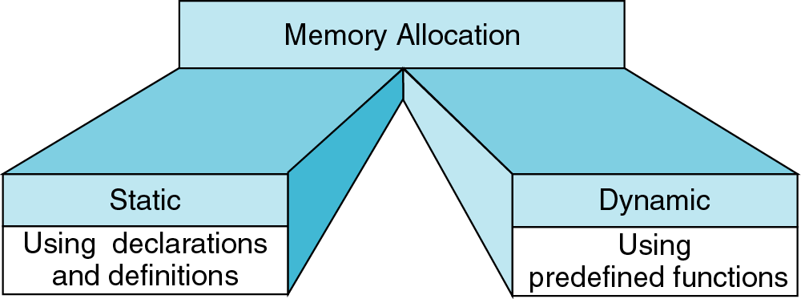
Memory Allocation
new
delete
{
int a[200];
…
}
int* ptr;
ptr = new int[200];
…
delete [] ptr;

Slide 36
Object (variable) creation: New
Syntax
ptr = new SomeType;
where ptr is a pointer of type SomeType
Example
int* p = new int;
Uninitialized int variable
p

Slide 37
Object (variable) destruction: Delete
Syntax
delete p;
storage pointed to by p is returned to free store and p is now undefined
Example
int* p = new int;
*p = 10;
delete p;
p
10

Slide 38
Array of New: dynamic arrays
Syntax
P = new SomeType[Expression];
Where
P is a pointer of type SomeType
Expression is the number of objects to be constructed -- we are making an array
Because of the flexible pointer syntax, P can be considered to be an array

Slide 39
Example
Dynamic Memory Allocation
Request for “unnamed” memory from the Operating System
int *p, n=10; p = new int;
p = new int[100];
new
p
new
p
new
p = new int[n];
p

Slide 40
Memory Allocation Example
Want an array of unknown size
#include <iostream>
using namespace std;
void main()
{
int n;
cout << “How many students? “;
cin >> n;
int *grades = new int[n];
for(int i=0; i < n; i++){
int mark;
cout << “Input Grade for Student” << (i+1) << “ ? :”;
cin >> mark;
grades[i] = mark;
}
. . .
printMean( grades, n ); // call a function with dynamic array
. . .
}

Slide 41
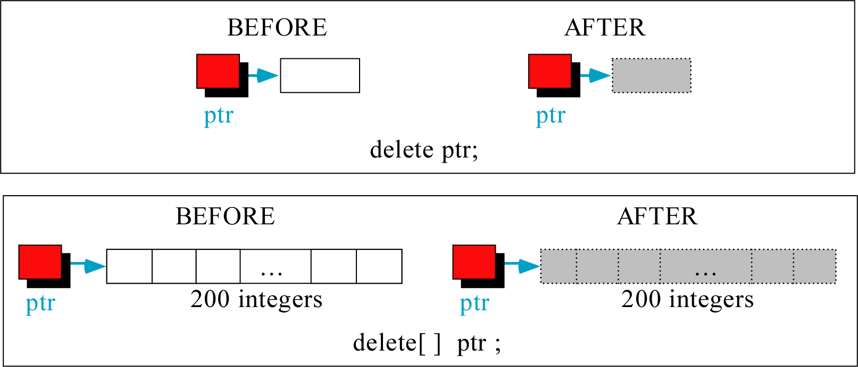
Freeing (or deleting) Memory

Slide 42
A Simple Dynamic List Example
cout << "Enter list size: ";
int n;
cin >> n;
int *A = new int[n];
if(n<=0){
cout << "bad size" << endl;
return 0;
}
initialize(A, n, 0); // initialize the array A with value 0
print(A, n);
A = addElement(A,n,5); //add an element of value 5 at the end of A
print(A, n);
A = deleteFirst(A,n); // delete the first element from A
print(A, n);
selectionSort(A, n); // sort the array (not shown)
print(A, n);
delete [] A;

Slide 43
Initialize
void initialize(int list[], int size, int value){
for(int i=0; i<size; i++)
list[i] = value;
}

Slide 44
print()
void print(int list[], int size) {
cout << "[ ";
for(int i=0; i<size; i++)
cout << list[i] << " ";
cout << "]" << endl;
}
Remember in C++, array parameters are always passed
by reference. That is, void print(int list[], int size) {…} is the same as
void print(int * list , int size) {…}
Note: no & used here, so, the pointer itself is passed by value

Slide 45
Adding Elements
// for adding a new element to end of array
int* addElement(int list[], int& size, int value){
int* newList = new int [size+1]; // make new array
if(newList==0){
cout << "Memory allocation error for addElement!" << endl;
exit(-1);
}
for(int i=0; i<size; i++)
newList[i] = list[i];
if(size) delete [] list;
newList[size] = value;
size++;
return newList;
}

Slide 46
Delete the first element
// for deleting the first element of the array
int* deleteFirst(int list[], int& size){
if(size <= 1){
if( size) delete list;
size = 0;
return NULL;
}
int* newList = new int [size-1]; // make new array
if(newList==0){
cout << "Memory allocation error for deleteFirst!" << endl;
exit(-1);
}
for(int i=0; i<size-1; i++) // copy and delete old array
newList[i] = list[i+1];
delete [] list;
size--;
return newList;
}

Slide 47
Adding Element (version 2)
// for adding a new element to end of array
// here “list” is a reference to a pointer variable: if the value of the pointer is changed in function, the change is global.
void addElement( int * & list, int & size, const int value ){
int * newList = new int [size + 1];
if( newList == NULL ){
cout << "Memory allocation error for addElement!" << endl;
exit(-1);
}
for( int i = 0; i < size; i++ )
newList[ i ] = list[ i ];
if( size ) delete [] list;
newList[ size ] = value;
size++;
list = newList;
return;
}

Slide 48
Deleting Element (version 2)
void deleteFirst( int * & list, int & size ){
if( size <= 1 ){
if( size )
delete list;
list = NULL;
size = 0;
return;
}
delete list; // delete the first element
list++;
size--;
return;
}

Slide 49
Another Main program
int main(){
int * A = NULL;
int size = 0;
int i;
for( i = 0; i < 10; i++ )
addElement( A, size, i );
for( i = 0; i < 10; i++ )
cout << A[i] << " ";
cout << endl;
for( i = 0; i < 4; i++ )
deleteFirst( A, size );
for( i = 0; i < 6; i++ )
cout << A[i] << " ";
cout << endl;
return 0;
}
0 1 2 3 4 5 6 7 8 9
4 5 6 7 8 9

Slide 50
Dangling Pointer Problem
int *A = new int[5];
for(int i=0; i<5; i++)
A[i] = i;
int *B = A;
delete [] A;
B[0] = 1; // illegal!

Slide 51
Memory Leak Problem
int *A = new int [5];
for(int i=0; i<5; i++)
A[i] = i;
A = new int [5];
1
2
3
A
0
2
4

Slide 52
A Dynamic 2D Array
A dynamic array is an array of pointers to save space when not all rows of the array are full.
int **table;
table
32
18
12
24
table[0]
table[1]
table[2]
table[3]
table[4]
table[5]
13
11
16
12
42
19
14
22
13
13
14
11
18
table = new int*[6];
…
table[0] = new int[4];
table[1] = new int[7];
table[2] = new int[1];
table[3] = new int[3];
table[4] = new int[2];
table[5] = NULL;

Slide 53
Memory Allocation
int **table;
table = new int*[6];
table[0]= new int[3];
table[1]= new int[1];
table[2]= new int[5];
table[3]= new int[10];
table[4]= new int[2];
table[5]= new int[6];
table[0][0] = 1; table[0][1] = 2; table[0][2] = 3;
table[1][0] = 4;
table[2][0] = 5; table[2][1] = 6; table[2][2] = 7; table[2][3] = 8; table[2][4] = 9;
table[4][0] = 10; table[4][1] = 11;
cout << table[2][5] << endl;

Slide 54
Memory Deallocation
Memory leak is a serious bug!
Each row must be deleted individually
Be careful to delete each row before deleting the table pointer.
for(int i=0; i<6; i++)
delete [ ] table[i];
delete [ ] table;

Slide 55
Create a matrix of any dimensions, m by n:
Put it into a function:
int m, n;
cin >> m >> n >> endl;
int** mat;
mat = new int*[m];
for (int i=0;i<m;i++)
mat[i] = new int[n];
int m, n;
cin >> m >> n >> endl;
int** mat;
mat = imatrix(m,n);
…
int** imatrix(nr, nc) {
int** m;
m = new int*[nr];
for (int i=0;i<nr;i++)
m[i] = new int[nc];
return m;
}

