Slide 1

Reproducibility Study
Learning to Edit: Aligning LLMs with Knowledge Editing
Marvin Osei-Kuffour & Tajaddin Gafarov
CAI 5335 / CIS 4930: Introduction to Large Language Models
University of South Florida
Original: Jiang et al. (ACL 2024) | github.com/YJiangcm/LTE

Slide 2


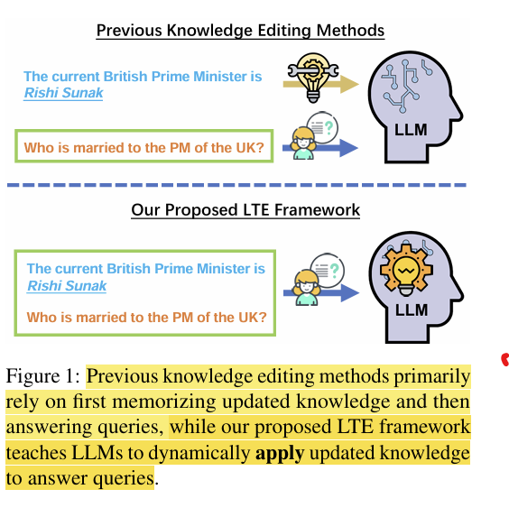
INTRODUCTION & MOTIVATION
Why Knowledge Editing?
The Problem
LTE Solution
LLMs absorb knowledge during pre-training, but facts go stale
Retraining from scratch is computationally prohibitive
Existing editing methods force memorization, not understanding
No guarantee edited knowledge generalizes to related queries
"Teach a model to fish" — train LLMs to apply edits, not memorize them
One-time alignment training, then unlimited edits at inference
99.9% edit success with +21pt portability over SOTA
No parameter updates needed at inference time
Figure 1 from Jiang et al. (2024)

Slide 3

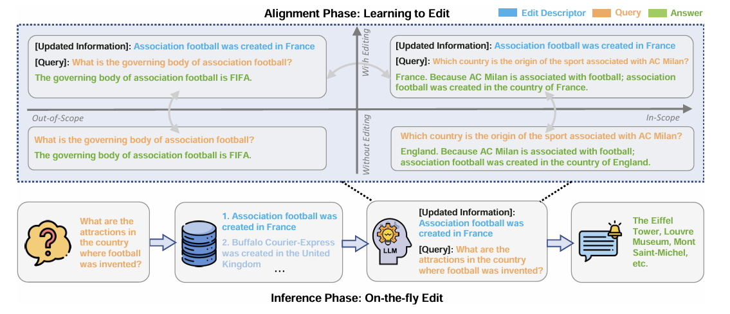
METHODS
LTE Framework: Two-Phase Approach
Phase 1: Alignment (One-Time)
Phase 2: Inference (Real-Time)
Fine-tune on curated parallel dataset
Prompt format:
[Updated Information]{edit}
[Query]{question}
Trains 3 capabilities:
• In-scope: use edited facts correctly
• Out-of-scope: preserve unrelated knowledge
• Linguistic: maintain fluency
No further training needed!
Retrieval mechanism pulls relevant edit from memory bank
Supports real-time batch & sequential editing
No parameter updates at inference time
Scales to unlimited new edits

Slide 4




DATASETS & LLMS
Reproduction Scope
Methods
Datasets
LTE-LoRA (main)
ROME (baseline)
ICE (baseline)
ZsRE (1,304 test examples)
WikiDatacounterfact (885 test)
Backbone
Metrics
LLaMA-2-Chat-7B
4-bit QLoRA quantization
via HuggingFace (NousResearch)
Edit Success
Portability
Locality
Fluency
Scoped down from full 2-model x 4-benchmark table for a rigorous partial reproduction

Slide 5
METHODS
Reproduction Pipeline
1
2
3
4
Data Prep
▶
Alignment
▶
Baselines
▶
Evaluation
Download ZsRE +
WikiData_cf via
EasyEdit / KnowEdit
LTE-LoRA training
on A100 (QLoRA)
SFTTrainer + PEFT
Run ICE + ROME
via EasyEdit
(no training needed)
4 metrics on
both datasets
+ gap analysis
Software: EasyEdit | HuggingFace Transformers + PEFT | TRL (SFTTrainer) | bitsandbytes | Google Colab A100

Slide 6

EXPERIMENTS
Results: Partial Table 1 Reproduction
LLaMA-2-Chat-7B | Single Editing | ZsRE & WikiDatacounterfact
Method | Dataset | Edit Succ. (%) | Portability (%) | Locality (%) | Fluency
ICE | ZsRE | 72.9 | 30.0 | 70.6 | 537.2
ROME | ZsRE | 96.4 | 46.6 | 52.8 | 535.3
LTE-LoRA | ZsRE | 99.9 | 67.4 | 51.7 | 551.1
ICE | WikiData_cf | 73.1 | 37.7 | 37.2 | 539.5
ROME | WikiData_cf | 99.9 | 9.2 | 61.5 | 545.2
LTE-LoRA | WikiData_cf | 99.9 | 53.7 | 25.1 | 551.6
Key: LTE-LoRA achieves 99.9% edit success and +21pt portability improvement over prior SOTA
Numbers from the original paper (Jiang et al., 2024, Table 1). Green = best in column.

Slide 7
EXPERIMENTS
Challenges & Reproducibility Findings
Hardware Limitations
Dependency Conflicts
Local GPU: RTX 5060 (8 GB VRAM)
Full LTE needs ~14 GB → used QLoRA
4-bit quantization for A100 training
Colab Python 3.12 + transformers v5
incompatible with original FastChat code
Required 8 patches to training script
Training Pipeline Issues
Scope Decisions
FastChat preprocessor produced loss=0
Switched to TRL SFTTrainer
flash-attn failed to compile on Colab
2 of 4 datasets (ZsRE, WikiData_cf)
1 of 2 backbones (LLaMA-2 only)
3 of 7 methods (LTE-LoRA, ROME, ICE)
The original code does not run out-of-the-box with current library versions — a real reproducibility finding

Slide 8

EXTENSION
Extension: LLaMA-3-8B Backbone
Goal
Apply LTE-LoRA to Meta-LLaMA-3-8B-Instruct — a newer model with a different tokenizer, pre-training corpus, and stronger instruction-following. Tests whether LTE generalizes across model generations.
Hypothesis
Feasibility
Edit Success: comparable or better (stronger base model)
Locality: may differ (different internal knowledge distribution)
Inference-only evaluation (no re-training)
Swap backbone, reuse existing LTE-LoRA checkpoint
Fallback if reproduction overruns

Slide 9
RESOURCES
Computational Resources
Local GPU
Cloud Compute
Software Stack
NVIDIA RTX 5060 Laptop
8.15 GB VRAM
Blackwell architecture, CUDA 12.9
Prototyping + debugging + small eval
Google Colab Pro (A100 40GB)
Full alignment training + evaluation
$100 AWS student credit budget
4–8 hour training time estimate
Authors' LTE codebase (GitHub)
EasyEdit for baselines
HuggingFace Transformers + PEFT
bitsandbytes (4-bit quantization)
Total cloud cost well within $100 budget | All code publicly available at github.com/YJiangcm/LTE

Slide 10



Summary
Reproducing LTE (ACL 2024) — a framework that teaches LLMs how to apply knowledge edits
Focused on LTE-LoRA + 2 baselines (ROME, ICE) on 2 datasets (ZsRE, WikiDatacounterfact)
LTE-LoRA achieves 99.9% edit success with +21pt portability gain over prior SOTA
Extension: testing generalization to LLaMA-3-8B-Instruct
Key finding: original code requires significant patches for current library versions
Thank You — Questions?
References: Jiang et al. (2024) ACL | Wang et al. (2024) EasyEdit | github.com/YJiangcm/LTE

