Slide 1

Customer Churn Analysis
Telecom Subscription Data — SQL · Excel · Power BI
DATA CLEANING
SQL ANALYSIS
POWER BI DASHBOARD
BUSINESS INSIGHTS

Slide 2

Project Overview
Raw customer data cleaned, explored via SQL, and visualized in Power BI to identify who is churning, why, and where to focus retention.
Excel
Data cleaning
SQL
Querying & analysis
Power BI
Interactive dashboard
Jupyter
Exploration

Slide 3
Key Metrics
442
105
335
Total Customers
Churned
Retained
23.76%
₹21.96M
Churn Rate
Total Revenue

Slide 4
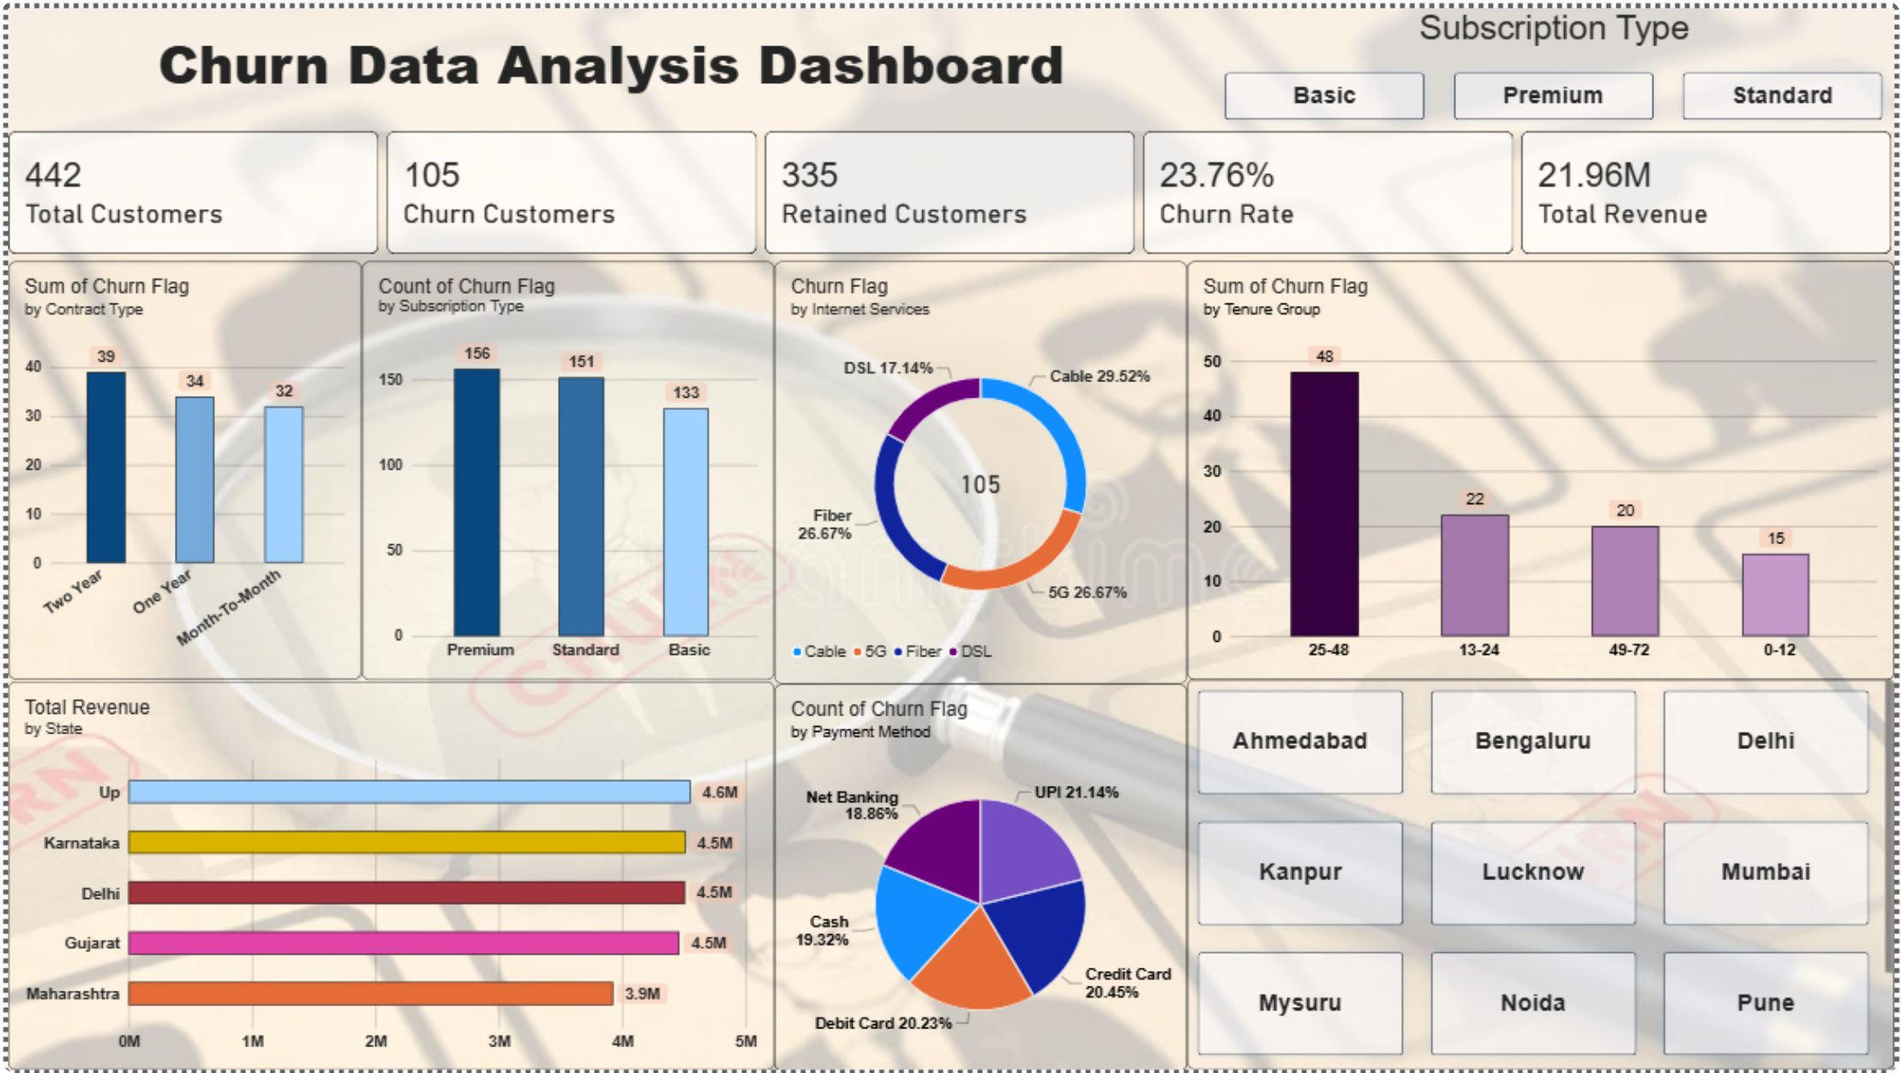
Power BI Dashboard
Churn broken down by contract type, subscription plan, internet service, tenure, state, and payment method.

Slide 5
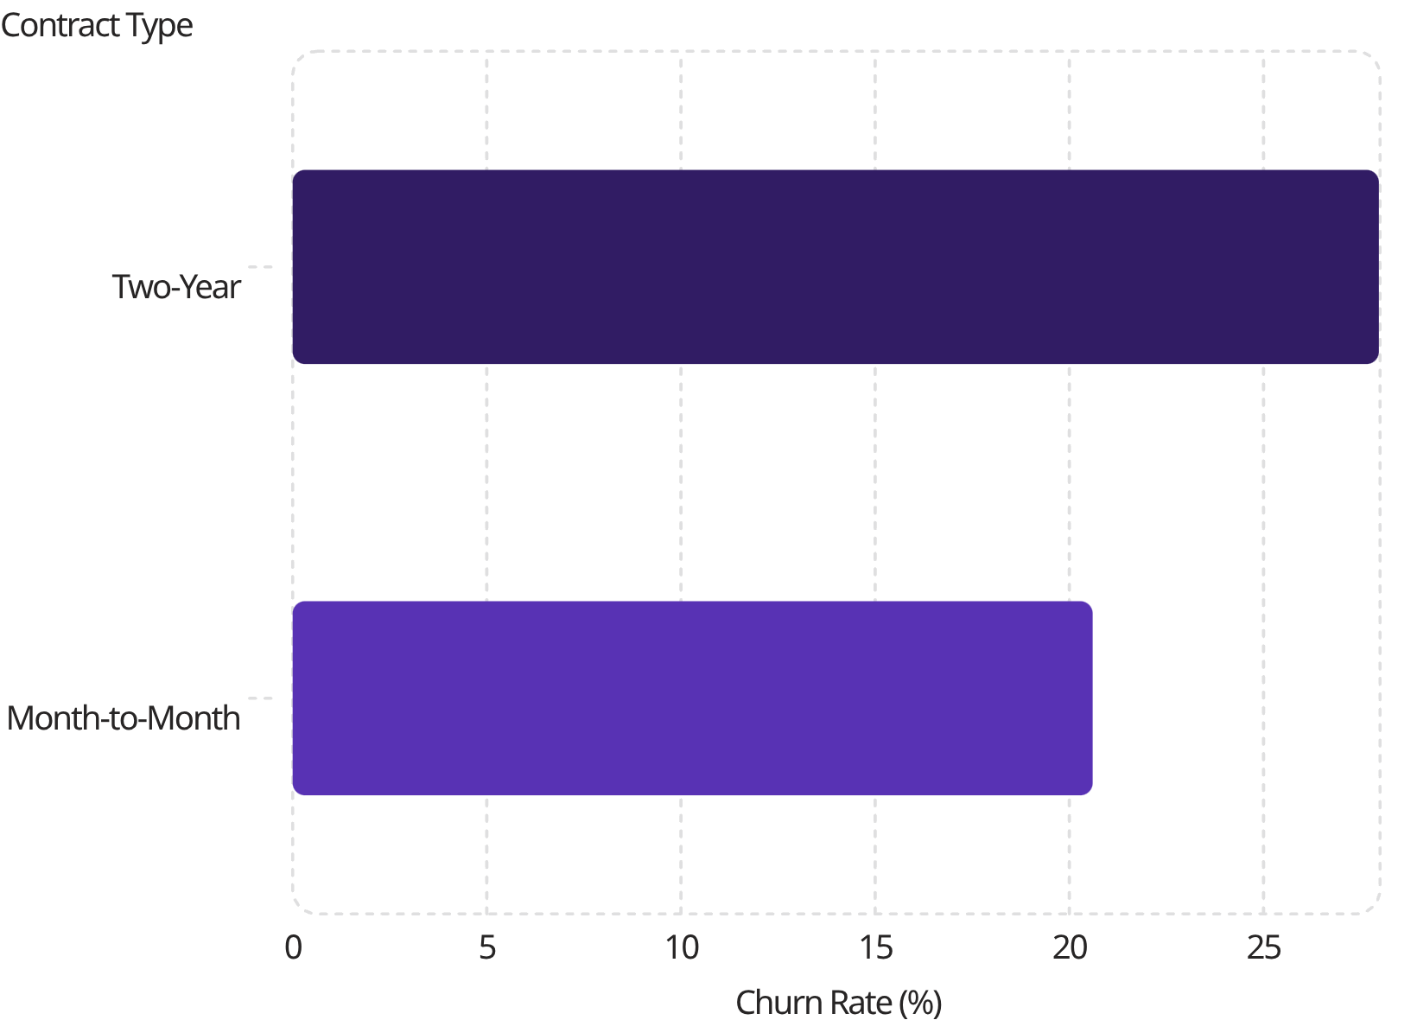
Contract & Subscription Insights
Key Findings
Two-Year contracts churn most — long-term commitment isn't preventing churn
Standard & Premium subscribers churn ~2x more than Basic
High-value customers are at higher churn risk

Slide 6
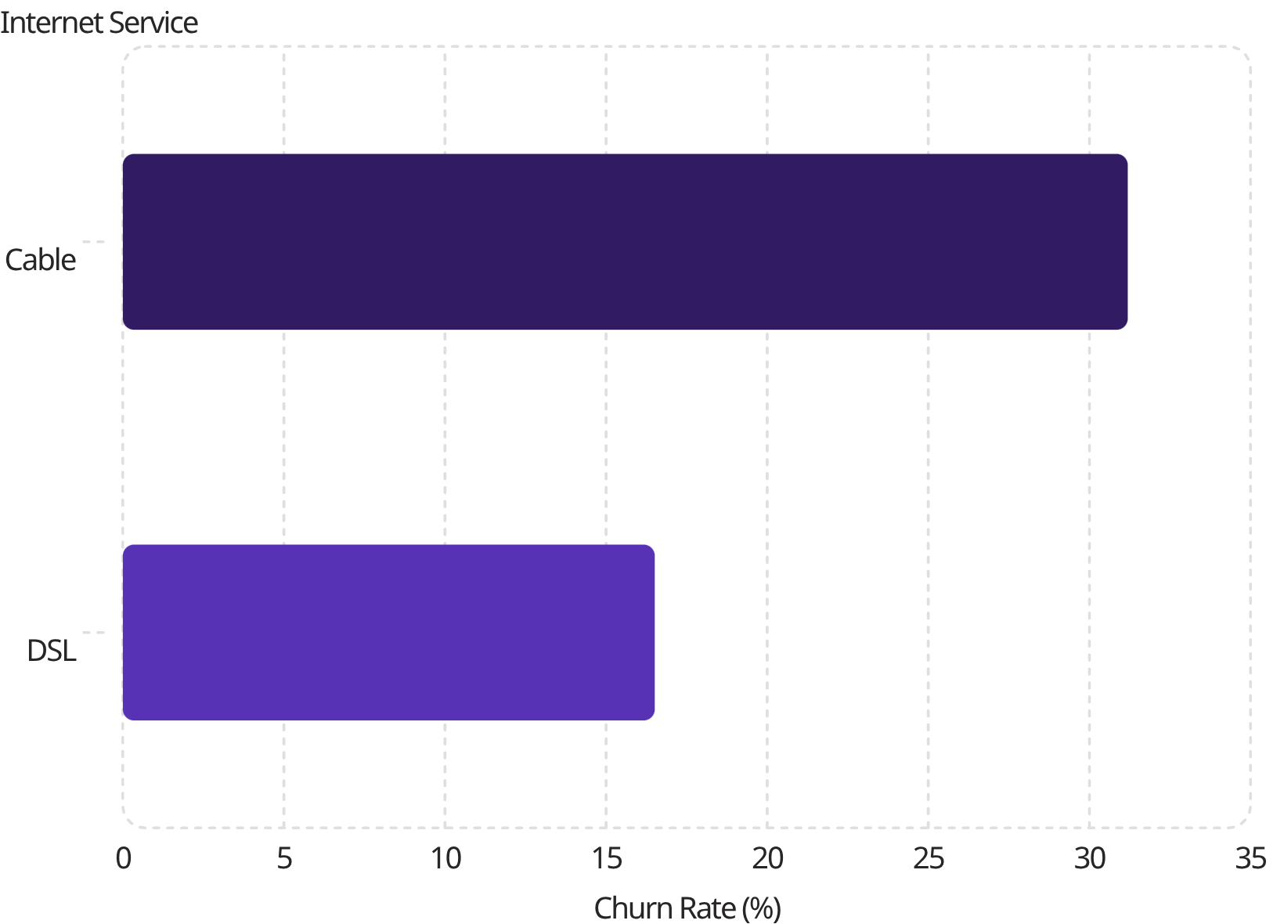
Service Quality & Customer Lifecycle
Service Quality
Cable has highest churn (31.19%)
DSL has lowest churn (16.51%)
Customer Lifecycle
Churn peaks at 13–48 months tenure (28.40%)
Beyond 4 years: only 13.9% churn
Mid-term customers are the priorities

Slide 7



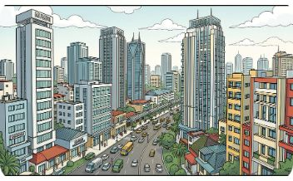
Behavioral & Geographic Patterns
Customers with Dependents
Tech Support Usage
Uttar Pradesh
Maharashtra
Minimal impact on churn — not a strong retention driver
Highest regional churn: 27.96%
Lowest regional churn: 16.46%
Churn 26.6% — unexpected trend worth deeper analysis

Slide 8
SQL Analysis Approach
Cleaned dataset loaded into customer_churn table — queried for churn rate, averages, and segment breakdowns.
Analysis | Purpose
Overall churn rate | % churned vs. total
Churn by contract & internet | Segment comparisons
Churn by state | Highest-churn regions
Avg. charges & tenure | Baseline customer profile
Top 10 high-value customers | Ranked by customer_value
Customers without tech support | Churn-driver review

Slide 9

Business Recommendations
Target 13–48 month tenure window
Improve Cable internet quality
Loyalty programs for Premium/Standard subscribers
Investigate Uttar Pradesh regional causes
Design targeted offers for customers with dependents

Slide 10
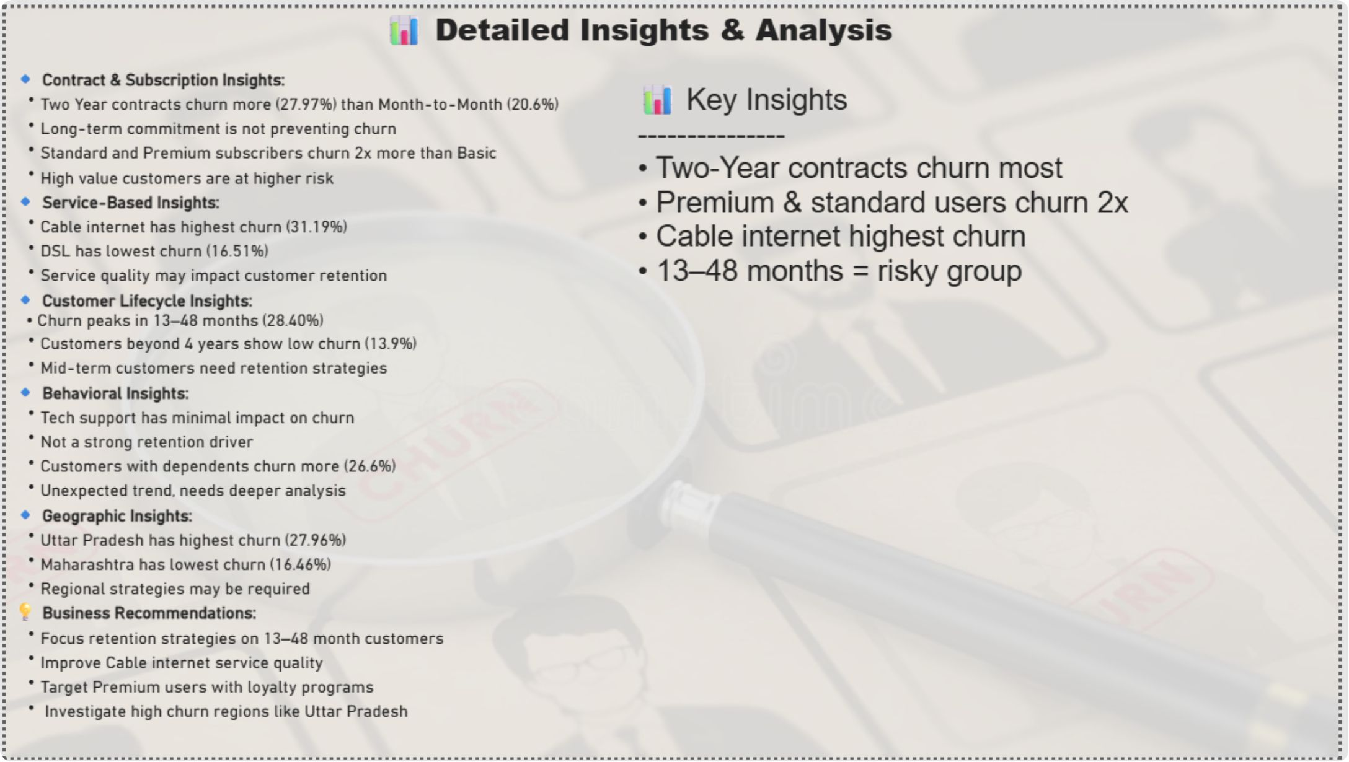

Conclusion
Where Churn Concentrates
Mid-tenure customers (13–48 months)
Premium & Standard subscribers
Cable internet users
High-churn states (e.g. Uttar Pradesh)
Targeted retention in these segments offers the clearest path to reducing the 23.76% churn rate.

