Slide 1
CIRCLE 2 PRESENTATION SLIDE INTRODUCTION
The parch and posey database contains the order, accounts, web events, region and sales reps table.
The data in these tables are clean and in proper data types.
This implies that the database is analysis-ready.
Exploratory analysis shows that 3,675,765 orders were placed by 6912 distinct customers. These orders generated a revenue of $23,141,511.83 in 5 years.
The organization also have 50 sales representatives and are present in 4 regions.
Cost incurred within this period was not provided. Therefore, we cannot calculate net profit.

Slide 2
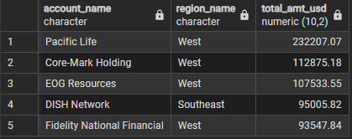
TOP ACCOUNTS PER REGION

Slide 3
INSIGHTS FROM TOP ACCOUNTS
The top accounts patronizing the company are Pacific Life, Core Mark Holding, EOG Resources, DISH Network and Fidelity National Financial.
These accounts should be retained by launching retention offers
Solid customer relationship should be established with them to make sure whatever issues they main run into is promptly attended to.
For customers with low order frequency or those who have churned, a targeted campaign can bring them back.
Have your sales reps or account managers check in with these accounts, not just to sell, but to understand their needs and challenges. Use this information to offer solutions and build trust, which can lead to higher-value sales down the line.

Slide 4
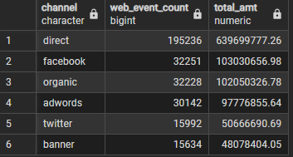
AMOUNT GENERATED PER WEB EVENT CHANNELS

Slide 5
INSIGHTS FROM AMOUNT GENERATED PER WEB EVENT CHANNELS
The "direct" channel is the most effective and profitable, accounting for a massive 195,236 orders. This signifies that a large portion of customers are either loyal, already familiar with the company, or actively seeking it out by directly visiting the website. This suggests strong brand recognition or customer loyalty.
Facebook is the second most successful channel, with 32,251 orders. While it's a distant second to the direct channel, its contribution is still substantial, indicating that social media marketing on Facebook is a highly effective way to drive sales.
Twitter and banner channels brought in the lowest sales. This indicates that the company's marketing efforts or presence on these platforms are not as effective at converting to sales compared to direct traffic and Facebook.

Slide 6
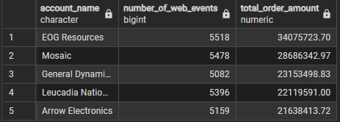
ACCOUNTS WITH THE HIGHEST ORDERS AMOUNT FROM WEB EVENTS

Slide 7
INSIGHT FROM ACCOUNTS WITH THE HIGHEST ORDERS AMOUNT FROM WEB EVENTS
EOG Resources stands out as the single most valuable customer, with a total order amount of over $34 million. While their number of web events (5,518) is not significantly higher than the others on the list, their spending is in a class of its own. This indicates that their orders are of a much larger average size or value compared to the other top accounts.
The accounts Mosaic, General Dynamics, Leucadia National, and Arrow Electronics all show a similar pattern:
Their total order amounts are all in the range of $21 million to $28 million.
Their number of web events are also closely clustered, ranging from just over 5,000 to just under 5,500.
This suggests that these are all major, high-value clients with a similar buying and engagement behavior. They are very active online and generate significant revenue.

Slide 8
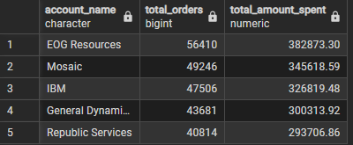
HIGH VALUE ACCOUNTS

Slide 9
HIGH VALUE ACCOUNTS
EOG Resources is the undisputed leader, generating over $34 million in sales, which is significantly more than the other accounts on the list. The other four accounts—Leucadia National, General Dynamics, Mosaic, and Arrow Electronics—are all in a similar, elite class, each contributing over $20 million in revenue.
The company's strategy should heavily focus on retaining and growing these five accounts. Given their massive contribution to revenue, ensuring their satisfaction and nurturing these relationships is paramount. The performance of the sales representatives associated with these accounts—especially Samara Bell—is a key driver of the company's financial success.

