Slide 1


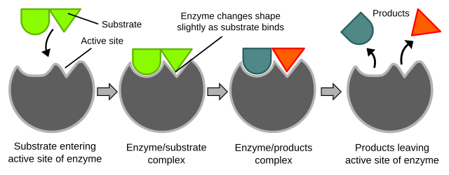
Enzyme Immobilization
Microbial Enzyme Technology
MIC-4511
PREPARED BY: Ms. Noor
Department of Microbiology

Slide 2
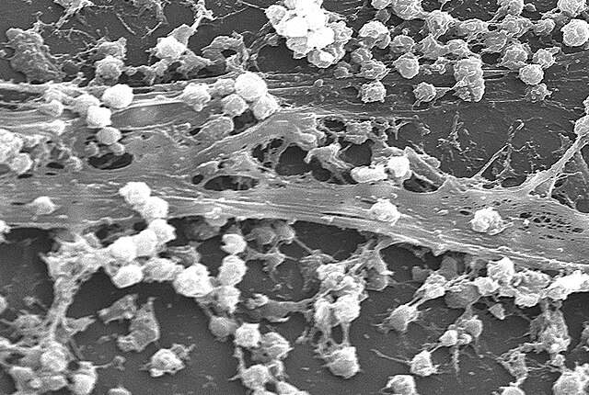
Learning objectives
Define products in the context of Enzyme Immobilization.
Staphylococcus biofilm SEM · CDC / Janice Carr · Public domain (CDC)
02 / 12

Slide 3

Products — Enzyme Immobilization
Antibiotics (Penicillium, Streptomyces), industrial enzymes (amylases, proteases, cellulases).
Organic acids, vitamins, and recombinant proteins (insulin, vaccines) in E. coli or CHO.
Immobilised cells and enzymes improve reuse; alginate beads are the teaching example.
Synthetic biology: pathway refactoring, CRISPR, cell-free systems for rapid prototyping.
Alginate hydrogel beads · JUW-MicroSlides teaching visual (CC0) · CC0
03 / 12
Koch R. Die Aetiologie der Tuberkulose. Mitt Kaiserlichen Gesundheitsamte. 1884:1–88.

Slide 4
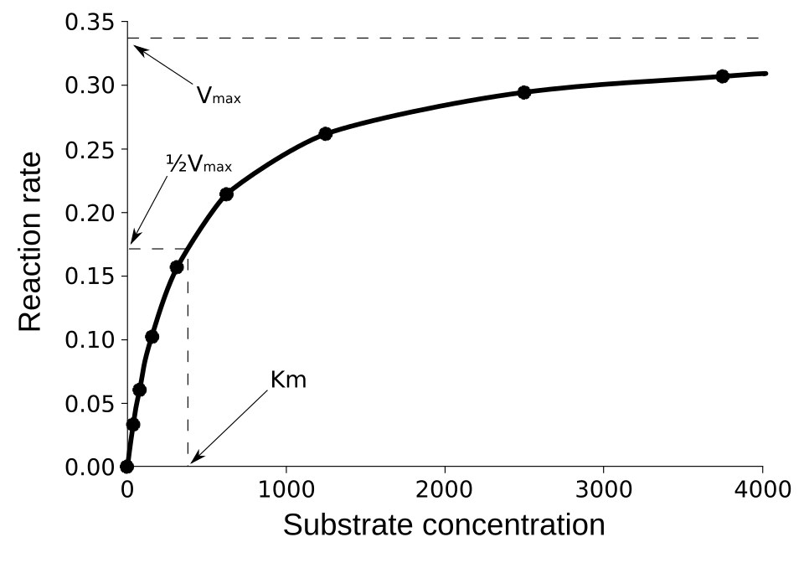
What Enzyme Immobilization actually is
Give a one-sentence operational definition of Enzyme Immobilization that a first-year could mark.
Name the scale (molecule, cell, population, process) this lecture lives on.
State what it is not — the nearest confusion students bring into the room.
Write the noun you want on the exam script and nowhere else.
Michaelis–Menten saturation curve · Wikimedia Commons · CC BY-SA
04 / 12

Slide 5
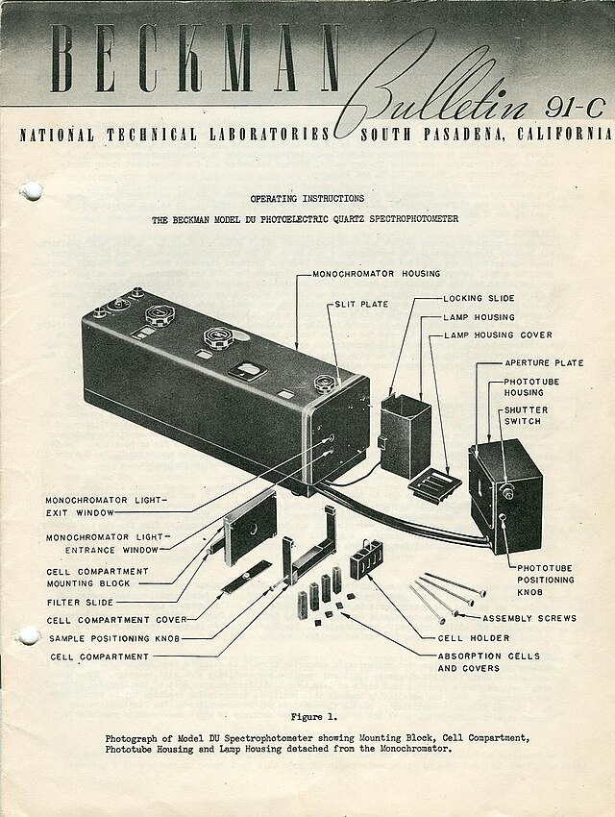
Why Enzyme Immobilization was hard to see
Which method first made the phenomenon visible (stain, culture, assay, sequence, sensor)?
What did a negative result mean in that first method?
Which modern method replaced it for treatment or process decisions?
Flag one artefact that still fools student practicals.
Laboratory spectrophotometer · Wikimedia Commons · CC BY-SA
05 / 12

Slide 6
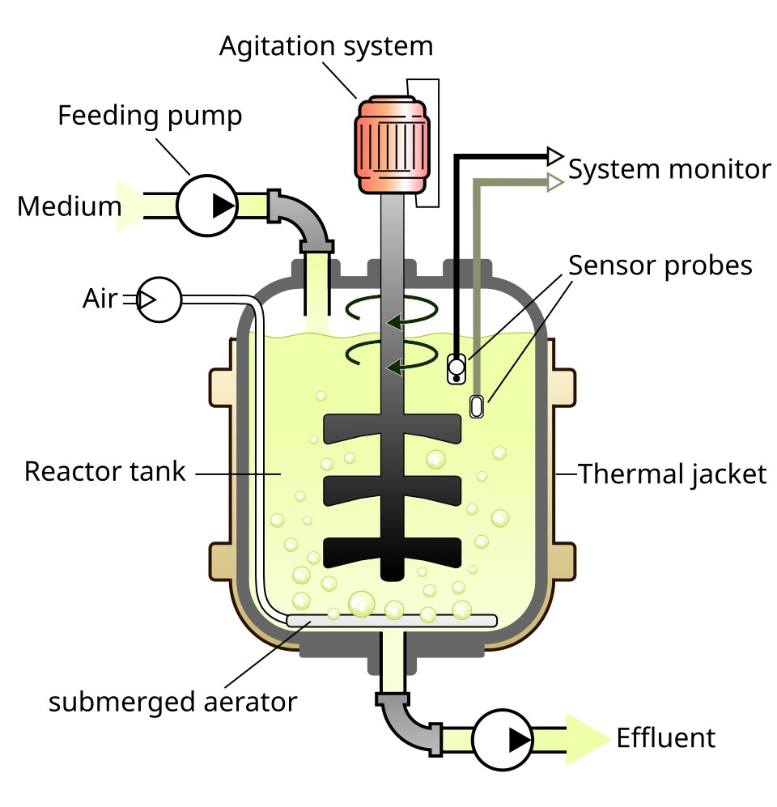
Enzyme Immobilization: compare and contrast
What a novice confuses this with
Shared jargon or surface features
Where the textbooks overlap
The discriminating test or structure
The cost of getting it wrong
The one sentence that should stay on the exam
Stirred-tank bioreactor · Wikimedia Commons · CC BY-SA
06 / 12

Slide 7
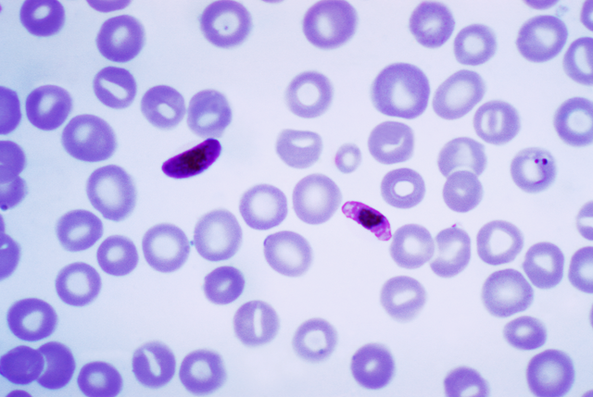
Methods that make Enzyme Immobilization visible
Name the first-line stain, culture, or assay you would run before specialised tests for Enzyme Immobilization.
State what a negative result does — and does not — rule out.
Pair a rapid method with a confirmatory method and say which is used for a decision.
Flag one biosafety or contamination trap in the student laboratory.
Plasmodium falciparum ring forms · CDC / Dr. Mae Melvin · Public domain (CDC)
07 / 12

Slide 8
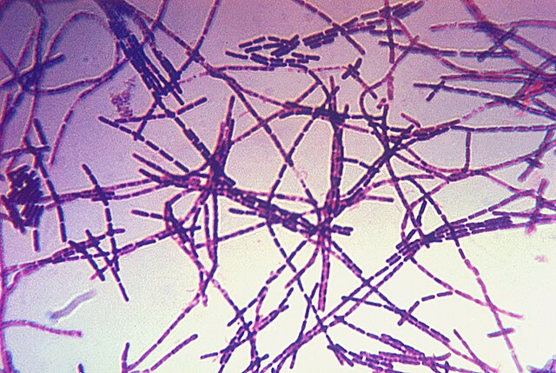
Read this figure — Enzyme Immobilization
What is the specimen, stain, or schematic actually showing?
Which labelled structure would be absent in a knockout or a failed process?
Write one exam-style question whose answer is on this figure.
Bacillus anthracis Gram stain · CDC · Public domain (CDC)
08 / 12

Slide 9
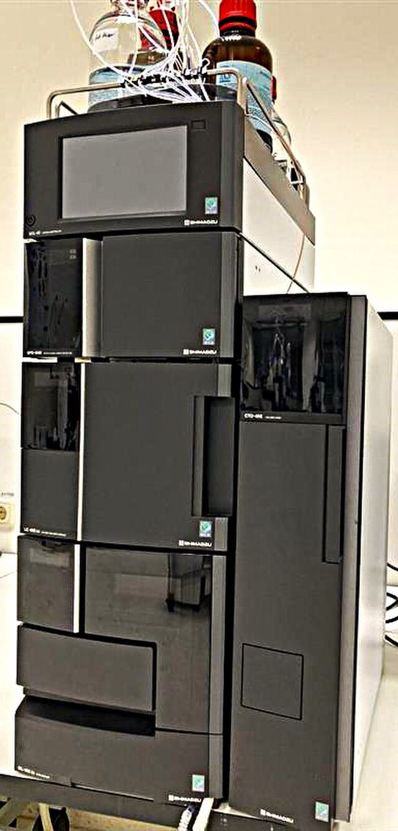
Case vignette — Enzyme Immobilization
Give the room a short stem (patient, plant, fermenter, or outbreak) with two red herrings.
Ask which observation would change the working model of Enzyme Immobilization.
Require one cited mechanism, not a list of names.
Instructor brief: JUW MIC-4511 Microbial Enzyme Technology. Prepared by Ms. Noor.
HPLC chromatography system · Wikimedia Commons · CC BY-SA
09 / 12

Slide 10

Why Enzyme Immobilization matters
Connect Enzyme Immobilization to diagnostics, therapeutics, or environmental practice the class will meet this term.
Identify one misconception a first-year student typically brings into the room.
Name a method (stain, culture, PCR, serology, sequencing) that makes the organism or process visible.
Instructor emphasis: JUW MIC-4511 Microbial Enzyme Technology. Prepared by Ms. Noor.
Chlorella cells · JUW-MicroSlides teaching visual (CC0) · CC0
10 / 12
Woese CR, Fox GE. Phylogenetic structure of the prokaryotic domain: the primary kingdoms. Proc Natl Acad Sci USA. 1977 74:5088–5090. doi:10.1073/pnas.74.11.5088

Slide 11
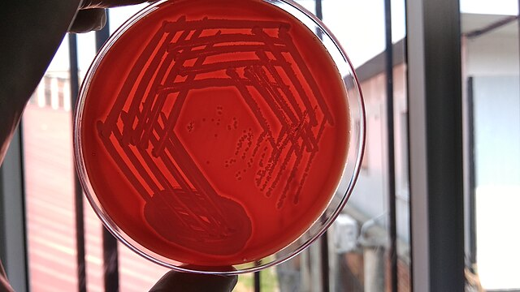
Take-home points
Antibiotics (Penicillium, Streptomyces), industrial enzymes (amylases, proteases, cellulases).
Bacterial colonies on agar · N. F. / Wikimedia Commons · CC BY-SA 3.0
11 / 12

Slide 12
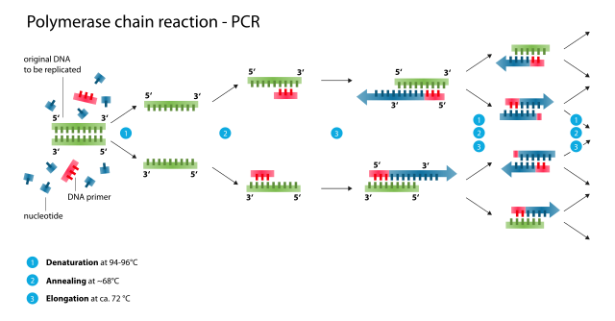
Selected references
Koch R (1884). Die Aetiologie der Tuberkulose.
Woese CR, Fox GE (1977). Phylogenetic structure of the prokaryotic domain: the primary kingdoms.
PCR thermal cycle · Enzoklop / Wikimedia · CC BY-SA 3.0
12 / 12
Koch R. Die Aetiologie der Tuberkulose. Mitt Kaiserlichen Gesundheitsamte. 1884:1–88. · Woese CR, Fox GE. Phylogenetic structure of the prokaryotic domain: the primary kingdoms. Proc Natl Acad Sci USA. 1977 74:5088–5090. doi:10.1073/pnas.74.11.5088

