Slide 1


NSU-ACM-W-SC LEARNING BOOTCAMP-2021

Slide 2
PROJECT NAME: TRENDZTA
TRENDZTA is a clothing e-commerce website.
Framework: HTML5, CSS3 and BOOTSTRAP4.
The website is responsive.
The website has total of 8 sections.
The sections are: Navbar, Carousal, Sub-bar, New Collection, Parallex, Featured Collection, Latest Articles, Contact.
As the project is an e-commerce website it can be used by any shop for their online business purpose. As for now it is one page but in the future I have plan to extend it further and make it a complete responsive e-commerce website with modern features.

Slide 3
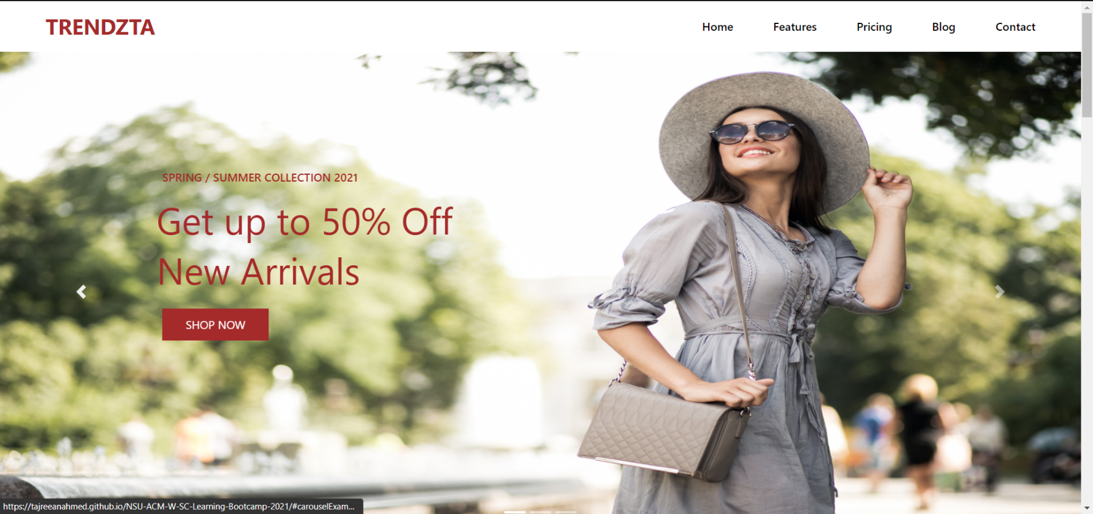
TRENDZTA

Slide 4
GITHUB LINK
https://tajreeanahmed.github.io/NSU-ACM-W-SC-Learning-Bootcamp-2021/

Slide 5
Thank You!

