Slide 1
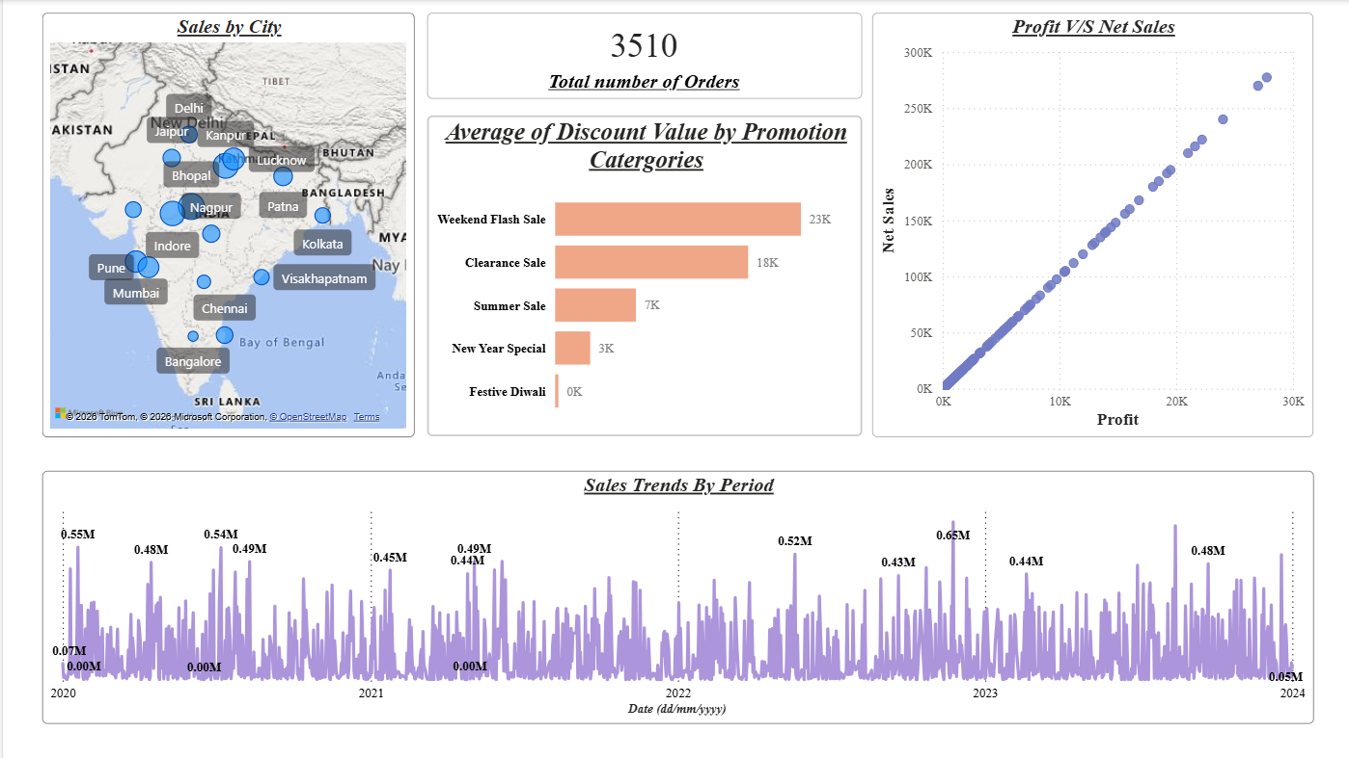
ELECTROHUB
Sales Analytics Dashboard
A Power BI report on 3,510 orders across 50 customers, 30 products and 5 promotions, 2020 to 2023
Notes:
Welcome. This deck walks through the ElectroHub Power BI dashboard: what it answers, how the data is modelled, and what the visuals show.

Slide 2
What the dashboard answers
1
2
3
4
Top / bottom 5 products by sales, profit and quantity
How sales trend over time
Relationship between sales and profit
Compare any two periods chosen by the user
5
6
7
8
Average discount per promotion category
Total number of orders
Order-level details with visual filters
Sales by city
Notes:
These are the eight requirements the dashboard was built to meet. Each of the next slides maps back to one or more of them.

Slide 3
Star-schema data model
Dim Customers
Fact: Orders (Sheet3)
Dim Product
Customer ID, Name
City, State, Pincode
EmailID, Phone Number
50 customers
Date, CustomerID, PromotionID
Product ID, Units Sold
Price Per Unit, Total Sales
Discount %, Discount Value
Net Sales (3,510 rows)
ProductID, Product Name
Product Line
Price (INR)
30 products
Dim Promotion
ID, Name, Ad Type, Coupon Code, Reduction Type
5 promotions
Notes:
One fact table of orders joined to three dimension tables for customers, products and promotions. Every visual in the report slices the same fact table.

Slide 4
The headline numbers
3,510
122M
12.2M
7.1K
Total orders
Net sales (INR)
Total profit
Units sold
About 10% profit margin (12.2M profit on 122M net sales), 1 Jan 2020 to 1 Jan 2024
Notes:
Across the full period the business made 122M in net sales and 12.2M in profit from 3,510 orders and about 7,100 units.

Slide 5
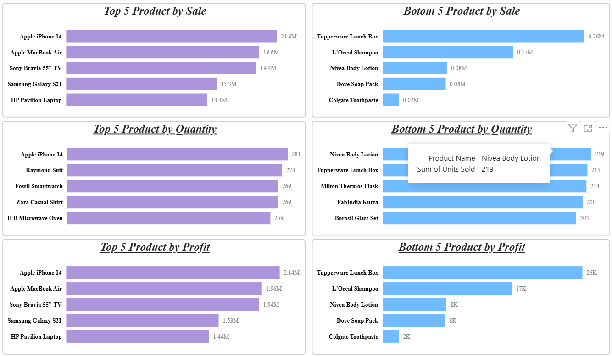
Top and bottom 5 products
Sales
iPhone 14 leads at 21.4M; Colgate Toothpaste trails at 0.02M
Quantity
Bottom 5 still sell 203 to 219 units: low price, not low demand
Profit
Electronics fill the top 5, led by iPhone 14 at 2.14M
Notes:
Purple bars are the top five, blue bars the bottom five. High-ticket electronics dominate sales and profit, while apparel and accessories lead on units sold.

Slide 6
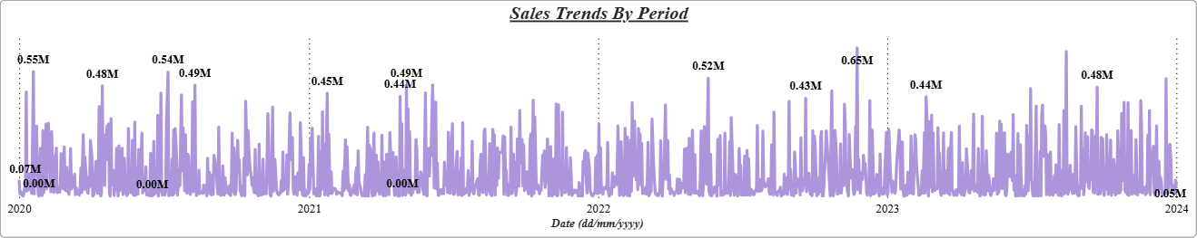
Sales trend over time
Spiky, not smooth
Daily sales jump to 0.4M to 0.65M against a low baseline
Highest peak
About 0.65M, around late 2022
Quiet days
Some days drop to 0.00M, so demand is uneven
Notes:
The line chart plots net sales by date from 2020 to 2024. Labelled points mark the biggest peaks and the zero-sales days.

Slide 7
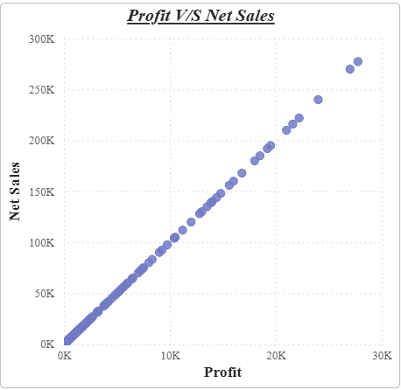
Sales and profit move together
A straight line
Profit rises in direct proportion to net sales
About 10% margin
12.2M profit on 122M net sales
Biggest order
Roughly 278K net sales earning about 28K profit
Notes:
Each dot is an order. They sit almost perfectly on a line, which shows profit is a steady share of net sales.

Slide 8
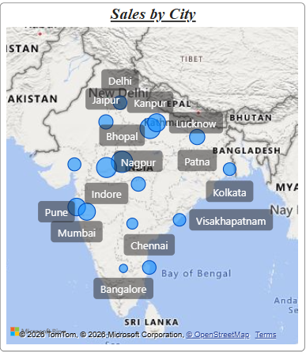
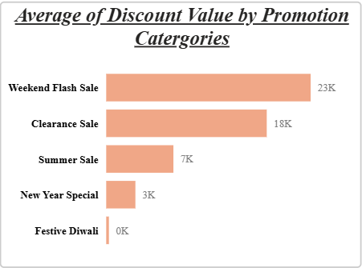
Where we sell, how we discount
Bubble size shows sales in each city across India
Weekend Flash Sale has the highest average discount value (23K); Festive Diwali is near zero
Notes:
Left: sales by city on a map. Right: average discount value for each promotion category.

Slide 9
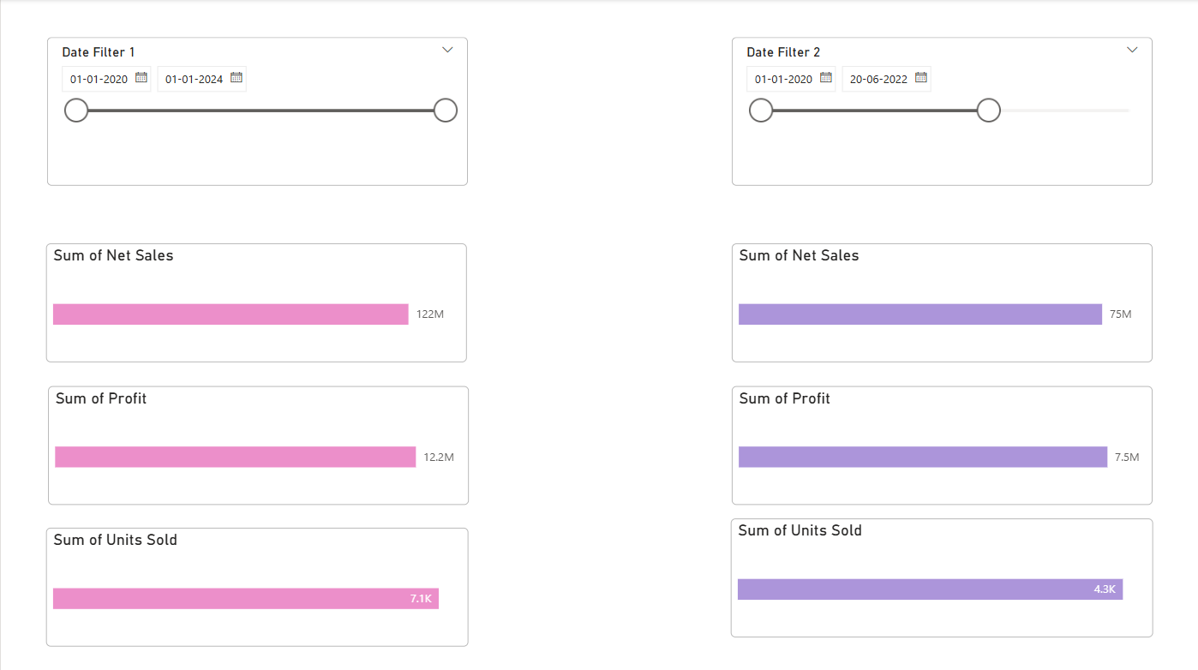
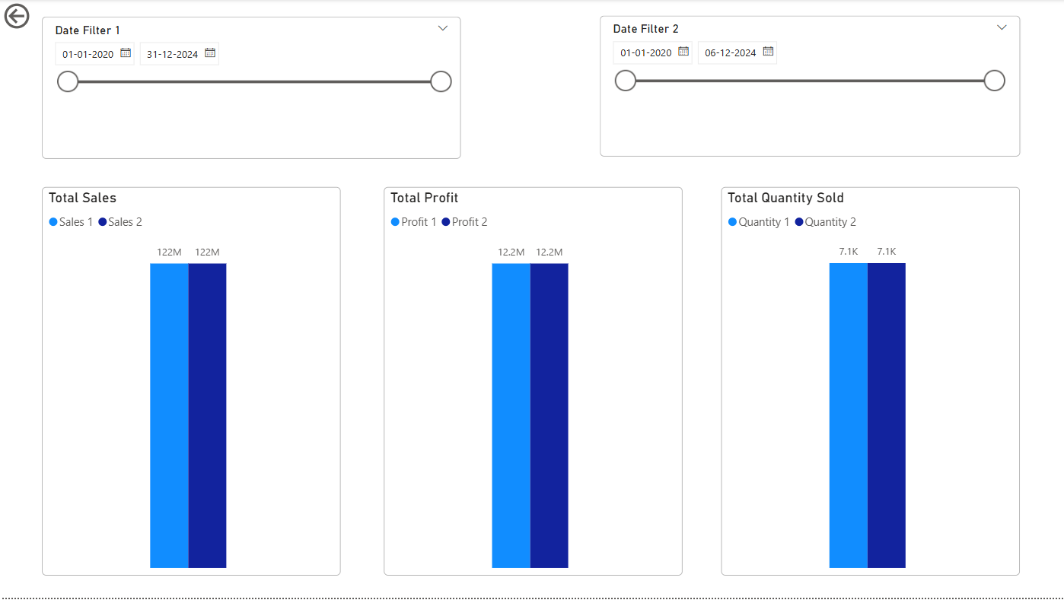
Compare any two periods
Page 1: KPI bars for each period
Page 2: side-by-side columns
Two date sliders let the user pick Period 1 and Period 2
Notes:
Date Filter 1 and Date Filter 2 are independent, so any two periods can be compared on sales, profit and quantity sold.

Slide 10
Example: full period vs early period
Period 1 1 Jan 2020 to 1 Jan 2024 Period 2 1 Jan 2020 to 20 Jun 2022
Net sales
122M
75M
Profit
12.2M
7.5M
Units sold
7.1K
4.3K
Period 2 delivers about 61% of the full-period sales, profit and units
Notes:
Values read from the comparison page. The second period covers roughly two and a half of the four years and carries about 61% of each measure.

Slide 11
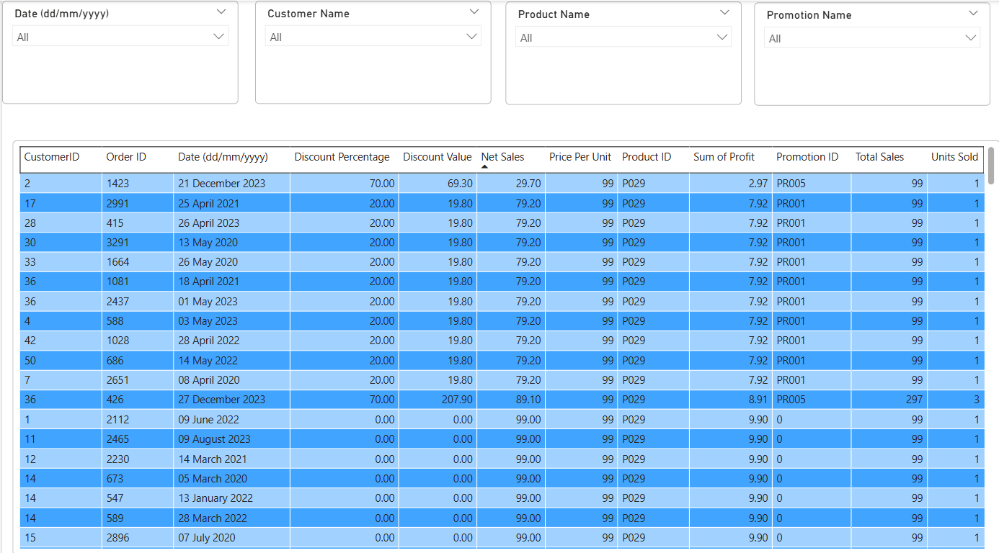
Order-level explorer
Visual filters
Date, Customer Name, Product Name, Promotion Name
Fields per order
Sales, profit, discount %, discount value, net sales, units, price, product and promotion IDs
Notes:
The table lists every order with all its fields and can be sliced with the four filters at the top.

Slide 12
Key takeaways
Electronics drive sales and profit, led by iPhone 14
1
Profit tracks net sales at about 10%
2
Weekend Flash Sale has the highest average discount
3
Filters and two-period comparison make the data explorable
Thank you
4
Notes:
Close with the four takeaways and invite questions.

