Slide 1

Protein Structural Class and Ligand Binding Prediction Using Image Based Features

Slide 2





Dr. Swakkhar Shatabda
Associate Professor & Undergraduate Program Coordinator
Al Amin Neaz Ahmed
Md Tajul Islam
Nafees Sadique
Md. Nawshad Pervage

Slide 3
Index
Problem Statement
Motivation
Our Contribution
Novel Features
Similarity Based Clustering
Experiments
Conclusion

Slide 4

Problem Statement
Structural Class Prediction
Protein Ligand Bond Prediction
Notes:
Protein tertiary structure comparison is very important in many applications of modern structural biology, drug design, drug discovery, in studies of protein-protein in-teractions and other fields. This is especially significant because the structure of a protein is more protected than the protein sequence [1]. Many works have been done to find protein binding [2].

Slide 5
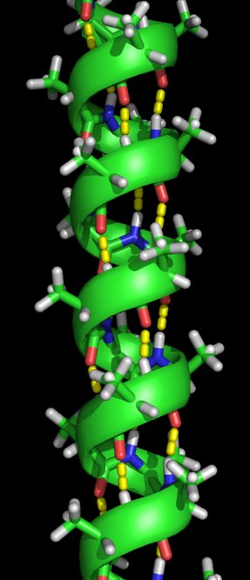
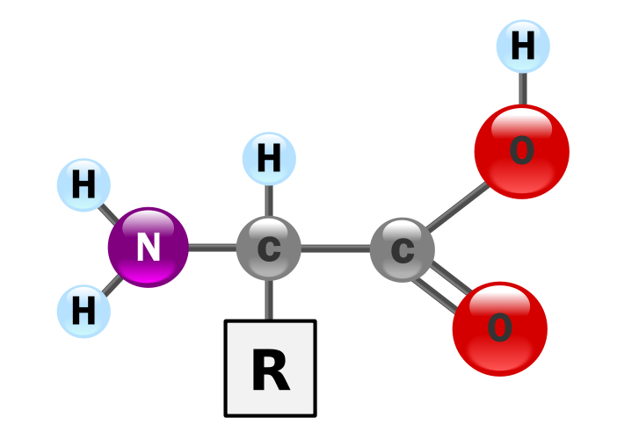

Structural Class Prediction
Protein Functions, Classification, Binding Site
Protein 1 + Protein 1 = Same Kind

Slide 6
Structural Class Prediction
C_{𝜶}
(X,Y,Z)
Image Features
Technique
Distance Matrix
Protein Structural Class

Slide 7
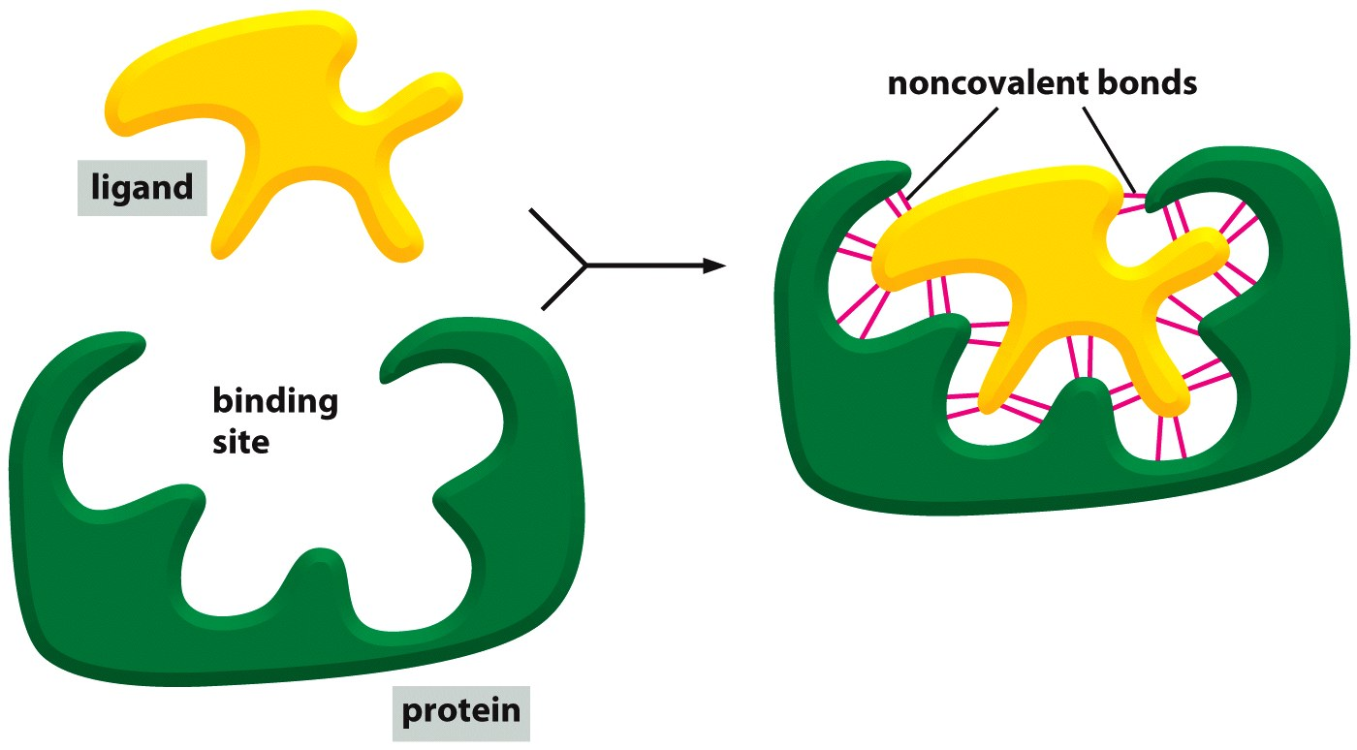
Protein Ligand Bond Prediction
Search Algorithm
Scoring Functions

Slide 8

Protein sequence is more informative
To drug design, drug discovery
To decipher many biological processes
Notes:
Protein tertiary structure comparison is very important in many applications of modern structural biology, drug design, drug discovery, in studies of protein-protein in-teractions and other fields. This is especially significant because the structure of a protein is more protected than the protein sequence [1]. Many works have been done to find protein binding [2].
Predicting interactions between small molecules and proteins is a crucial step to decipher many biological processes, and plays a critical role in drug discovery. When no detailed 3D structure of the protein target is available, ligand-based virtual screening allows the construction of predictive models by learning to discriminate known ligands from non-ligands. However, the accuracy of ligand-based models quickly degrades when the number of known ligands decreases, and in particular the approach is not applicable for orphan receptors with no known ligand.

Slide 9
Our Contribution
Feature Generation
Class Prediction
Similarity Based Clustering
Notes:
Brief this two points (as a linkage of the two procedures)

Slide 10
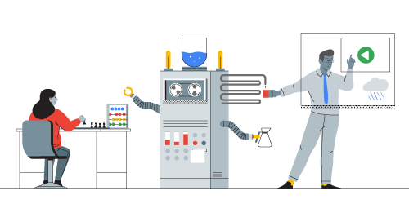
Novel Features

Slide 11
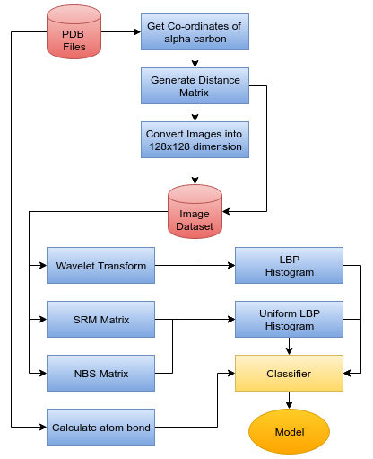
Feature Extraction Methodology

Slide 12
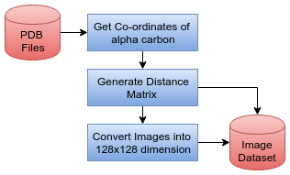
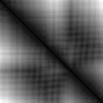
Image Generation
total number of α carbon atoms are calculated from the PDB file
the x,y and z coordinates of the α carbon are used to generate a distance matrix
The matrix is used as the image of the protein structure

Slide 13
Scaling Images to Same Dimension
128
CoMOGrad and PHOG have used Bi-cubic interpolation and wavelet transform to scale all the protein images into 128 x128 dimension
128

Slide 14
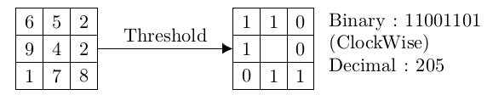
Local Binary Pattern Histogram
Comparing each pixel with its neighboring pixels the local representation is created
Clockwise direction starting
from the top-left one provides a binary number
Bin size 256

Slide 15
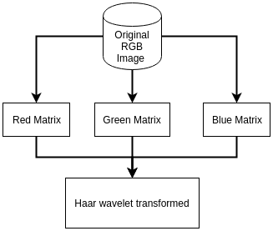
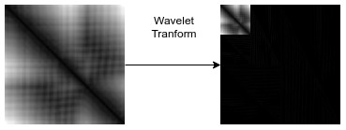
Wavelet transformed Local Binary Pattern
Histogram
Haar wavelet transform is used for the transformation of the images
Original image is converted into three two dimensional matrices for storing blue, green and red value of each pixel
Wavelet transformed images are then added together to make the wavelet transformed images

Slide 16

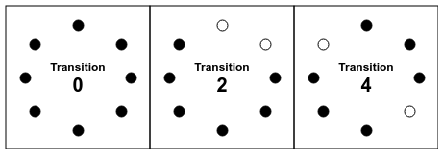
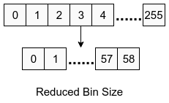
Uniform Local Binary Pattern Histogram

Slide 17
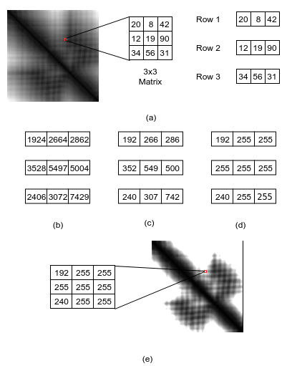
Separate Row Multiplication Matrix with Uniform
Local Binary Pattern Histogram

Slide 18
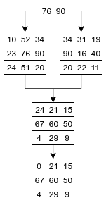
Neighbor Block Subtraction Matrix with Uniform Local Binary Pattern Histogram
Subtracting 2 neighboring blocks and adding the result in the same block
Two blocks of matrices are considered neighbors for this method if the center cells are neighboring
0 is placed instead of the negative value in the result block

Slide 19
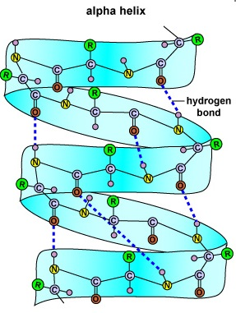
Atom Bond Features
Identified unique atoms
counted occurrences of each atom
Taken the percentage as the feature of the bond of each unique pair of atoms among all the bonds

Slide 20
Summary of Feature Groups
Identifier | Feature Group Name | Number of Features
A | Local Binary Pattern Histogram (LBP-Hist) | 256
B | Wavelet transformed Local Binary Pattern Histogram (WtLBP-Hist) | 256
C | Separate Row Multiplication Matrix with Uniform Local Binary Pattern Histogram (SRM Matrix-ULBP-Hist) | 59
D | Neighbour Block Subtraction Matrix with Uniform Local Binary Pattern Histogram(NBS Matrix-ULBP-Hist) | 59
E | Atom Bond Features | 116

Slide 21
Protein Ligand Bond Prediction
Similarity Based Clustering (Weak Learner)

Slide 22
Data Pre processing
Ligands with single atom (33)
Missing “Negative” data (highly imbalacned)
Random negative data
Clustering Based Undersampling
Protein | Ligand | Bond
Protein 1 | Ligand 1 | Yes
Protein 2 | Ligand 2 | Yes
Protein 3 | Ligand 3 | Yes
Protein 4 | Ligand 4 | Yes
}
3000

Slide 23

Random Negative Data
Pairs
9000000
Positive
3000
Unseen
8997000
Negative
3000
Protein 1
Ligand 1
Yes
Protein 2
Ligand 2
Yes
Unseen
Protein 3
Ligand 3
Unseen
Balanced
Yes
Protein 4
Ligand 4
Unseen
Yes

Slide 24
Clustering Based Undersampling
(Protein i) + (Ligand i)
Yes
(Protein i) + (Ligand j)
Unseen -> No
Balanced
Cluster 1
Cluster 3
Cluster 2

Slide 25
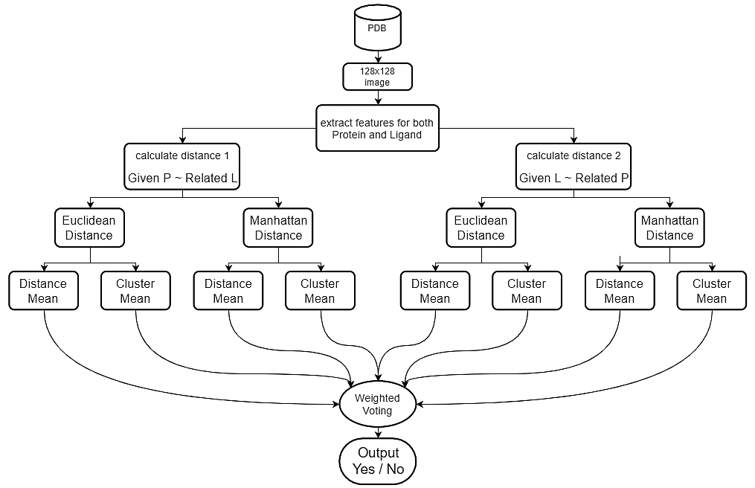
Methodology

Slide 26
Distance 1: Given P ~ Related L
If (Distance1 < Threshold)
Yes
Else
No
Given Protein
Nearest P 1
Nearest P 3
Nearest P 2
Given Protein
?
Given Ligand
Distance 1
Yes
L 1
Ligand Cluster Center
Yes
L 2
Yes
L 3
Related Ligands

Slide 27
Distance 2: Given L ~ Related P
Given Protein
?
Given Ligand
Distance 2
P 1
Yes
Nearest L 1
Protein Cluster Center
P 2
Yes
Nearest L 2
If (Distance2 < Threshold)
Yes
Else
No
P 3
Nearest L 3
Yes
Related Proteins

Slide 28
Dependency
Number of nearest neighbour
Noisy Data
Distance threshhold
Average distance of the nearest neighbors
Minimum Distance
in K-nearest neighbor
Maximum Distance
in K-nearest neighbor
Average Distance
in K-nearest neighbor

Slide 29
Feature Selection
ComogPHOG (1021 + 1020)
4 LBP Feature groups (630 + 630)

Slide 30

Experiments

Slide 31
Dataset (Class Prediction)
Class Name | Total Instances
Small Proteins | 640
All α Proteins | 2195
α and β proteins(a/b) | 3305
α and β proteins(a+b) | 3006
Membrane and cell surface proteins and peptides | 204
All β proteins | 1485
Multi-domain proteins(α and β) | 219
Used 40 percent ID filtered subset of PDB-style files for SCOPe domains version 2.03
12119 PDB files
Seven protein classes
For benchmark analysis , the pdb files were reduced to 11052 PDB Files

Slide 32

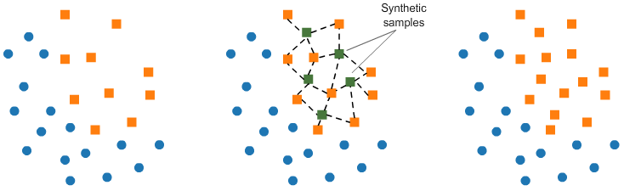
Removing Multi Class Imbalance Problem
Nearest neighbours : 5
Percentage Equation :
Synthetic Minority Oversampling Technique (SMOTE).

Slide 33
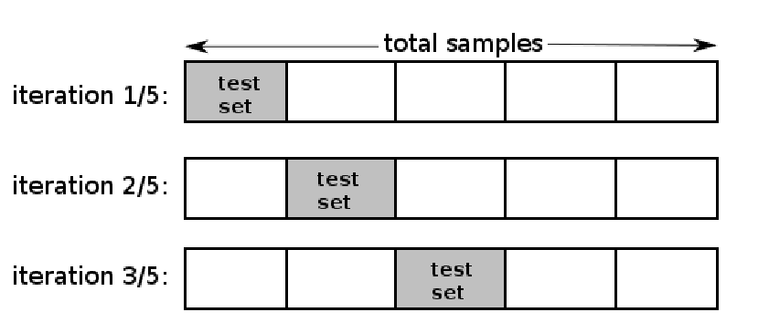
Performance Evaluation
Used 3-Fold cross validation technique as it overcomes the problem of overfitting.
Used accuracy as the performance metric to compare between learned models

Slide 34
Analysis of the Features
Image Type | Feature Type | KNN | Naive Baysian | SVM | Adaboost | Random Forest
Non Scaled | A | 68.69 | 33.15 | 65.62 | 83.37 | 87.5
Non Scaled | B | 77.28 | 32.17 | 67.24 | 83.52 | 86.88
Scaled | A | 74.06 | 53.06 | 78.58 | 83.3 | 85.22
Scaled | B | 78.69 | 49.79 | 79.8 | 84.68 | 86.68
Scaled | C | 84.1 | 51.02 | 71.02 | 83.2 | 85.11
Scaled | D | 81.58 | 56.4 | 72.25 | 81.89 | 83.99
 | E | 66.96 | 21.79 | 44.49 | 62.26 | 69.92
Scaled + Non Scaled | AB | 78.62 | 41.87 | 83.08 | 83.08 | 86.08
Scaled | CD | 84.65 | 57.55 | 78.1 | 84.24 | 86.28
Scaled + Non Scaled | ACD | 84.51 | 41.96 | 81.99 | 86.97 | 88.66
Scaled | BCD | 81.87 | 55.02 | 84.29 | 85.64 | 87.37
Scaled + Non Scaled | ABCD | 84.38 | 36.9 | 83.53 | 86.48 | 88.77
Scaled + Non Scaled | ABCDE | 76.47 | 36.86 | 85.78 | 87.57 | 89.03

Slide 36
Accuracy with Negative Data (Binding Prediction)
Features |  | AdaBoost |  |  | KNN |  | Random Forest | SVM | Naïve Baysian | Our Method
 |  | J48 | Random Forest | Naïve Baysian | 1 | 5
LBP | random | 40.60% | 31.46% | 42.43% | 15.93% | 36.16% | 31.82% | 42.85% | 43.98% | 55.85%
 | cluster |  |  |  | 35.54% | 45.42% |  |  | 49.06% | 55.22%
ComogPhog | random
 | cluster

Slide 37
Sensitivity (True Positive Rate)
Features |  | AdaBoost | KNN |  | Random Forest | SVM | Naïve Baysian | Our Method
 |  | J48 | 1 | 5
LBP | random | 64.20% |  |  |  |  |  | 85.10%
ComogPHOG | random

Slide 38
Future Work
Prediction of Protein Fold Class, Family, Super Family
Using scoring Function in Similarity Based Clustering
Reducing Dimensionality Problem in Ligand dataset by introducing new features

Slide 39




Our Application Deployment
Internet
Remote Server
Host Server
Client
Result
Link: http://brl.uiu.ac.bd/PL

Slide 40

Demo

Slide 41
Thank You

