Slide 1
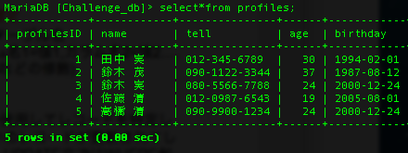



Challenge6_1
Challenge6_2
Challenge6_3
Challenge6_4

Slide 2




Challenge6_5
Challenge6_6
Challenge6_7
Challenge6_8

Slide 3



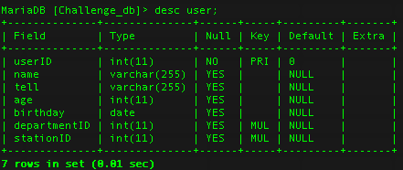
Challenge6_9_1
Challenge6_9_2
Challenge6_9_3
Challenge6_9_4

Slide 4


Challenge6_9_5
Challenge6_9_6

