Slide 1
Capstone Presentation
E-COMMERCE CUSTOMER CHURN
-Sayan Mondal

Slide 2
Business Problem Understanding
An E Commerce company is facing a lot of competition in the current market and it has a become a challenge to retain the existing customers in the current situation. In this company we observe one account may have multiple users which implies loosing a customer may lead to loss of multiple customers.
Thus we data analyst are hired to build a model to predict customers who are about to leave the company. Analysing those customers can help the company to improve their business plan in order to maintain a good relationship with their customers.

Slide 3
Business opportunity
Research done by Bain & Company has found that the cost of acquiring a new customer can be 5-6 times higher than that of retaining a customer.
Increasing customer retention rates by a mere 5% could increase profits by 25% to 95%.
Success rate of selling any new product or services to existing Customer is at 60-70% whereas to new customer is at 5-20%.
Increasing customer retention by 5% can increase profits from 25-95%.
Social opportunity
When a company put efforts in retaining their existing customers it automatically builds loyalty from their customers. Which in long run brings more business to the company through referrals. It also helps to build reputation for the company.

Slide 4
Model Building Approach
Since we need to categorize customers into two different class (Churner and Non-Churner), we build a classification model.
For this purpose we use machine learning models such as-
Logistic Regression
Linear Discriminant Analysis
Bagging(Random Forest)
Ada Boosting
These machine learning models are hyper tuned to improve performance.

Slide 5
Model Selection
We create a table containing train and test scores of all the models used for classification.
 | Logistic Regression | LDA | Bagging(Random Forest) | Ada Boosting
Train Data
Recall | 0.77 | 0.70 | 1 | 0.56
Precision | 0.48 | 0.48 | 1 | 0.75
Test Data
Recall | 0.75 | 0.68 | 0.81 | 0.56
Precision | 0.43 | 0.46 | 0.91 | 0.74
We select a optimal model comparing these scores.

Slide 6
Model Insights
Our objective was to predict those customers who are prone to churning. Class-1 represents churners. Thus we observe recall and precision values corresponding to class-1 for each model used.
Bagging performs accurately for train data. But when we see the test scores the scores are not as good as train scores. Hence the model is over fitting.
Comparing these values for each model we can say Logistic Regression is the optimal model amongst them.

Slide 7
Optimal model
Logistic Regression is the best model among the models used for classification.
Best predictors of churn:
Complain Last Year
City Tier
Account Segment
Tenure
Coupon used for payment
(Arranged in descending order of magnitude of the weights associated)

Slide 8
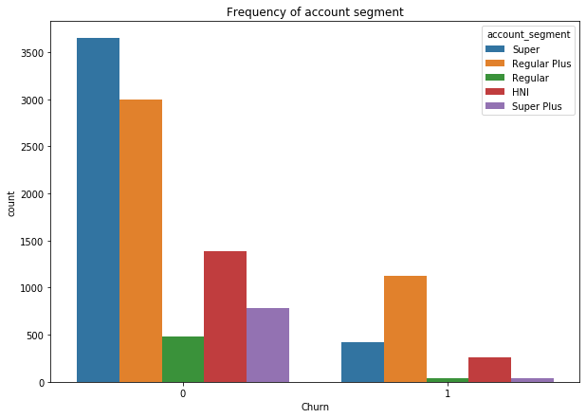
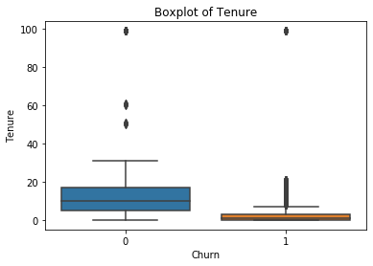
Overall Insights
Average tenure for customers churning is almost one-third of tenure for customers not churning.
Churning rate in customer segment ‘ Regular Plus ’ is very high.
There are very few customers from Tier-2 cities.
Churning rate in Tier-1 city is very high.
Cashback is directly proportional to tenure of customers.

Slide 9
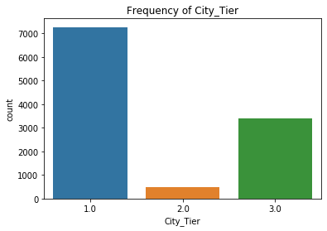
Recommendations
We can introduce payment through e-wallet and offer some cashback on the wallet itself to increase engagement of customers who have less tenure.
We need to increase business in Tier-2 cities. Acquire more customers through marketing.
Customers in Tier-1 cities are more prone to churning. This may be due to high competition. We have to improve the quality of product and service as well.
The customer segment Regular Plus have high churning rate. So, we need to understand the issue and act accordingly.

Slide 10
Thank you!

