Slide 1
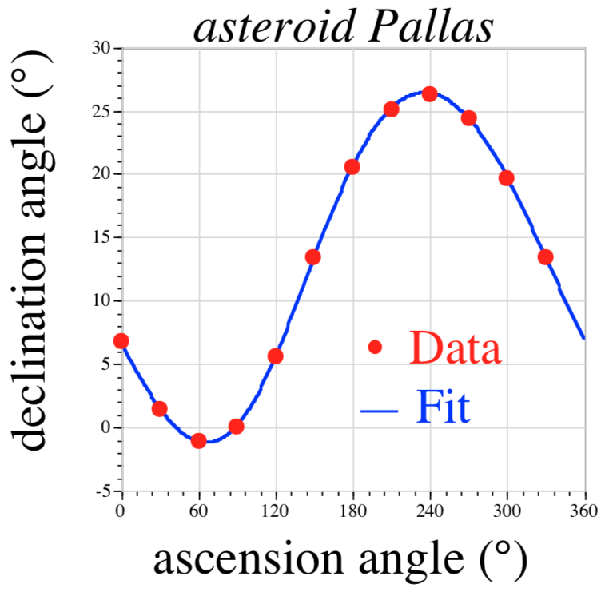
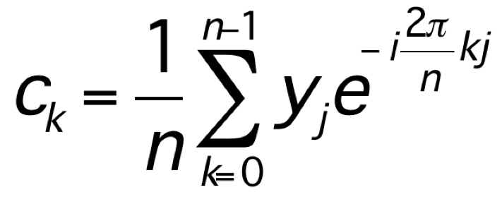
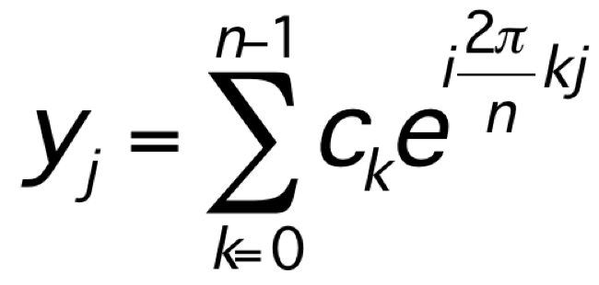
In the beginning (c. 1805): Carl Friedrich Gauss
trigonometric interpolation:
generalizing work
of Clairaut (1754)
and Lagrange (1762)
discrete Fourier transform (DFT):
(before Fourier)

Slide 2
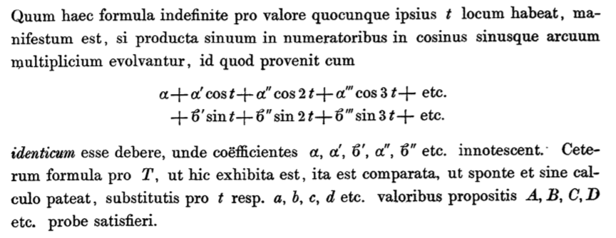
Gauss’ DFT notation:
From “Theoria interpolationis methodo nova tractata”
Kids: don’t try this at home!

Slide 3
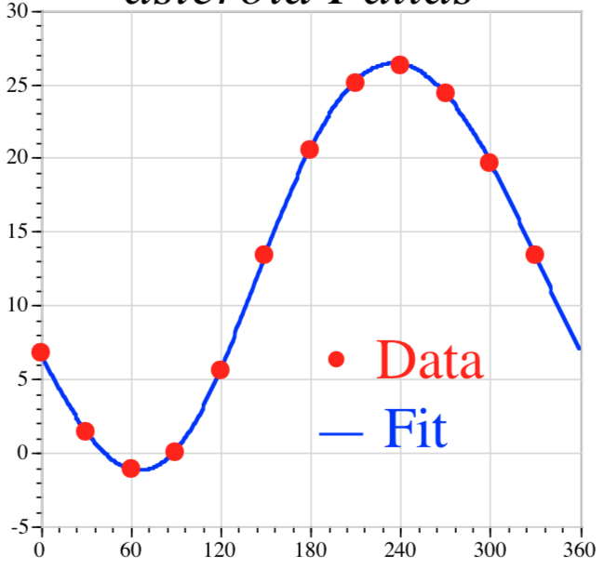
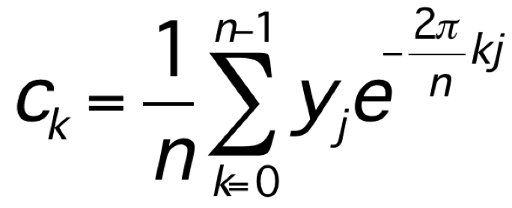
Gauss’ fast Fourier transform (FFT)
?
how do we compute:
— not directly: O(n²) operations … for Gauss, n=12
Gauss’ insight: “Distribuamus hanc periodum primo in tres periodos quaternorum terminorum.”
= We first distribute this period
[n=12] into 3 periods of length 4 …
Divide and conquer.
(any composite n)

Slide 4
But how fast was it?
“illam vero methodum calculi mechanici taedium magis minuere”
= “truly, this method greatly reduces
the tedium of mechanical calculation”
(For Gauss, being less boring was good enough.)

Slide 5
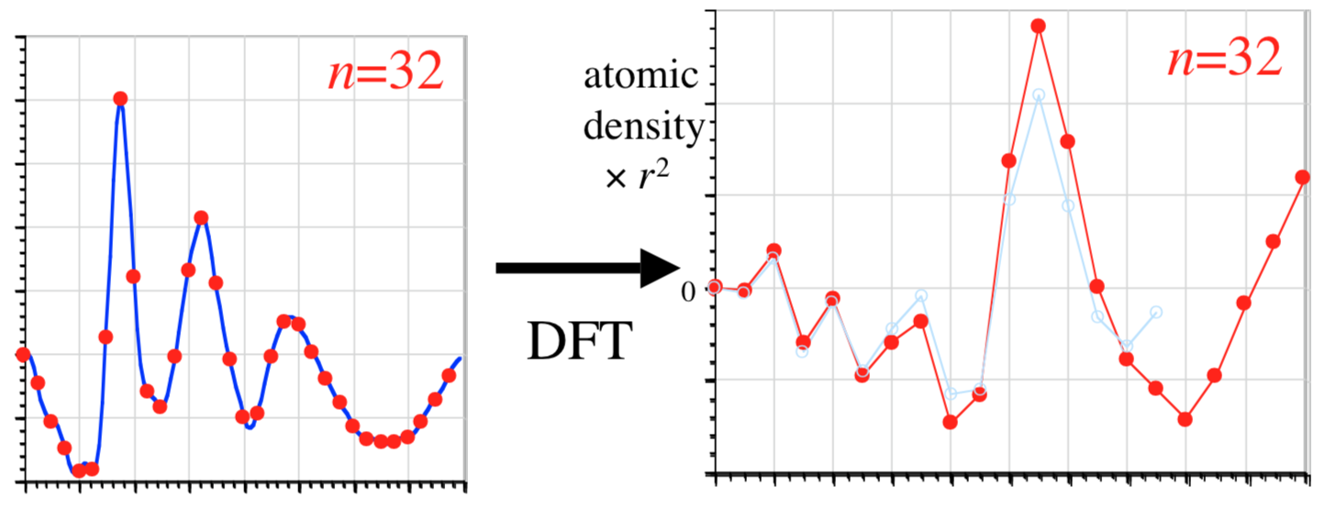
two (of many) re-inventors: Danielson and Lanczos (1942)
[ J. Franklin Inst. 233, 365–380 and 435–452]
Given Fourier transform of density (X-ray scattering) find density:
discrete sine transform (DST-1) = DFT of real, odd-symmetry
sample
the spectrum
at n points:
radius r
…double sampling until density (DFT) converges…

Slide 6
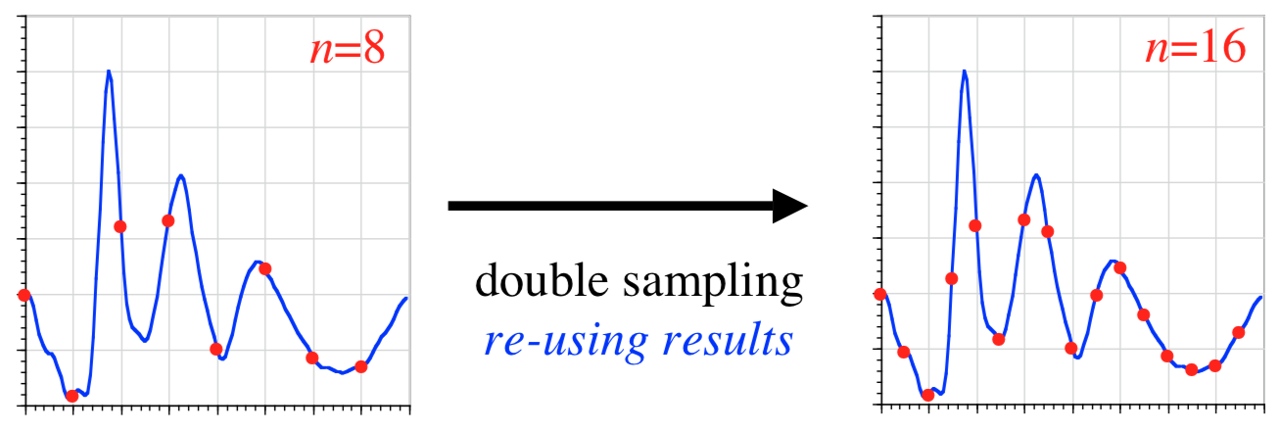
Gauss’ FFT in reverse: Danielson and Lanczos (1942)
[ J. Franklin Inst. 233, 365–380 and 435–452]
“By a certain transformation process, it is possible to double the number of ordinates with only slightly more than double the labor.”
from
O(n²) to ???
64-point DST in only 140 minutes!

Slide 7
re-inventing Gauss (for the last time) Cooley and Tukey (1965)
[ Math. Comp. 19,
297–301 ]
N = N₁N₂
1d DFT of size N:
= ~2d DFT of size N₁ × N₂
(+ phase rotation by twiddle factors)
= Recursive DFTs of sizes N₁ and N₂
O(N²)
O(N log N)
n=2048, IBM 7094, 36-bit float: 1.2 seconds
(~10⁶ speedup vs. Dan./Lanc.)

Slide 8
The “Cooley-Tukey” FFT Algorithm
N = N₁N₂
1d DFT of size N:
₀
₁
₂
₃
₄
…
n
= ~2d DFT of size N₁ × N₂
input re-indexing
n = n₁ + N₁n₂
N₁
output re-indexing
n₁
k = N₂k₁ + k₂
₀
₁
₂
multiply by n
“twiddle factors”
n₂
₃
₄
…
N₂
N₂
k₂
transpose
k₁
₀
₁
₂
₃
₄
…
N₁
= contiguous
first DFT columns, size N₂
(non-contiguous)
finally, DFT columns, size N₁
(non-contiguous)

Slide 9
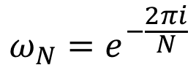
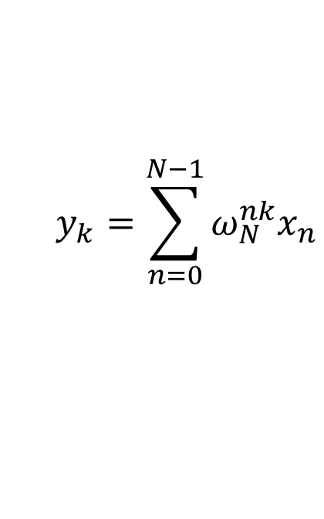

“Cooley-Tukey” FFT, in math
Recall the definition of the DFT:
$$y_{k}=\sum_{n=0}^{N−1}{ω_{N}^{nk}x_{n}}$$
$$ω_{N}=e^{−\frac{2πi}{N}}$$
where
Trick: if $N=N_{1}N_{2}$, re-index $n=n_{1}+N_{1}n_{2}$ and $k=N_{2}k_{1}+k_{2}$:
$$y_{N_{2}k_{1}+k_{2}}=\sum_{n_{1}=0}^{N_{1}−1}{\sum_{n_{2}=0}^{N_{2}−1}{ω_{N}^{n_{1}N_{2}k_{1}}ω_{N}^{n_{1}k_{2}}ω_{N}^{{N_{1}n}_{2}N_{2}k_{1}}ω_{N}^{{N_{1}n}_{2}k_{2}}x_{n_{1}+N_{1}n_{2}}}}$$
= $\sum_{n_{1}=0}^{N_{1}−1}{ω_{N_{1}}^{n_{1}k_{1}}ω_{N}^{n_{1}k_{2}}\left(\sum_{n_{2}=0}^{N_{2}−1}{ω_{N_{2}}^{n_{2}k_{2}}x_{n_{1}+N_{1}n_{2}}}\right)}$
size-N₁ DFTs
twiddles
size-N₂ DFTs
… repeat recursively.

Slide 10
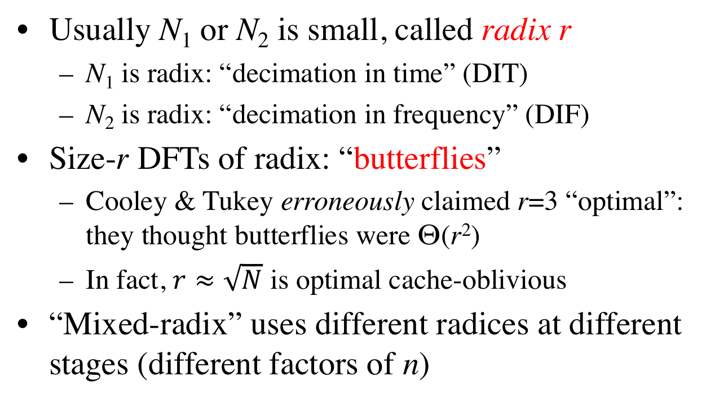
Cooley–Tukey terminology
Usually N₁ or N₂ is small, called radix r
N₁ is radix: “decimation in time” (DIT)
N₂ is radix: “decimation in frequency” (DIF)
Size-r DFTs of radix: “butterflies”
Cooley & Tukey erroneously claimed r=3 “optimal”: they thought butterflies were Θ(r²)
In fact, $r≈\sqrt{N}$ is optimal cache-oblivious
“Mixed-radix” uses different radices at different stages (different factors of n)

Slide 11
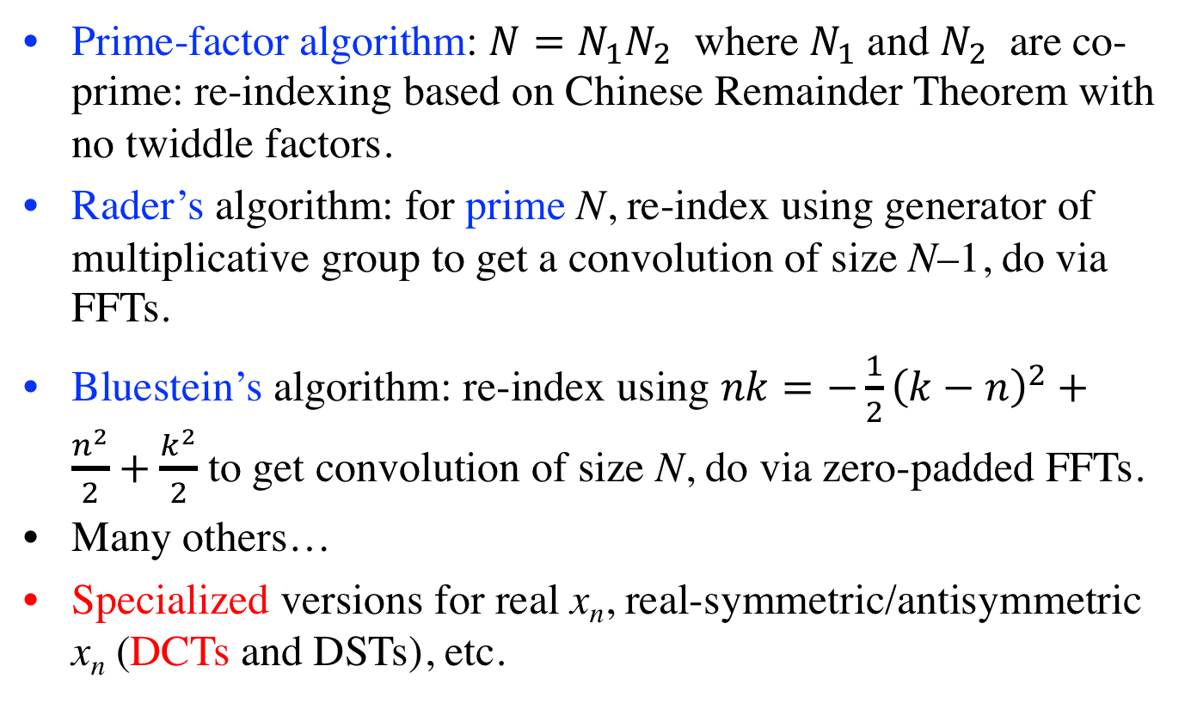
Many other FFT algorithms
Prime-factor algorithm: $N=N_{1}N_{2}$ where $N_{1}$ and $N_{2}$ are co-prime: re-indexing based on Chinese Remainder Theorem with no twiddle factors.
Rader’s algorithm: for prime N, re-index using generator of multiplicative group to get a convolution of size N–1, do via FFTs.
Bluestein’s algorithm: re-index using $nk=−\frac{1}{2}{\left(k−n\right)}^{2}+\frac{n^{2}}{2}+\frac{k^{2}}{2}$ to get convolution of size N, do via zero-padded FFTs.
Many others…
Specialized versions for real x_{n}, real-symmetric/antisymmetric x_{n} (DCTs and DSTs), etc.

Slide 12
…but how do we make it faster?
We (probably) cannot do better than Θ(n log n).
(the proof of this remains an open problem)
[ unless we give up exactness ]
We’re left with the “constant” factor…

Slide 13
The Next 30 Years…
Assume “time”
= # multiplications
# multiplications + # additions (= flops)
Winograd (1979): # multiplications = Θ(n)
(…realizable bound! … but costs too many additions)
Yavne (1968): split-radix FFT, saves 20% over radix-2 flops
[ unsurpassed until last 2007, another ~6% saved
by Lundy/Van Buskirk and Johnson/Frigo ]

Slide 14
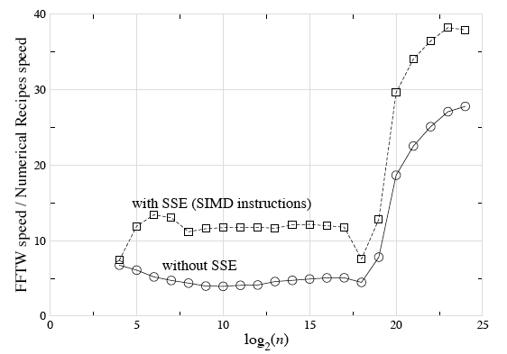
Are arithmetic counts so important?

Slide 15
The Next 30 Years…
Assume “time”
= # multiplications
# multiplications + # additions (= flops)
Winograd (1979): # multiplications = Θ(n)
(…realizable bound! … but costs too many additions)
Yavne (1968): split-radix FFT, saves 20% over radix-2 flops
[ unsurpassed until last 2007, another ~6% saved]
last 15+ years: flop count (varies by ~20%)
no longer determines speed (varies by factor of ~10+)

Slide 16
a basic question: If arithmetic no longer dominates, what does?

Slide 17
The Memory Hierarchy (not to scale)
disk (out of core) / remote memory (parallel)
(terabytes)
…what matters is not
how much work you
do, but when and where
you do it.
RAM (gigabytes)
L2 cache (megabytes)
the name of the game:
• do as much work as
possible before
going out of cache
L1 cache (10s of kilobytes)
registers (~100)
…difficult for FFTs
…many complications
…continually changing

Slide 18

The “Fastest Fourier Transform in the West”
:
Steven G. Johnson, MIT Applied Mathematics
Matteo Frigo, Oracle; formerly MIT LCS (CSAIL)

Slide 19
What’s the fastest algorithm for _____? (computer science = math + time = math + $)
1
Find best asymptotic complexity
naïve DFT to FFT: O(n²) to O(n log n)
2
Find best exact operation count?
3
Find variant/implementation that runs fastest
hardware-dependent — unstable answer!
Better to change the question…

Slide 20
What’s the smallest set of “simple” algorithmic steps whose compositions ~always span the ~fastest algorithm?
A question with a more stable answer?

Slide 21

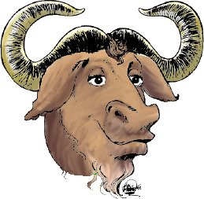
FFTW
the “Fastest
Fourier Tranform
in the West”
• C library for real & complex FFTs (arbitrary size/dimensionality)
(+ parallel versions for threads & MPI)
• Computational kernels (80% of code) automatically generated
• Self-optimizes for your hardware (picks best composition of steps)
= portability + performance
free software: http://www.fftw.org/

Slide 22
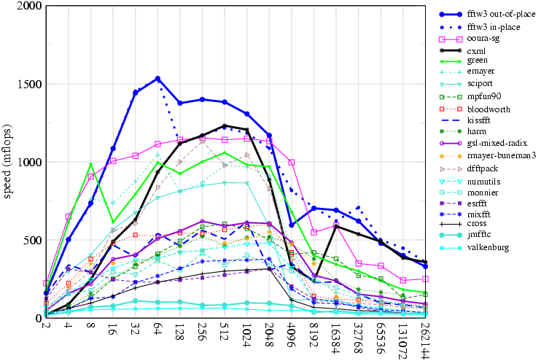
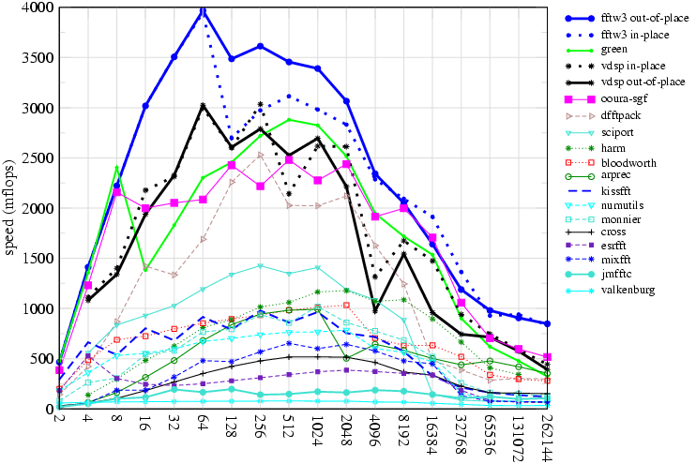
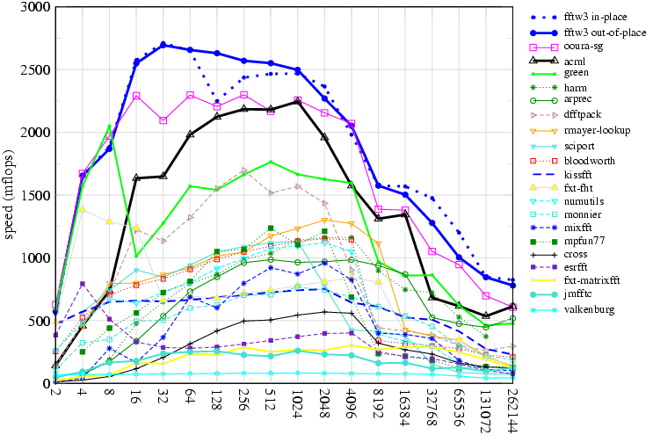
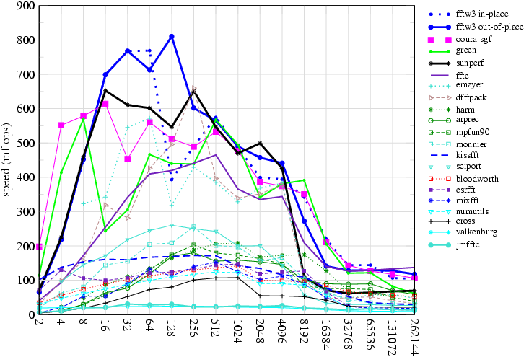
FFTW performance power-of-two sizes, double precision
833 MHz Alpha EV6
2 GHz PowerPC G5
2 GHz AMD Opteron
500 MHz Ultrasparc IIe

Slide 23
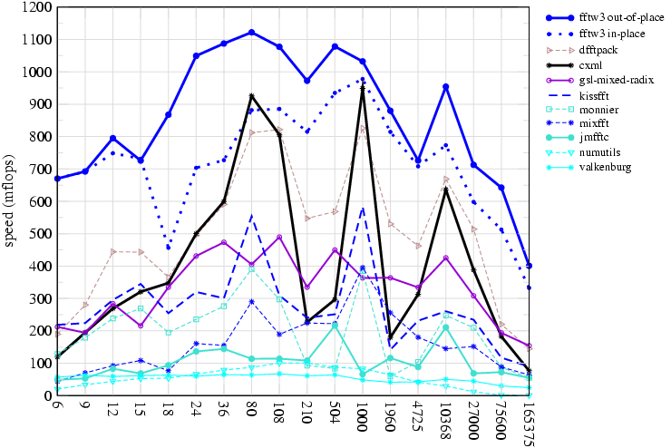
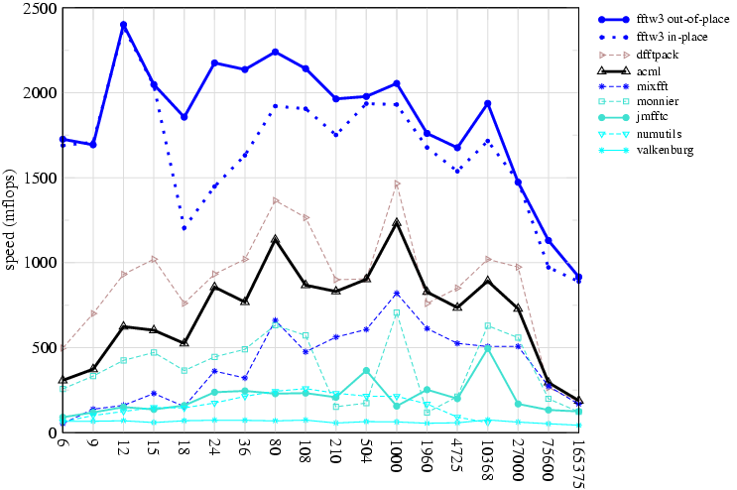
FFTW performance non-power-of-two sizes, double precision
unusual: non-power-of-two sizes
receive as much optimization
as powers of two
833 MHz Alpha EV6
2 GHz AMD Opteron
…because we
let the code do the optimizing

Slide 24
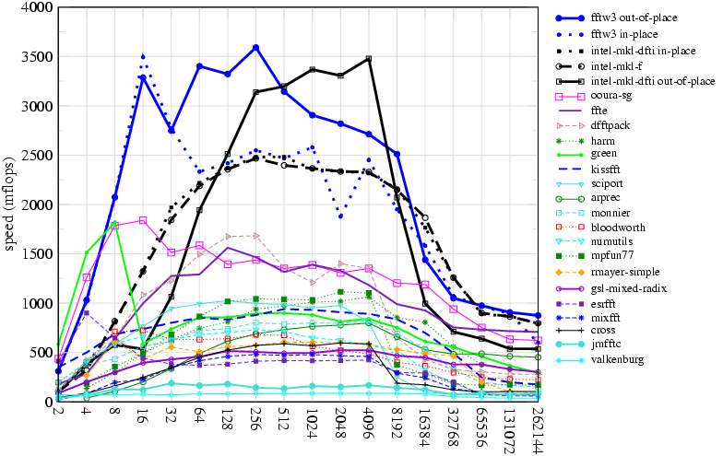
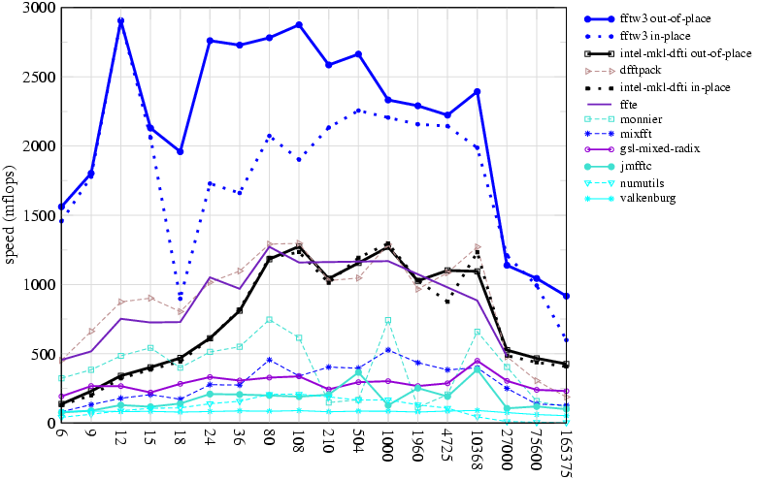
FFTW performance double precision, 2.8GHz Pentium IV: 2-way SIMD (SSE2)
powers of two
exploiting CPU-specific
SIMD instructions
(rewriting the code)
is easy
non-powers-of-two
…because we
let the code write itself

Slide 25
Why is FFTW fast?
FFTW implements many FFT algorithms:
A planner picks the best composition (plan)
by measuring the speed of different combinations.
Three ideas:
1
A recursive framework enhances locality.
2
Computational kernels (codelets)
should be automatically generated.
3
Determining the unit of composition is critical.

Slide 26
FFTW is easy to use
{
complex x[n];
plan p;
p = plan_dft_1d(n, x, x, FORWARD, MEASURE);
...
execute(p); /* repeat as needed */
...
destroy_plan(p);
}
Key fact: usually,
many transforms of same size are required.

Slide 27
Why is FFTW fast?
FFTW implements many FFT algorithms:
A planner picks the best composition (plan)
by measuring the speed of different combinations.
Three ideas:
1
A recursive framework enhances locality.
2
Computational kernels (codelets)
should be automatically generated.
3
Determining the unit of composition is critical.

Slide 28
Why is FFTW slow?
1965 Cooley & Tukey, IBM 7094, 36-bit single precision:
size 2048 DFT in 1.2 seconds
2003 FFTW3+SIMD, 2GHz Pentium-IV 64-bit double precision:
size 2048 DFT in 50 microseconds (24,000x speedup)
(= 30% improvement per year)
(
Moore’s prediction:
30 nanoseconds
)
(= doubles every ~30 months)
FFTs are hard:
don’t get “peak” CPU speed
especially for large n,
unlike e.g. dense matrix multiply

Slide 29
Discontiguous Memory Access
n = pq
1d DFT of size n:
= ~2d DFT of size p x q
p
multiply by n “twiddle factors”
q
transpose
q
p
= contiguous
first DFT columns, size q
(non-contiguous)
finally, DFT columns, size p
(non-contiguous)

Slide 30
Cooley-Tukey is Naturally Recursive
Size 8 DFT
p = 2 (radix 2)
Size 4 DFT
Size 4 DFT
Size 2 DFT
Size 2 DFT
Size 2 DFT
Size 2 DFT
But traditional implementation is non-recursive,
breadth-first traversal:
log₂ n passes over whole array

Slide 31
Traditional cache solution: Blocking
Size 8 DFT
p = 2 (radix 2)
Size 4 DFT
Size 4 DFT
Size 2 DFT
Size 2 DFT
Size 2 DFT
Size 2 DFT
breadth-first, but with blocks of size = cache
optimal choice: radix = cache size
radix >> 2
…requires program specialized for cache size
…multiple levels of cache = multilevel blocking

Slide 32
Recursive Divide & Conquer is Good
(depth-first traversal)
[Singleton, 1967]
Size 8 DFT
p = 2 (radix 2)
Size 4 DFT
Size 4 DFT
Size 2 DFT
Size 2 DFT
Size 2 DFT
Size 2 DFT
eventually small enough to fit in cache
…no matter what size the cache is

Slide 33
Cache Obliviousness
• A cache-oblivious algorithm does not know the cache size
— for many algorithms [Frigo 1999],
can be provably “big-O” optimal for any machine
& for all levels of cache simultaneously
… but this ignores e.g. constant factors, associativity, …
cache-obliviousness is a good beginning,
but is not the end of optimization
we’ll see: FFTW combines both styles
(breadth- and depth-first) with self-optimization

Slide 34
Why is FFTW fast?
FFTW implements many FFT algorithms:
A planner picks the best composition (plan)
by measuring the speed of different combinations.
Three ideas:
1
A recursive framework enhances locality.
2
Computational kernels (codelets)
should be automatically generated.
3
Determining the unit of composition is critical.

Slide 35
The Codelet Generator
a domain-specific FFT “compiler”
• Generates fast hard-coded C for FFT of a given size
Necessary to give the planner a large space of codelets to experiment with (any factorization).
Exploits modern CPU
deep pipelines & large register sets.
Allows easy experimentation with different optimizations & algorithms.
…CPU-specific hacks (SIMD) feasible
(& negates recursion overhead)

Slide 36
The Codelet Generator
written in Objective Caml [Leroy, 1998], an ML dialect
Abstract FFT algorithm
n
Cooley-Tukey: n=pq,
Prime-Factor: gcd(p,q) = 1,
Rader: n prime, …
Symbolic graph (dag)
Simplifications
powerful enough
to e.g. derive real-input FFT
from complex FFT algorithm
and even find “new” algorithms
Optimal cache-oblivious
scheduling
(cache .EQ. registers)
Optimized C code (or other language)

Slide 37
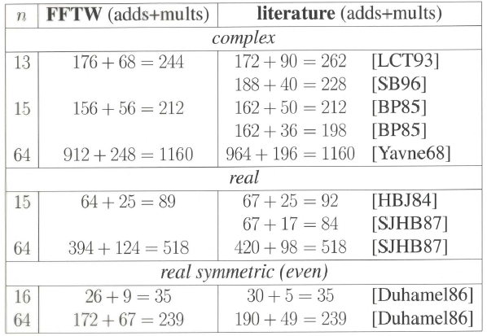
The Generator Finds Good/New FFTs

Slide 38
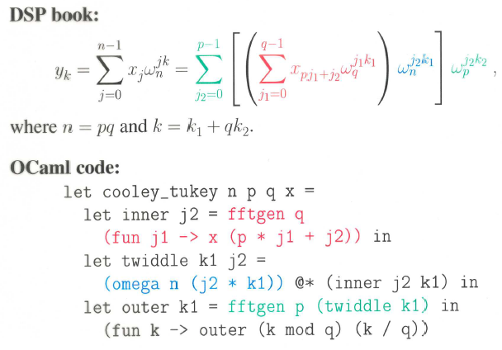
Symbolic Algorithms are Easy Cooley-Tukey in OCaml

Slide 39
Simple Simplifications
Well-known optimizations:
Algebraic simplification, e.g. a + 0 = a
Constant folding
Common-subexpression elimination

Slide 40
Symbolic Pattern Matching in OCaml
The following actual code fragment is
solely responsible for simplifying multiplications:
stimesM = function
| (Uminus a, b) -> stimesM (a, b) >>= suminusM
| (a, Uminus b) -> stimesM (a, b) >>= suminusM
| (Num a, Num b) -> snumM (Number.mul a b)
| (Num a, Times (Num b, c)) ->
snumM (Number.mul a b) >>= fun x -> stimesM (x, c)
| (Num a, b) when Number.is_zero a -> snumM Number.zero
| (Num a, b) when Number.is_one a -> makeNode b
| (Num a, b) when Number.is_mone a -> suminusM b
| (a, b) when is_known_constant b && not (is_known_constant a) ->
stimesM (b, a)
| (a, b) -> makeNode (Times (a, b))
(Common-subexpression elimination is implicit
via “memoization” and monadic programming style.)

Slide 41
Simple Simplifications
Well-known optimizations:
Algebraic simplification, e.g. a + 0 = a
Constant folding
Common-subexpression elimination
FFT-specific optimizations:
Network transposition (transpose + simplify + transpose)
_________________ negative constants…

Slide 42
A Quiz: Is One Faster?
Both compute the same thing, and
have the same number of arithmetic operations:
a = 0.5 * b;
c = 0.5 * d;
e = 1.0 + a;
f = 1.0 - c;
a = 0.5 * b;
c = -0.5 * d;
e = 1.0 + a;
f = 1.0 + c;
Faster because no separate load for -0.5
10–15% speedup

Slide 43
Non-obvious transformations require experimentation

Slide 44
Quiz 2: Which is Faster?
accessing strided array
inside codelet (amid dense numeric code), nonsequential
array[stride * i]
array[strides[i]]
using precomputed stride array:
strides[i] = stride * i
This is faster, of course!
Except on brain-dead architectures…
…namely, Intel Pentia:
integer multiplication conflicts with floating-point
up to ~10–20% speedup
(even better to bloat:
pregenerate various constant strides)

Slide 45
Machine-specific hacks are feasible if you just generate special code
stride precomputation
SIMD instructions (SSE, Altivec, 3dNow!)
fused multiply-add instructions…

Slide 46
The Generator Finds Good/New FFTs

Slide 47
Why is FFTW fast?
FFTW implements many FFT algorithms:
A planner picks the best composition (plan)
by measuring the speed of different combinations.
Three ideas:
1
A recursive framework enhances locality.
2
Computational kernels (codelets)
should be automatically generated.
3
Determining the unit of composition is critical.

Slide 48
What does the planner compose?
• The Cooley-Tukey algorithm presents many choices:
— which factorization? what order? memory reshuffling?
Find simple steps that combine without restriction
to form many different algorithms.
… steps to do WHAT?
FFTW 1 (1997):
steps solve out-of-place DFT of size n

Slide 49
“Composable” Steps in FFTW 1
SOLVE — Directly solve a small DFT by a codelet
CT-FACTOR[r] — Radix-r Cooley-Tukey step =
execute loop of r sub-problems of size n/r
✗
Many algorithms difficult to express via simple steps.
— e.g. expresses only depth-first recursion (loop is outside of sub-problem)
— e.g. in-place without bit-reversal requires combining
two CT steps (DIT + DIF) + transpose

Slide 50
What does the planner compose?
• The Cooley-Tukey algorithm presents many choices:
— which factorization? what order? memory reshuffling?
Find simple steps that combine without restriction
to form many different algorithms.
… steps to do WHAT?
FFTW 1 (1997):
steps solve out-of-place DFT of size n
Steps cannot solve problems that cannot be expressed.

Slide 51
What does the planner compose?
• The Cooley-Tukey algorithm presents many choices:
— which factorization? what order? memory reshuffling?
Find simple steps that combine without restriction
to form many different algorithms.
… steps to do WHAT?
FFTW 3 (2003):
steps solve a problem, specified as a DFT(input/output, v,n):
multi-dimensional “vector loops” v of multi-dimensional transforms n
{sets of (size, input/output strides)}

Slide 52
Some Composable Steps (out of ~16)
SOLVE — Directly solve a small DFT by a codelet
CT-FACTOR[r] — Radix-r Cooley-Tukey step =
r (loop) sub-problems of size n/r
(& recombine with size-r twiddle codelet)
VECLOOP — Perform one vector loop
(can choose any loop, i.e. loop reordering)
INDIRECT — DFT = copy + in-place DFT
(separates copy/reordering from DFT)
TRANSPOSE — solve in-place m × n transpose

Slide 53
Many Resulting “Algorithms”
• INDIRECT + TRANSPOSE gives in-place DFTs,
— bit-reversal = product of transpositions
… no separate bit-reversal “pass”
[ Johnson (unrelated) & Burrus (1984) ]
• VECLOOP can push topmost loop to “leaves”
— “vector” FFT algorithm [ Swarztrauber (1987) ]
• CT-FACTOR then VECLOOP(s) gives “breadth-first” FFT,
— erases iterative/recursive distinction

Slide 54
Many Resulting “Algorithms”
• INDIRECT + TRANSPOSE gives in-place DFTs,
— bit-reversal = product of transpositions
… no separate bit-reversal “pass”
[ Johnson (unrelated) & Burrus (1984) ]
• VECLOOP can push topmost loop to “leaves”
— “vector” FFT algorithm [ Swarztrauber (1987) ]
• CT-FACTOR then VECLOOP(s) gives “breadth-first” FFT,
— erases iterative/recursive distinction

Slide 55
Depth- vs. Breadth- First for size n = 30 = 3 × 5 × 2
A “depth-first” plan:
30
CT-FACTOR[3]
VECLOOP x3
10
10
10
CT-FACTOR[2]
SOLVE[2, 5]
5
5
5
5
5
5
A “breadth-first” plan:
30
CT-FACTOR[3]
CT-FACTOR[2]
10
10
10
VECLOOP x3
SOLVE[2, 5]
5
5
5
5
5
5
(Note: both are executed by explicit recursion.)

Slide 56
Many Resulting “Algorithms”
• INDIRECT + TRANSPOSE gives in-place DFTs,
— bit-reversal = product of transpositions
… no separate bit-reversal “pass”
[ Johnson (unrelated) & Burrus (1984) ]
• VECLOOP can push topmost loop to “leaves”
— “vector” FFT algorithm [ Swarztrauber (1987) ]
• CT-FACTOR then VECLOOP(s) gives “breadth-first” FFT,
— erases iterative/recursive distinction

Slide 57
In-place plan for size 2¹⁴ = 16384 (2 GHz PowerPC G5, double precision)
CT-FACTOR[32]
CT-FACTOR[16]
INDIRECT
TRANSPOSE[32 × 32] x16
SOLVE[512, 32]
Radix-32 DIT + Radix-32 DIF = 2 loops = transpose
… where leaf SOLVE ~ “radix” 32 x 1

Slide 58
Out-of-place plan for size 2¹⁹=524288 (2GHz Pentium IV, double precision)
CT-FACTOR[4] (buffered variant)
CT-FACTOR[32] (buffered variant)
VECLOOP (reorder) x32
~2000 lines
hard-coded C!
CT-FACTOR[64]
INDIRECT
+ VECLOOP (reorder)
(+ …)
=
huge improvements
for large 1d sizes
INDIRECT
VECLOOP (reorder) x64
VECLOOP x4
COPY[64]
VECLOOP x4
SOLVE[64, 64]
Unpredictable: (automated) experimentation is the only solution.

Slide 59
Dynamic Programming the assumption of “optimal substructure”
Try all applicable steps:
CT-FACTOR[2]: 2 DFT(8)
CT-FACTOR[4]: 4 DFT(4)
DFT(16) = fastest of:
CT-FACTOR[2]: 2 DFT(4)
CT-FACTOR[4]: 4 DFT(2)
SOLVE[1,8]
DFT(8) = fastest of:
If exactly the same problem appears twice,
assume that we can re-use the plan.
— i.e. ordering of plan speeds is assumed independent of context

Slide 60
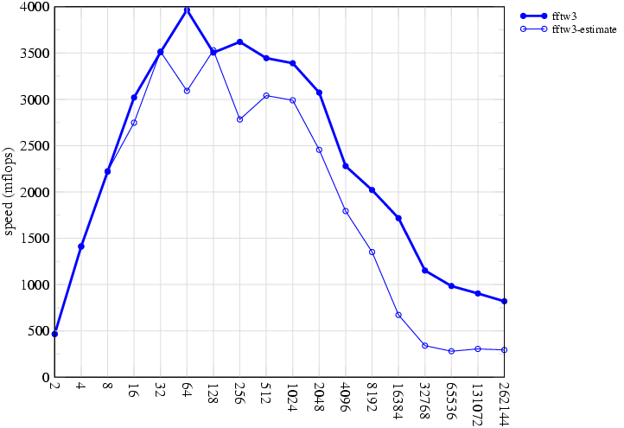
Planner Unpredictability
double-precision, power-of-two sizes, 2GHz PowerPC G5
FFTW 3
Classic strategy:
minimize op’s
fails badly
another test:
Use plan from:
another machine?
e.g. Pentium-IV?
… lose 20–40%
heuristic: pick plan
with fewest
adds + multiplies + loads/stores

Slide 61
We’ve Come a Long Way?
•
In the name of performance, computers have become
complex & unpredictable.
•
Optimization is hard: simple heuristics (e.g. fewest flops)
no longer work.
•
One solution is to avoid the details, not embrace them:
(Recursive) composition of simple modules
+ feedback (self-optimization)
High-level languages (not C) & code generation
are a powerful tool for high performance.

