Slide 1
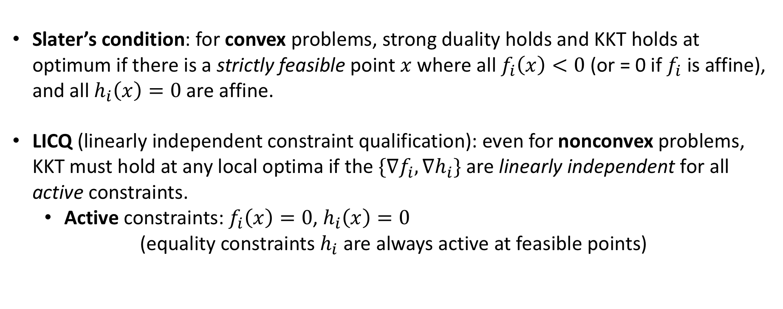
Sufficient conditions for KKT at optima:
(slide added by SGJ)
Slater’s condition: for convex problems, strong duality holds and KKT holds at optimum if there is a strictly feasible point $x$ where all $f_{i}\left(x\right)<0$ (or = 0 if $f_{i}$ is affine), and all $h_{i}\left(x\right)=0$ are affine.
LICQ (linearly independent constraint qualification): even for nonconvex problems, KKT must hold at any local optima if the ${\{∇f}_{i},∇h_{i}\}$ are linearly independent for all active constraints.
Active constraints: $f_{i}\left(x\right)=0$, $h_{i}\left(x\right)=0$
(equality constraints $h_{i}$ are always active at feasible points)

