Slide 1
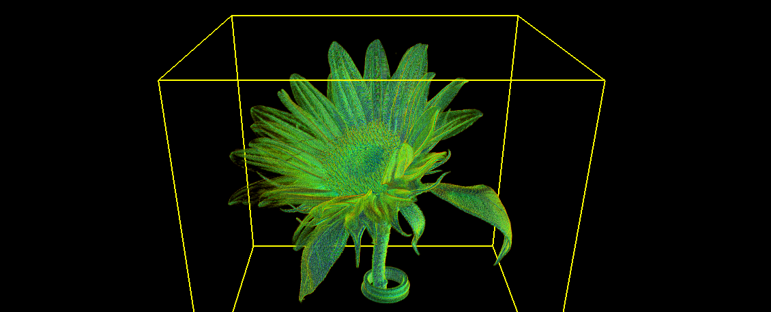
RoiPainter3D

