Slide 1
An Overview of Tcl and Tk
John Ousterhout
Sun Microsystems Laboratories
john.ousterhout@eng.sun.com
Tcl/Tk Tutorial, Part I

Slide 2
Introduction
Component technologies:
  Tcl: embeddable scripting language
  Tk: GUI toolkit and widgets based on Tcl.
The principle: universal scripting language controls everything: functions, interfaces, communication.
Results:
  Raise the level of X programming: simpler, 5-10x faster application development.
  Greater power: more things programmable, applications work together.
  Active objects: replace data with scripts.

Slide 3
Outline
Tcl scripting language.
Tk toolkit.
Tk applications.
Survey of applications and extensions.
Conclusions.

Slide 4
Tcl: Tool Command Language
Interactive programs need command languages:
  Typically redone for each application.
  Result: weak, quirky.
  emacs and csh powerful, but can't reuse.
Solution: reusable scripting language.
  Interpreter is a C library.
  Provides basic features: variables, procedures, etc.
  Applications extend with additional features.

Slide 5
Scripting Language Philosophy
Ґ
Program size, complexity, reuse
1
Large, complex applications:
  Performance important.
  Need structure.
  Goal: prevent bad things.
Interactive commands, scripting:
  Performance less important.
  Minimum structure: less overhead, easy interchange.
  Goal: enable good things.
One language can't meet all needs?

Slide 6
Two-Language Approach
Ґ
Program size, complexity, reuse
1
C
Tcl
Use Tcl for scripting, C or C++ for large things.
Goals for Tcl:
  Minimal syntax: easy to learn and type.
  Minimal structure: make things play together.
  Simple interfaces to C: extensibility.

Slide 7
Tcl: Tool Command Language
Simple syntax (similar to sh, C, Lisp):
  set a 47 н 47
Substitutions:
  set b $a н 47
  set b [expr $a+10] н 57
Quoting:
  set b "a is $a" н a is 47
  set b {[expr $a+10]} н [expr $a+10]

Slide 8
More On The Tcl Language
Rich set of built-in commands:
  Variables, associative arrays, lists.
  C-like expressions.
  Conditionals, looping:
    if "$x < 3" {
    puts "x is too small"
    }
  Procedures.
  Access to UNIX files, subprocesses.
Only representation is strings:
  Easy access from C.
  Programs and data interchangeable.

Slide 9
Factorial Procedure
proc fac x {
if $x<=1 {return 1}
expr $x*[fac [expr $x-1]]
}
fac 4 н 24

Slide 10
Embedding Tcl In Applications
Application generates scripts.
Tcl parses scripts, passes words to command procedures.
Application extends built-in command set:
  Define new object types in C.
  Implement primitive operations as new Tcl commands.
  Build complex features with Tcl scripts.
Tcl
Application
Init
Command
Loop
Parser
Built-In Commands
Application Commands

Slide 11
Extensions
Extension
Tcl
Application
Init
Command
Loop
Parser
Extension Commands
Built-In Commands
Application Commands
Extensions can be developed independently:
  Network communication, database access, security, ...
Applications can include combinations of extensions.

Slide 12
The Tk Toolkit
The problem:
  Too hard to build applications with nice user interfaces.
The wrong solution:
  C++, object-oriented toolkits.
  Only small improvement (10-20%?): must still
  program at a low level.
The right solution:
  Raise the level of programming.
  Create interfaces by writing Tcl scripts.

Slide 13
Creating User Interfaces With Tk
Additional Tcl commands:
  Create Motif-like widgets.
  Arrange widgets.
  Bind events to Tcl commands.
  Manipulate X selection, focus, window manager, etc.
Library of C procedures:
  Create new widget classes.
  Create new geometry managers.

Slide 14
What's A Tk-Based Application?
The Tcl interpreter.
The Tk toolkit.
Application-specific C code (primitives!):
  New object types.
  New widgets.
Tcl scripts (compose primitives):
  Build user interface.
  Respond to events.
Tcl commands

Slide 15
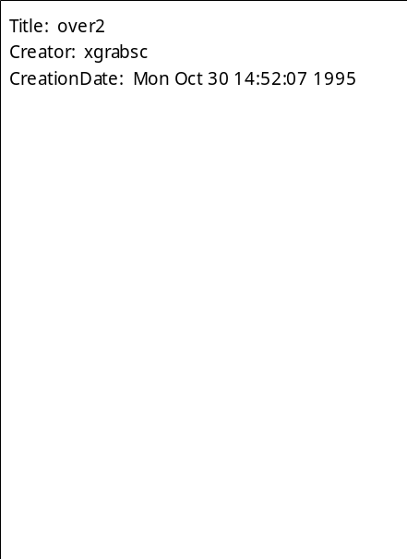
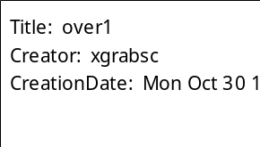
Wish: Windowing Shell
Create user interfaces by writing Tcl scripts.
Hello, world:
  button .hello -text "Hello, world" -command exit
  pack .hello
Simple directory browser: 30 lines
Web browser: 2000 lines
10x less code for simple things.

Slide 16
Browser Wish Script
#!/usr/local/bin/wish4.0
listbox .list -yscroll ".scroll set" \
-width 20 -height 20
pack .list -side left
scrollbar .scroll -command \
".list yview"
pack .scroll -side right -fill y
if {$argc > 0} {
set dir [lindex $argv 0]
} else {
set dir .
}
foreach i [lsort [glob * .*]] {
.list insert end $i
}
bind .list <Double-ButtonPress-1> {
browse $dir [selection get]
}
bind all <Control-c> {destroy .}
proc browse {dir file} {
if {$dir != "."} {
set file $dir/$file
}
if {file isdirectory $file] {
exec browse $file &
} else {
if [file isfile $file] {
exec xedit $file &
} else{
error "can't browse $file"
}
}
}

Slide 17
Other Uses For Tcl
Data representation:
  Store data on disk as Tcl scripts.
  To load information, evaluate script.
Active objects:
  Store scripts in objects.
  Evaluate scripts at interesting times to give objects behavior.
Communication: send Tcl scripts between applications.
Executable content:
  Active e-mail messages, Web pages.
  Agents.

Slide 18
Status
Runs on all UNIX/X platforms.
PC/Mac alpha releases: September 1995.
Source and documentation freely available.
100,000 developers world-wide?
Hundreds of commercial products, free extensions.
Newsgroup: comp.lang.tcl.
2 introductory books (Ousterhout, Welch).

Slide 19
Representative Applications
Multimedia, groupware.
Active e-mail messages.
System administration.
Testing.
Scientific applications: instrument control, simulation, visualization, CAD.
Real-time control system for offshore platform.
British teletext system.
Feature animation at Walt Disney Studios.
On-air broadcast control system for NBC.

Slide 20
Popular Extensions
Available via public FTP:
  ftp://ftp.aud.alcatel.com/tcl
Expect: remote control for interactive programs such as ftp, telnet, crypt, and fsck:
  #!/usr/local/bin/expect
  spawn rlogin [lindex $argv 0]
  expect -re "($|#|%) "
  send "cd [pwd]\r"
  expect -re "($|#|%) "
  send "setenv DISPLAY $env(DISPLAY)\r"
  interact

Slide 21
Popular Extensions, cont'd
TclX: general-purpose extensions:
  POSIX system calls.
  Keyed lists.
  File scanning (similar to awk).
  Date/time manipulation.
  Debugging, help, profiling.
Oratcl and Sybtcl: access to commercial databases.
Incr tcl: object-oriented programming in Tcl.

Slide 22
Popular Extensions, cont'd
Tcl-DP: socket-based remote procedure calls, distributed objects.
  Sample server:
    set myId 0
    proc GetId {} {
    global myId
    incr myId
    return $myId
    }
    dp_MakeRPCServer 4545
  Sample client:
    set server [dp_MakeRPCClient foo.bar.com 4545]
    dp_rpc $server GetId

Slide 23
Where You Might Use Tcl and Tk
Creating graphical user interfaces.
Testing.
Applications that need scripting or extension facilities.
Platform-independent applications.

Slide 24
Drawbacks
Must learn new language (substitution rules confusing to some people).
Interpreted language has performance limits (but surprisingly high).
C interfaces incompatible with Xt, Motif library.

Slide 25
Plans For The Future
Increase accessibility:
  More work on PC/Mac ports (native look and feel).
  SpecTcl: interactive GUI builder.
  Better development tools (debugger, etc.)
Improve the language/toolkit:
  Incremental on-the-fly compiler.
  Better support for modules, data structures.
  Better internationalization (Asian character sets).
Create exciting Internet applications:
  Active documents?

Slide 26
Conclusions
High-level programming:
  Less to learn.
  Build applications more quickly.
Universal scripting language:
  Extend and modify applications at run-time.
  Make many things work together.
Use scripts instead of data:
  Active objects, executable content.
Tcl + Tk = shell of the 1990's?

