Slide 1
Building User Interfaces With
Tcl And Tk
John Ousterhout
Sun Microsystems Laboratories
john.ousterhout@eng.sun.com
Tcl/Tk Tutorial, Part III

Slide 2
Outline
Basic structures: windows, widgets, processes.
Creating widgets: class commands.
Widget commands.
Geometry management: the placer and the packer.
Bindings.
Other commands: send, focus, selection, window manager, grabs.
Two examples: showVars, mkDialog.

Slide 3
Structure Of A Tk Application
Widget hierarchy.
One Tcl interpreter.
One process (can have > 1 application in a process).
Widget: a window with a particular look and feel.
Widget classes implemented by Tk:
  Frame Menubutton Canvas
  Label Menu Scrollbar
  Button Message Scale
  Checkbutton Entry Listbox
  Radiobutton Text Toplevel

Slide 4
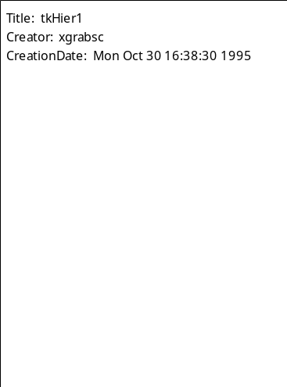
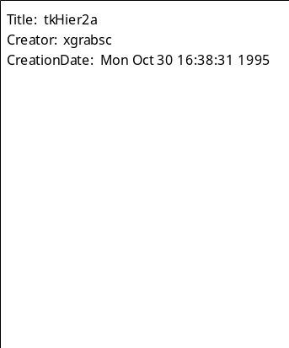
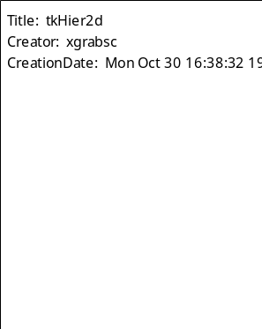




The Widget Hierarchy
.
.listbox
.menu
.scroll
.menu.file
.menu.help

Slide 5
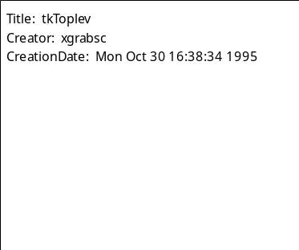
Types Of Windows
Main window
Internal windows
.
Top-level window
.listbox
.menu
.scroll
.dlg
.menu.file
.menu.help
.dlg.msg
.dlg.no
.dlg.yes

Slide 6
Creating Widgets
Each widget has a class: button, listbox, scrollbar, etc.
One class command for each class, used to create instances:
  button .a.b -text Quit -command exit
  scrollbar .x -orient horizontal
class name
configuration options
window name

Slide 7
Configuration Options
Defined by class. For buttons:
  -activebackground -disabledforeground -justify -underline
  -activeforeground -font -padx -width
  -anchor -foreground -pady -wraplength
  -background -height -relief
  -bitmap -highlightbackground -state
  -borderwidth -highlightcolor -takefocus
  -command -highlightthickness -text
  -cursor -image -textvariable
If not specified in command, taken from option database:
  Loaded from RESOURCE_MANAGER property or .Xdefaults file.
  May be set, queried with option command.
If not in option database, default provided by class.

Slide 8
Widget Commands
Tcl command for each widget, named after widget.
Used to reconfigure, manipulate widget:
  button .a.b
  .a.b configure -relief sunken
  .a.b flash
  scrollbar .x
  .x set 0.2 0.7
  .x get
Widget command is deleted when widget is destroyed.
Principle: all state should be readable, modifiable, anytime.

Slide 9
Geometry Management
Widgets don't control their own positions and sizes: geometry managers do.
Widgets don't even appear on the screen until managed by a geometry manager.
Geometry manager = algorithm for arranging slave windows relative to a master window.
Parameters from application designer
Requested size from slave
Geometry of master
Geometry
Manager
Size and location of slave
Requested size for master

Slide 10
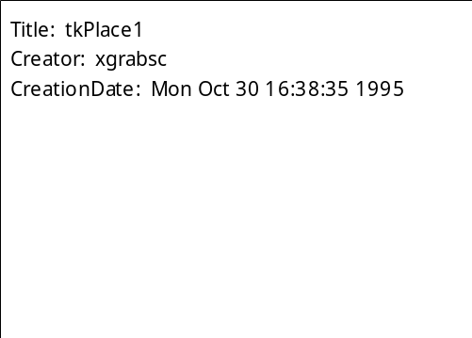
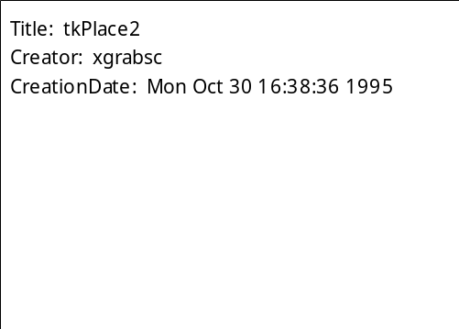
The Placer
Simple but not very powerful.
Each slave placed individually relative to its master.
place .x -x 0 -y 0
place .x -x 1.0c -rely 0.5 -anchor w

Slide 11


The Placer, cont'd
place .x -relx 0.5 -rely 0.5 \
-height 2c -anchor center
place .x -relheight 0.5 \
-relwidth 0.5 -relx 0 -rely 0.5

Slide 12
The Packer
More powerful than the placer.
Arranges groups of slaves together (packing list).
Packs slaves around edges of master's cavity.
For each slave, in order:
1. Pick side of cavity.
3. Optionally grow slave
to fill parcel.
2. Slice off parcel
for slave.
4. Position slave
in parcel.

Slide 13
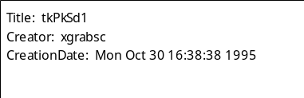
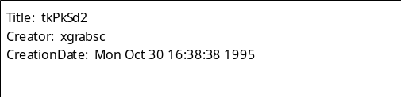
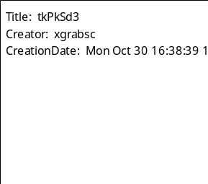
The Packer: Choosing Sides
button .ok -text OK
button .cancel -text Cancel
button .help -text Help
pack .ok .cancel .help -side left
.cancel configure -text "Cancel Command"
pack .ok .cancel .help -side top

Slide 14
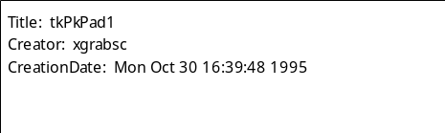

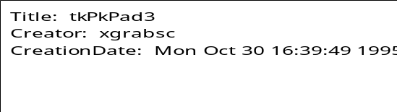
The Packer: Padding
pack .ok .cancel .help -side left \
-padx 2m -pady 1m
pack .ok .cancel .help -side left \
-ipadx 2m -ipady 1m
pack .ok .cancel .help -side left \
-padx 2m -pady 1m -ipadx 2m -ipady 1m

Slide 15

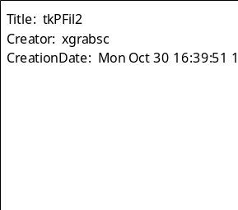
The Packer: Filling
Stretch widgets to fill parcels:
pack .ok .cancel .help -side top
pack .ok .cancel .help -side top -fill x

Slide 16
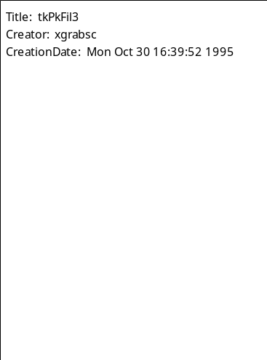

The Packer: Filling, cont'd
pack .menu -side top
pack .scrollbar -side right
pack .listbox
pack .menu -side top -fill x
pack .scrollbar -side right -fill y
pack .listbox

Slide 17
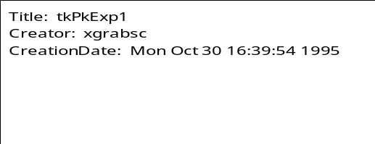
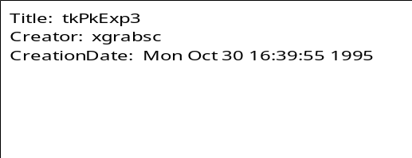

The Packer: Expansion
Increase parcel size to absorb extra space in master:
pack .ok .cancel .help -side left
pack .ok .cancel -side left
pack .help -side left -expand true
pack .ok .cancel -side left
pack .help -side left \
-expand true -fill x

Slide 18
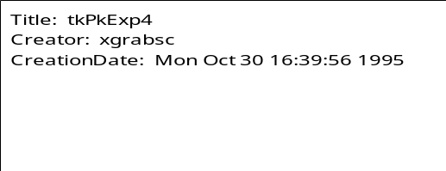
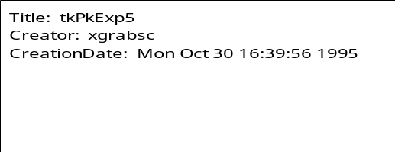
The Packer: Expansion, cont'd
pack .ok .cancel .help -side left \
-expand true
pack .ok .cancel .help -side left \
-expand 1 -fill both

Slide 19
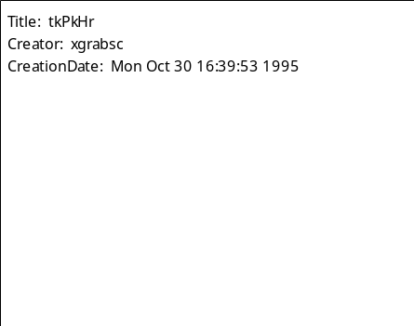
Hierarchical Packing
Use additional frames to create more complex arrangements:
frame .left
pack .left -side left -padx 3m -pady 3m
frame .right
pack .right -side right -padx 3m -pady 3m
foreach size {8 10 12 18 24} {
radiobutton .pts$size -variable pts \
-value $size -text "$size points"
}
pack .pts8 .pts10 .pts12 .pts18 .pts24 \
-in .left -side top -anchor w
checkbutton .bold -text Bold \
-variable bold
checkbutton .italic -text Italic \
-variable italic
checkbutton .underline -text Underline \
-variable underline
pack .bold .italic .underline \
-in .right -side top -anchor w

Slide 20
Connections
How to make widgets work together with application, other widgets? Tcl scripts.
Widget actions are Tcl commands:
  button .a.b -command exit
Widgets use Tcl commands to communicate with each other:
  scrollbar .s -command ".text yview"
Application uses widget commands to communicate with widgets.
button release
exit
click on arrow
.text yview scroll 1 unit

Slide 21
Bindings
Associate Tcl scripts with X events:
  bind .b <Control-h> {backspace .t}
Use tags to select one or more windows:
  Name of window: .b
  Widget class: Text
  All windows: all
  Arbitrary string: foo, bar, ...
Window(s)
Event
Script

Slide 22
Bindings: Specifying Events
Specifying events:
  <Double-Control-ButtonPress-1>
  <3>
  <KeyPress>
  a
Modifiers
Event Type
Button or Keysym

Slide 23
Bindings: Substitutions
% substitutions in binding scripts:
  Coordinates from event: %x and %y.
  Window: %W.
  Character from event: %A.
  Many more...
Examples:
  bind .c <B1-Motion> {move %x %y}
  bind .t <KeyPress> {insert %A}
  bind all <Help> {help %W}

Slide 24
Binding Order
What if multiple bindings match an event?
  bind .t a ...
  bind all <KeyPress> ...
One binding triggers per tag: most specific.
Default order of tags: widget, class, toplevel, all.
Can change tags with bindtags command:
  bindtags .b {MyButton .b foo all}
Can use break to skip later tags.
Note: these rules apply only to Tk 4.0.

Slide 25
More On Bindings
Text and canvas widgets support bindings internally:
  Associate tags with text or graphics:
  .t tag add foo 1.0 2.0
  .c create rect 1c 1c 2c 2c -tags foo
  Associate bindings with tags:
  .t bind foo <1> {...}
  .c bind foo <Enter> {...}
Bindings always execute at global level:
  If binding created in procedure, procedure's local variables aren't available at event-time.

Slide 26
Quoting Hell
Often want binding script to use some information from binding-time, some from event-time.
Use list commands to generate scripts.
Use procedures to separate event-time information from bind-time information.
  bind .x <1> {set y [expr $a + $b]}
  bind .x <1> "set y [expr $a + $b]"
  proc sety a {
  global b y
  set y [expr $a + $b]
  }
  bind .x <1> [list sety $a]
Wrong
Use bind-time value
Use event-time value
Right

Slide 27
Other Tk Commands
The selection:
  selection get
  selection get FILE_NAME
Issuing commands to other Tk applications:
  send tgdb "break tkEval.c:200"
  winfo interps
  н wish tgdb ppres
Window information:
  winfo width .x
  winfo children .
  winfo containing $x $y

Slide 28
Access To Other X Facilities
Keyboard focus:
  focus .x.y
Communication with window manager:
  wm title . "Editing main.c"
  wm geometry . 300x200
  wm iconify .
Deleting windows:
  destroy .x
Grabs:
  grab .x
  grab release .x

Slide 29
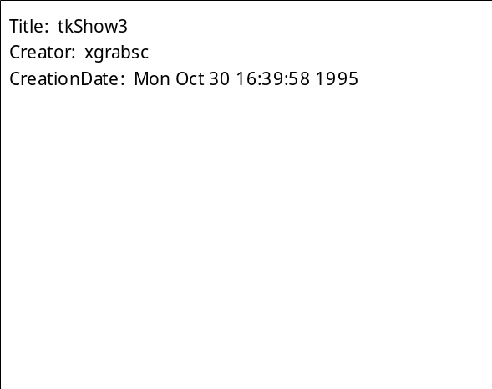
Example #1: showVars
Displays values of one or more values, updates automatically:
  showVars .vars name age ssn phone

Slide 30
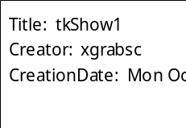
showVars, cont'd
proc showVars {w args} {
toplevel $w
wm title $w "Variable values"
frame $w.menu -relief raised -bd 2
pack $w.menu -side top -fill x
menubutton $w.menu.file -text File \
-menu $w.menu.file.m -underline 0
pack $w.menu.file -side left
menu $w.menu.file.m
$w.menu.file.m add command -label Quit \
-command "destroy $w" -underline 0
...
}

Slide 31
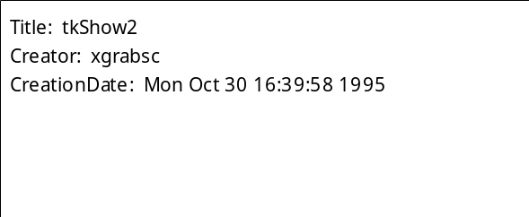
showVars, cont'd
proc showVars {w args} {
...
frame $w.bot -relief raised -bd 2
pack $w.bot -side bottom -fill both
label $w.bot.title -width 20 -anchor center \
-text "Variable values:" -font \
-Adobe-Helvetica-Medium-r-normal--*-180-*-*-*-*-*-*-
pack $w.bot.title -side top -fill x
...
}

Slide 32

showVars, cont'd
proc showVars {w args} {
...
foreach i $args {
frame $w.bot.$i
pack $w.bot.$i -side top -anchor w
label $w.bot.$i.name -text "$i: "
label $w.bot.$i.value -textvariable $i
pack $w.bot.$i.name -side left
pack $w.bot.$i.value -side left
}
}
showVars .vars name age ssn phone

Slide 33
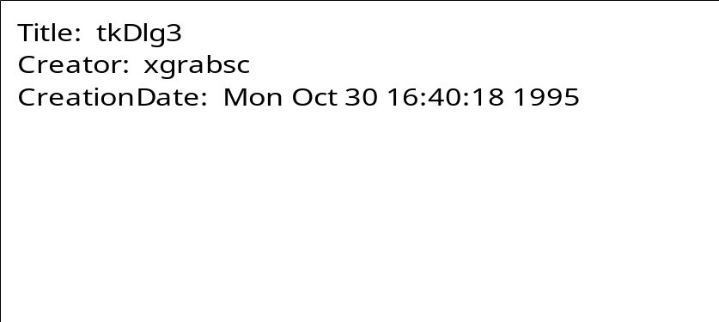
Example #2: mkDialog
Creates dialog box, waits until button pressed, returns index.
  mkdialog .d "File Modified" $msg warning \
  "Save File" "Discard Changes" "Return To Editor"
Window Name
Title
Message
Bitmap
Button Labels

Slide 34
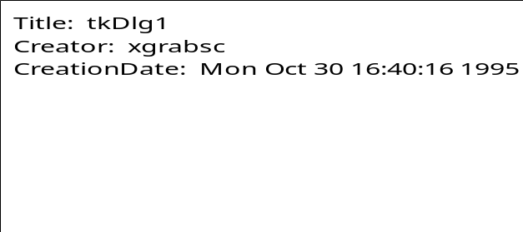
mkDialog, cont'd
proc mkDialog {w title text bitmap args} {
toplevel $w
wm title $w $title
wm protocol $w WM_DELETE_WINDOW { }
frame $w.top -relief raised -bd 1
pack $w.top -side top -fill both
frame $w.bot -relief raised -bd 1
pack $w.bot -side bottom -fill both
label $w.msg -wraplength 3i -text $text \
-justify left -font \
-Adobe-Times-Medium-R-Normal--*-180-*-*-*-*-*-*
pack $w.msg -in $w.top -side right \
-expand 1 -fill both -padx 3m -pady 3m
...
}

Slide 35
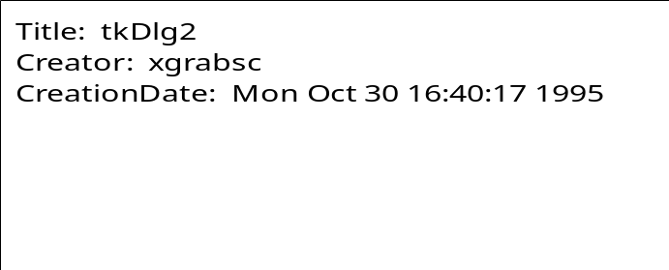
mkDialog, cont'd
proc mkdialog {w title text bitmap args} {
...
if {$bitmap != ""} {
label $w.bitmap -bitmap $bitmap
pack $w.bitmap -in $w.top -side left \
-padx 3m -pady 3m
}
...
}

Slide 36
mkDialog, cont'd
proc mkDialog {w title text bitmap args} {
...
set i 0
foreach but $args {
button $w.button$i -text $but \
-command "set button $i"
pack $w.button$i -in $w.bot -side left \
-expand 1 -padx 3m -pady 2m
incr i
}
...
}

Slide 37
mkDialog, cont'd
proc mkDialog {w title text bitmap args} {
global button
...
grab $w
set oldFocus [focus]
focus $w
tkwait variable button
destroy $w
focus $oldFocus
return $button
}

Slide 38
Summary
Creating interfaces with Tk is easy:
  Create widgets.
  Arrange with geometry managers.
  Connect to application, each other.
Power from single scripting language:
  For specifying user interface.
  For widgets to invoke application.
  For widgets to communicate with each other.
  For communicating with outside world.
  For changing anything dynamically.

