Slide 1
Battle Ship MCU Team (I2C 통신 MPU6050)
변진혁, 김형준

Slide 2
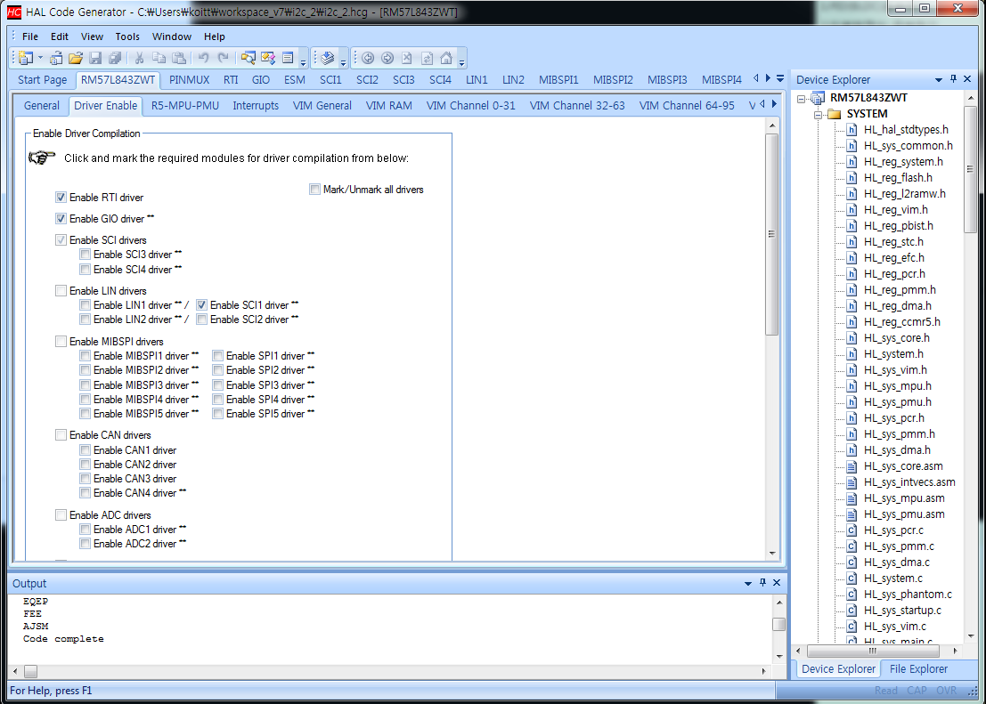
Halcogen Setting(1) – Driver Enable(1)

Slide 3
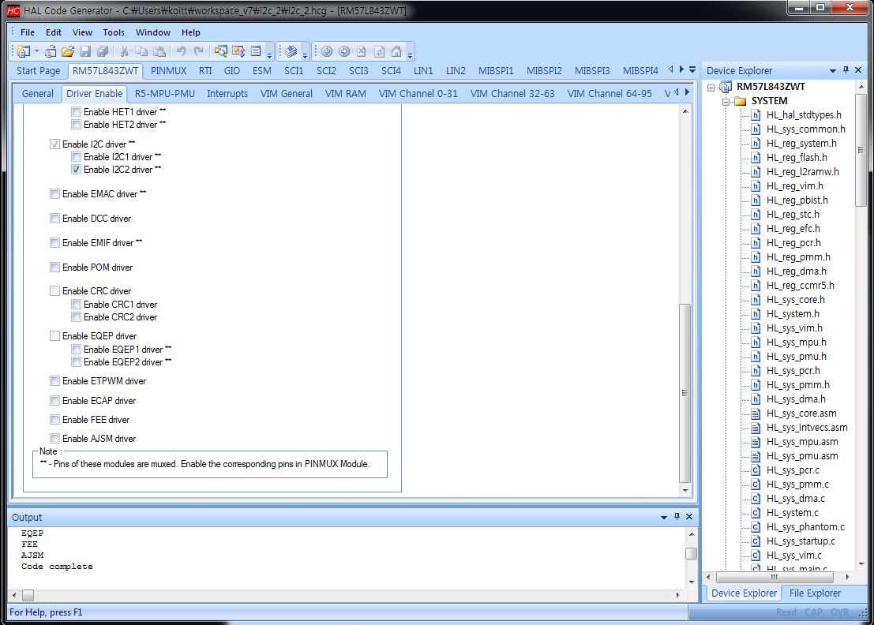
Halcogen Setting(2) – Driver Enable(2)

Slide 4
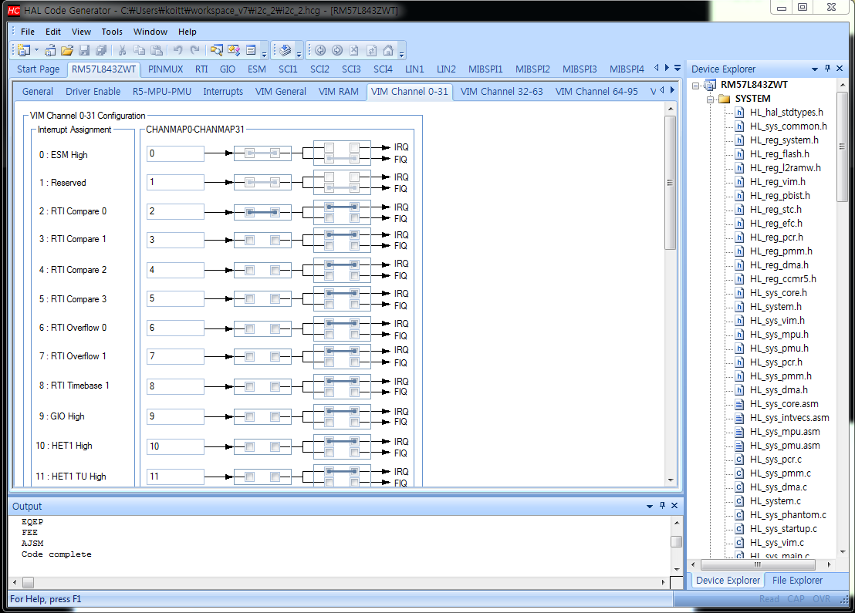
Halcogen Setting(3) – Channel

Slide 5
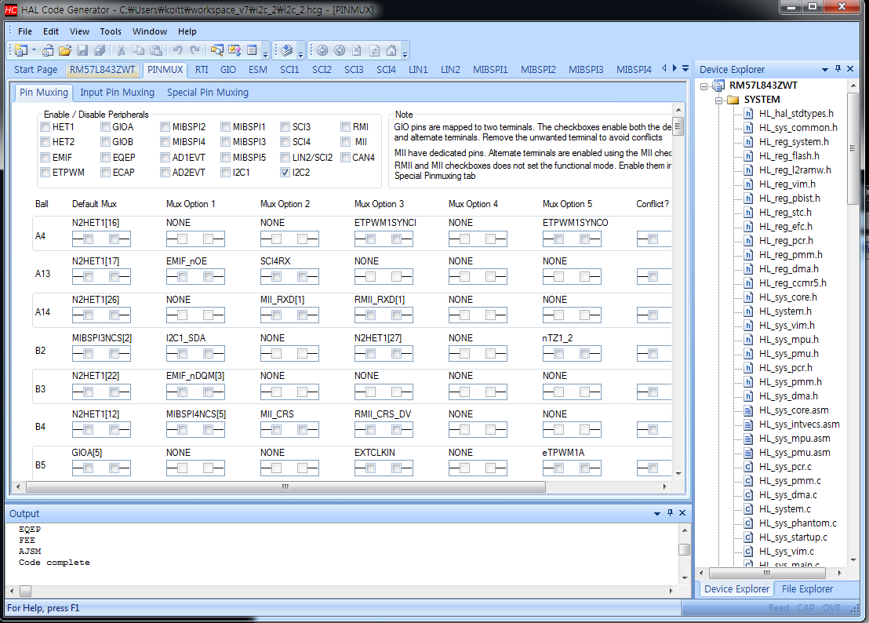
Halcogen Setting(4) – PINMUX(1)

Slide 6
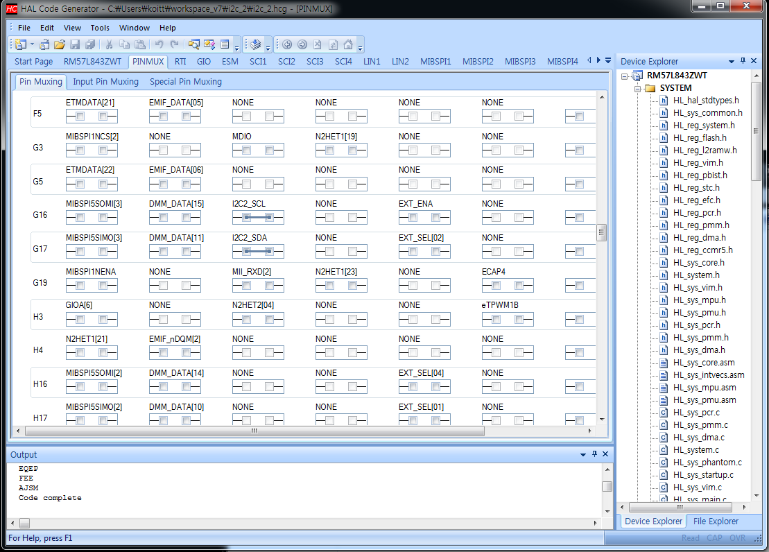
Halcogen Setting(5) – PINMUX(2)

Slide 7
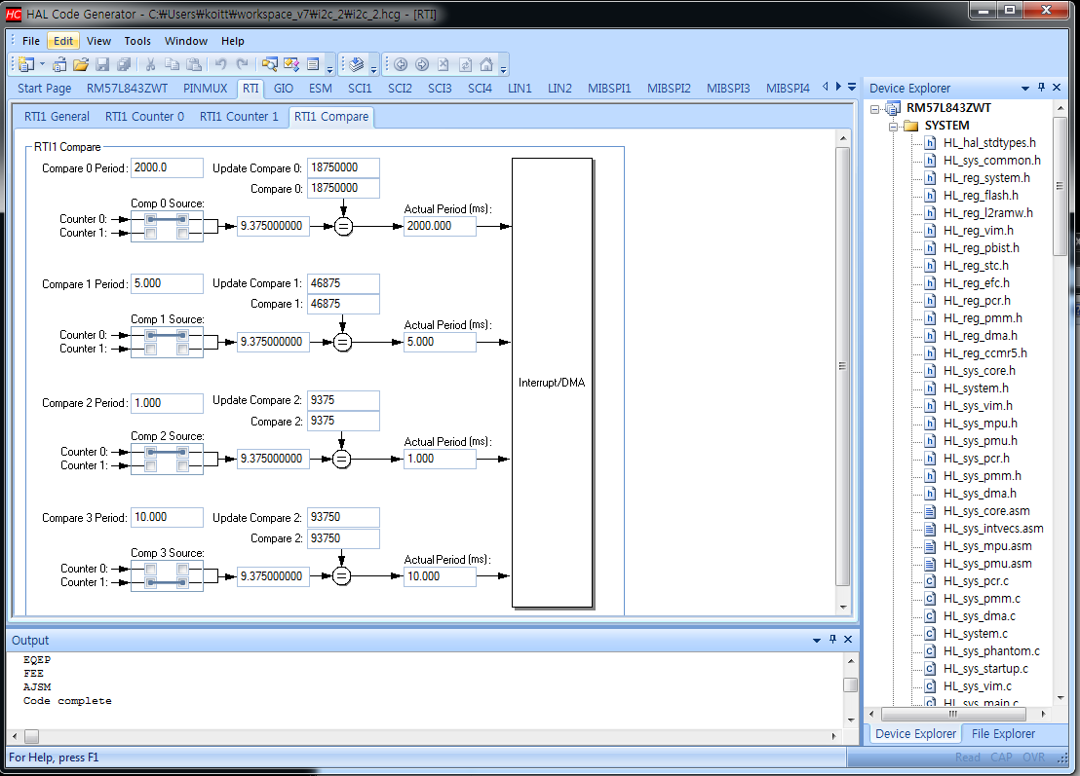
Halcogen Setting(6) – RTI Compare

Slide 8
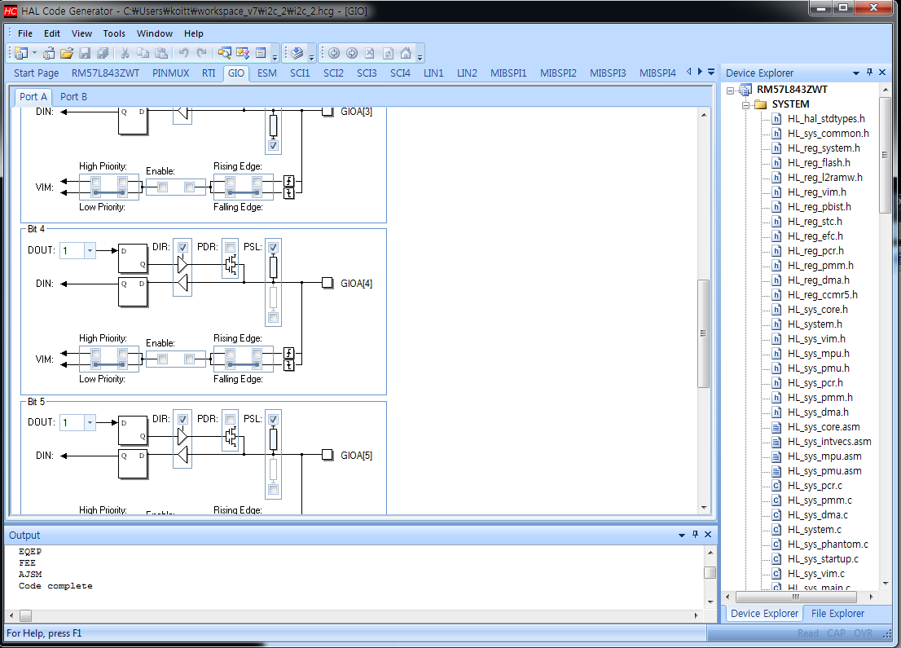
Halcogen Setting(7) – GIO

Slide 9
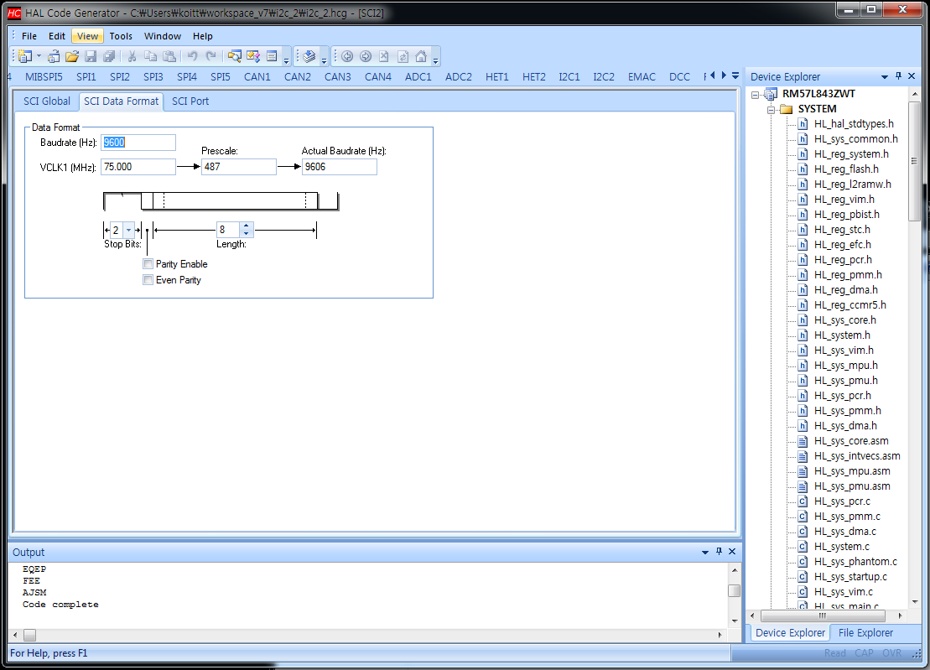
Halcogen Setting(8) – SCI Data Format

Slide 10
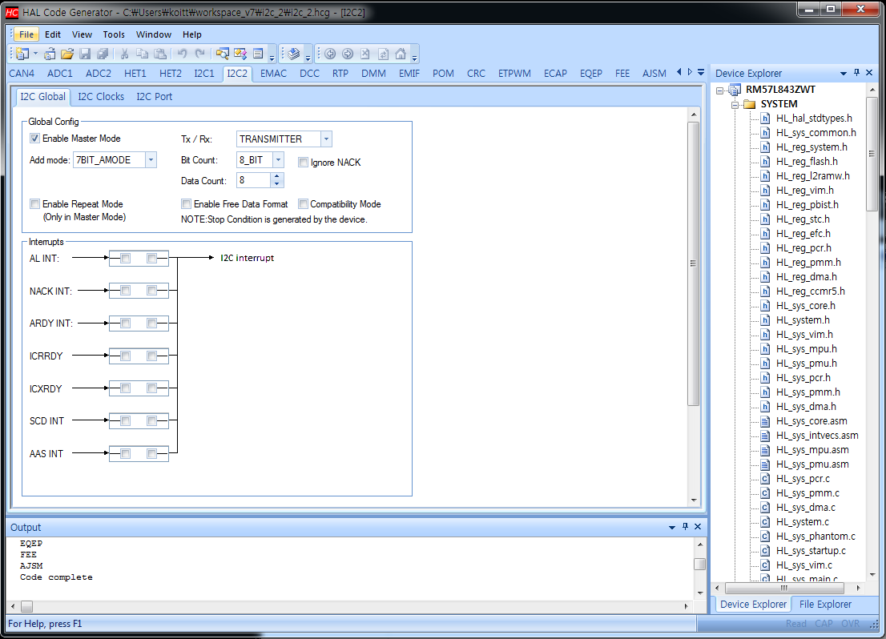
Halcogen Setting(9) – I2C Global

Slide 11
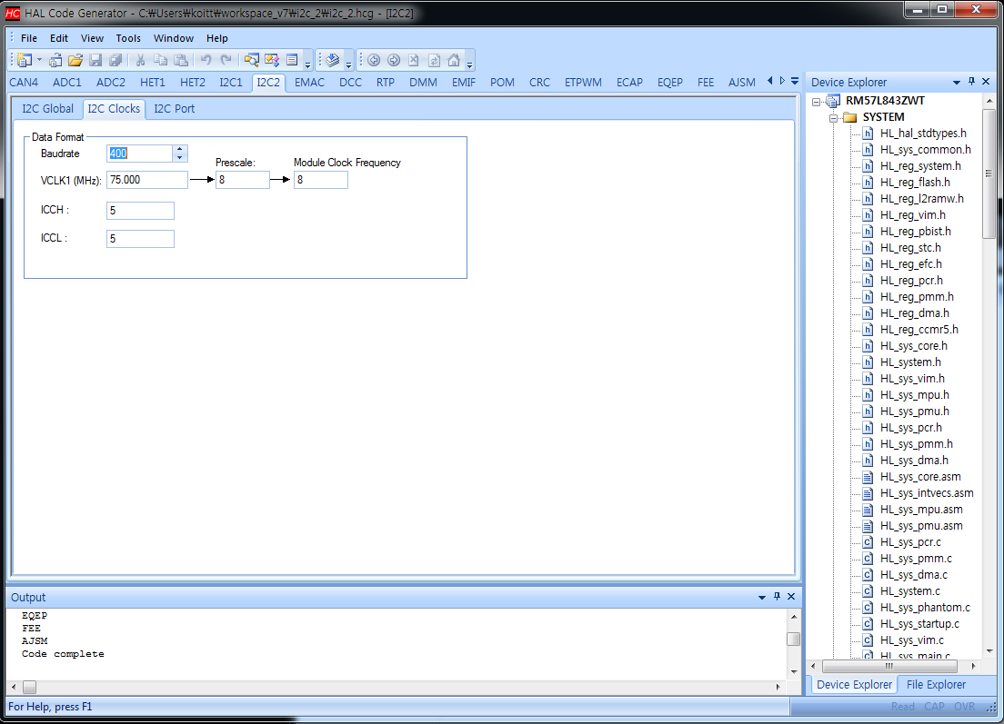
Halcogen Setting(10) – I2C Clocks

Slide 12
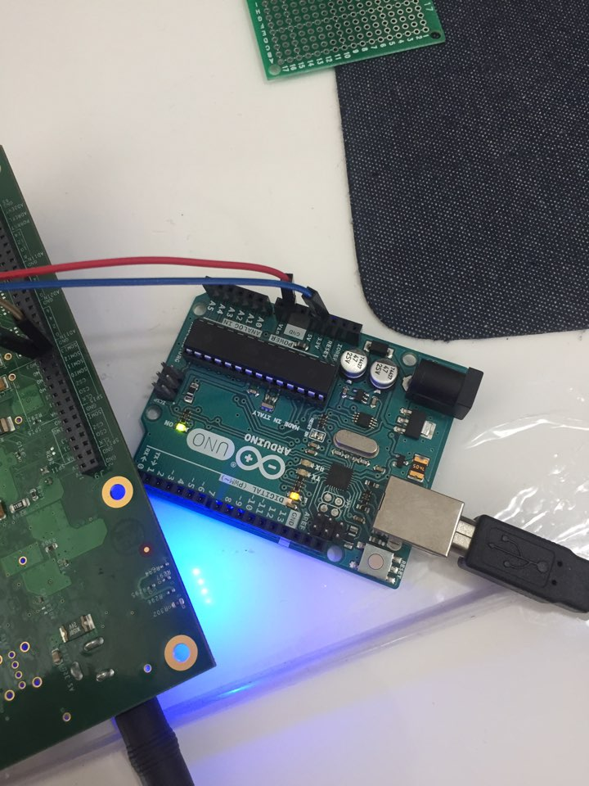
Circuit(1)

Slide 13
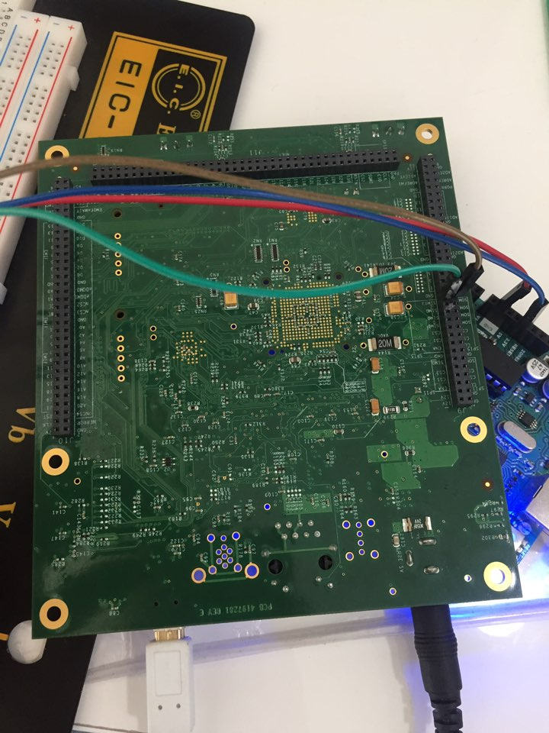
Circuit(2)

Slide 14
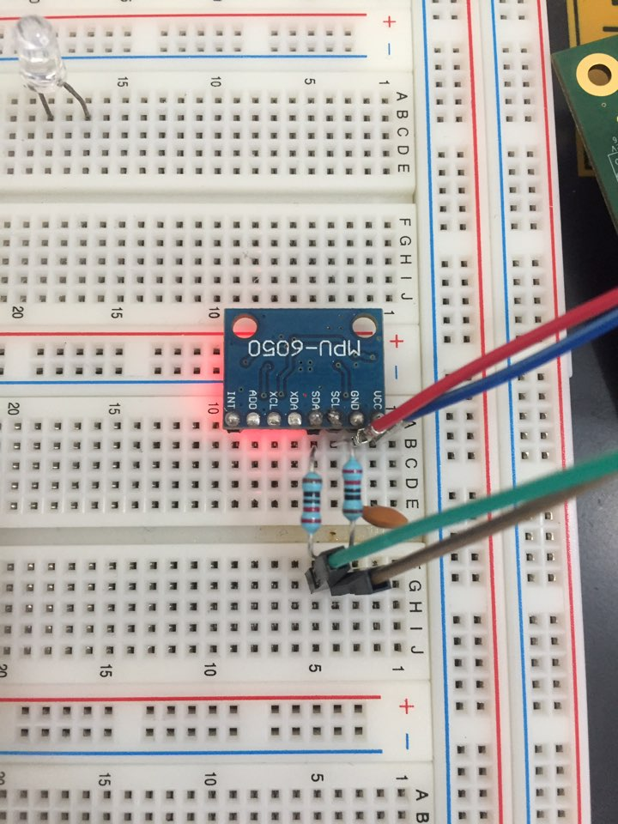
Circuit(3)

Slide 15
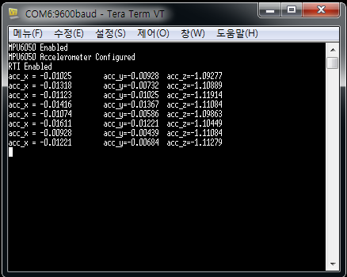
Result(I2C)

