Slide 1
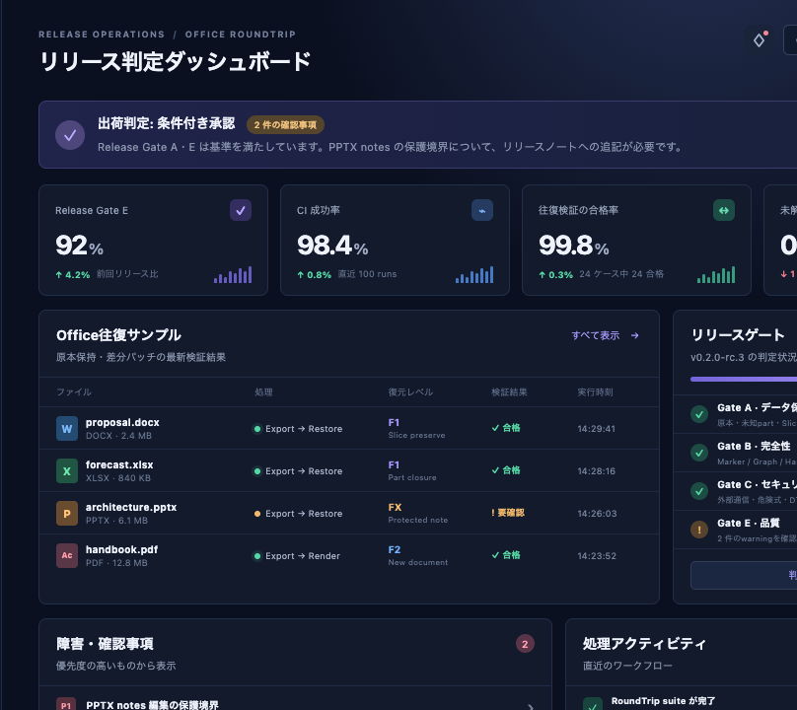
GO / NO-GO REVIEW · 2026-08-21
Project Atlas
v2.4.0 release readiness
PPTX RELEASE DECISION: CONDITIONAL GO
Canary release is approved after two documentation actions. Automatic rollback remains mandatory through hypercare.
Control-room snapshot · v0.2.0-rc.3
PROJECT ATLAS • RELEASE OPERATIONS 1
Notes:
[Sources]
- Screenshot captured from the local RTMD fixture dashboard on 2026-08-21.
- All metrics are deterministic RTMD verification-fixture data; no external claims.

Slide 2
Evidence gates make rollout reversible
Every promotion records a result; the canary gate is the last point before global traffic.
01
02
03
04
05
Merge
CI / Security
Staging
Canary 10%
Global
2 approvals
release freeze
tests · SAST
license audit
migration
smoke checks
15 min
error < 0.5%
staged traffic
30 min hypercare
ROLLBACK · SLO breach → previous image → INC-2026 bridge
PROJECT ATLAS • RELEASE OPERATIONS 2
Notes:
[Sources]
- Flow follows internal runbook OPS-RUN-042.
- All metrics are deterministic RTMD verification-fixture data; no external claims.

Slide 3
All implementation areas clear the 98% gate
76 / 76
automated tests passed
0
build warnings and errors
2
documentation actions remain
PROJECT ATLAS • RELEASE OPERATIONS 3
Notes:
[Sources]
- Metrics are generated by the local Release build and test run.
- All metrics are deterministic RTMD verification-fixture data; no external claims.

Slide 4
Close two documentation actions, then open the window
Release Manager owns the final change-ticket decision; Platform Engineering owns rollout, rollback, and hypercare.
Gate | Owner | Status | Exit evidence
A · Preservation | Format Team | PASS | Unknown parts and raw slices retained
B · Integrity | Core Team | PASS | Markers, graph, map, and hashes verified
C · Security | AppSec | PASS | DTD, external rels, and risky formulas blocked
E · Quality | QA | REVIEW | Add notes-boundary and OCR-confidence disclosures
Decision after closure: GO
Preservation sentinel: PPTX-PRESERVE-OPS-2026
PROJECT ATLAS • RELEASE OPERATIONS 4
Notes:
[Sources]
- Gate definitions are internal fixture data from the RTMD design and test suite.
- All metrics are deterministic RTMD verification-fixture data; no external claims.

