Slide 1
Local search algorithms for the dial-a-ride problem with convex time windows and ride time penalty
Kiyoshi Takeda , Yagiura lab

Slide 2
Outline
Background
Introduction
pickup and delivery problem
dial-a-ride problem
complexity of dial-a-ride problem
Proposed method
Summary and future work

Slide 3
Background
Users specify the location and time
Multiple users share the same vehicles
These demand are increasing as traffic in urban areas increases in recent years.
Such features arise in services such as,
Share taxi service,
Health care service.

Slide 4

Background
From: school
To: home
Time: 1:00
From: university
To: station
Time: 1:30
By finding optimal routes in these services,
efficient services would be provided for both users and service providers

Slide 5
pickup and delivery problem (PDP)
Input: pairs of pickup and delivery requests,
number of vehicles, etc
Constraints:
All vertices must be visited
Vehicles start and terminate at depots
Each requests must be served by the same vehicle
Objective
design a set of minimum cost vehicle routes

Slide 6
dial-a-ride problem
Dial-a-ride problem (DARP) is an extension of PDP for human transportation.
What makes the difference between PDP and DARP is
users’ dissatisfactions must be considered.

Slide 7
dial-a-ride problem
The problem in which all requests are known in advance is called static DARP, and the one in which all requests are not known is called dynamic DARP.
We deal with the static DARP

Slide 8
Complexity of the dial-a-ride problem
In the dial-a-ride problem, we set the number of vehicles to 1 and the start locations to depots
TSP(Travelling Salesman Problem) can be reduced to the dial-a-ride problem
TSP is known as a NP-hard problem,
so dial-a-ride problem is a NP-hard problem as well.

Slide 9
dial-a-ride problem
Many approach is proposed about static DARP, however, in all of previous researches, time windows and maximum ride time are considered as hard constraints.
In this research, we consider with the DARP in which time windows and the maximum ride time are piecewise linear convex functions.

Slide 10
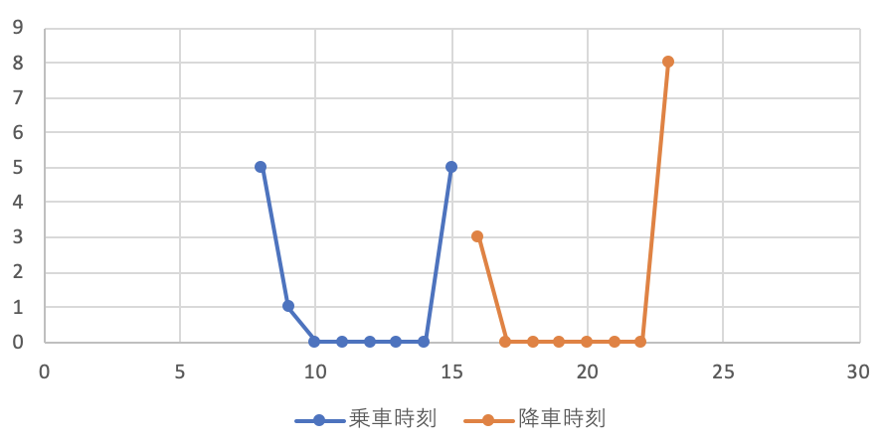
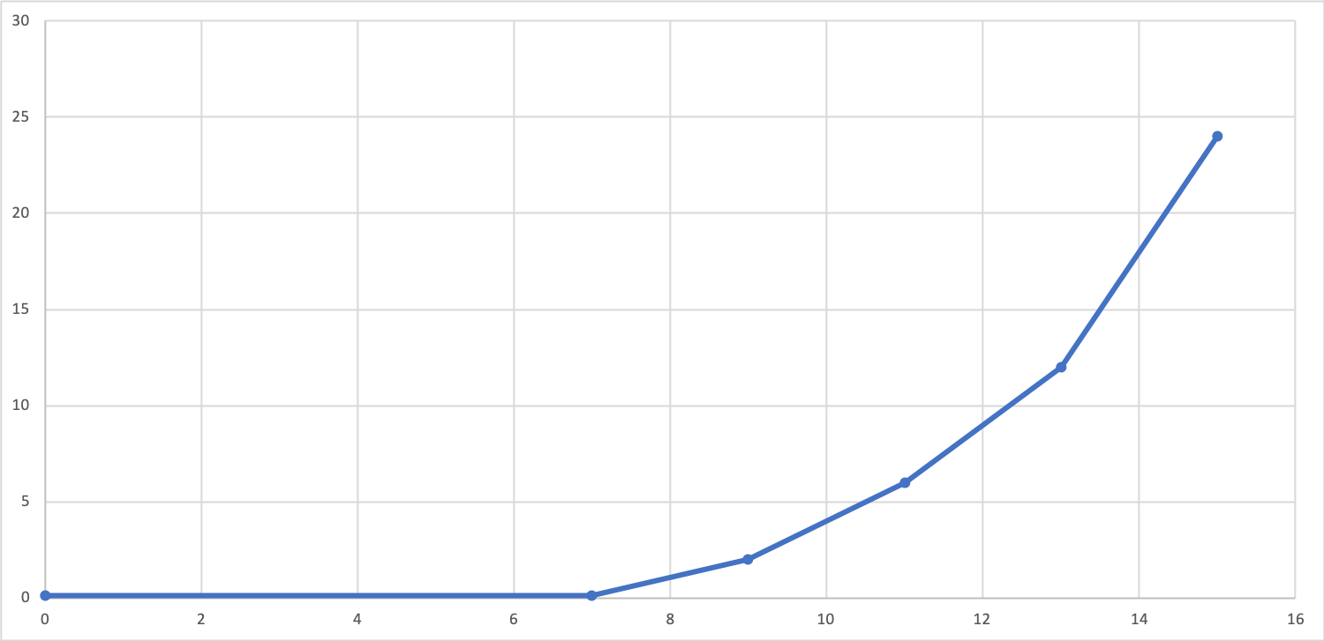
piecewise linear convex functions
Penalty functions
time windows ride time
By giving these constraints as soft one, this problem can be a more generic dial-a-ride problem.

Slide 11
Problem definition
input
A complete digraph whose vertices are depots and visiting points
Number of vehicles, capacity of vehicles
For each requests: penalty functions and number of passengers
output
Permutation of visiting points and the arrival time at each points

Slide 12
Problem definition (constraints)
vehicles must start and terminate at depots
for every requests, picking points and dropping points must belong to the same route
vehicle capacity constraints

Slide 13
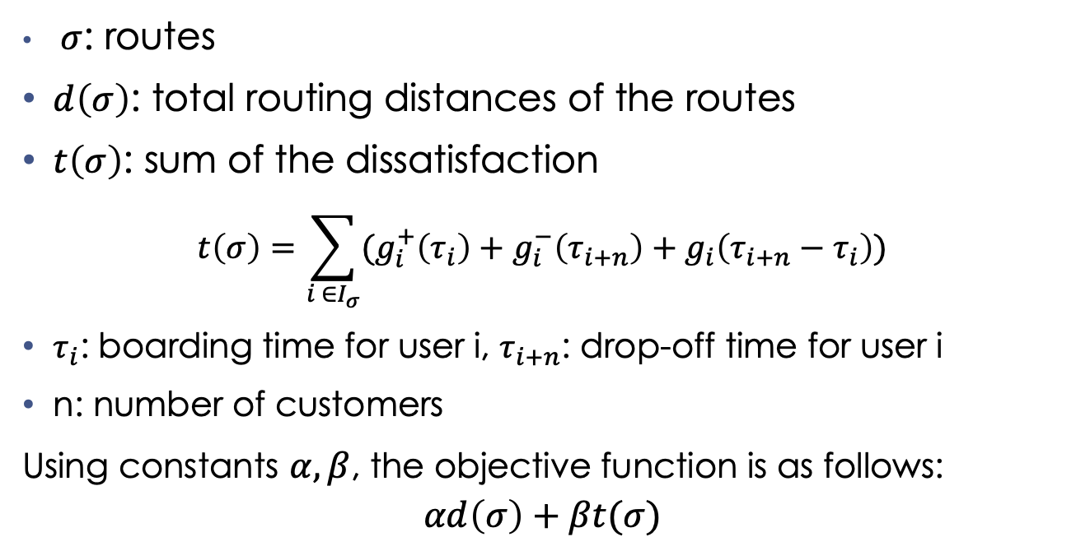
Objective function
$σ$: routes
$d\left(σ\right)$: total routing distances of the routes
$t\left(σ\right)$: sum of the dissatisfaction
$$t\left(σ\right)=\sum_{i ∈I_{σ}}{(g_{i}^{+}\left(τ_{i}\right)+g_{i}^{−}\left(τ_{i+n}\right)+g_{i}\left(τ_{i+n}−τ_{i}\right))}$$
$τ_{i}$: boarding time for user i, $τ_{i+n}$: drop-off time for user i
n: number of customers
Using constants $α,β$, the objective function is as follows:
$$αd\left(σ\right)+βt(σ)$$
Notes:
ルートがシグマ

Slide 14
Proposed method
Construction of initial solution
Local search
At each iteration, we minimize users’ dissatisfaction using LP solver
We perform a computational experiment with a modified version of instances of the previous study.

Slide 15
Construction of initial solution
We choose requests at random, then insert them into routes
(we pair pick-up and drop-off requests and insert them)
Repeat until no more requests are left.
By following these rules:
vehicle capacity constraints
The order
Same vehicle visit pick-up and drop-off points
We can create a solution that satisfies the above constraints.

Slide 16
The example of constructing initial solution
vehicle 1
P2
D2
P1
D1
P4
D4
Vehicle 2
P5
D5
P3
D3
Pairs of requests
P1
D1
P2
D2
P3
D3
P4
D4
P5
D5
Notes:
print

Slide 17
Local search
moving from solution to solution in the space of candidate solutions by applying local changes
Repeat until the termination condition is satisfied
In this research, we perform intra-route and inter-route exchange

Slide 18
Algorithm flow
Construction of initial solution
Intra-route exchange
Inter-route exchange
if termination condition is satisfied exit
otherwise step 3

Slide 19
Intra-route exchange
19
Every vertex is removed from its vehicle and reinserted.
it is reinserted in the best position so as to minimize the objective function
depot
P1
D1
P2
D2
depot
depot
P1
P2
D1
D2
depot

Slide 20
Inter-route exchange
Insertion exchange
removing a vertex pair and reinserts in a different route
Swap exchange
Swapping two pairs of vertices between two routes
In both exchange operation, vertices are inserted in the best position as to minimize the objective function

Slide 21
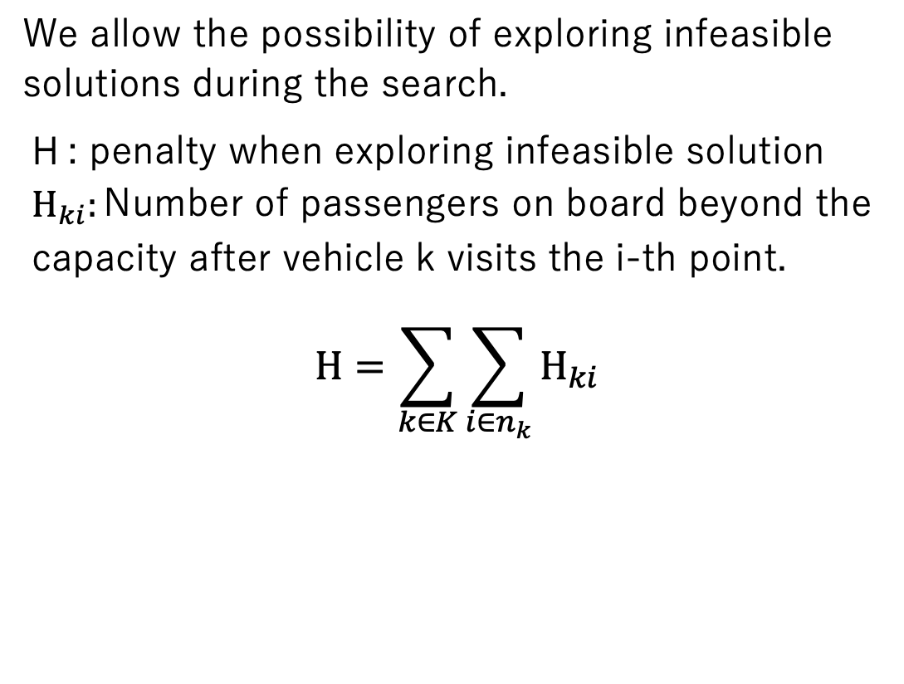
Relaxation of constraints
We allow the possibility of exploring infeasible solutions during the search.
H : penalty when exploring infeasible solution
$$Η_{ki}:\text{Number} \text{of} \text{passengers} \text{on} \text{board} \text{beyond} \text{the} \text{capacity} \text{after} \text{vehicle} \text{k} \text{visits} \text{the} \text{i}\text{−}\text{th} \text{point}\text{.}$$
$$Η=\sum_{k∈K}{\sum_{i∈n_{k}}{Η_{ki}}}$$

Slide 22
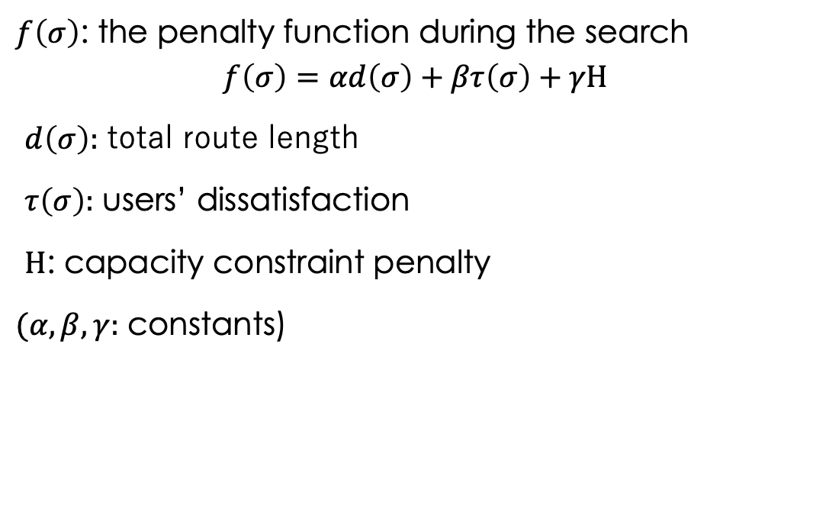
Evaluation function
$f\left(σ\right)$: the penalty function during the search
$$f\left(σ\right)=αd\left(σ\right)+βτ\left(σ\right)+γΗ$$
$d\left(σ\right):$ total route length
$τ\left(σ\right):$ users’ dissatisfaction
$Η$: capacity constraint penalty
$(α,β,γ:$ constants)
Notes:
We can explore the search space and

Slide 23
Optimal start time of services
In every iterations, we have to determine the optimal time of services at every visiting points.
The objective function and constraints can be expressed as linear equations
We formulate it as a linear programming problem
In this research, we use gurobi optimizer (ver 9.0.0)

Slide 24
 | Size |  | Our propose |  |  |  | cordeau
 | num of customers | Num of vehicles | route length | penalty | GAP (%) | Num of iteration | Route length
r1a | 24 | 3 | 209.39 | 0.00 | 10.1 | 292 | 190.02
r1b | 24 | 3 | 207.15 | 0.00 | 25.8 | 204 | 164.46
r2a | 48 | 5 | 354.76 | 0.00 | 17.1 | 1172 | 302.08
r2b | 48 | 5 | 376.21 | 0.00 | 27.0 | 762 | 296.06
r3a | 72 | 7 | 698.78 | 0.00 | 31.2 | 4653 | 532.08
r3b | 72 | 7 | 662.65 | 0.00 | 34.2 | 1826 | 493.30
r4a | 96 | 9 | 881.69 | 0.00 | 53.8 | 3092 | 572.68
r4b | 96 | 9 | 769.49 | 0.00 | 43.7 | 2201 | 535.90
Notes:
赤色が最良値

Slide 25
Result
We use insertion exchange for inter-route operation
We confirmed that we get solutions with 0 penalty.
we find solutions about 30% difference from previous research

Slide 26
Approaches to reduce calculation time
It took too much time to find solutions.
Before trying some heuristic approaches, we tried three different ways to store the information in gurobi optimizer.

Slide 27
Three different approaches
Storing all information in one model and calculate the start time at all vertices
Storing the information in multiple models and calculate the start time at the vertices of routes where the order changes
Storing all information in one model and calculate the start time at the vertices where the order in route changes

Slide 28
 | Approach 1 |  | Approach 2 |  | Approach 3
 | Route length | Cpu time | Route length | cpu time | Route length | Cpu time
r1a | 219.27 | 117.14 | 237.30 | 154.22 | 232.51 | 105.23
r1b | 208.56 | 183.03 | 254.11 | 124.93 | 206.52 | 117.26
r2a | 431.61 | 847.93 | 437.01 | 1136.47 | 437.98 | 877.47
r2b | 402.11 | 843.17 | 465.56 | 1311.07 | 421.96 | 1110.43
r3a | 779.04 | 3404.06 | 825.01 | 3901.42 | 806.99 | 3155.24
r3b | 697.87 | 3231.22 | 817.24 | 3948.20 | 767.10 | 3674.59
Notes:
赤色が最良値

Slide 29
New approach to calculate optimal start time of services
it takes too much time to calculate optimal start time using LP solver at each iteration
we utilize the property that the function is convex
By using approach by T. Ibaraki ^{[1]}, we assume that we can reduce the calculation time
[1] T.Ibaraki, Effective Local Search Algorithms for Routing and Scheduling Problems with General Time-Window Constraints

Slide 30
Summary and future work
Summary
We got solutions about 30% difference from previous research using LP solver
We tried 3 different approaches to reduce calculate time, however, none of them worked.
Future work
working together with 佐藤くん to reduce calculation time.
Improving routes using heuristic approach

