Slide 1
algorithms for the dial-a-ride problem with convex time windows and ride time penalty
Kiyoshi Takeda , Yagiura lab

Slide 2
Outline
Background
Introduction
pickup and delivery problem
dial-a-ride problem
Summary

Slide 3
Background
Users specify the location and time
Multiple users share the same vehicles
These demand are increasing as traffic in urban areas increases in recent years.
Such features arise in services such as,
Share taxi service,
Health care service.

Slide 4

Background
From: school
To: home
Time: 1:00
From: university
To: station
Time: 1:30
By finding optimal routes in these services,
efficient services would be provided for both users and service providers

Slide 5
pickup and delivery problem (PDP)
Input: pairs of pickup and delivery requests,
number of vehicles, etc
Constraints:
All vertices must be visited
Vehicles start and terminate at depots
Each requests must be served by the same vehicle
Objective
design a set of minimum cost vehicle routes

Slide 6
dial-a-ride problem
Dial-a-ride problem (DARP) is an extension of PDP for human transportation.
What makes the difference between PDP and DARP is
users’ dissatisfactions must be considered.

Slide 7
dial-a-ride problem
Many approach is proposed about static DARP, however, in all of previous researches, time windows and maximum ride time are considered as hard constraints.
In this research, we consider with the DARP in which time windows and the maximum ride time are piecewise linear convex functions.

Slide 8
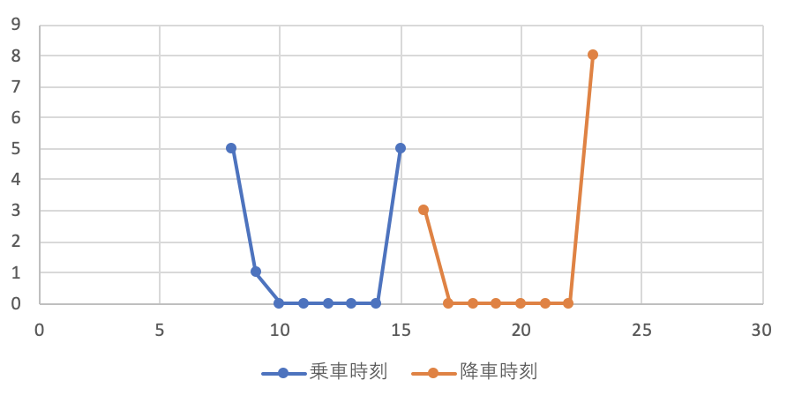
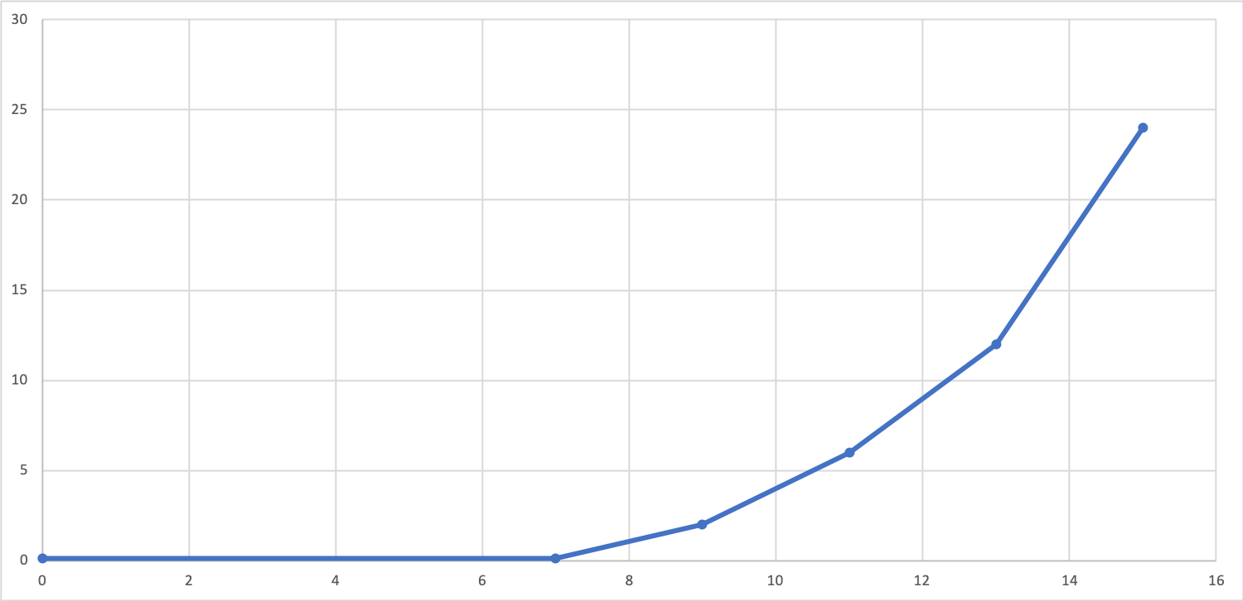
piecewise linear convex functions
Penalty functions
time windows ride time
By giving these constraints as soft one, this problem can be a more generic dial-a-ride problem.

Slide 9
Summary and future work
Summary
We got solutions about 30% difference from previous research using LP solver
Future work
Improving routes using heuristic approach

