Slide 1
A mathematical modeling for the stowage planning problem
Kiyoshi, TAKEDA
Yagiura lab

Slide 2
Outline
Background
Problem Definition
Modeling
Summary

Slide 3
Background
A carrier ship carries various loads through some ports.
e consider the ship that carries various type of cars. (e.g. passenger car, truck, wrecker, bulldozer...)
Assignment of cars to ship is planned manually.
We aim to make assignment automatically

Slide 4
Background
Planning assignments that make it easy to load and unload cars is important.
To avoid human errors
We also have to pay attention the balance of the total load of the ship
Unbalanced assignments may result in a sinking.

Slide 5
Problem Definition
We consider the ships which has 12 decks(floors).
Each deck has up to 4 holds

Slide 6
Problem definition
Given information are as follows.
Order Information
Hull(ship) information

Slide 7
Stowage plan
We assign cars in every order to the hold.

Slide 8
Mathematical Modeling
We model this assignment based on interviews with planners.
I and Mr.Ukawa made model for this assignment last year.
I will explain constrains and objectives one by one.

Slide 9
Constraints
Travel routes in the ship
Weight balance of cargo
Rules for splitting orders

Slide 10
Travel paths in the ship
There must be a certain amount of space in the path of the car.

Slide 11
Weight balance of cargo(Forward and backward direction)

Slide 12
Weight balance of cargo(Left-right direction)

Slide 13
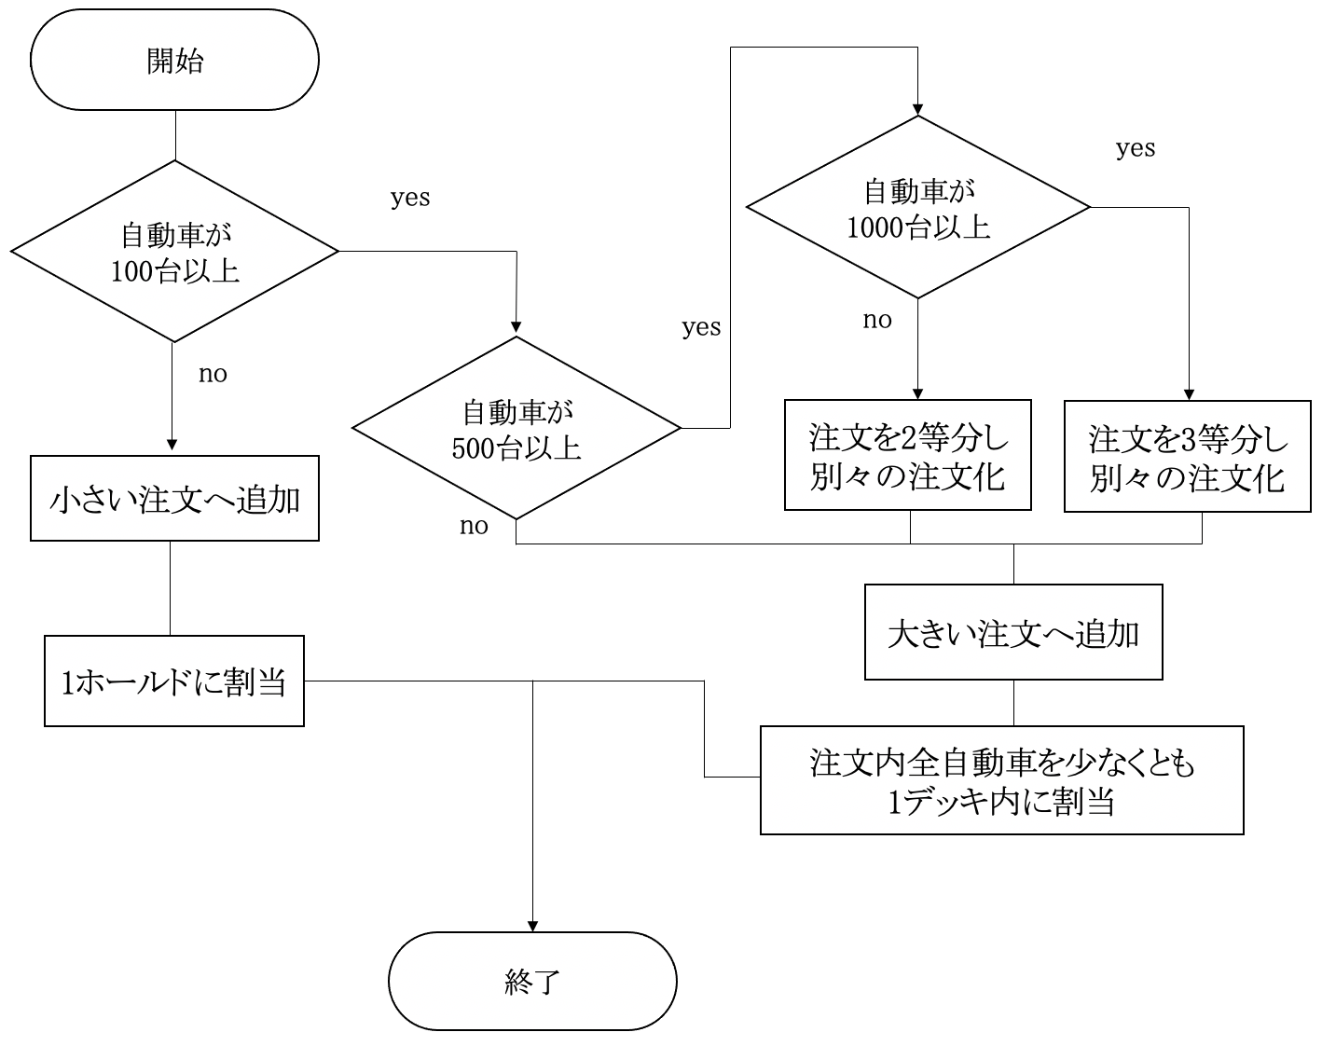
Rules for splitting orders
For large orders, we have to split them up.

