Slide 1
TakeTopDSHTeam
AI Team Collaboration Platform
Partners + TakeTop
September 15, 2026

Slide 2


01
Company Introduction
CONTENT
02
Product Introduction
03
Function Introduction
04
Customer Profile
05
Case Analysis
06
Cooperation Model
able of ontents

Slide 3
PART 1
Company Introduction
TakeTopSoftware was founded in 2010, focusing on project management software R&D, implementation, and management consulting services. With software plus consulting, we provide comprehensive project management solutions for enterprises. After years of effort, we have grown into a highly competitive provider of management software and consulting services, and are an important ISV partner of Yonyou Group.

Slide 4

1-1. Company Introduction
TakeTop Software was founded in 2010. After years of development, it has grown into a highly competitive professional project management software development and consulting company. With software plus consulting, the company has a high-quality workforce. Core R&D and consulting personnel have extensive work management experience in large domestic and international enterprises, with professional and rich experience in software engineering, coding, testing, maintenance, implementation, service, and management.
Leveraging professional technical advantages and extensive practical project experience, we have developed extremely flexible and advanced management software. Currently, there are four core products: [TakeTop AI Team Collaboration Platform (TakeTopDSHTeam)], [TakeTop R&D Project Platform (TakeTopRDMP)], [TakeTop Engineering Design Project Platform (TakeTopENPMP)], [TakeTop IT Service Project Management Platform (TakeTopITSMP)]. These integrated platforms have a large user base, and with our service philosophy of 'enthusiastic and thoughtful, fast and agile' and our 'technology + service' support model, we have won unanimous praise from clients across industries.
With ambition and pragmatism, leveraging years of industry insight and keen market awareness, we maintain excellent technical foresight to help clients maximize ROI. Through open innovation, excellent operations management, people-oriented HR strategy, customer-centric organization and service network development, as well as alliance and partnership strategies, we comprehensively build core competitiveness, create value for clients and society, realize the value of technology, and make the company an outstanding IT solution and service provider.

Slide 5
PART 2
Product Introduction

Slide 6
2-1. Product Introduction
TakeTop AI Team Collaboration Platform (TakeTopDSHTeam) transforms DeepSeek Harness (DSH) into a multi-user AI collaboration platform for teams — a self-hosted web workspace suitable for any industry (software development, engineering design, document editing, media processing, etc.). Each member has their own AI workbench with an isolated DSH, file management, and task management. Conversations, files, and tasks circulate within the team, knowledge accumulates continuously, and efficiency keeps improving. Supports multiple LLMs (DeepSeek, OpenAI, Claude, Kimi, Local Models, etc.), and all members can share a single API LLM Key — easier to manage, more cost-effective!

Slide 7
2-1. Advantages
- **Team Experience Sharing** — Each member's work experience becomes reusable knowledge for the entire team, getting better with use!
- **Per-User Isolation** — Each user runs independently in a dedicated sandbox workspace; users cannot access each other's workspace directories.
- **Split-Screen Workbench** — Left side = File Manager / My Tasks; Right side = DSH Chat.
- **Single Entry, Single Port** — All members share one login URL, one launcher reverse-proxies to each member's DSH.
- **Task Assignment & Dispatch** — Admins assign tasks to members (rich text + images + attachments); supports 'Continue Assignment' for hierarchical dispatch, with inline-expandable parent/subtask trees. Unified storage in a shared database.
- **Built-in File Manager** — Upload, folders, tree browsing, compress/decompress, rename, move, delete, online preview, download — right-click menu for everything.
- **Bilingual Interface** — Full English / Chinese, supports all pages, switch anytime!
- **One-Click Offline Installation** — Copy the folder and run; no compilation, no additional downloads.
- **Upgrade Without Breaking** — One-click upgrade, enjoy new features instantly!
- **Cross-Platform** — Supports Windows / macOS / Linux, secure and reliable!

Slide 8
PART 3
Feature Introduction

Slide 9
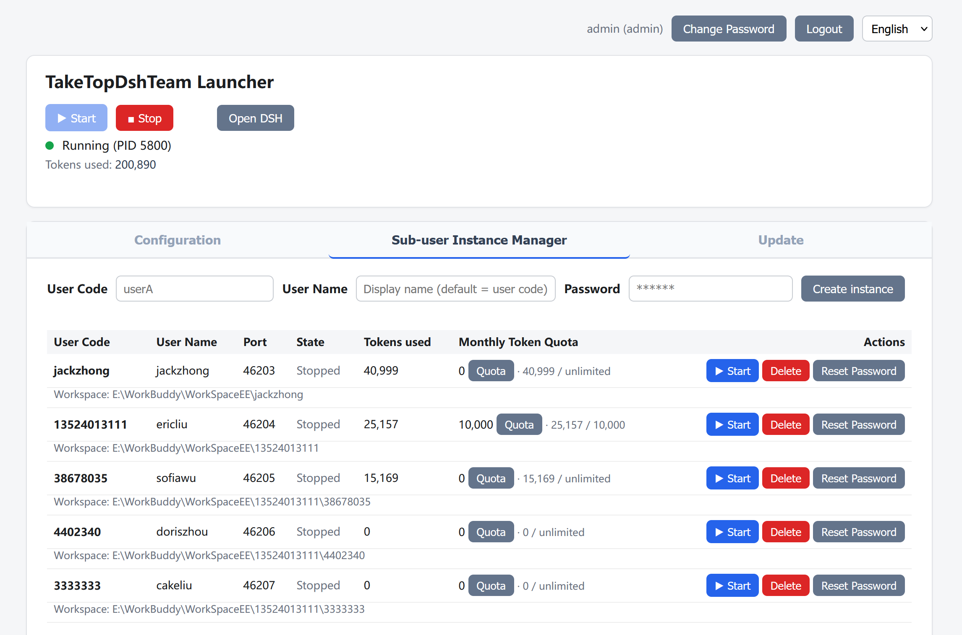
3.1 Console
Here, each user can start their service, open their workbench, add sub-members, and manage each member's token usage quota!

Slide 10
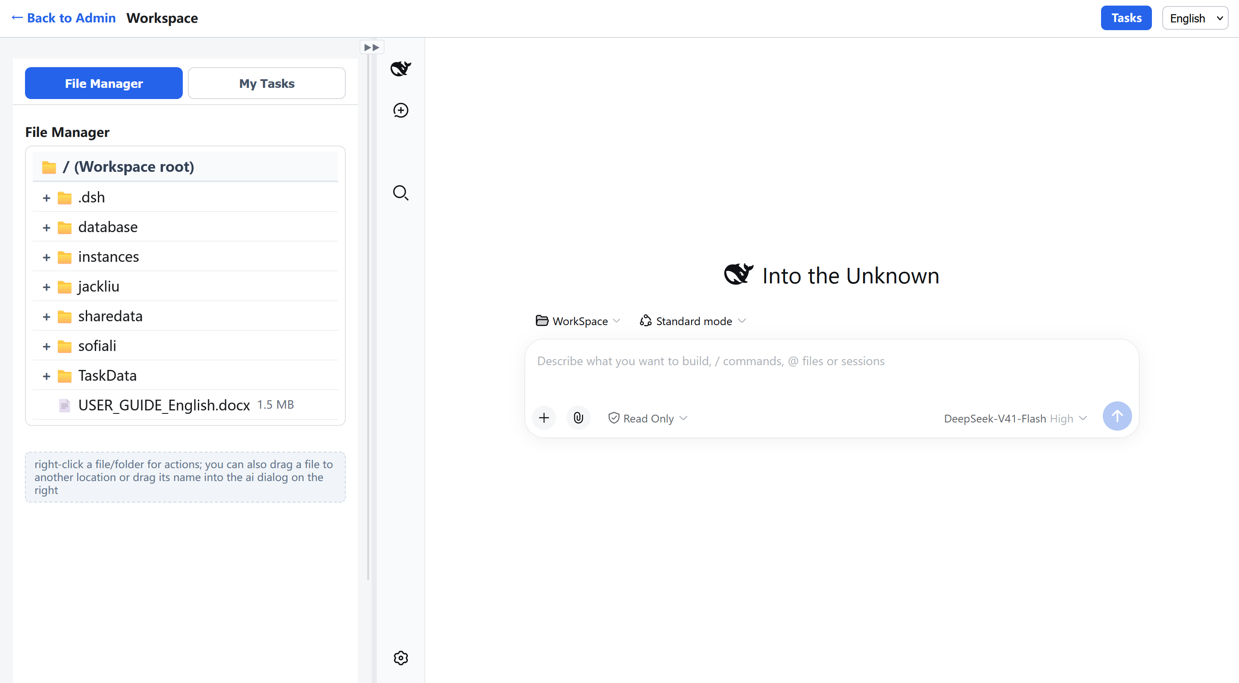
3.1 Workbench

Slide 11
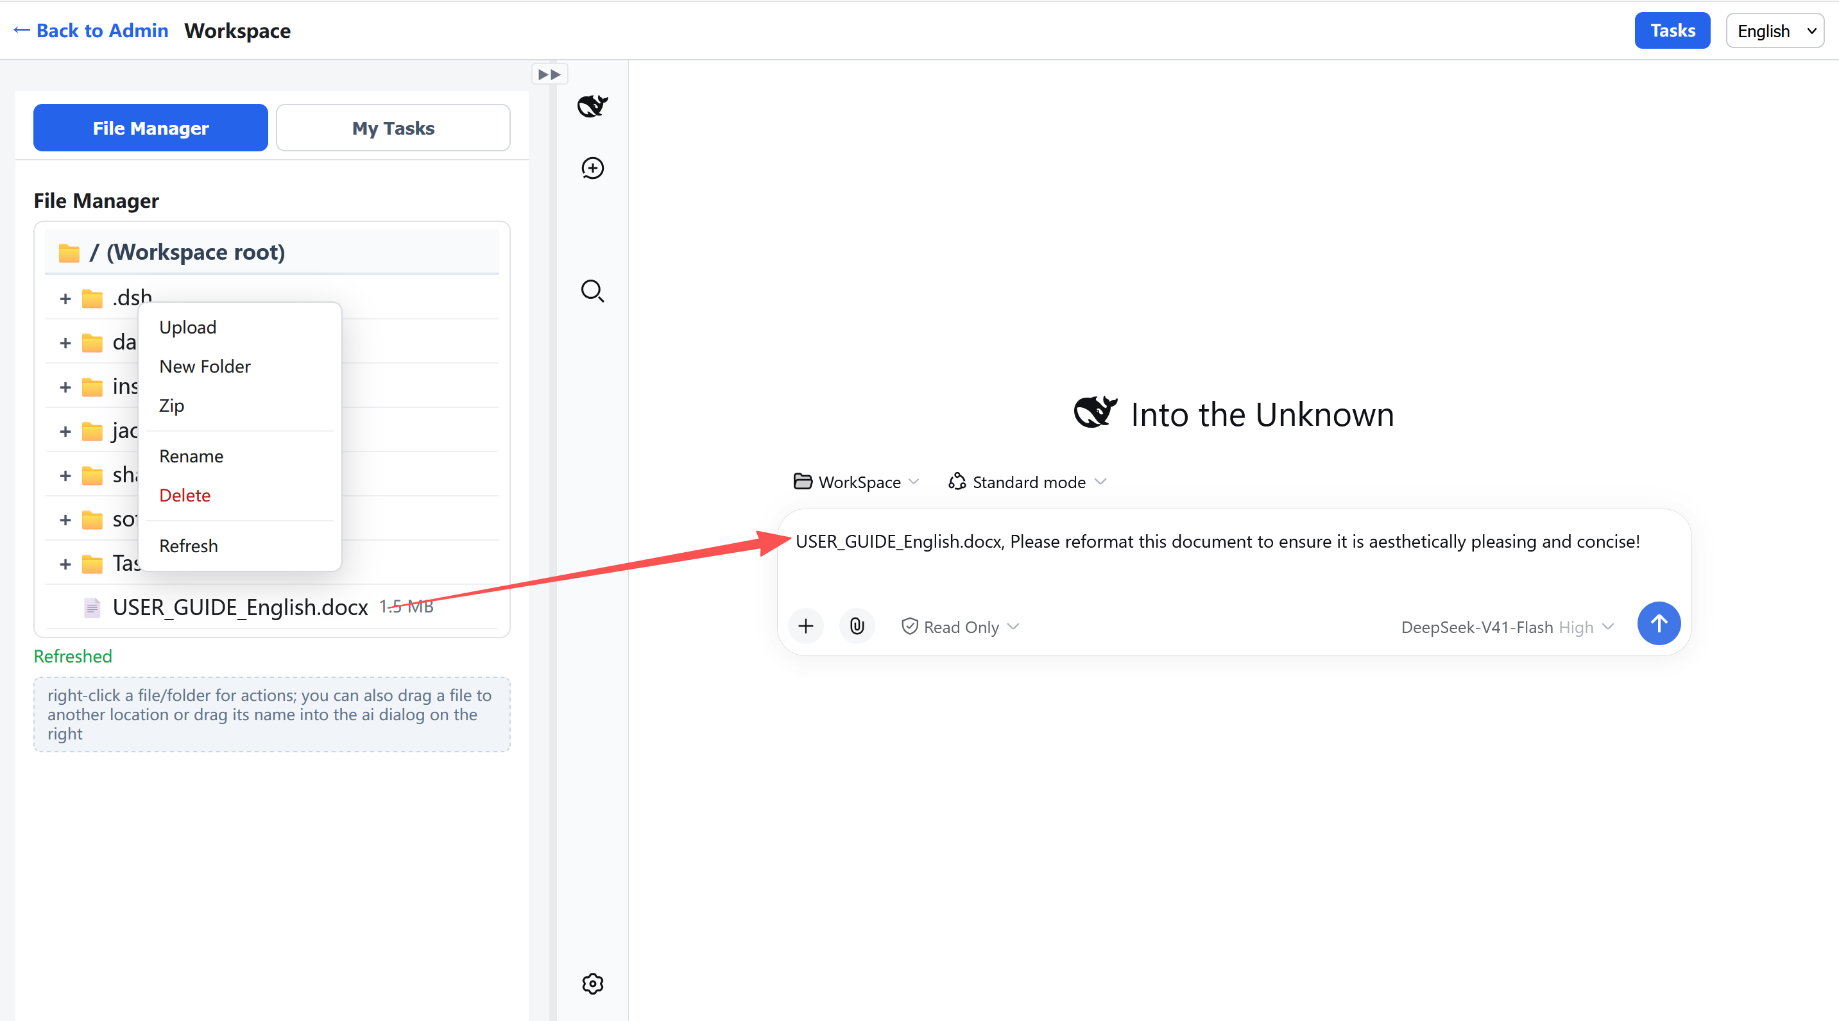
3.2 File Management
Here, each user can upload various work files for themselves or sub-members, perform various file operations, and drag files into the AI chat box on the right for AI to process!

Slide 12
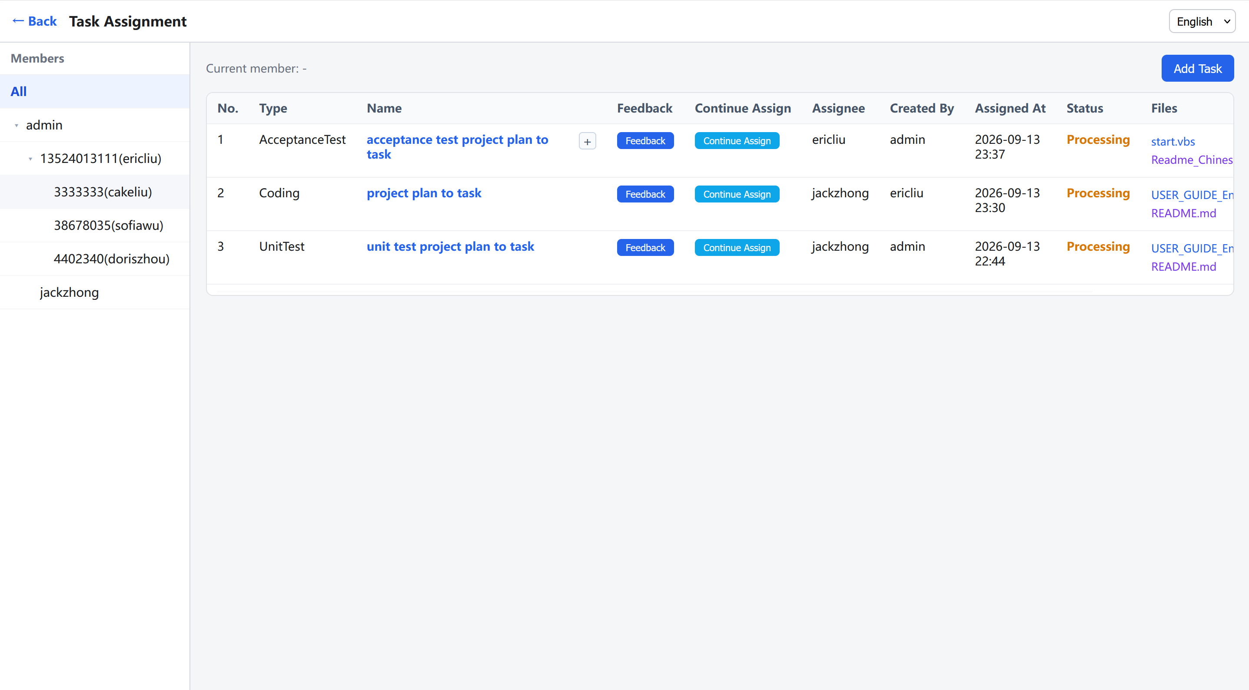
3.2 Task Management
Here, all tasks created by you for yourself or other members are listed, and tasks can be expanded hierarchically.

Slide 13
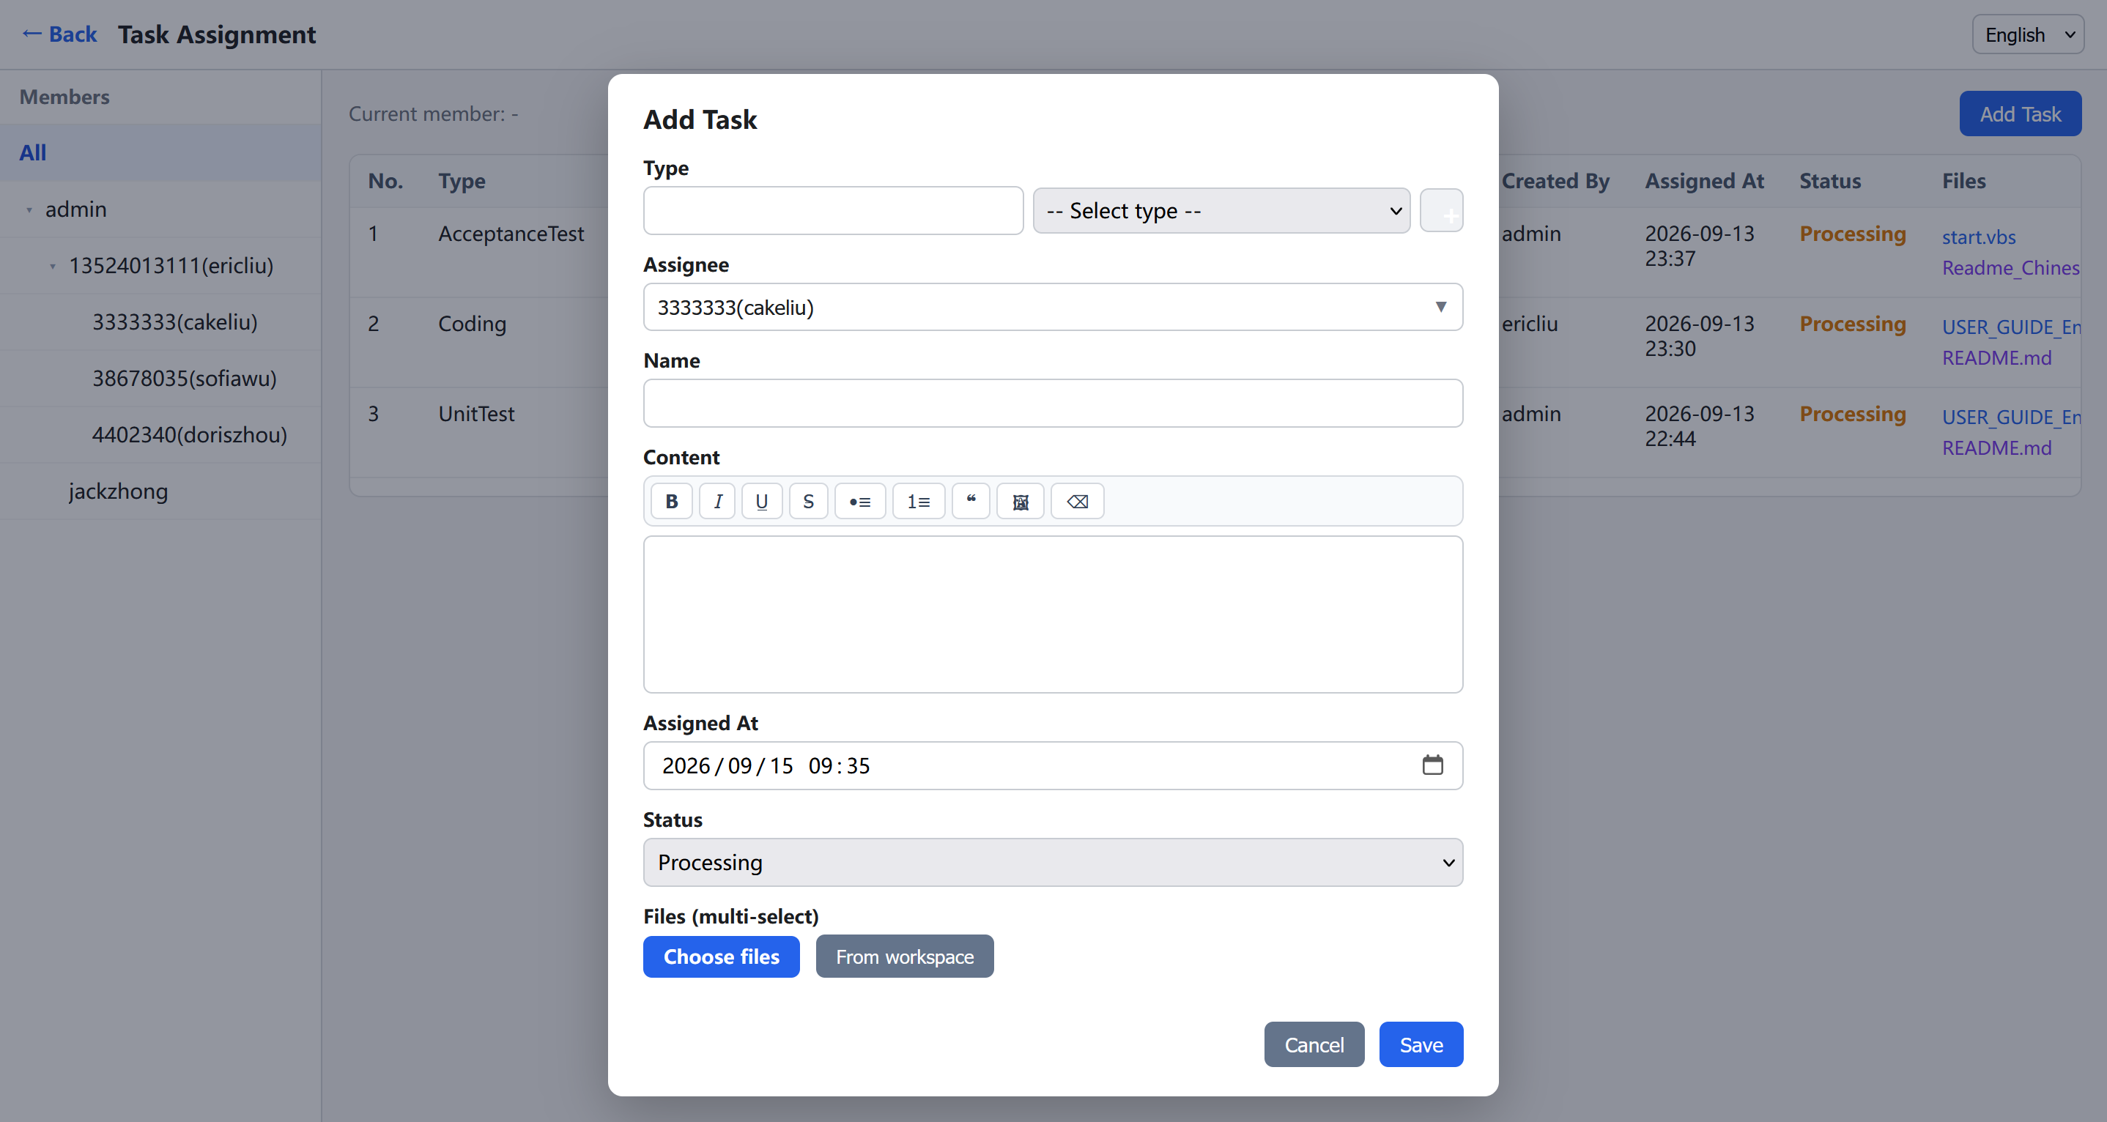
3.2 Task Management

Slide 14
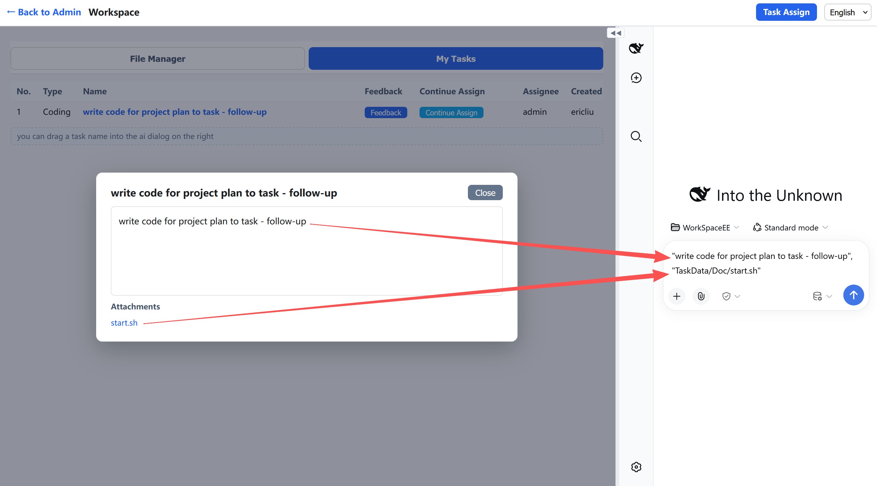
3.2 Task Management
Here, you can work on your tasks, and drag tasks along with their associated files into the AI chat box for AI to process!

Slide 15
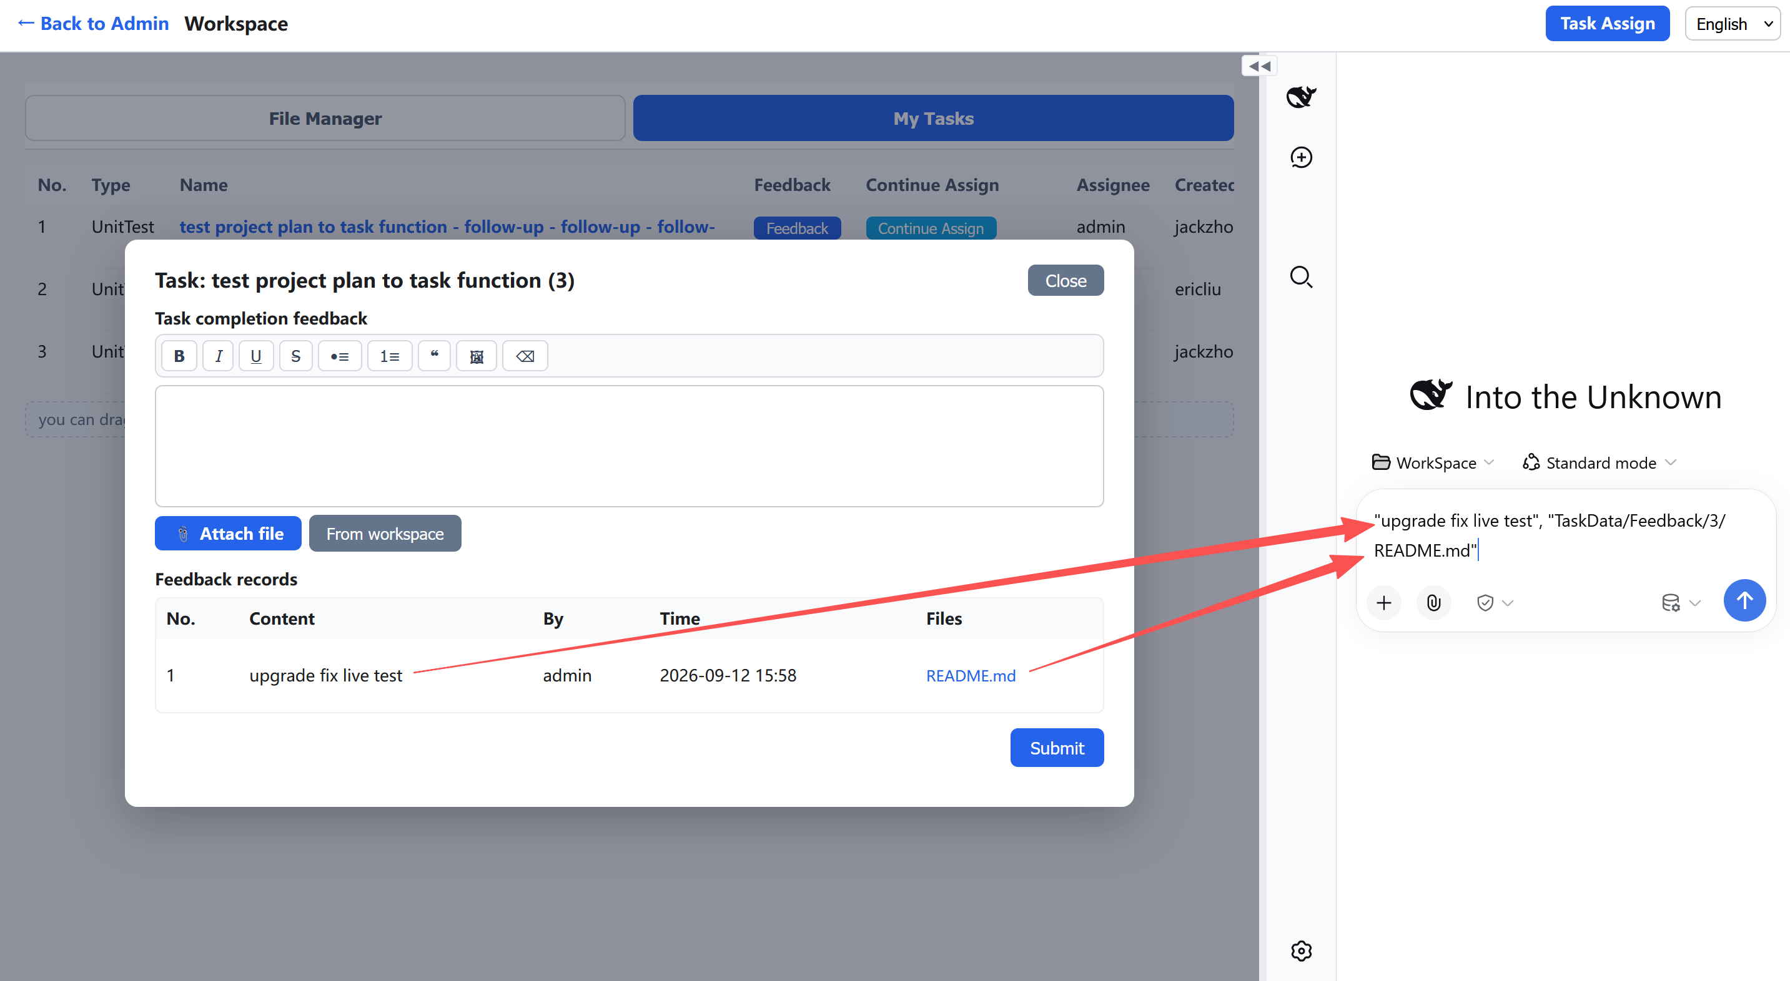
3.4 Task Feedback
Here, you can provide feedback and upload your work results for this task, and drag work requirements and files from your superiors or members into the AI chat box for AI to process!

Slide 16
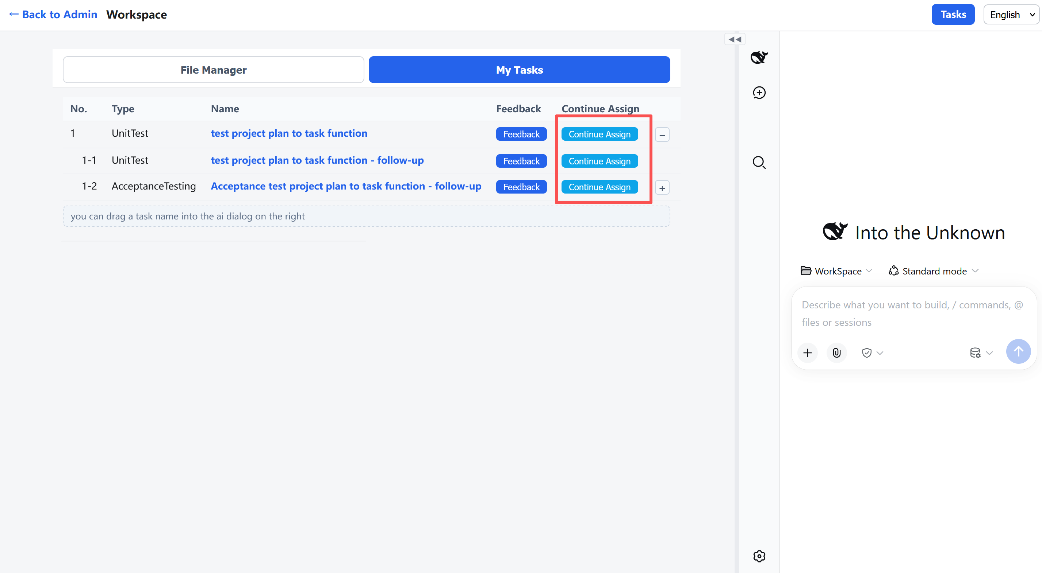
3.2 Task Management
Here, you can continue assigning your tasks to other members!

Slide 17
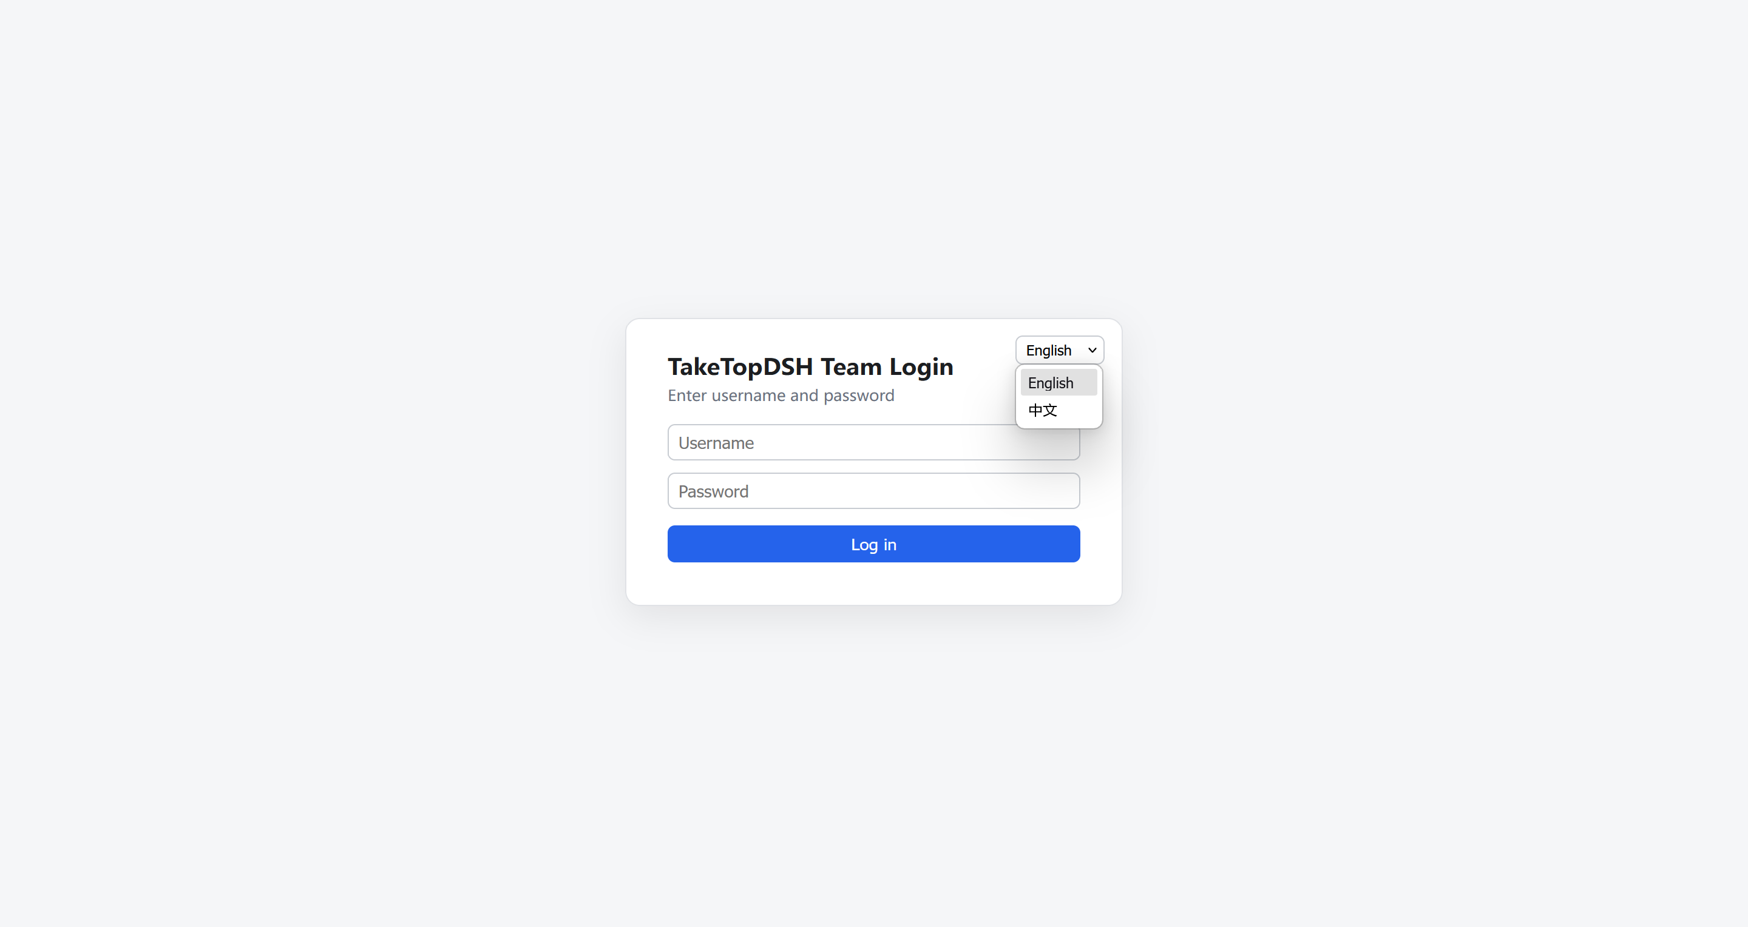
3. Multi-Language Support
All interfaces support English and Chinese. If you have additional language needs, we can add them within a day!

Slide 18
PART 4
&Target Customer
Target Customers

Slide 19
4-1. Target Customers
Who is this for: Teams that are already using (or want to use) AI agents but need multi-user collaboration with full data control — who don't want to install a separate AI agent for each person, nor hand data to cloud services. Suitable for any industry (office management, design management, R&D management, document processing, multimedia processing, etc.)!

Slide 20
PART 5
Cooperation Model
Sales, Service, Revenue Sharing

Slide 21
5-1. Cooperation Model
Software licensing fee (features + user count): TakeTop 30%, Partner 70%. Service fees (implementation, customization, annual after-sales — each half). Sales led by partner, TakeTop supports. Implementation, customization, and annual after-sales services led by TakeTop, partner assists!
TakeTop AI Team Collaboration Platform comes in two editions: [Standard] and [Enterprise]. The [Standard] edition uses MIT license and is free. If your team needs stronger control capabilities, we offer a paid [Enterprise] edition with additional features:
- **Per-Member Token Control** — View and control each member's token usage.
- **Pyramid Member Management** — Regular members can create and manage sub-members, who can further create their own sub-members, forming a pyramid management structure.
- **Service Support** — During the paid period, we provide uninterrupted service to quickly resolve usage issues.

Slide 22
5-1. download address
--Standard Edition download:
--https://github.com/TakeTopITS/TakeTopDSHTeam
- One-Click Offline Installation** — Copy the folder and run; no compilation, no additional downloads.
- Cross-Platform** — Supports Windows / macOS / Linux, secure and reliable!

Slide 23
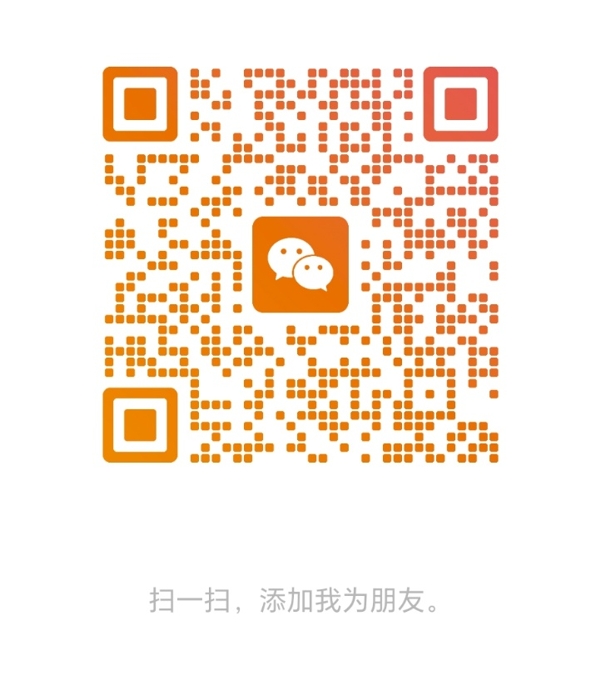
4-2. Contact Us
Ms. Zhang: Tel: (+86) 13761192321 Email: service@taketopits.com

