Slide 1




Little Mermaid
Introduction to Data Science and Data Engineering

Slide 2

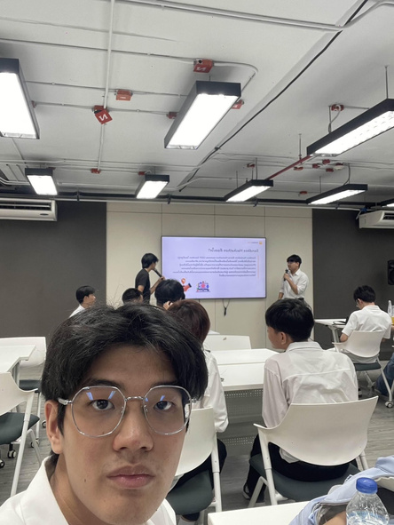

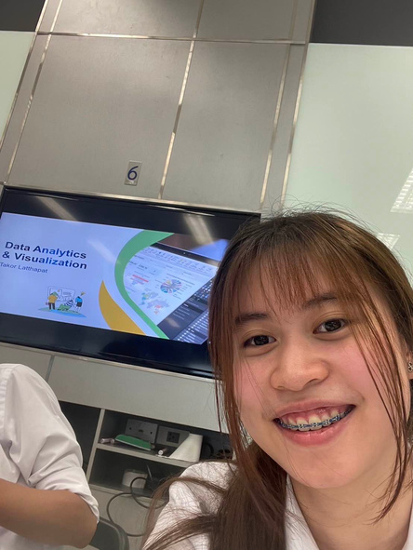


Member
Pattaradanai
Thanomsittikul
Supanat Thanaphonpho
Naphat Chartwanchai
Phavarisa Pitavaratorn
Jirayu
Khunrak
Peeratuch Khammeesak
6633185721
6633249221
6633059321
6633181121
6633036921
6633175421

Slide 3
Objectives
To analyze engineering research data , identifying key trends, collaboration, and emerging topics, while presenting actionable insights through a comprehensive and visually engaging pipeline.

Slide 4

Raw Data (JSON)
primary data requirement provided data from Scopus
Data Used
Scopus API
data from Scopus API from 2015-2024
Web Scraping
Perform web scarping from Arxiv

Slide 5
Data Collected
Title
The name or headline of the research paper.
Abstract
A concise summary of the research.
Author
Names of authors who contributed to the research.
Aggregation Type
The type or method used for grouping or categorizing this paper.
Publisher
The organization or entity responsible for publishing the research.
Publication Date
The date when the paper was published.
Institutions
The academic or research institutions affiliated with the authors.
Keywords
A set of terms that capture the main topics of the research.

Slide 6

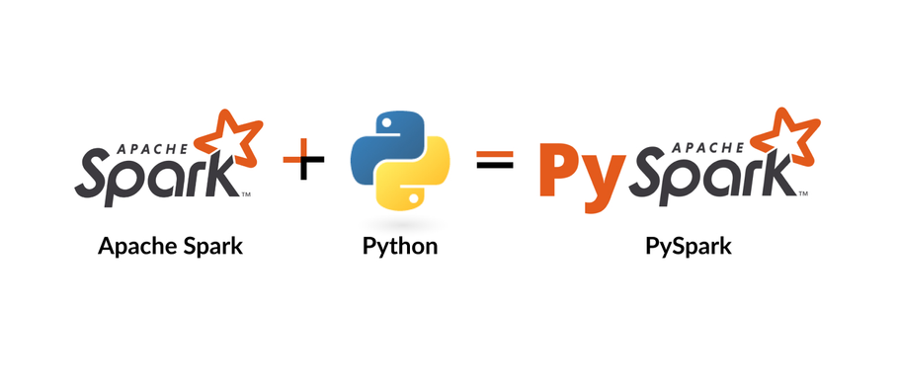



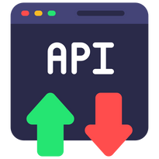
Data Pipeline
Raw Data (JSON)
Analysis
AI/ML
Scopus API
Web Scraping

Slide 7
Data Engineering
Data from
Scopus API: getting Title, Abstract, Authors, Aggregation type, Publisher, Publication Date, Institutions, and Keywords collected to CSV file
Web Scraping from Arxiv getting Title, Abstract, Authors, and Publication Date collected to CSV file
Raw Data
Data Cleansing
Collect all the data and aggregate it using Kafka running on Docker. The Kafka Producer will create topics for each year to organize the data for each year into a single file. Afterward, the data will be consumed through a Kafka Consumer, producing output files separated by year. These files will then be used for further processing.

Slide 8
Data Scientist
Topic Modeling
to uncover the latent (hidden) thematic structure in a large collection of unstructured text data and aims to group words into coherent topics and assign those topics to documents.
Recommend System
A system designed to allow users to input sentences or words and find the most relevant or suitable research articles. This system leverages NLTK (Natural Language Toolkit) to process text and identify similarities or connections between the input and a database of research articles.
Publication Trend
A system designed to analyze and predict trends in research publication over the years, categorized by quarterly periods.

Slide 9
Data Analysis
Coauthor Network
Visualize the collaboration network of researchers by displaying connections between authors based on their joint publications. This network representation highlights key collaborators, research clusters, and influential authors within the field.
Topic
Analysis
Display trending research topics for each year by leveraging machine learning techniques to classify and extract themes from research publications. This analysis provides insights into the evolution of research interests and emerging areas of study.
Keyword
Analysis
Compare the most frequently used keywords year by year to identify shifts in focus areas and terminology within the research domain. This analysis highlights trending keywords and provides a deeper understanding of the research landscape.

Slide 10
Dashboard &
Results Showcase
Notes:
1.Topic Modeling, Clustering หรือ Sentiment Analysis
2.อธิบายสั้น ๆ ว่าใช้โมเดลอะไรและทำไมถึงเลือกใช้

Slide 11
Conclusion
From the analysis conducted in our project, several key insights and future trends have emerged. One notable finding is that the highest number of publications consistently occurs in the first quarter (Q1) of each year, and this trend is expected to continue in the foreseeable future. Over the past decade, the top five most frequently used keywords have been COVID-19, Machine Learning, Artificial Intelligence, Educational Innovation, and Higher Education. In terms of emerging topics for 2024, the focus appears to be on AI and ML applications in industry, sustainability, environmental concerns, and agriculture, with aggregation systems also being a key area of interest. Additionally, journals remain the most popular type of publication among researchers. These trends provide valuable insights into the evolving research landscape, guiding future research directions aligned with current and emerging topics.
Notes:
Closing Statement: This project highlights the power of data science in uncovering valuable insights from research data. The findings not only shed light on past and current trends but also pave the way for future innovations in engineering, emphasizing the importance of interdisciplinary approaches in tackling global challenges.

Slide 12
Thank You
Notes:
Closing Statement: This project highlights the power of data science in uncovering valuable insights from research data. The findings not only shed light on past and current trends but also pave the way for future innovations in engineering, emphasizing the importance of interdisciplinary approaches in tackling global challenges.

