Slide 1
THAI-MOD
🗃 8 Datasets | ~30K unique samples
🤖 WangchanBERTa | TF-IDF + LR
Multilingual Online Toxicity Detection System
⚡ FastAPI | Real-time inference
📊 MLflow experiment tracking
Term Project Final Presentation · April 2026
🔍 PSI data drift monitoring
🔐 Session-based auth + Admin UI
✅ GitHub Actions CI/CD pipeline

Slide 2
01 · INTRODUCTION
Problem Statement & Solution
• Online platforms suffer from toxic Thai and English content including hate speech, bullying, and offensive language.
◦ Manual moderation is slow and inconsistent at scale.
• THAI-MOD is a binary toxicity classifier (Toxic vs Non-toxic) built as a human-in-the-loop decision support tool.
◦ It provides real-time scoring for moderators — the human always makes the final call.
• Supports Thai, English, and code-switching (Thaiglish) text inputs.
• End-to-end MLOps demonstration: data → training → API → monitoring → retraining.

Slide 3
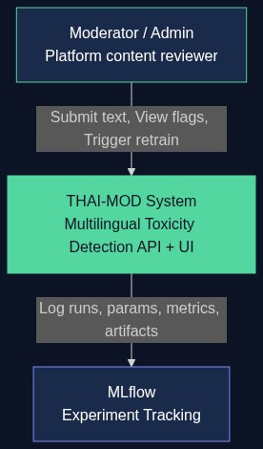
02 · ARCHITECTURE | C4 Level 1
System Context Diagram

Slide 4
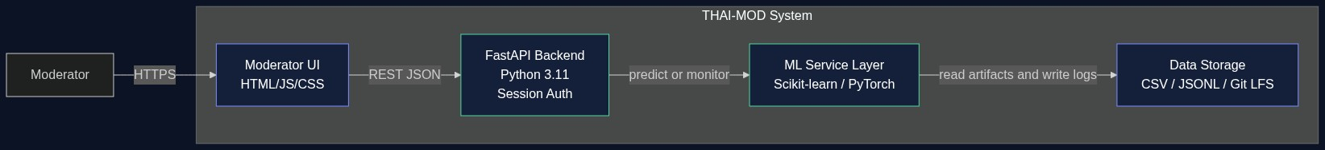
02 · ARCHITECTURE | C4 Level 2
Container Diagram

Slide 5
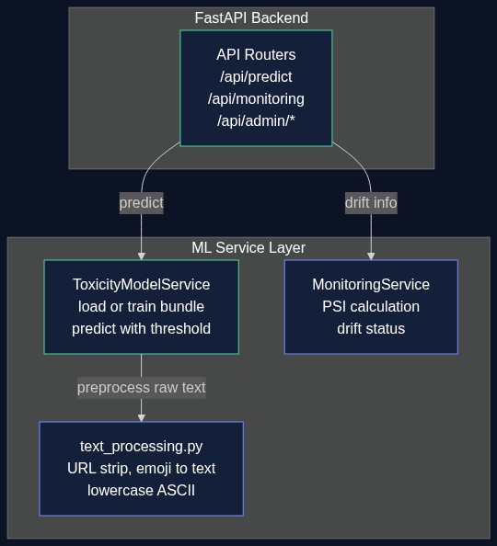
02 · ARCHITECTURE | C4 Level 3
ML Component Diagram

Slide 6
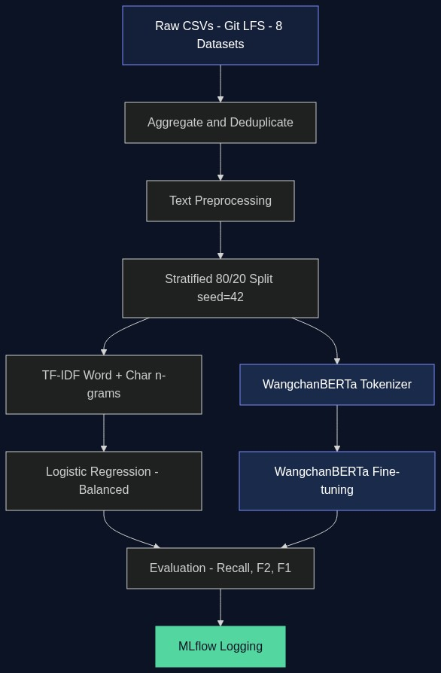
03 · DATA & EXPERIMENTS
ML Pipeline Flow

Slide 7
03 · DATA & EXPERIMENTS
Dataset Sources & Statistics
#
Dataset
Language
Domain
Size
1
Wisesight Sentiment
Thai
Sentiment
23,545
2
Thai Toxicity Tweet Corpus
Thai
Toxicity
2,160
3
HateThaiSent
Thai
Hate Speech
4,953
4
Thai Sentiment Analysis
Thai
Sentiment
341
5
Thai Cyberbullying LGBT
Thai
Cyberbullying
16,749
6
Jigsaw Toxic Comments
English
Toxicity
159,571
7
Hate Speech SNS Dataset
English
Hate Speech
1,829
8
Hate Speech & Offensive
English
Hate Speech
24,783
Combined (after dedup)
Both
Binary
~30,620

Slide 8
04 · MODEL EVALUATION
Model Comparison — Test Set (n=6,124)
Model
Accuracy
Precision
Recall
F1
✅ WangchanBERTa (selected research)
0.891
0.800
0.775
0.787
PhayaThaiBERT
0.889
0.804
0.760
0.782
XLM-RoBERTa
0.865
0.775
0.678
0.723
Linear SVC (Balanced)
0.840
0.780
0.800
0.790
✅ Logistic Regression (deployed)
0.830
0.780
0.810⭐
0.790
LogReg threshold=0.3
0.820
0.770
0.810
0.780
LogReg threshold=0.4 (default)
0.840
0.790
0.790
0.790

Slide 9
04 · MODEL EVALUATION
Why Recall is the Primary Metric
• Class imbalance: 73.9% non-toxic vs 26.1% toxic — pure accuracy is misleading.
◦ A model predicting 'non-toxic' always would achieve ~74% accuracy.
• False Negative (FN): toxic comment reaches users → psychological harm, credibility risk.
• False Positive (FP): safe comment flagged → moderator reviews it → corrected with HITL.
◦ Asymmetry of harm → prioritise Recall (minimise FN).
• Supporting metric: F2-Score gives 2× weight to Recall over Precision.
• Threshold tuned to 0.4 (from default 0.5) → improves Recall 0.74 → 0.79 keeping F1 stable.
• Uncertain zone (0.4–0.6 score) always routed to human review regardless of threshold.

Slide 10
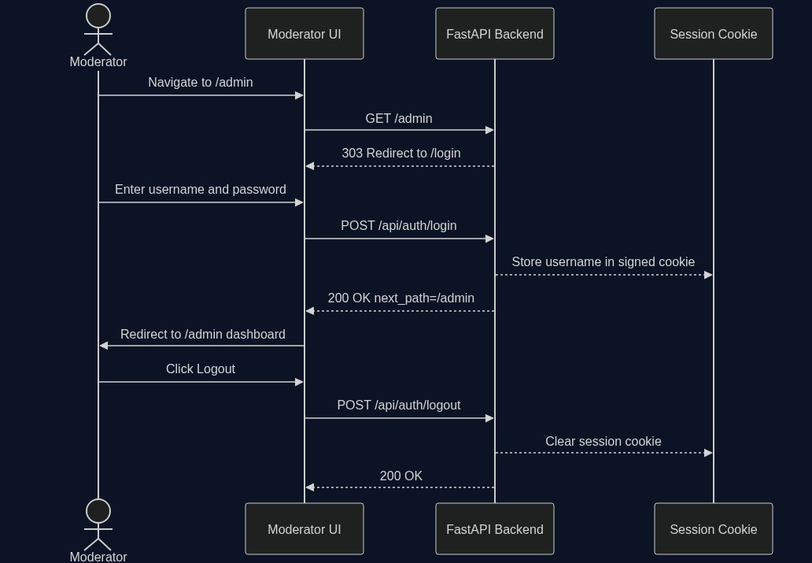
05 · USE CASE & ACCESS CONTROL
Authentication Flow

Slide 11
05 · MLOPS & DEPLOYMENT
Deployment, Automation & CI/CD
• Serving layer: FastAPI backend + Static HTML/JS Moderator UI.
◦ Serving mode auto-selects WangchanBERTa (if artifact present) or falls back to LR.
◦ Model served via /api/predict and /api/batch-predict — model-agnostic contract.
• GitHub Actions CI pipeline (.github/workflows/ci.yml):
◦ Triggers on every push and pull request to main.
◦ Runs pytest --cov ≥ 70%. Blocks merge if tests fail.
◦ No LFS download in CI — fast mock bundle strategy; full suite < 60 seconds.
• Candidate Retraining pipeline (LR): Train → Evaluate → Promote via Admin UI buttons.
◦ Background subprocess model: no downtime during training job.

Slide 12
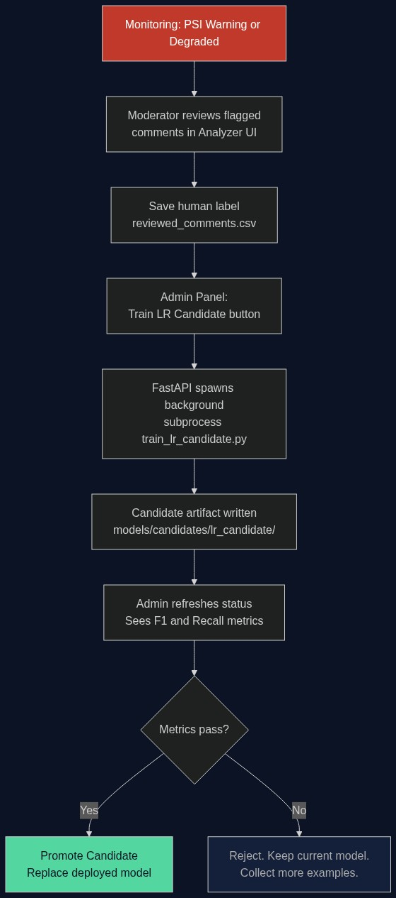
05 · MLOPS & DEPLOYMENT
Candidate Retraining & Promotion Flow

Slide 13
06 · TESTING & MAINTAINABILITY
Test Strategy
• 58 automated tests across 4 test files covering the full stack.
• test_preprocessing.py (20 tests) — URL removal, emoji, case, edge cases, PyThaiNLP tokenizer.
• test_dataset_prep.py (18 tests) — label mapping neg→1/neu→0, NaN handling, deduplication.
• test_api.py (20 tests) — /api/health, /api/predict contract, threshold logic, 422 validation.
• test_monitoring_service.py — MonitoringService summary and drift helpers.
• Mock bundle strategy: no real training in CI, deterministic toxic_score=0.75.
• Known Technical Debt:
◦ No BERT inference tests (GPU-dependent). Auth tests limited. perf/latency tests pending.

Slide 14
07 · MONITORING
Data Drift Detection — PSI on Language Mix
• Fixed reference profile built from all 8 datasets (100 samples each, seed=42, ~800).
◦ Language distribution in reference: Thai 55% | English 37.5% | Mixed 7.25% | Other 0.25%.
• Live predictions logged as JSONL (text_length, toxicity_score, language_bucket — no raw text).
• PSI computed on language-mix distribution shift:
◦ < 0.10 Healthy | 0.10–0.20 Observe | 0.20–0.35 Warning | ≥ 0.35 Degraded
• Admin Panel shows: Drift State, PSI, Toxic Ratio trend, Language Mix shift., recent events.
• Clear recent log button resets the window for a clean live demo.
• Performance degradation requires human-reviewed labels — PSI alone cannot confirm recall drop.

Slide 15
09 · RESPONSIBLE ML
Ethics, Privacy & Fairness
• Privacy-first logging: ONLY metadata stored (text_length, language, score). NO raw text.
◦ Complies with Thai PDPA data minimisation principle.
• Human-in-the-loop everywhere: model flags, human decides. No auto-removal/auto-ban.
• Explainability: deployed TF-IDF+LR model weights fully inspectable. BERT uses attention (limited).
• Fairness gap: training data covers LGBT cyberbullying well; other target groups under-represented.
• Model NOT appropriate for: law enforcement, automated enforcement, high-stakes decisions.
• Label noise: Datasets 1 & 4 are sentiment datasets — negative opinion ≠ toxic content.
• Evasion robustness gap: character substitution (อ_เ_ี้ย), new slang, dog whistles not handled.

Slide 16
🎯 LIVE DEMO
Demo Flow (20 min)
• 1. Authentication flow: navigate /admin while logged out → see /login redirect → sign in.
• 2. Analyzer UI (/):
◦ Thai toxic: "ไอ้หน้าโง่ ออกไปให้พ้น" → expect FLAG_FOR_REVIEW, score > 0.6
◦ Mixed code-switch: "โคตร toxic เลย report มันไป" → borderline interesting case
◦ Non-toxic: "ขอบคุณมากนะครับ ทีมทำงานเก่งมาก" → ALLOW, low score
◦ English: "You are absolutely disgusting, go away" → FLAG_FOR_REVIEW
• 3. Admin Panel: navigate /admin → show model metrics, confusion matrix, dataset info.
• 4. Drift Demo: clear recent log → submit English-heavy batch → refresh → PSI changes.
• 5. Retraining: click Train LR Candidate → Refresh Status → see Candidate Performance metrics.
• 6. Logout: click logout → confirm redirect back to /login.

Slide 17
PROJECT SUMMARY
THAI-MOD — What We Built
🗃
8 public datasets aggregated, deduplicated, versioned with Git LFS
🤖
WangchanBERTa fine-tuned (research) + TF-IDF+LR deployed baseline (0.81 recall)
⚡
FastAPI REST backend with session auth, prediction endpoints, background retraining
📊
MLflow experiment tracking with full hyperparameter + metric logging
🔍
PSI data-drift monitoring with language-mix reference profile
✅
58 automated tests, GitHub Actions CI blocking bad merges
🔐
Privacy-first logging, HITL design, ethical use boundaries documented
Thank you! Questions welcome.

