Slide 1

How do annual members and casual users use Cyclistic bikes differently?
Nov 2021
Takehiro Kuroki

Slide 2
Introduction
Our financial analysis has concluded that annual members are much more profitable than casual users. To maximize the number of annual members while avoiding costly campaigns to raise awareness, we can convert current casual users into members. This would be a key to long-term growth.
This is why we want to design marketing strategies to convert these casual riders into members. To do that, we first need to identify how members and casual users use Cyclistic bikes differently.
Data from Sep 2020 to Aug 2021 is used for this analysis.
(“Casual users” refers to those who have purchased a single-ride pass or an full-day pass. “Members” refers to those who have purchased annual membership.)

Slide 3
For the summary, please go to slide 14.
For the R code, please visit this GitHub page.

Slide 4
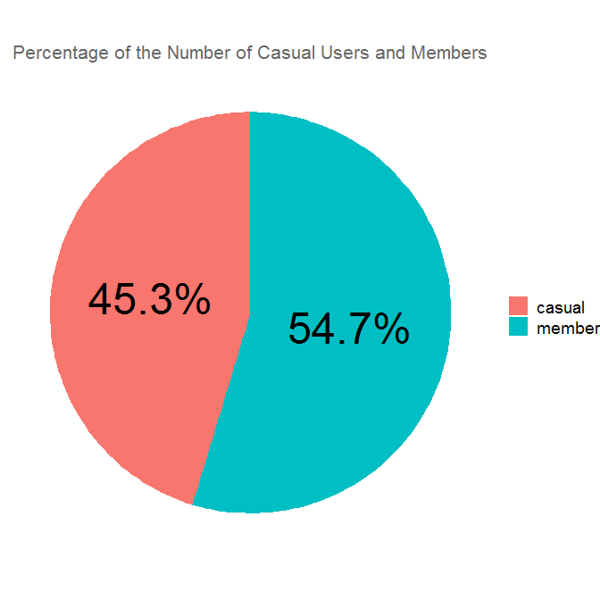
How many uses are from casual users and members respectively?
Casual: ~2,221,000 (45.3%) Member: ~2,680,000 (54.7%)
(Note that this doesn't necessarily mean there are more unique members than casual users.)

Slide 5
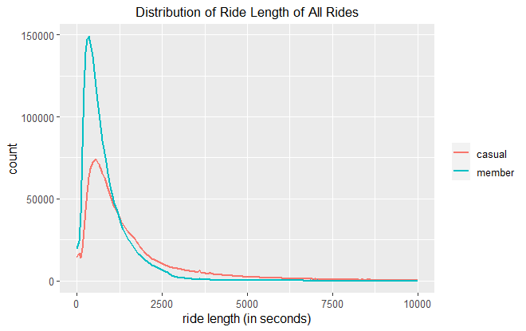
When we look at the graph, between 0 and ~1250s (~20.8m), the two share almost the same shapes and peak at almost the same place. But the number of members is twice as high as casual users. After ~20m, the number of casual users stays higher than that of members. Members are highly right-skewed, while casual users are less concentrated and spread along the longer ride length side.

Slide 6
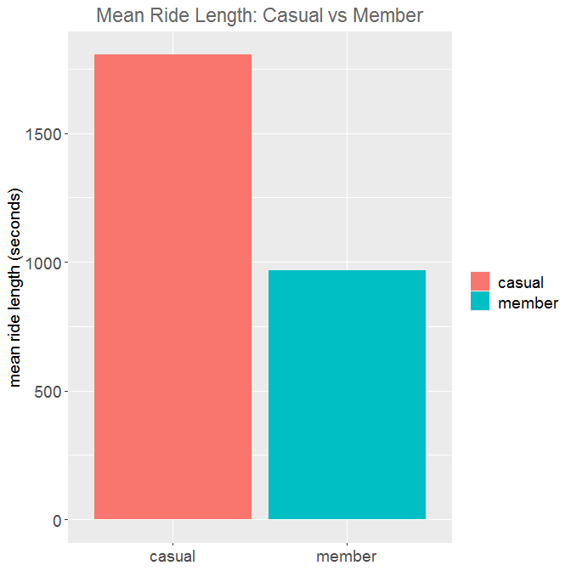
What is the mean ride length of casual users and members?
The mean ride length for all is 22m 27s.
Casual: 30m 4s Members: 16m 8s
The mean ride length for members is almost half of casual users.

Slide 7
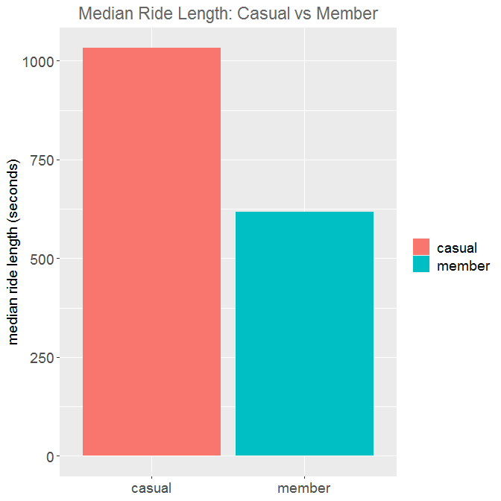
What is the median ride length of casual users and members?
The median ride length for all is 12m 52s.
Casual: 17m 12s Members: 10m 17s
Both medians are much lower than the means. This means that long length rides have pulled the means up by a lot, more so for casual users.
(Mean is the total ride length divided by all uses; median is the ride length that lies in the middle.)

Slide 8
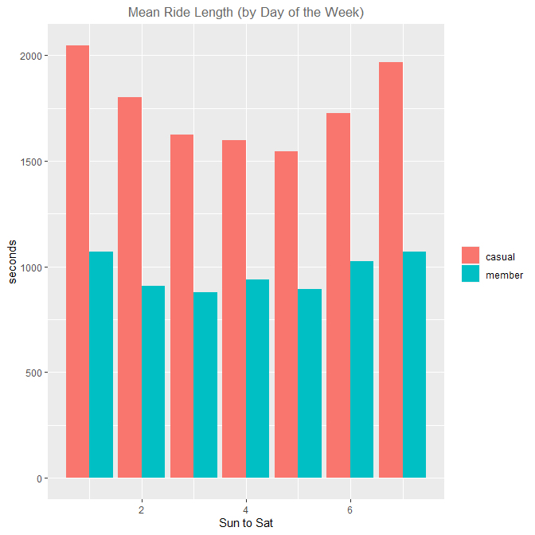
What if we look at the mean ride lengths by days of the week?
If we look at the mean ride lengths from Sunday to Saturday, the patterns between casual users and members are almost the same: they show a U-shape; more on the weekends, less on the weekdays. However, the U of the casual is much deeper, demonstrating a much wider range.
Casual: 25:47~34:06 (8m 19s) Members: 14:38~17:52 (3m 14s)
This means that although members also use the bikes for a longer time on weekends, the difference between weekends and weekdays is not significant. In contrast, casual users use the bikes on weekends for much longer than weekdays.

Slide 9
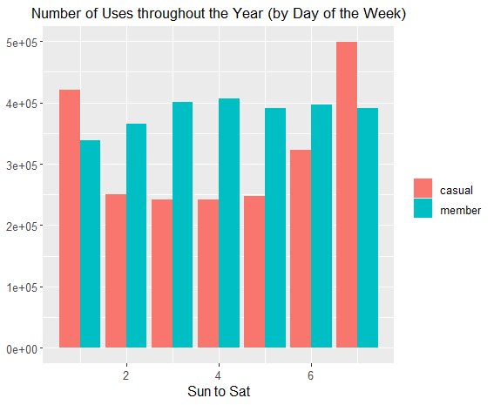
How many uses by casual users and members are there in total from Sunday to Saturday in the past year?
This time we see much more different patterns between the two.
While there are a lot more casual users on weekends than on weekdays, it is the inverse for members: there are slightly more member users on weekdays in general. In fact, Sunday has the lowest rate of members; Saturday has the third.
And just like ride length, there is a much bigger range between weekdays and weekends in casual users than in members:
Casual: 241,410 ~ 498,478 (257,068) Members: 336,633 ~ 405,997 (69,364)
Again, there is more variability in casual users.

Slide 10
If we wake up in the morning and forget whether it is Friday or Saturday, we will still know that we are going to have roughly the same number of members, but we will not know that for casual users: on a Saturday, there are way more of them, and they ride for much longer (on average about 4 minutes).

Slide 11
To give us further insights, we can look at the total number casual users and members who use the bikes for less than 10 minutes (i.e. short-distance), and more than 30 minutes (i.e. long-distance).
How many are using for short-distance and how many are using for long-distance?

Slide 12
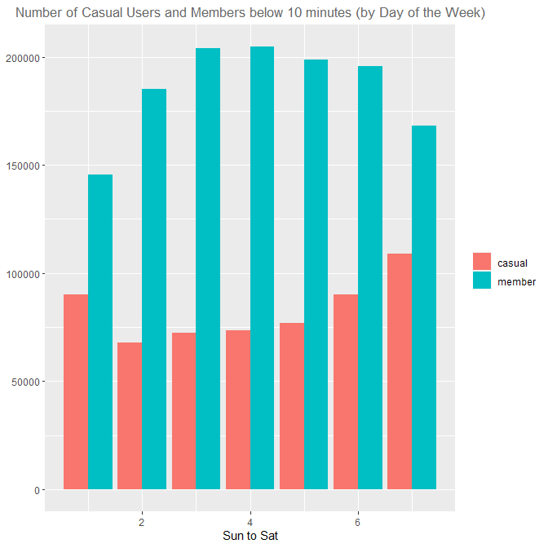
How many uses are less than 10 min?
- Members are all significantly higher than casual users.
- There are way more members on any weekday than on Saturday/Sunday. (e.g. Wed: 204661; Sun: 145507)
- Similar to the overall pattern, there are more casual users on Sat/Sun than on any weekday (except Fri where it's as high as Sat).
- About 26% of all rider by casual users are short distance (<10 min). In contrast, almost half (49%) of all rides by members are short distance.

Slide 13
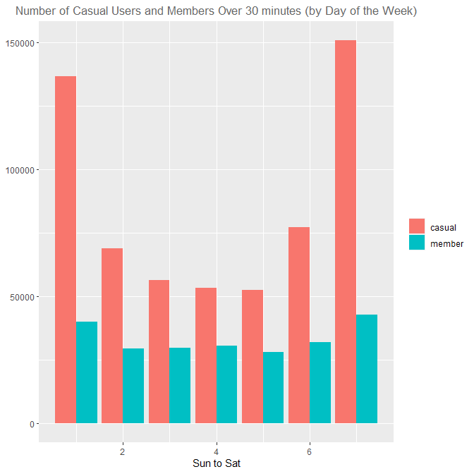
How many uses are more than 30 min?
- Casual users are all significantly higher than members.
- Casual users of both Saturday and Sunday are about double of any weekday.
- Unlike the overall pattern and the 10-minute pattern, there are more members on weekends than on weekdays.
- About 27% of all rides by casual users are long distance (>30 min). In contrast, only 8% of all rides by members are long distance.

Slide 14
Summary of Key Findings
Distance
Casual users tend to ride for longer than members
Median of casual: 17m 12s; median of members: 10m 17s
Members are highly right-skewed (towards the short ride length side); casual users are also right-skewed, but much less concentrated and spread along the longer distance side
Days of the Week
Casual users tend to ride on weekends
Members tend to ride on weekdays (the difference is not as significant)

Slide 15
Summary of Key Findings
Number of Uses
Uses by members are about 5% higher than that of casual users. (or ~400,000)
While there are more uses by members, casual users ride for much longer
Variability
Compared to members, there is much more variability in casual users in terms of ride length and number of uses throughout the week

Slide 16
Without having extra data about the users, the assumption is that members tend to use our bikes as a mean of daily transportation. They use our bikes when they don't or can't drive, and don’t prefer other means of commute (e.g. public transportation); whereas casual users tend to use our bikes for leisure, and they perhaps use them less frequently. This would explain why: 1. there are a lot more long-length rides by casual users than members; 2. members use our bikes least on Sundays, while casual users are highest on weekends; 3. long-ride-length casual users are highly concentrated on weekends, not weekdays.
Although individual uses by members are short-length, they are probably frequent and repeated uses.
Discussion

Slide 17
Without the data to identify unique users, we have no information on how unique users behave, e.g. how often they repeat uses, how they would behave differently on weekdays and weekends, etc.
Limitations

Slide 18
In order to convert current casual users into members, we should focus on the characteristics of current casual users: first weekends, then long distance. As a marketing strategy, for two months, we could offer a discount for membership to those who have had a moderately long distance ride (e.g. 20 min)/full-day pass on Sat/Sun, and to those who have had a longer distance ride (e.g. 30 min)/full-day pass on any day of the week. The goal is to make these customers feel that they have gotten a special deal just for them.
We can also consider the possibility of creating a new type of annual pass for only weekends. This could be just slightly cheaper than the regular annual pass. This could potentially capture those who would refuse to pay the full price for the regular annual pass, but would opt for a better deal for regular weekend rides throughout the year.
Suggestions

Slide 19
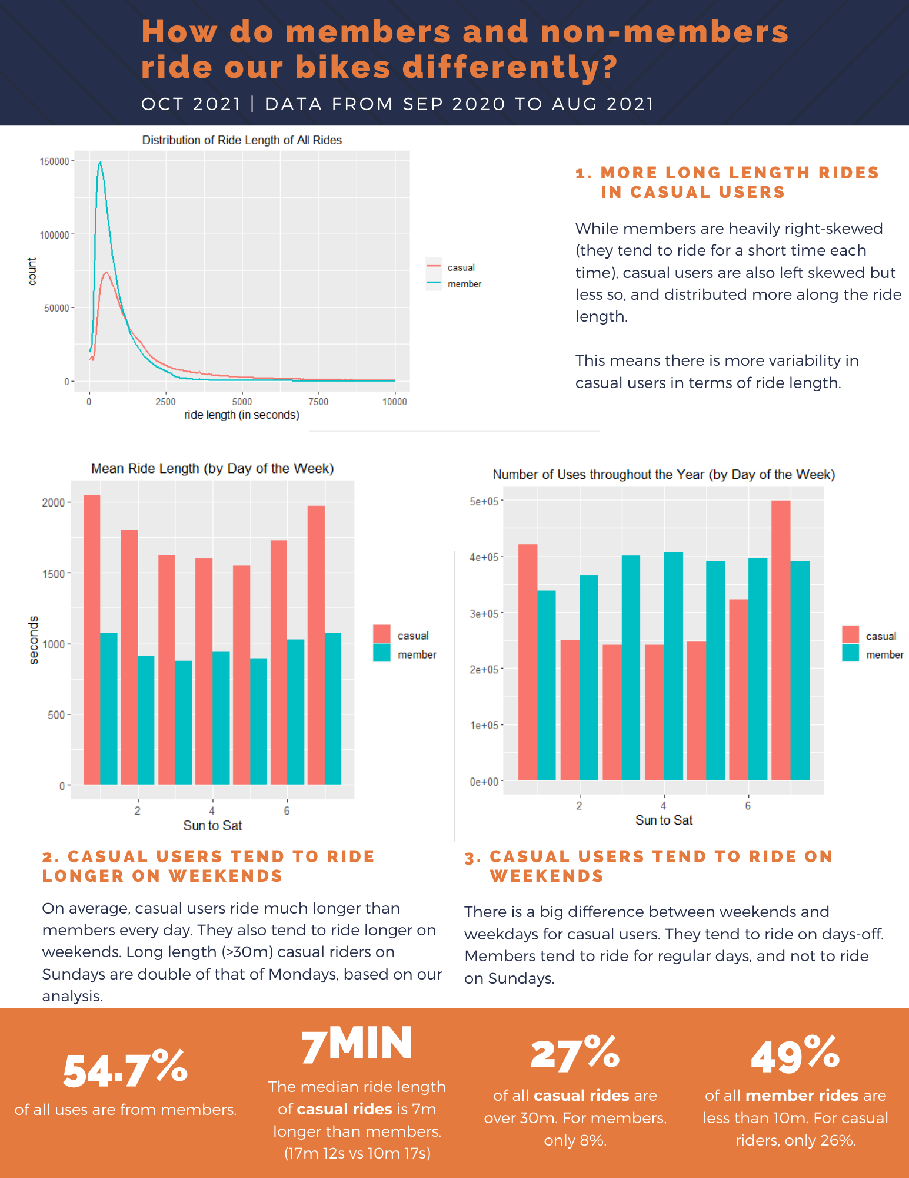

Slide 20
data from Sep 2020 to Aug 2021 combined
column of ride length added
day of the week column added
To filter out noise that would not help us understand the behaviors of the users, rentals below 5 seconds are filtered out. They are seen as errors as no one would intentionally rent a bike for less than 5 seconds. These observations constitute almost 0.2% of the dataset. About 1 out of 500 uses is under five seconds.
Data Cleaning and Manipulation

