Slide 1
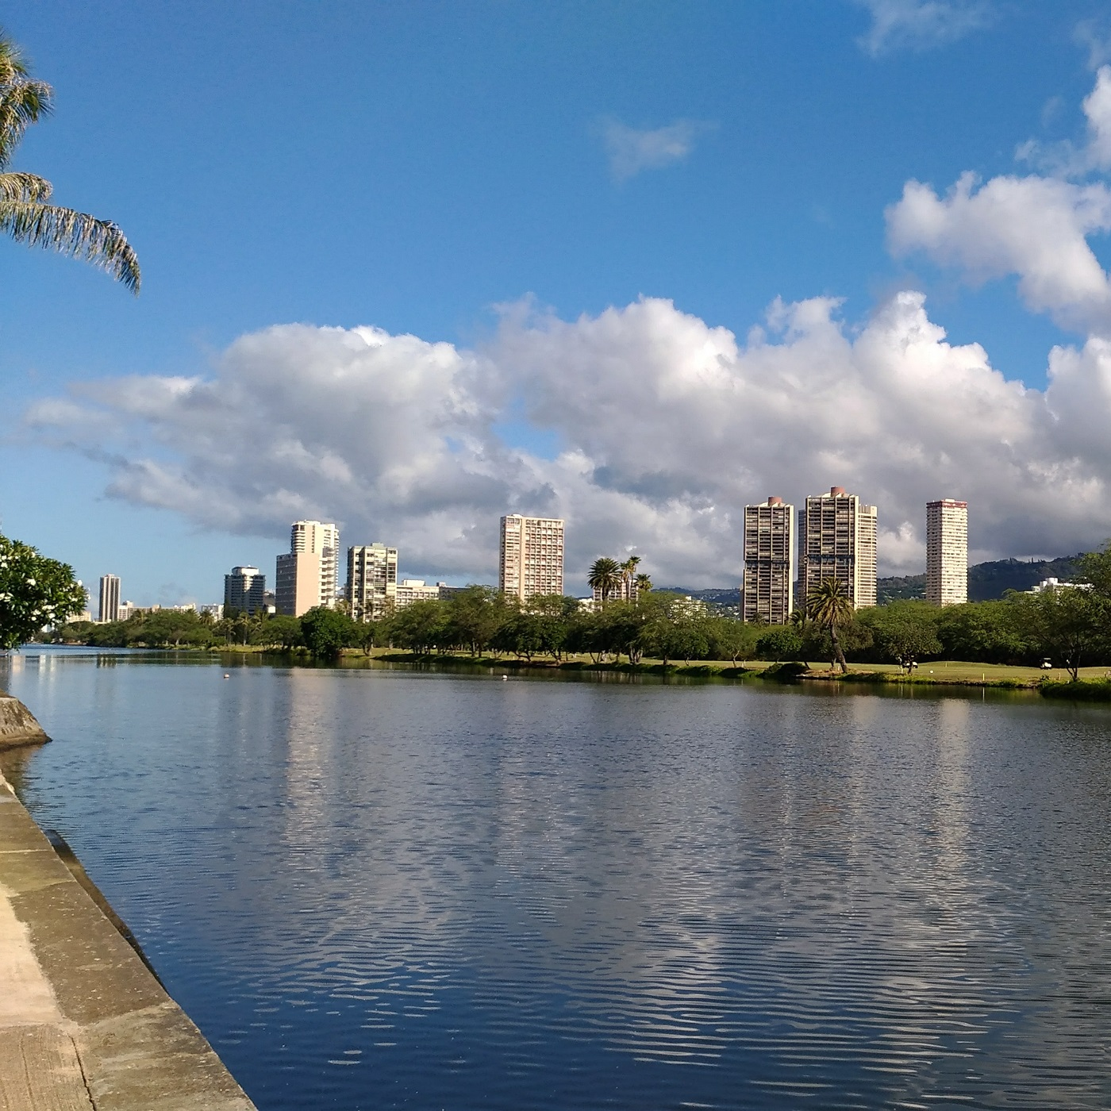

Slide 2



Slide 3

Reca
Log

